Slide 1
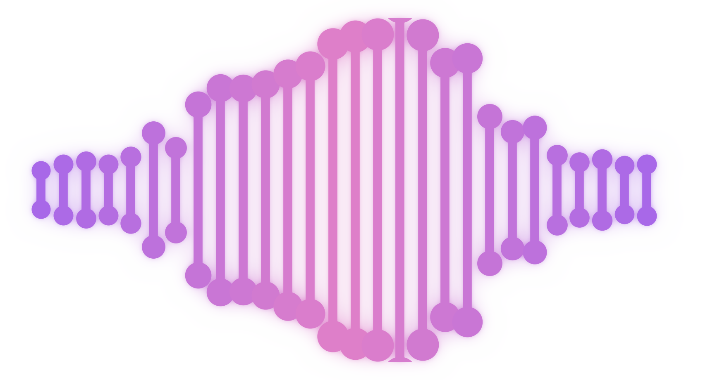
NURSE STRESS STUDY | WEARABLE DATA
Does a wristband know how a nurse feels?
Wearable data from 15 hospital nurses was matched to the stress levels they reported.
15
nurses, about 1,250 hours of wristband data
214
reported work periods with sensor data
4
body signals: skin conductance, heart rate, skin temperature, movement
1
Line up each report with the wristband data
→
2
Compare high-stress periods with the rest
→
3
Allow for each nurse's own normal
Notes:
DEFINITIONS AND UNITS. EDA = electrodermal activity (skin conductance), microsiemens (uS), recorded at 4 Hz. HR = heart rate, beats per minute, 1 Hz. TEMP = skin temperature, degrees C, 4 Hz. Movement = accelerometer magnitude in g (raw counts divided by 64), 32 Hz. Not used: blood volume pulse, inter-beat interval, button tags. DATA. 609 session zips from 15 nurses, about 1,250 hours. Each signal averaged to 1 Hz and merged on the Unix second. Survey times are local (America/Chicago) and were converted to UTC after testing hourly offsets per nurse. Each sensor second inherits the stress level of the reported period containing it. 245 of 358 survey rows had a numeric stress level (113 rows say na); 3 of those are exact duplicates, leaving 242 distinct windows; 28 have no sensor data (missing recordings), leaving 214 windows that were modelled. All 609 zips loaded, and the best clock offset is 0 h for all 15 nurses. CUTOFFS. High stress = level 2 (0 and 1 = not high). Implausible values set to missing: HR outside 30-220 bpm (none found), skin temperature outside 25-42 C (22,202 s, all below 25), EDA outside 0.01-60 uS (128,973 s, all below 0.01); the upper limits never triggered. Gaps of 5 s or less forward-filled. 1-minute epochs; rolling windows 30 or 60 s within each session. REPRODUCIBILITY. Every number in this deck is reproduced by running run_all.R in the project repository (about 3 minutes); the documentation PDF in the repository explains each assumption by assessment part. MODEL. Mixed-effects logistic regression, random intercept per nurse, predictors scaled to 1 SD, two-sided 0.05 level with Wald 95% intervals, no multiplicity correction.

Slide 2
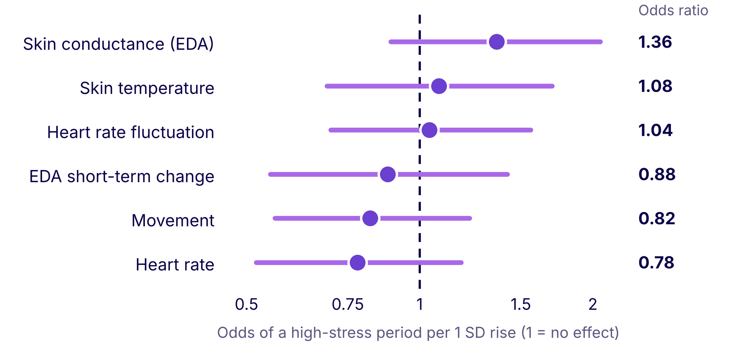



WHAT THE DATA SHOW
Wrist signals alone did not flag stress
Does any signal predict a high-stress period?
What explains a high-stress period?
4.6% the 6 body measures
16.5% which nurse it is
78.9% not explained
No signal separates high-stress periods from the rest.
Who the nurse is matters more than the signals.
73% of reports were the top level: few calm periods to compare.
Every bar crosses 1, so no signal clearly raises or lowers the odds.
Notes:
Left: odds ratio per 1 SD with 95% confidence interval from the mixed-effects logistic model on 214 survey windows: EDA 1.36 (0.89-2.06), skin temperature 1.08 (0.69-1.70), heart rate fluctuation 1.04 (0.70-1.56), EDA short-term change 0.88 (0.55-1.42), movement 0.82 (0.56-1.22), heart rate 0.78 (0.52-1.18). All intervals include 1. Heart rate fluctuation = standard deviation of heart rate over 60 s, a short-term proxy and not clinical heart rate variability. EDA short-term change = EDA minus its trailing 30 s mean. Right: variance split from the model: marginal R2 0.046 (physiology), conditional R2 0.211, so nurse identity adds about 16.5 points; ICC 0.17. Correlations with reported stress on 1-minute epochs are all 0.13 or less (skin temperature 0.13, EDA 0.07, movement 0.07, heart rate fluctuation -0.07, EDA changes -0.04, heart rate -0.03); they weight every epoch equally so long windows dominate, while the model weights each window once. Of 242 distinct usable surveys, 177 were level 2, 19 level 1 and 46 level 0.

Slide 3



WHAT IT MEANS
Wearables show the body.
People report how it feels.
What it means
Limitations
Next steps
A wrist band on its own cannot say who is stressed right now.
Each nurse has their own normal, so one threshold for everyone may misfire.
Only 214 reported periods; about 8% of time is labelled.
Stress is reported once per period.
Associations only; the level 2 cutoff is an analyst choice.
Compare each nurse against their own baseline.
Test stressor types, such as patient crisis or workload.
Validate on new nurses with regular check-ins.
Notes:
Interpretation: after allowing for which nurse was recording, average skin conductance, heart rate, skin temperature and movement did not reliably separate high-stress from other periods. LIMITATIONS: 214 windows (3 to 324 minutes long, median 16, each counted once) with 53 not high stress for six predictors (about 8.8 events per predictor); one reported level per period; outcome cutoff at level 2 is an analyst choice and a level-1 sensitivity run was not done; window averages lose within-window dynamics; Cook's distance flagged 13 windows but is unreliable for mixed logistic models; binned residuals 80% inside bounds; most cutoffs (EDA 0.01-60 uS, temperature 25-42 C, 5 s fill) were not tested for sensitivity, and the 3-epoch minimum and the upper limits removed nothing; associations only. NEXT STEPS: nurse-specific baselines, survey stressor categories, validation on new nurses with more frequent check-ins.

Slide 4
HOW IT COMPARES
The analysis lines up with the dataset paper
Signal | What the paper reports | What the analysis found | Match
Skin conductance (EDA) | Most informative signal in its stress detector; a positive link for some nurses, not all | Largest odds ratio (1.36), but the range includes 1 | Partly
Heart rate | No strong link to stress; also driven by physical activity | No link (odds ratio 0.78, correlation -0.03) | Consistent
Skin temperature | Higher with high stress, but not significant (p = 0.22) | Weak positive link (correlation 0.13), not significant | Consistent
Nurse differences | Signals vary between nurses; personalised models advised | Nurse explains about 17% of the picture, signals about 5% | Consistent
Overall | Wearables complement, not replace, reports and interviews | A wristband alone did not flag stress | Consistent
Where the analysis differs: the paper's random forest predicted stress from short signal windows, and its labelled periods were first flagged by that detector. All signals were tested together, adjusted for nurse, so the numbers are not directly comparable.
Notes:
Paper: Hosseini et al., A multimodal sensor dataset for continuous stress detection of nurses in a hospital, Scientific Data 9:255 (2022). What the paper reports (pages 8 to 10): EDA-based features (mean, min, max) are the best predictors in its random forest (higher entropy and information gain, Table 5); by visual inspection stress has a positive link with EDA for some participants but not all. Heart rate does not appear strongly correlated with stress and is raised by physical activity. Skin temperature was higher with high stress, but a paired t-test gave a statistic of 1.3 and p = 0.22 (not significant). The BVP t-test gave 2.3, p = 0.0501 (not significant). Signals vary between subjects and the paper cites work saying models should be personalised. Biometric detection is described as a complementary modality, not a replacement for reports and qualitative interviews (page 10). How the labels arose (pages 4, 5 and 8): a random forest trained on the AffectiveRoad driving dataset flagged possible stress events; nurses then rated them at the end of the shift (0 = no stress, 1 = low or medium, 2 = high); nurses added no extra events, and the paper notes that unlabelled time does not mean no stress. Rows marked na are events labelled by the detector but not validated by the nurse. This confirms the 0/1/2 coding used in this analysis. The results: odds ratios per 1 SD (95% CI): EDA 1.36 (0.89-2.06), heart rate 0.78 (0.52-1.18), skin temperature 1.08 (0.69-1.70); correlations with reported stress: skin temperature 0.13, EDA 0.07, heart rate -0.03; ICC 0.17 and marginal R2 0.046. Differences in method: the paper compared signals separately (t-tests, information gain) and built a prediction model; this analysis fitted one mixed-effects logistic model with all signals and a nurse intercept on nurse-reported level, so results are not directly comparable. Because the labelled periods were first flagged by the detector (which uses EDA, skin temperature and heart rate), the signals may differ less between the high-stress and other periods than they would across all work time.

