Slide 1

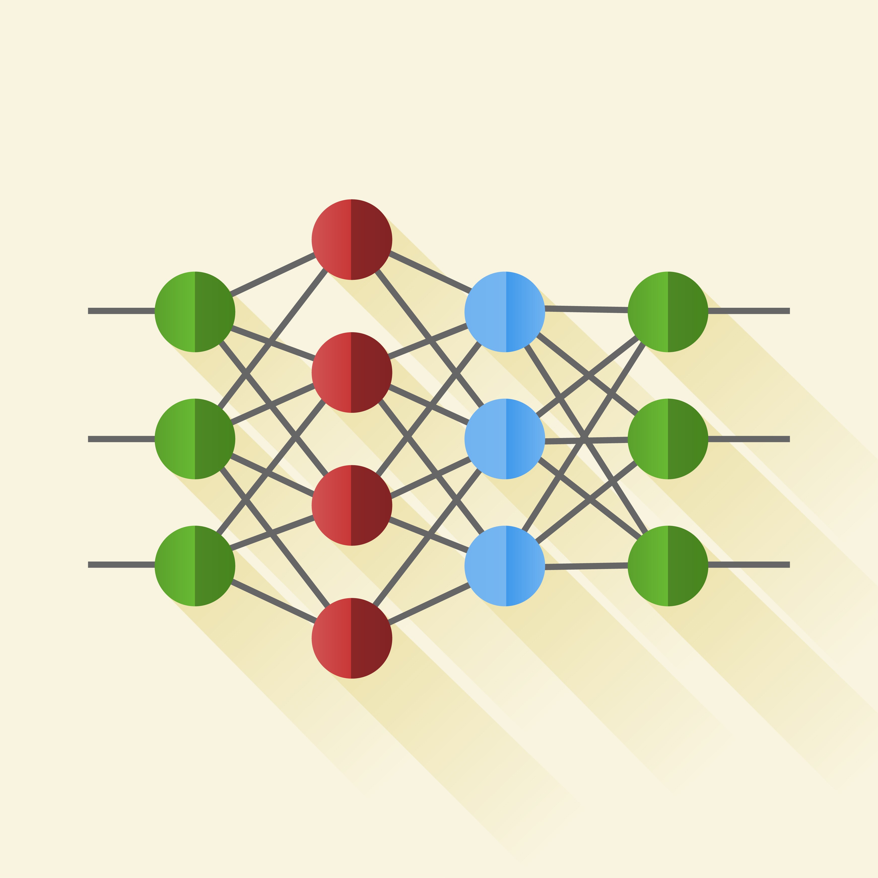
Pranav Parnerkar
ARL-W Intern (Summer 2023-Spring 2024)

Slide 2
My Research @ ARL-W
Advisor: Dr. Russell Cohen Hoffing

Slide 3
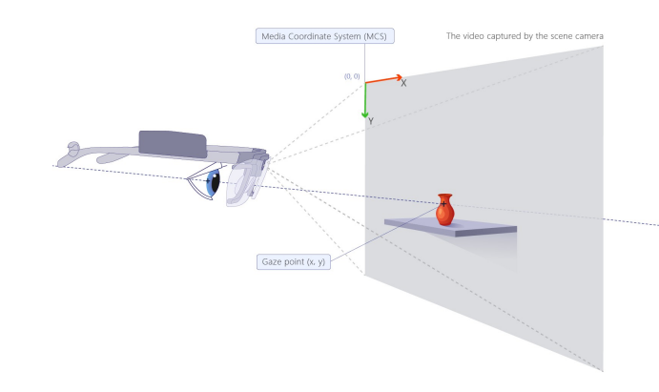
The Problem – Only the ‘Where’, not the ‘What’!

Slide 4
The ‘What’ Component of the XR Toolkit
Problem: Our task is to enable gaze-based object detection for improving human-machine teaming in critical environments.
Why should we address this problem?
It adds precision to target recognition-related use-cases.
It helps us analyse eye movements in critical environments to generate valuable insights and strategies, thereby bettering decision making.
How our pipeline addresses this problem?
We utilize zero-shot object detection models and gaze to detect “unseen” objects instead of the conventional object detection pipeline.
Why zero-shot learning: Humans are able to perform "Zero-Shot Learning" because of their existing language knowledge base. We can make connections between new or unseen classes and previously seen visual concepts. Like humans, Zero-Shot Learning relies on existing knowledge.

Slide 5
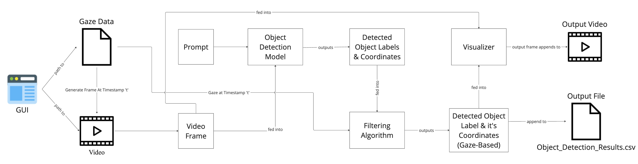
Object of Interest Identification using Gaze and Computer Vision
A tool to speed up annotation for analysis

Slide 6
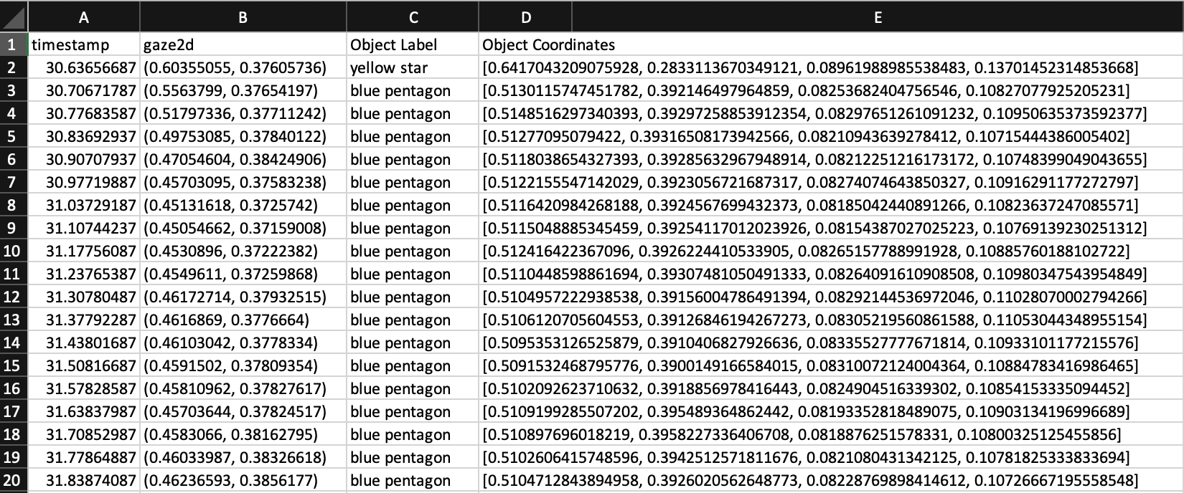
The GUI and Results File
GUI Video

Slide 7
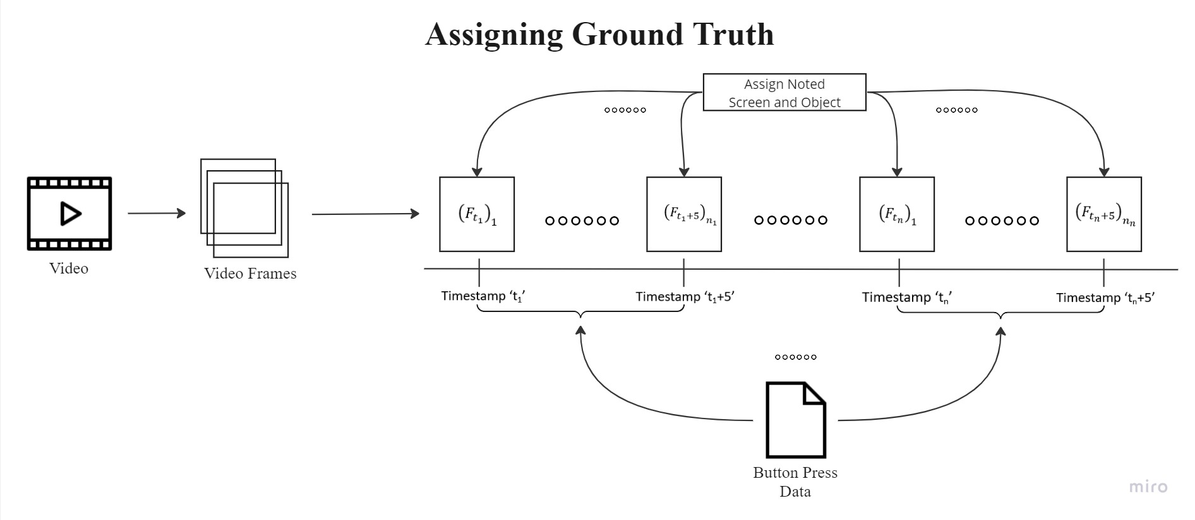
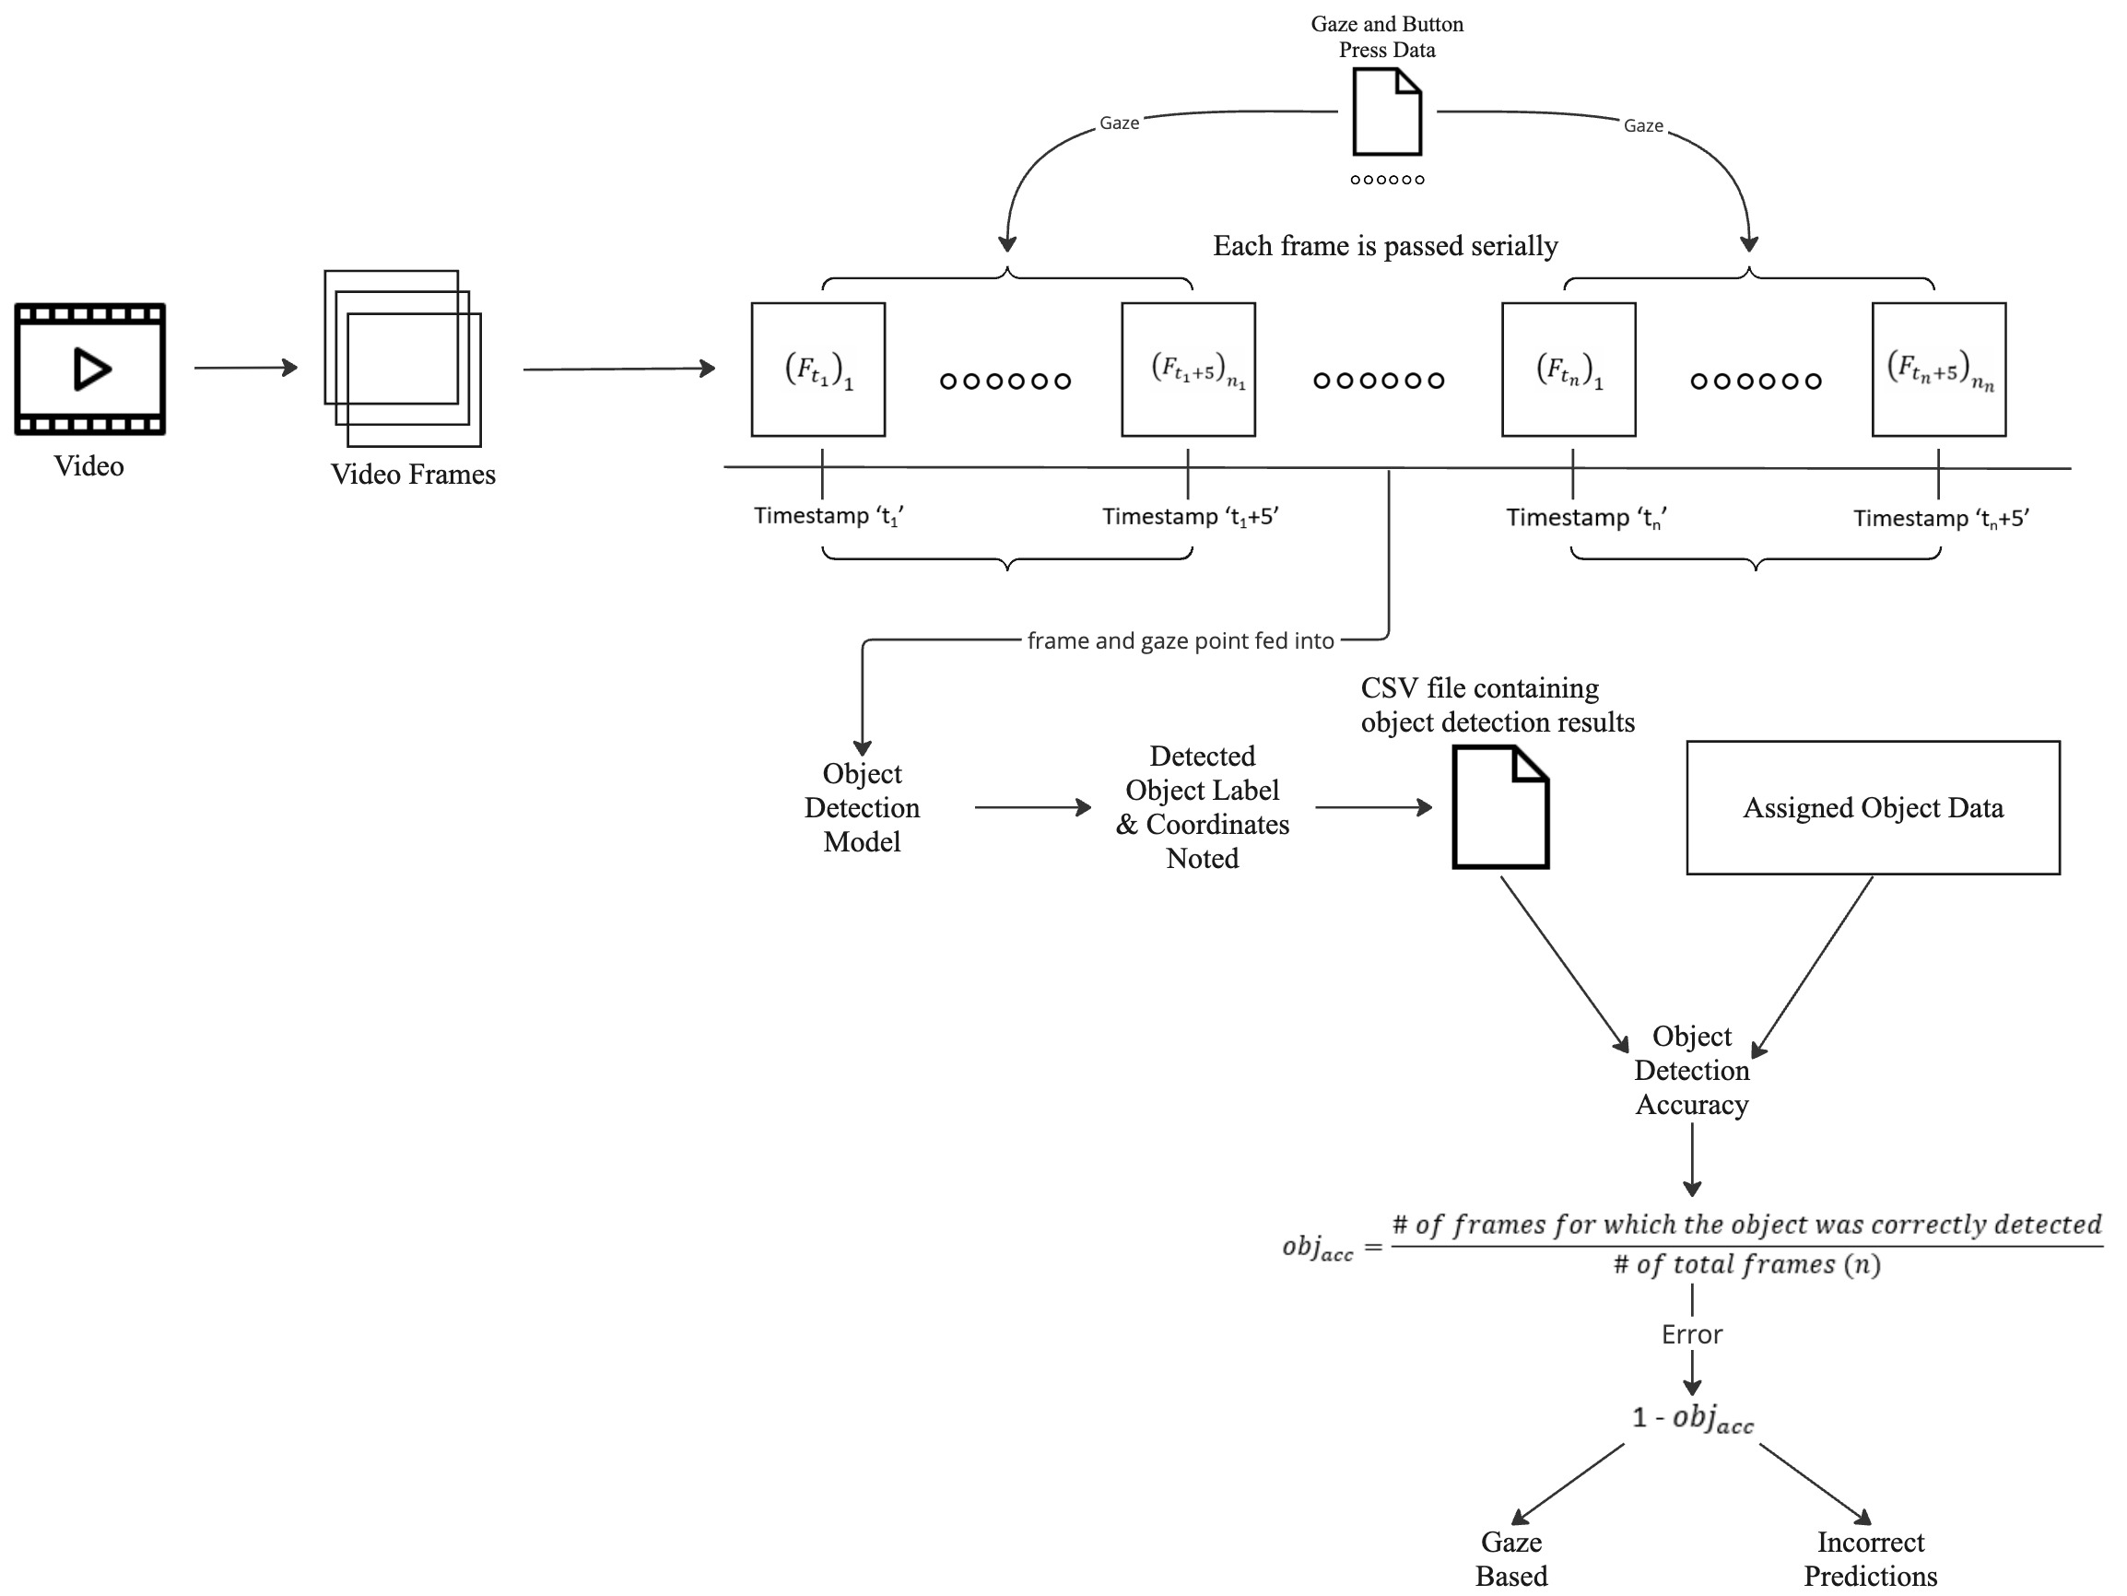
Validation
Assigning Ground Truth
Measuring Accuracy

Slide 8
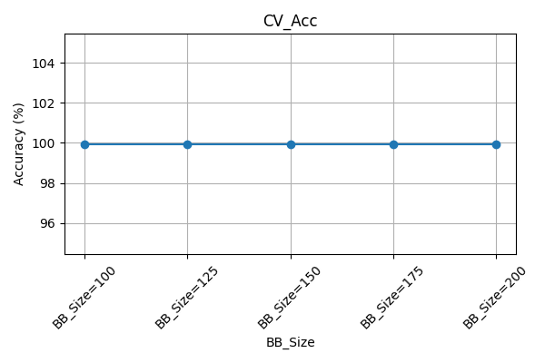
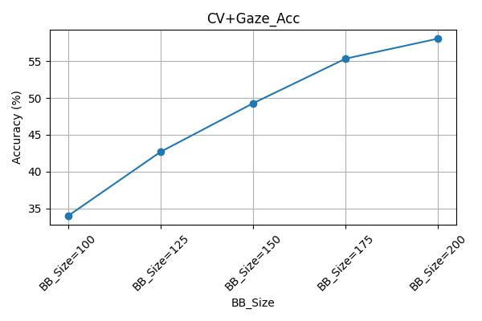
Initial Validation Results
Note: Only six simple objects were looked at during data collection

Slide 9
Limitations of the pipeline
Bad data ➔ Bad eye tracking/video capture ➔ bad results
Custom objects won’t be detected with the general model
Solution: Fine-tuning – Code available on Grounding DINO’s GitHub page

Slide 10
Screen Tracking
Screen Track Demo
The screen tracking algorithm which is based on April tag detection outputs the screen (that’s being looked at) by checking if the gaze point lies inside the bounding box of any of the detected screens in the field of view.

Slide 11
Future Research Directions
This pipeline is an essential piece for a broader system for human-machine teaming.
This system along with a rapid retraining loop can be used to collect data in the wild and train custom models quickly for detecting a wider range of objects.
Useful for interacting with autonomous agents – LLMs/LVMs

