Slide 1

CSCI 566 – Deep Learning and its Applications
Reinforcement Learning for Recommender Systems – Environment Suite
PRANAV PARNERKAR

Slide 2
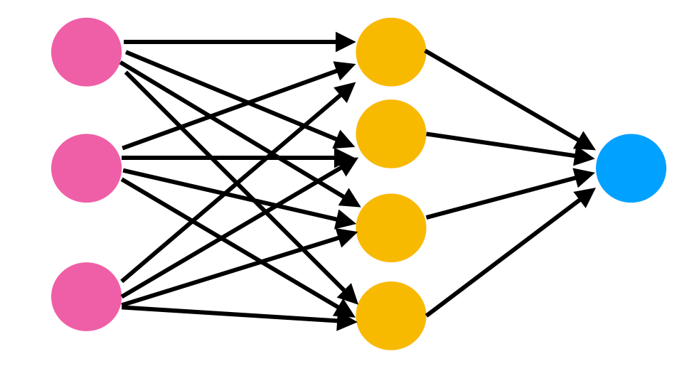
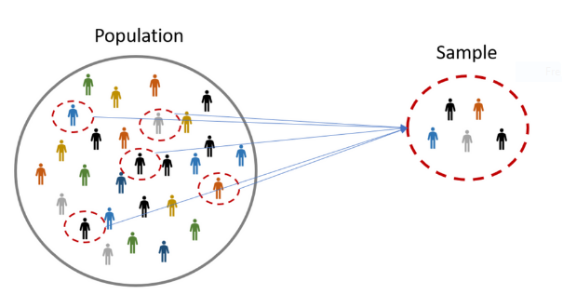

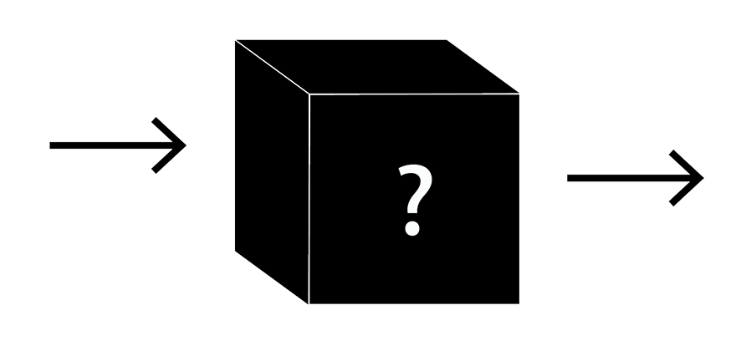

RL-based RecSys – WHY?
Deep Learning-based RecSys – The Norm
Myopia
Compromised Long-Term Utility
Neural Networks – Black Box
Compromised Interpretability
System-induced Bias
User Preferences Ignored

Slide 3
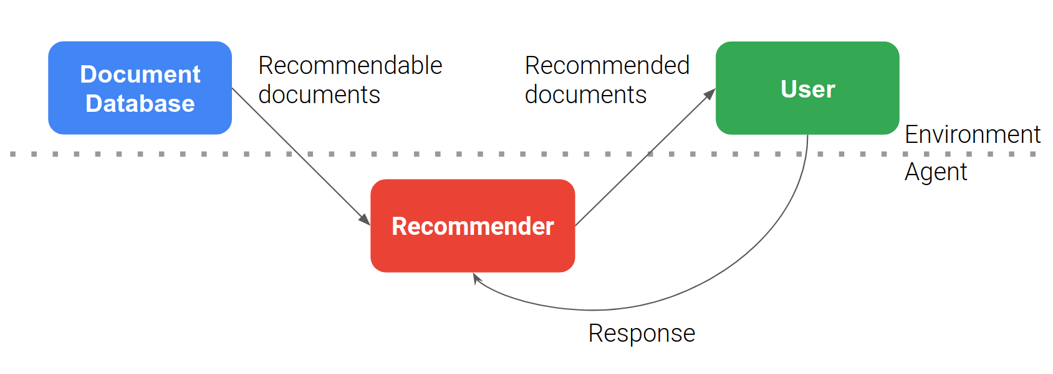
Problem Statement
Building an RL-RecSys Environment for Video Recommendations (Netflix/YouTube) – Using Google RecSim.
Benchmarking simple RL agents on developed environment.
Identifying relevant RL-RecSys challenges/future scope.

Slide 4
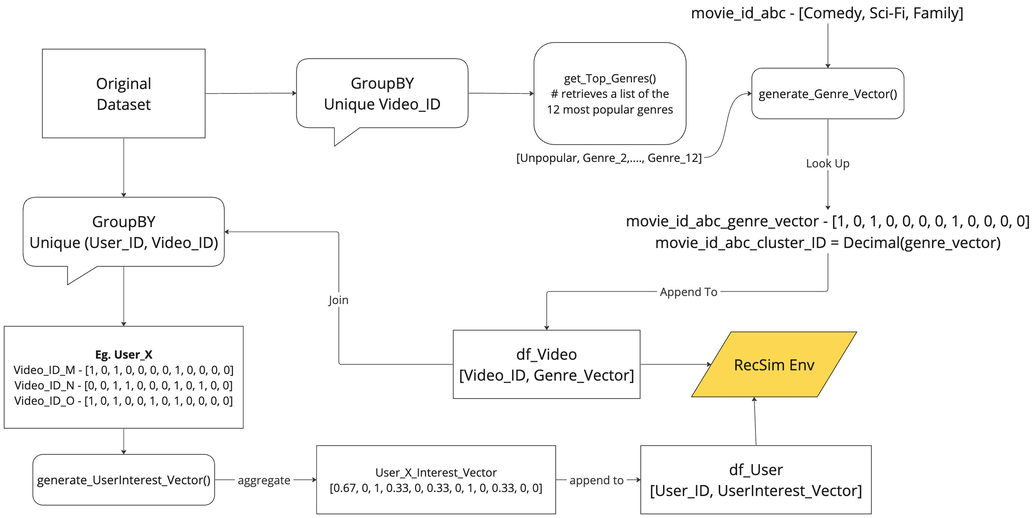
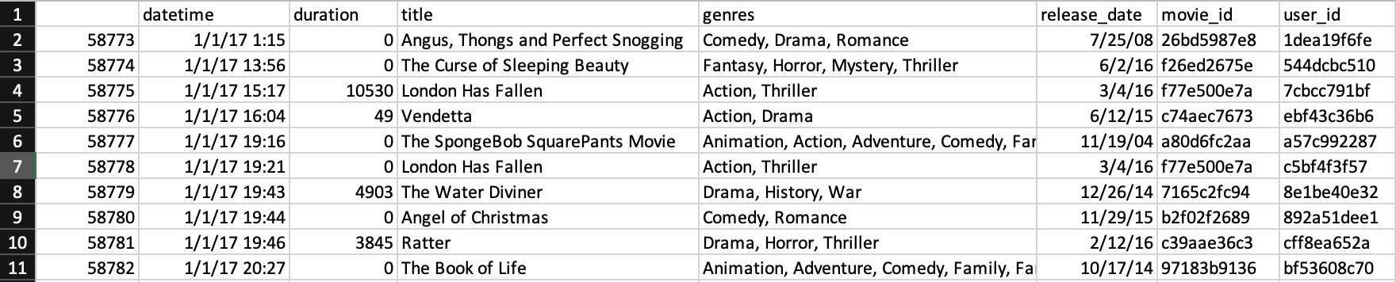
Dataset and Feature Engineering – Netflix Environment
Feature Engineering
Dataset
Netflix Audience Behavior Dataset – UK movies
by Vod Clickstream et al. – Hosted on Kaggle
[https://www.kaggle.com/datasets/vodclickstream/netflix-audience-behaviour-uk-movies]

Slide 5
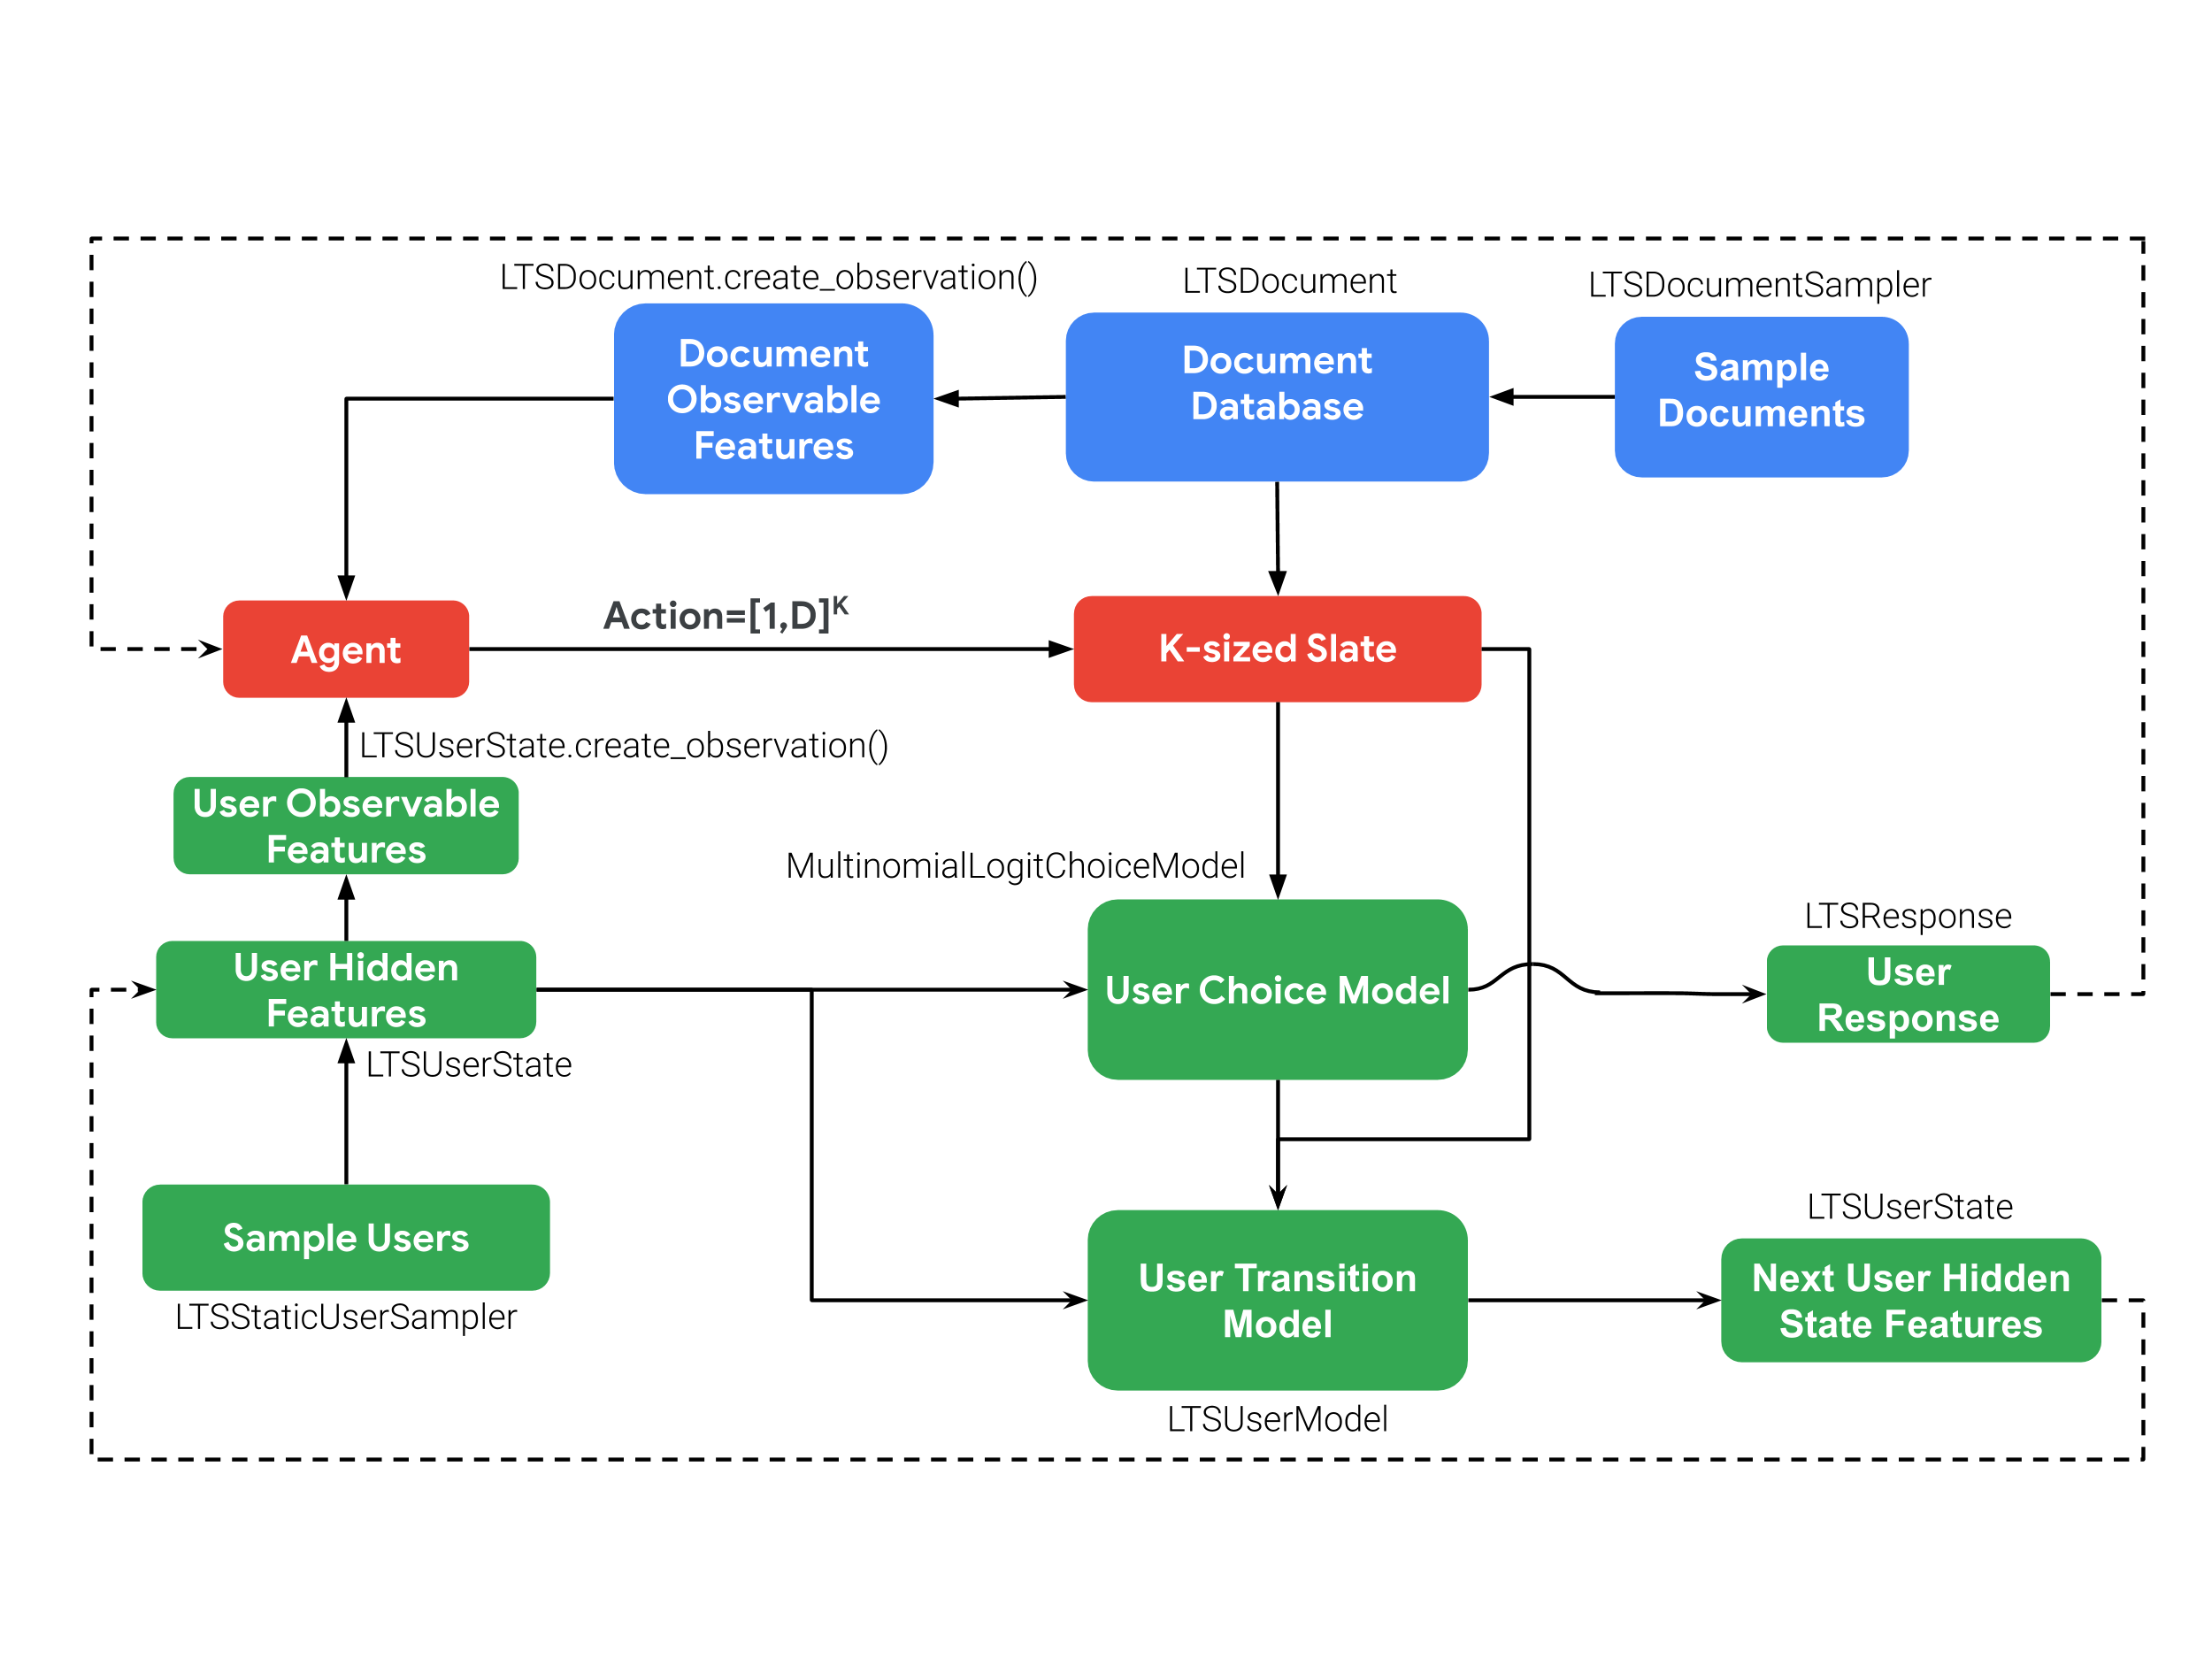
Technical Details – RecSim Environment Development
Salient Features
Relevance Score = (UserInterest_Vector) . (Video_Genre_Vector)
Choice model → Softmax(Relevance Score)
Updates:
- (Time Budget - Watch Time)
- Evolving interests – Update(UserInterest_Vector) based on
Selection
- Increase(Time Budget) - based on Diversity(Recommendation)
Reward - Watch Time(Clicked Video)
Trade off for longer sessions - Right balance b/w Diversity(Recommendation) & Relevance(Recommendation)

Slide 6
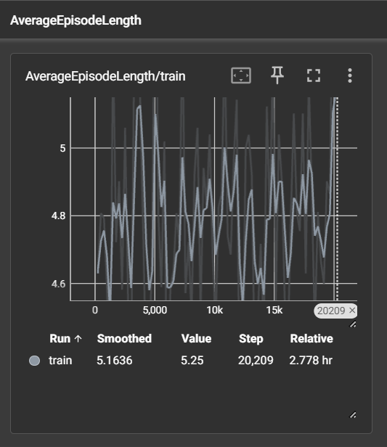
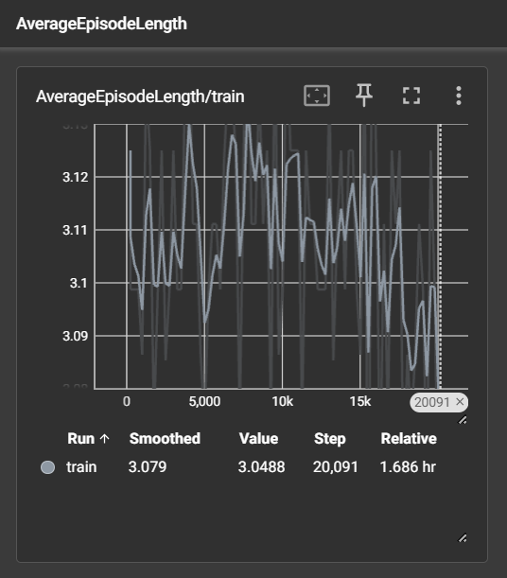
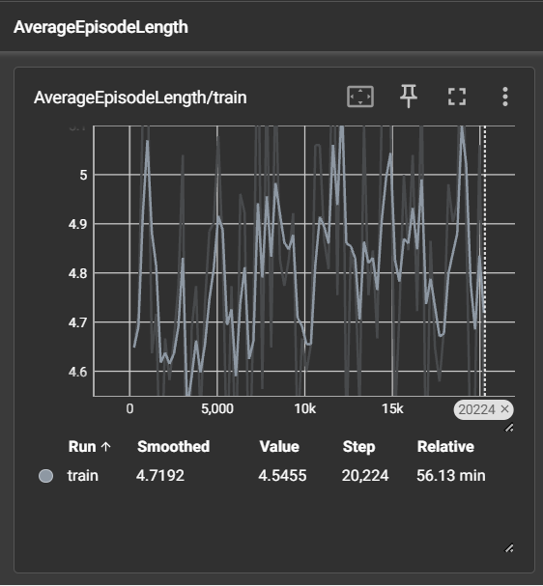
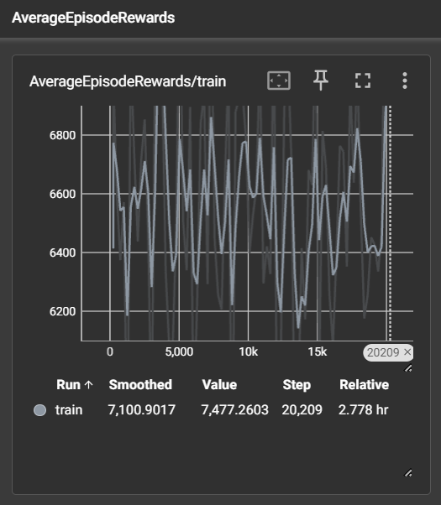
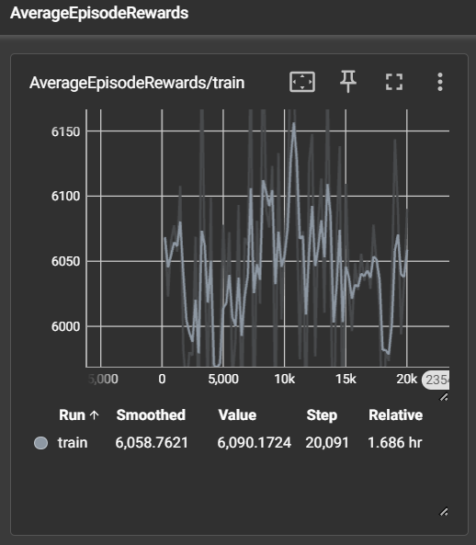
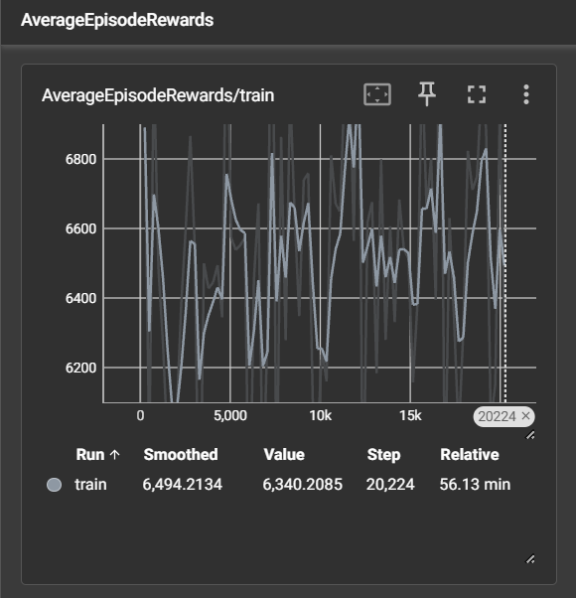
Benchmarking Agents – Random, Greedy, DQN
Random
Greedy
DQN

Slide 7
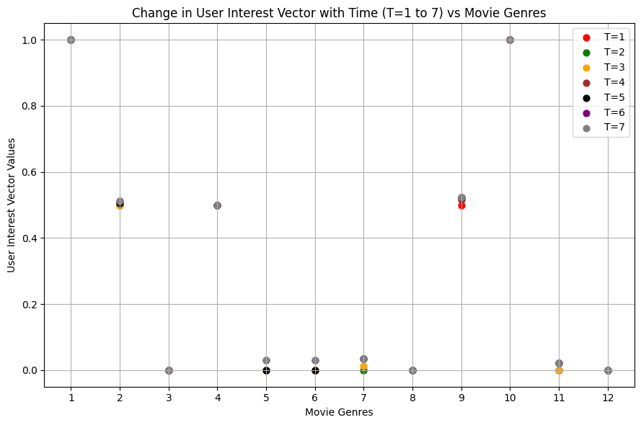
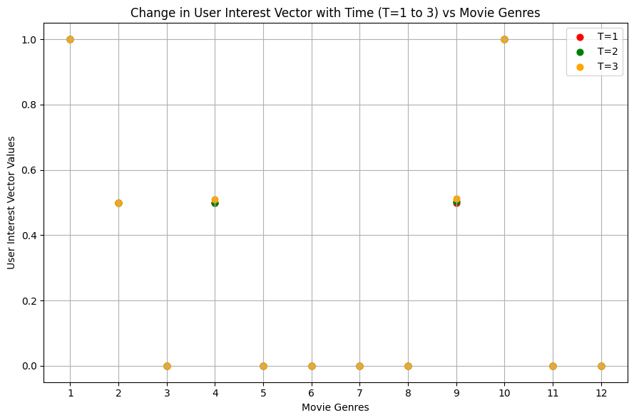
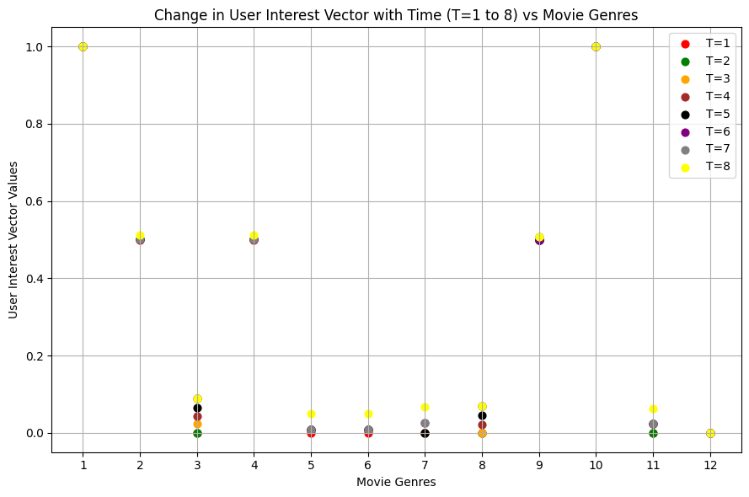
Benchmarking Agents – Random, Greedy, DQN
Long-Term Engagement
Myopic Engagement
Random
Greedy
DQN

Slide 8
Challenges | Future Scope
a. Feature Ingestion | a. Development of data ingestion modules for RecSim.
b. Exploration vs Exploitation - Environment Design & Tuning | b. AutoRL-based Tuning
c. Scalability Handling larger datasets/online data Training - Time/Compute | c. Rapid evolution of formal libraries, offering enhanced plug-n-play functionalities. Richer/Refined Data Sources Matured GPU-enabled training infrastructure for RecSim.

Slide 9


