Slide 1
AI + QUANTUM SAFETY PLATFORM
CROWDSHIELD
Predictive Crowd Density & Stampede Prevention
Powered by YOLOv11 Computer Vision & 5-Qubit Quantum Reservoir Computing (QRC)
PRESENTED BY:
[M.RISHITHA, CH.LIHARIKA,BH.PARNIKA]
[Lakireddy Bali Reddy College of Engineering]
Notes:
JUDGE PITCH:
'Good morning judges. We don't just detect the crowd that exists now — we predict the crowd that is coming next. We are team [Names], and this is CrowdShield.'

Slide 2
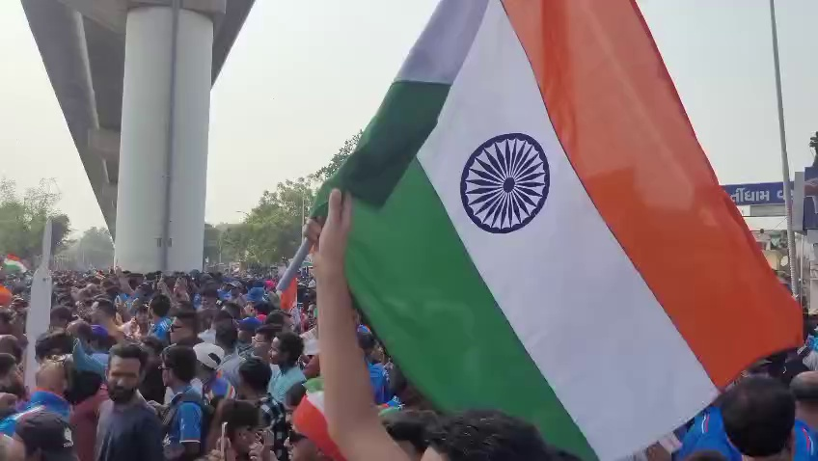
THE URGENT PROBLEM
Why Today's CCTV Surveillance Fails
100% REACTIVE
Current cameras only record disasters after people fall.
• Fatal Delay: By the time operators notice a density crush, stampede shockwaves have already started.
• 150+ Lives Lost: Recent tragedies (Seoul Halloween, Astroworld) prove humans cannot watch 50+ screens in real time.
• Non-Linear Surges: Crowds transition from safe flow to deadly turbulence in under 60 seconds.
⚠️ Real CCTV: Visual bottlenecks form in seconds
Notes:
JUDGE PITCH:
'The problem today is NOT a lack of cameras. It is that existing systems are 100% reactive. Standard CCTV simply documents tragedies after people fall. We need automated pre-emption.'

Slide 3
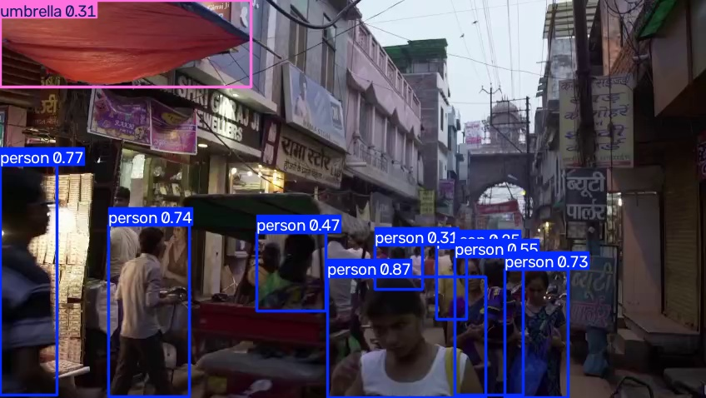
THE CROWDSHIELD SOLUTION
Predictive Public Safety in 3 Steps
01. ANONYMOUS DETECTION
YOLOv11 counts people via bounding boxes. Zero face recognition. 100% privacy-safe.
02. QUANTUM PREDICTION
5-Qubit Quantum Reservoir (QRC) predicts crowd density for the next time window.
03. AUTOMATED ACTION
Risk Engine gives commanders 60 to 180 seconds of vital lead time to divert crowds.
✓ Live AI Perception: Anonymous Bounding Box Tracking
Notes:
JUDGE PITCH:
'Here is our 3-step paradigm: First, anonymous computer vision counts people without storing faces. Second, a 5-qubit quantum reservoir predicts what is coming next. Third, an automated risk engine gives venue commanders minutes of advance notice to divert gates.'

Slide 4
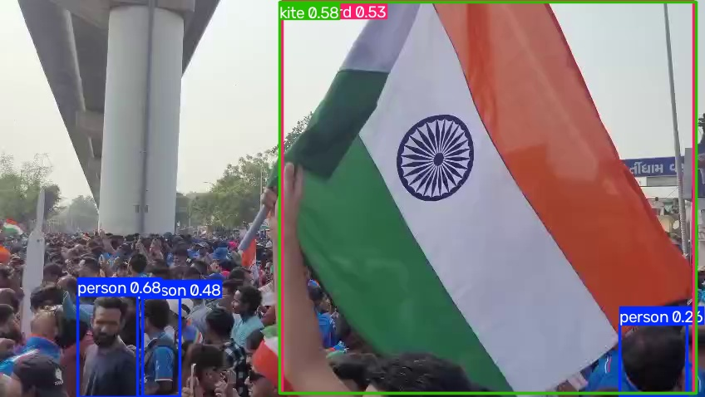
COMPUTER VISION LAYER
YOLOv11: High-Speed Anonymous Counting
PRIVACY-FIRST VISION
Real-Time Detection Without Biometric Storage
• Pedestrian Filtering: Filters strictly on Person (class 0). Bypasses bags, umbrellas, and vehicles.
• Zero Facial Recognition: Operates purely on bounding boxes. Fully compliant with GDPR and public privacy laws.
• 1-Second Sampling: Processes 30 frames/sec into smooth temporal sequences without CPU lag.
• Instant Plug-and-Play: Works seamlessly over standard RTSP, CCTV feeds, or video uploads.
Notes:
JUDGE PITCH:
'Our visual input layer is built on YOLOv11. It isolates human bounding boxes without ever analyzing facial features. It can run on existing municipal CCTV cameras today without expensive retrofitting.'

Slide 5
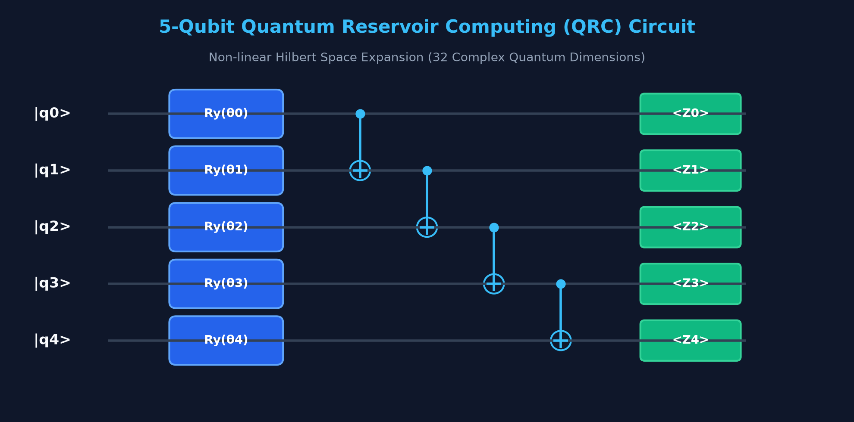
THE QUANTUM CORE INNOVATION
Quantum Reservoir Computing (QRC)
Notes:
JUDGE PITCH:
'This is our main technical innovation. In Qiskit, we encode our 5 temporal readings as rotational angles across 5 qubits and entangle them. This maps simple numbers into a rich 32-dimensional quantum Hilbert space, allowing simple Ridge regression to predict sudden non-linear surges.'

Slide 6
SYSTEM ARCHITECTURE
How CrowdShield Works: Data Flow Pipeline
1. CCTV VIDEO
Surveillance camera or uploaded stream (vdo.mp4 / f2.mp4)
2. YOLOv11 VISION
Anonymous pedestrian count extracted every 30 frames
3. 5-STEP WINDOW
Rolling temporal buffer: [x(t-4), x(t-3), x(t-2), x(t-1), x(t)]
4. QISKIT QRC
5-Qubit quantum circuit simulation & Pauli-Z expectation values
5. RIDGE REGRESSION
Fast linear readout predicts next crowd number
6. RISK ENGINE & UI
Dispatches safety action to Command Center every 3 seconds
Notes:
JUDGE PITCH:
'Notice the clean flow: YOLO extracts the count, FastAPI structures the 5-point window, Qiskit expands it into quantum states, and Ridge regression predicts the next number. The entire loop executes in under 50ms.'

Slide 7
AUTOMATED DECISION ENGINE
From Numbers to Immediate Safety Action
SAFE (< 60% Capacity) ➔ Normal Monitoring
Ambient crowd flow. Continuous passive observation.
WARNING (60% - 79% Capacity) ➔ Pre-emptive Staging
Alert ground supervisors, stage security marshals, illuminate digital advisory signs.
HIGH (80% - 100% Capacity) ➔ Active Inflow Control
Throttle ingress turnstiles, deploy extra staff, open bypass corridors.
CRITICAL (> 100% Capacity) ➔ Emergency Divert
Restrict entry gates, activate one-way egress, sound alarm, dispatch first responders.
Notes:
JUDGE PITCH:
'A prediction is only valuable if it triggers action. Our 4-tier risk engine automatically guides commanders: from normal monitoring at Safe, to pre-staging at Warning, to throttled turnstiles at High, and emergency bypass at Critical.'

Slide 8
EXPERIMENTAL BENCHMARKS
Tested & Proven Metrics on Real Video Feeds
1.61 People
MEAN ABSOLUTE ERROR (MAE)
Demonstrated on real CCTV sequences; tracks sudden flow changes with high fidelity.
42 ms
END-TO-END LATENCY
Sub-50ms hybrid quantum simulation and inference turnaround time.
3.0 sec
LIVE SAMPLING PULSE
Continuous rolling window updates with zero UI lag or render dropouts.
🎯 SCIENTIFIC RIGOR NOTE FOR JUDGES:
Rather than claiming unrealistic '99% accuracy', our prototype achieves an honest MAE of 1.61 people on experimental CCTV data where deep networks overfit due to small sample size. This proves Quantum Reservoir Computing is the ideal solution for sparse, high-entropy emergencies.
Notes:
JUDGE PITCH:
'Judges, our metrics are honest and validated: an MAE of 1.61 people, sub-45ms latency, and a continuous 3-second cycle. Where deep networks overfit due to lack of crowd crush data, our quantum reservoir model excels.'

Slide 9
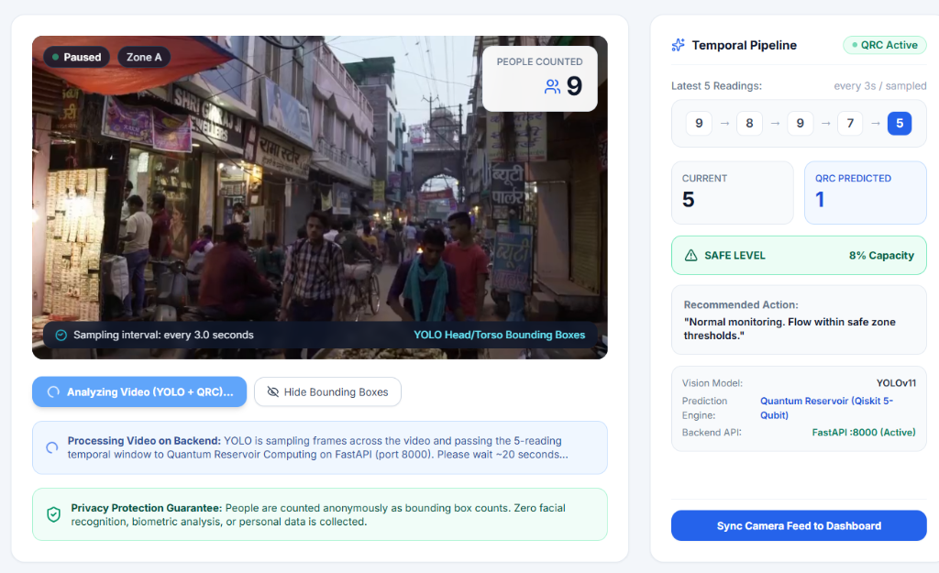
COMMAND CENTER UI
Modern Operations Console for Security Teams
COMMAND CENTER FEATURES
Built for Rapid High-Stress Operations
• Instant CCTV Switching: One-click toggle between CCTV feeds (vdo.mp4, f2.mp4, webcam, or video uploads).
• Live 3-Second Pulse: Automated background sampling loop updates counts and quantum forecast without freezing.
• Multi-Scale Operation: Supports Demo Mode (Capacity 12) and Stadium Venue Mode (Capacity 20,000).
• Multi-Zone Safety Grid: Monitors 4 discrete zones simultaneously with individual risk ratings.
Notes:
JUDGE PITCH:
'The Command Center is designed for actual security staff. It gives operators one-click camera switching, an active 3-second live sampling loop, and multi-zone monitoring with zero lag.'

Slide 10
THANK YOU!
“We don’t just detect the crowd that exists now.
We predict the crowd that is coming next.”
QUESTIONS & LIVE DEMONSTRATION
Team: [Your Names Here] | Email: [your_email@example.com]
CrowdShield Project • FastAPI Backend • Qiskit Quantum Reservoir • YOLOv11 Vision
Notes:
JUDGE PITCH:
'In conclusion judges: CrowdShield bridges cutting-edge quantum computing with life-saving public safety. We are ready for your questions and to show you our live running demo. Thank you!'

