Slide 1
Samsung Innovation Campus

Slide 2
Zomato Sales Price Prediction Using Data Analysis
Team name - Innovative Beasts

Slide 3
Project Name
UNIT 1. Introduction
1.1. Brief description about our project
1.2.Problem statement
1.3. Business Impact
UNIT 2. Data Collection
2.1. Sources of Data
2.2. Data Cleaning
UNIT 3. Exploratory Data Analysis
3.1. Key Variables
3.2. Visualization
3.3. Examples
Notes:
Note:

Slide 4
Project Name
UNIT 4. Model Selection
4.1 Model evaluation
4.2 Examples
UNIT 5. Model Results
5.1. Performance Metrics
5.2 Conclusion
Notes:
Note:

Slide 5
Using Data Analysis Techniques to Optimize Restaurant Pricing Strategy
Slide Title
Presented by
Jasmine Sardana (+91 9212143335)
Parnika Singh (+91 8851037812)
Adityanaryan Sanjay Tripathi (+91 9315120836)
Arsad Khan (+91 7060815734)
Deepanshu Singh (+91 9654772027)
Date – 30 September 2024

Slide 6
Problem Statement
1
Objective:
Zomato's listed restaurants struggle to optimize their pricing strategies due to a lack of accurate forecasting tools. Build a predictive model to forecast sales prices of restaurants listed on Zomato.
Use historical sales data, customer reviews, location, and other influencing factors to improve pricing strategies for restaurant owners.
Restaurant owners need a reliable model to predict sales prices and adjust their offerings accordingly for better profitability.
Business Impact:
Optimized Pricing Strategy
The predictive model enables restaurant owners to optimize their pricing based on real-time data analysis. This can lead to a better alignment between pricing and customer demand, ensuring that prices are competitive yet profitable.
Increased Profitability
By accurately predicting future sales prices, restaurants can avoid underpricing or overpricing their menu items, which can directly affect their bottom line.

Slide 7
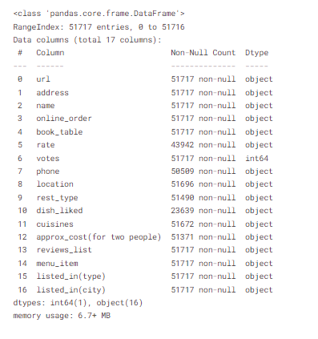
Data Collection
Sources of Data:
Historical Sales Data: Transaction data for each restaurant (price per meal, total sales).
Customer Reviews: Ratings and feedback from Zomato users.

Slide 8
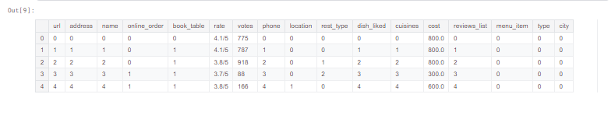
Data Cleaning: .
Missing Data Handling: Imputation of missing sales data, customer reviews, etc.
Normalization: Scaling of continuous variables like sales prices, reviews, etc.
Feature Engineering: Deriving new variables like average sales per location, sentiment analysis of reviews, etc.

Slide 9
Exploratory Data Analysis (EDA)
Key Variables to Analyze:
Sales price distribution over time.
Correlation between customer ratings and sales.
Impact of location on restaurant sales.
Effect of seasonal events or promotions.
Visualization Tools:
Histograms of sales prices.
Heatmaps for correlations.
Scatter plots of ratings vs. sales.

Slide 10
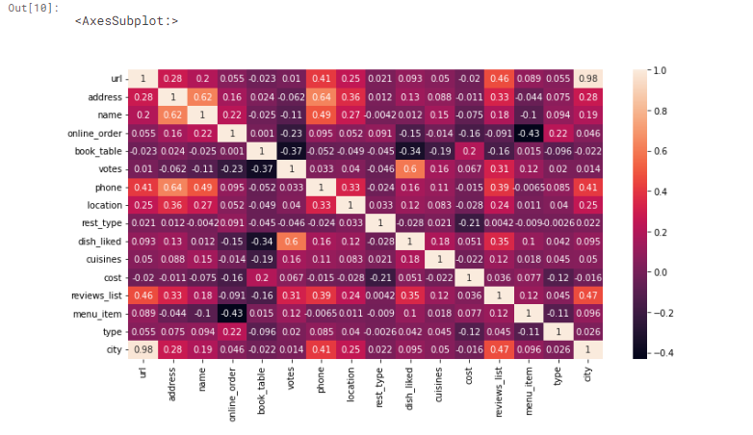
Correlation matrix of the dataset

Slide 11
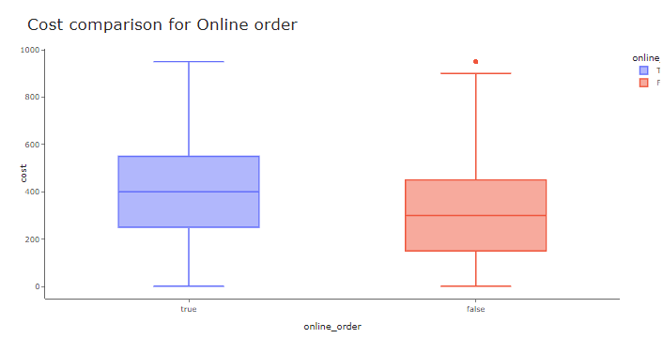
Cost comparison for Online orders V/s Offline orders :

Slide 12
Model Selection
Supervised Learning Algorithms:
Linear Regression: Baseline model for predicting continuous sales prices.
Random Forest Regressor: For capturing non-linear relationships.
XGBoost: Gradient boosting for high accuracy and handling complex interactions.
Time Series Models (if needed): ARIMA or Prophet for time-based predictions.
Model Evaluation:
Train-test split (80-20).
Cross-validation to prevent overfitting.
Evaluation Metrics: Mean Absolute Error (MAE), Root Mean Square Error (RMSE).

Slide 13
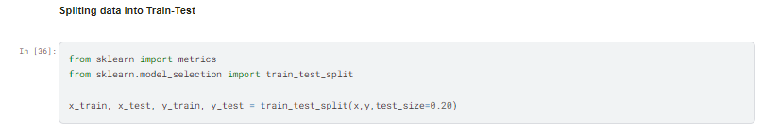
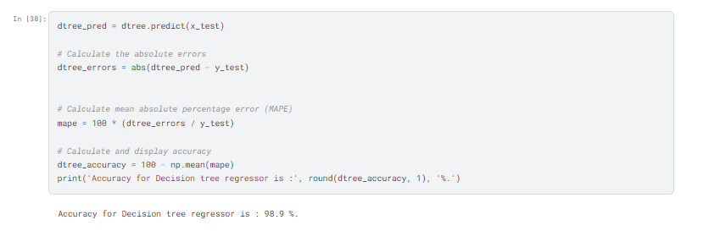
Some Code Snippets

Slide 14
Model Results
Performance Metrics:
Compare RMSE and MAE across different models.
Plot actual vs. predicted sales prices.
Model Accuracy:
Highlight the best-performing model based on validation data.
Mention any improvements from feature engineering.
|Conclusion:
The predictive model provides valuable insights into sales price drivers.
Restaurant owners can use these insights to refine pricing strategies, improve customer satisfaction, and boost profitability.
Future enhancements can include more data sources like competition analysis and real-time trends.

