Slide 1
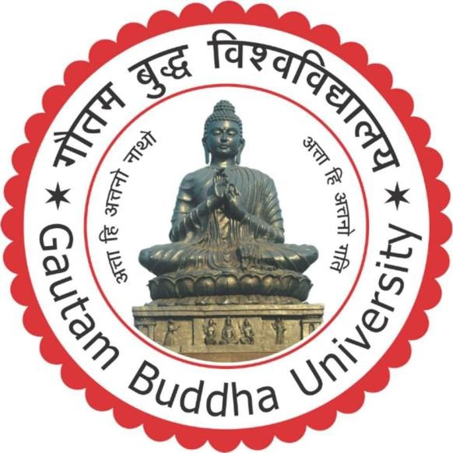
An Industrial Training report ML493
Submitted By:- Parnika Singh (215/UCM/017)
B.Tech CSE-ML

Slide 2
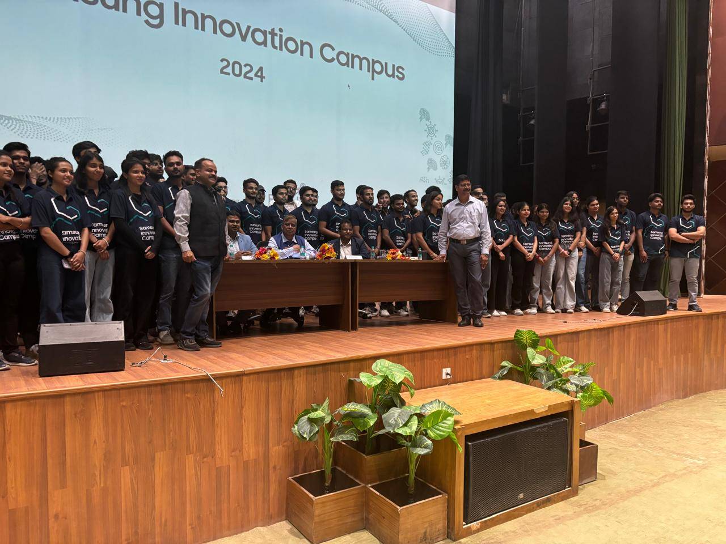
Samsung Innovation Campus

Slide 3
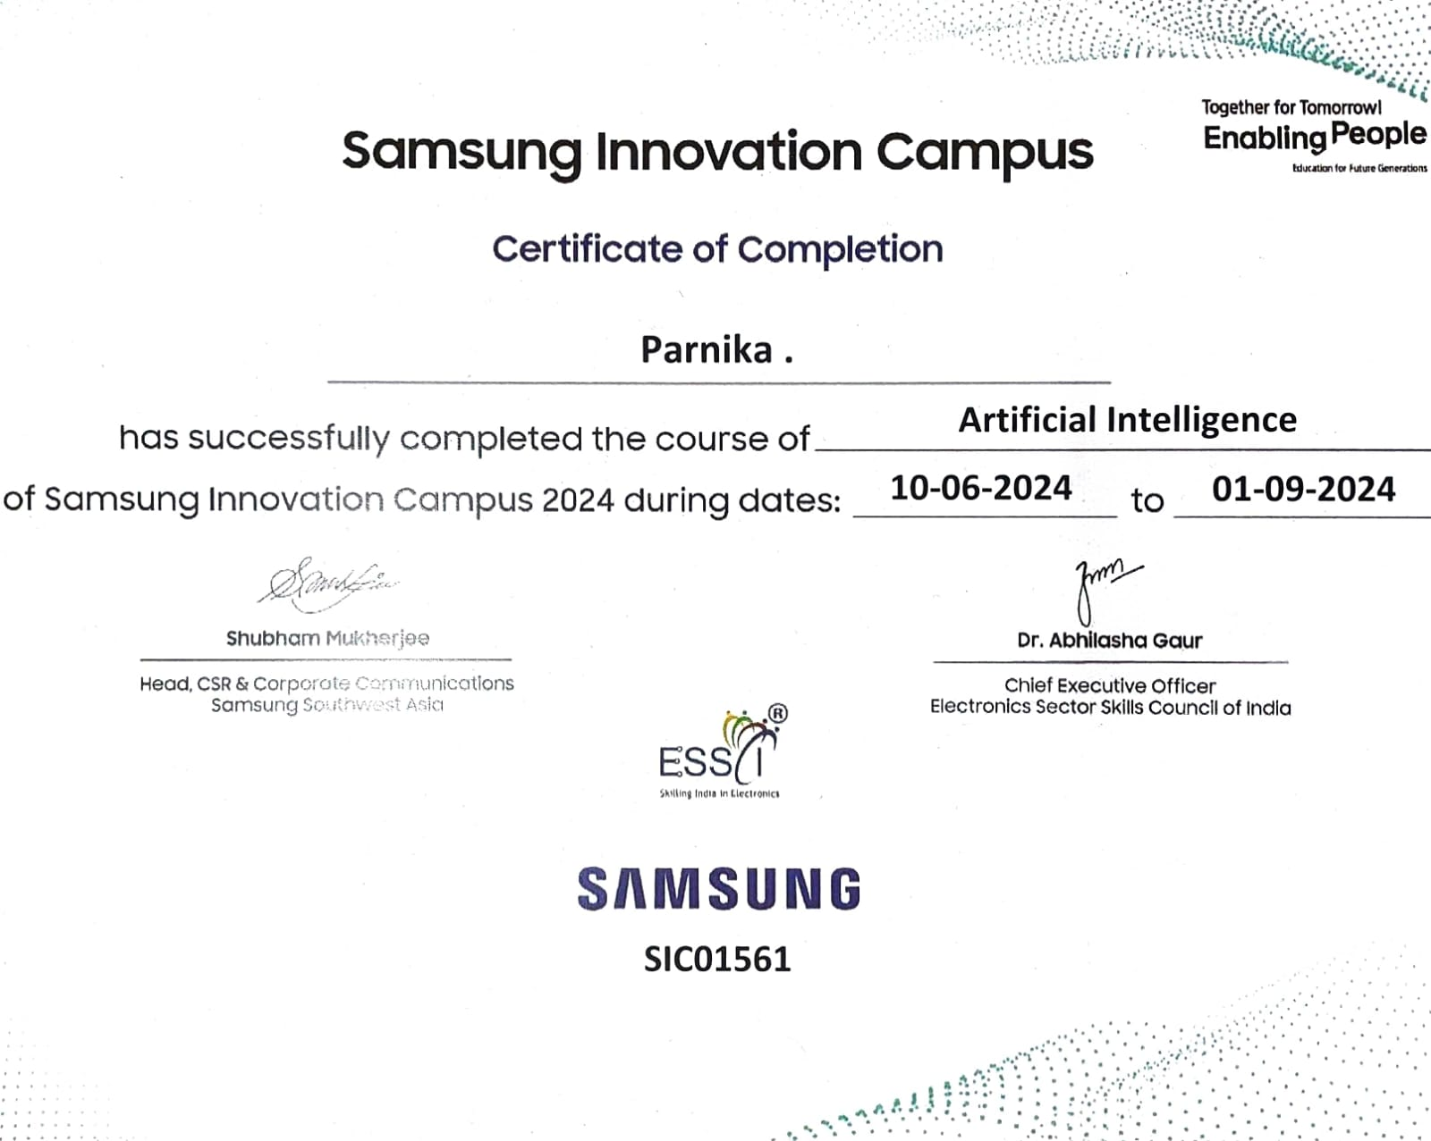

Slide 4
About SIC
The Samsung Innovation Campus (SIC) program is a global initiative that equips youth with essential skills in AI, IoT, Big Data, and programming, addressing industry demands. As a Computer Science Engineering student specializing in Machine Learning, my participation was invaluable for academic and professional growth. The program provided hands-on experience with AI tools and frameworks, enhancing my theoretical understanding and practical skills. It prepared me to tackle future challenges, fostering innovation and the ability to develop impactful technology-driven solutions.

Slide 5
Training Curriculum
The training program provided a comprehensive foundation in mathematics, artificial intelligence, machine learning, and natural language processing (NLP). I strengthened my knowledge of linear algebra, calculus, probability theory, and statistical techniques, essential for data manipulation and model optimization.

Slide 6
The AI module introduced data preprocessing and exploratory data analysis (EDA) using tools like NumPy, Pandas, Matplotlib, and Seaborn to clean, visualize, and uncover patterns in data.
In supervised learning, I studied algorithms like linear regression, logistic regression, decision trees, and SVMs, applying them to real-world scenarios such as sales prediction and fraud detection.
Unsupervised learning covered clustering techniques and dimensionality reduction methods, useful in market segmentation and anomaly detection.
The deep learning section focused on neural networks, including CNNs for image processing and RNNs for sequence data. Lastly, I explored NLP, mastering tasks like text classification, sentiment analysis.

Slide 7
Personal Contributions
During the Samsung Innovation Campus Artificial Intelligence Program, I worked on multiple practical projects that significantly strengthened my skills in machine learning (ML), deep learning (DL), and natural language processing (NLP). These projects provided hands-on experience with diverse datasets and industry-standard tools, bridging the gap between theoretical knowledge and real-world applications.
In the Titanic Dataset Analysis, I applied ML techniques to predict passenger survival, leveraging logistic regression and Random Forest models.
For the Diabetes Dataset Prediction, I used ensemble techniques like Gradient Boosting and XGBoost, combined with feature selection and scaling, to identify key risk factors like glucose levels and BMI, achieving high model accuracy.

Slide 8
The Employee Attrition Analysis focused on predicting turnover using Decision Trees and SVM. I addressed class imbalance with SMOTE and identified job satisfaction as a critical factor.
In House Price Prediction, I implemented Lasso and Ridge regression, addressing skewed distributions and optimizing hyperparameters for accurate predictions.
Finally, in Sentiment Analysis, I built an NLP pipeline with TF-IDF and models like Naive Bayes, effectively classifying customer feedback.

Slide 9
Skills Acquired
Python Programming: Proficient in Python for data analysis, machine learning, and deep learning.
NumPy & Pandas: Skilled in numerical operations, matrix manipulations, data cleaning, transformation, and aggregation.
Data Visualization: Created insightful visualizations using Matplotlib and Seaborn.
Machine Learning: Expertise in supervised and unsupervised learning algorithms, including regression, classification, clustering, and dimensionality reduction.
Deep Learning: Built and trained neural networks, including CNNs and RNNs, for advanced tasks.
NLP: Implemented text preprocessing, sentiment analysis, and transformer models like BERT and GPT.
EDA & Preprocessing: Conducted exploratory data analysis and data preprocessing, including feature engineering.

Slide 10
Challenges faced
Technical Complexity of Algorithms - Deep learning models like CNNs and RNNs were challenging due to their intricate architectures. I overcame this by revisiting foundational mathematics, practicing hands-on coding, and leveraging tutorials to build intuition.
Data Preprocessing and Cleaning - Messy datasets required handling missing values and outliers systematically. I learned to approach this methodically and collaborated with peers to refine preprocessing strategies.
Advanced Tools and Frameworks - Mastering tools like TensorFlow and PyTorch involved navigating steep learning curves. I utilized official documentation, forums, and group discussions to improve my proficiency.
Time Management - Balancing diverse topics such as NLP and deep learning was overwhelming. A structured study plan and task prioritization ensured consistent progress.

Slide 11
Debugging and Optimization - Issues like overfitting and poor model performance were common. Systematic debugging, hyperparameter tuning, and techniques like regularization enhanced model accuracy.
Real-World Applications - Applying theory to practical problems was daunting. Case studies, hackathons, and iterative model building bridged the gap between concepts and applications.
Burnout - The rigorous schedule caused mental fatigue. Regular breaks, mindfulness, and physical activities helped maintain motivation.

Slide 12
Outcomes and Impact
The Samsung Innovation Campus (SIC) program had a significant impact on my academic and professional journey. In the short term, it provided hands-on experience with advanced technologies such as machine learning, deep learning, and natural language processing.
Working on projects like Titanic Dataset Analysis, Diabetes Prediction, and Sentiment Analysis allowed me to apply theoretical knowledge to real-world problems, enhancing my problem-solving skills. I also gained valuable insights into industry practices through mentorship and interactions with professionals, helping me better understand the practical challenges of deploying technology solutions.

Slide 13
In the long term, the SIC program bridged the gap between academic learning and industry needs, preparing me for future career opportunities in AI, data science, and software development. The experience refined my technical skills, such as machine learning model design and feature engineering, making me more competitive in the job market.
Additionally, networking opportunities with industry experts expanded my professional connections, opening doors for potential collaborations and job prospects. This experience has played a pivotal role in shaping my career aspirations and boosting my confidence to pursue advanced roles in AI and technology.

