Slide 1
Regular Expressions(re) in Python
Regex

Slide 2
Problem
Write a Python code to check if the given mobile number is valid or not. The conditions to be satisfied for a mobile number are:
a) Number of characters must be 10
b) All characters must be digits and must not begin with a ‘0’

Slide 3
Validity of Mobile Number
Input | Processing | Output
A string representing a mobile number | Take character by character and check if it valid | Print valid or invalid

Slide 4
Test Case 1
abc8967891
Invalid
Alphabets are not allowed

Slide 5
Test Case 2
440446845
Invalid
Only 9 digits

Slide 6
Test Case 3
0440446845
Invalid
Should not begin with a zero

Slide 7
Test Case 4
8440446845
Valid
All conditions satisfied

Slide 8
Python code to check validity of mobile number (Long Code)
import sys
number = input()
if len(number)!=10:
print ('invalid')
sys.exit(0)
if number[0]==‘0’:
print ('invalid')
sys.exit(0)
for chr in number:
if chr.isalpha():
print ('invalid')
break
else:
print('Valid‘)

Slide 9
Manipulating text or data is a big thing
If I were running an e-mail archiving company, and you, as one of my customers, requested all of the e-mail that you sent and received last February, for example, it would be nice if I could set a computer program to collate and forward that information to you, rather than having a human being read through your e-mail and process your request manually.

Slide 10
Another example request might be to look for a subject line like “ILOVE_YOU,” indicating a virus-infected message, and remove those e-mail messages from your personal archive.
So this demands the question of how we can program machines with the ability to look for patterns in text.
Regular expressions provide such an infrastructure for advanced text pattern matching, extraction, and/or search-and-replace functionality.
Python supports regexes through the standard library re module -> import re

Slide 11
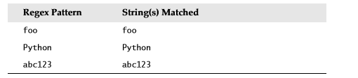
regexes are strings containing text and special characters that describe a pattern with which to recognize multiple strings.
Regexs without special characters
These are simple expressions that match a single string
Power of regular expressions comes in when special characters are used to define character sets, subgroup matching, and pattern repetition

Slide 12
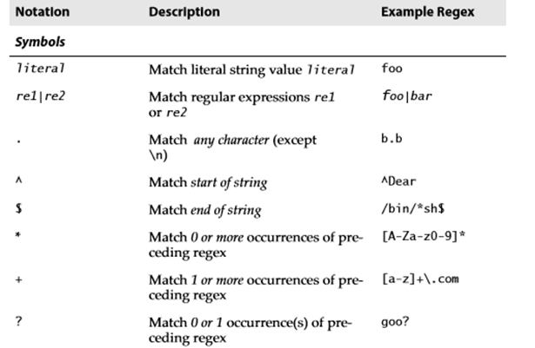
Special Symbols and Characters

Slide 13
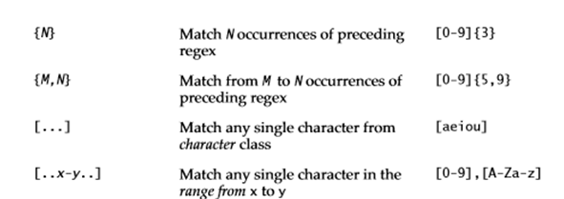
Special Symbols and Characters

Slide 14

Special Symbols and Characters

Slide 15
Matching Any Single Character (.)
dot or period (.) symbol (letter, number, whitespace (not including “\n”), printable, non-printable, or a symbol) matches any single character except for \n
To specify a dot character explicitly, you must escape its functionality with a backslash, as in “\.”

Slide 16
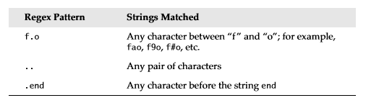
.end -> aend, 2end, qend

Slide 17
# Example - 1
import re
if re.match(“f.o","fooooo"):
print("Matched")
else:
print("Not matched")
Output:
Prints Matched
Since it searches only for the pattern ‘f.o’ in the string

Slide 18
# Example - 2
import re
if re.match("f.o$",“hi all foo all"):
print("Matched")
else:
print("Not matched")
Check that the entire string starts with ‘f’, ends with ‘o’ and contain one letter in between.

Slide 19
# Example – 3
import re
if re.match("..$","fooo hi ji"):
print("Matched")
else:
print("Not matched")
Not matched
Including a ‘$’ at the end will match only strings of length 2

Slide 20
# Example - 4
import re
if re.match("..","fooo"):
print("Matched")
else:
print("Not matched")
Matched
Two dots matches any pair of characters.

Slide 21
# Example – 5
import re
if re.match(".end",“bend hi all"):
print("Matched")
else:
print("Not matched")
Matched
The expression used in the example, matches any character for ‘.’

Slide 22
# Example – 6
import re
if re.match(".end","bends"):
print("Matched")
else:
print("Not matched")
Prints Matched

Slide 23
# Example – 7
import re
if re.match(“end.$",“all the ends best bends"):
print("Matched")
else:
print("Not matched“)
Prints Not matched - $ check for end of string

Slide 24
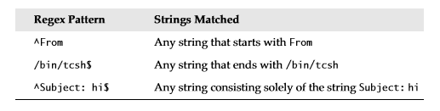
Matching from the Beginning or End of Strings or Word Boundaries (^, $)
^ - Match beginning of string
$ - Match End of string

Slide 25
if you wanted to match any string that ends with a dollar sign, one possible regex solution would be the pattern .*\$$

Slide 26
But not sufficient
Check whether the given register number of a VIT student is valid or not.
Example register number – 17BME1001
Register number is valid if it has two digits
Followed by three letters
Followed by four digits

Slide 27
Denoting Ranges (-) and Negation (^)
brackets [] also support ranges of characters
A hyphen [a-z] between a pair of symbols enclosed in brackets is used to indicate a range of characters;
For example: A–Z, a–z, or 0–9 or 1-9 for uppercase letters, lowercase letters, and numeric digits, respectively

Slide 28
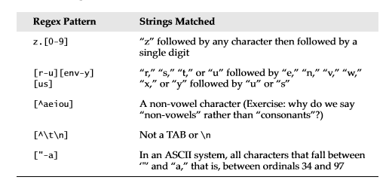

Slide 29
Multiple Occurrence / Repetition
Using Closure Operators (*, +, ?, {})
special symbols *, +, and ? , all of which can be used to match single, multiple, or no occurrences of string patterns
Asterisk or star operator (*) - match zero or more occurrences of the regex immediately to its left
Plus operator (+) - Match one or more occurrences of a regex

Slide 30
Question mark operator (?) : match exactly 0 or 1 occurrences of a regex.
There are also brace operators ({}) with either a single value or a comma-separated pair of values. These indicate a match of exactly N occurrences (for {N}) or a range of occurrences; for example, {M, N} will match from M to N occurrences.

Slide 31
Code to check the validity of register number
import re
register= input()
if re.match("^[1-9][0-9][a-zA-Z][a-zA-Z][a-zA-Z][0-9][0-9][0-9][0-9]$",register):
print("Matched")
else:
print("Not matched“)
Note:
^ - denote begin (Meaning is different when we put this symbol inside the square bracket)
$ - denote end

Slide 32
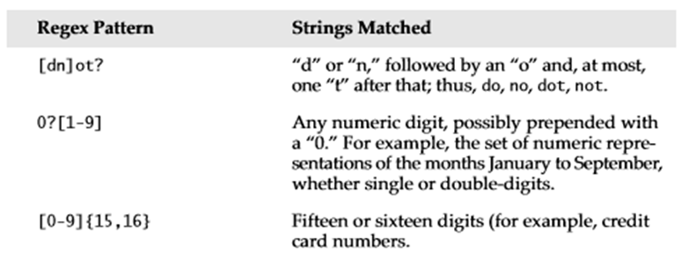

Slide 33
re | Valid | Invalid
[dn]ot? | dot, not, do, no | dnt, dn,dott,dottt
[dn]ot?$ | dot, not, do, no | dnt, dn,dott,nott
[dn]ot*$ | dott,nott,do,no | dotn
[dn]ot* | Do,no,dot,dottt
[0-9]{2,5} | 12, 123, 1234, 12345, a123456 | 1,2,4,5,
[0-9]{5} | 12345, 123456, a1234567,111111111 | 12, 123, 1234
aX{2,4} | aXX,aXXX,aXXXX | a ,aX

Slide 34
Refined Code to check the validity of register number
{n} – indicate that the pattern before the braces should occur n times
import re
register= input()
if re.match("^[1-9][0-9][a-zA-Z]{3}[0-9]{4}$”, register):
print("Matched") -> 20BCE1020
else:
print("Not matched")

Slide 35
Check validity of Mobile Number (Shorter Code)
import re
number = input()
if re.match(‘[^0][0-9]{9}',number):
print('valid')
else:
print('invalid')
Bug: Will also accept a843338320

Slide 36
Check validity of Mobile Number (Shorter Code)
import re
number = input()
if re.match(‘[1-9][0-9]{9}',number):
print('valid')
else:
print('invalid')

Slide 37
import re
pan=input()
print(len(pan))
if len(pan)<10 or len(pan)>10:
print ("PAN Number should be 10 characters")
exit
elif re.search("[^a-zA-Z0-9]",pan):
print ("No symbols allowed, only alphanumerics")
exit
elif re.search("[0-9]",pan[0:5]):
print ("Invalid - 1")
exit
elif re.search("[A-Za-z]",pan[5:9]):
print ("Invalid - 2")
exit
elif re.search("[0-9]",pan[-1]):
print ("Invalid - 3")
exit
else:
print ("Your card "+ pan + " is valid")
Check validity of PAN card number with RE
Ex: CCCCC9999C

Slide 38
logical “or”
The | denotes "OR" operator.
|. This character separates terms contained within each (...) group.
example, for instance:
^I like (dogs|penguins), but not (lions|tigers).$
This expression will match any of the following strings:
I like dogs, but not lions.
I like dogs, but not tigers.
I like penguins, but not lions.
I like penguins, but not tigers.

Slide 39
metacharacter \d
You can replace [0-9] by metacharacter \d, but not [1-9].
Ex.
[1-9][0-9]*|0 or [1-9]\d*|0
For "abc123xyz", it matches the substring "123".
For "abcxyz", it matches nothing.
For "abc123xyz456_0", it matches substrings: "123", "456" and "0" (three matches).
For "0012300", it matches substrings: "0", "0" and "12300" (three matches)!!!

Slide 40
^[1-9][0-9]*|0$ or ^[1-9]\d*|0$
The position anchors ^ and $ match the beginning and the ending of the input string, respectively. That is, this regex shall match the entire input string, instead of a part of the input string (substring).
an occurrence indicator, + for one or more, * for zero or more, and ? for zero or one.

Slide 41
metacharacter \w
metacharacter \w for a word character
[a-zA-Z0-9_].
Recall that metacharacter \d can be used for a digit [0-9].
[a-zA-Z_][0-9a-zA-Z_]* or [a-zA-Z_]\w*
Begin with one letters or underscore, followed by zero or more digits, letters and underscore.

Slide 42
metacharacter \s
\s (space) matches any single whitespace (same as [ \t\n\r\f], blank, tab, newline, carriage-return and form-feed).
The uppercase counterpart \S (non-space) matches any single character that doesn't match by \s (same as [^ \t\n\r\f]).
import re
if re.match(".[.*-]r\sm","a*r m"):
print("Correct")
else:
print(“Incorrect")
Correct
(Incorrect if, “a*r m”)

Slide 43
[Uppercase]metacharacter
In regex, the uppercase metacharacter denotes the inverse of the lowercase counterpart, for example, \w for word character and \W for non-word character; \d for digit and \D or non-digit.

Slide 44
Escape code \
The \ is known as the escape code, which restore the original literal meaning of the following character. Similarly, *, +, ? (occurrence indicators), ^, $ (position anchors), \. to represent . have special meaning in regex.
In a character class (ie.,square brackets[]) any characters except ^, -, ] or \ is a literal, and do not require escape sequence.
ie., only these four characters, ^, -, ] or \ , require escape sequence inside the bracket list: ^, -, ], \
Ex: [.-]? matches an optional character . or -.

Slide 45
Escape code \
Most of the special regex characters lose their meaning inside bracket list, and can be used as they are; except ^, -, ] or \.
To include a ], place it first in the list, or use escape \].
To include a ^, place it anywhere but first, or use escape \^.
To include a - place it last, or use escape \-.
To include a \, use escape \\.
No escape needed for the other characters such as ., +, *, ?, (, ), {, }, and etc, inside the bracket list
You can also include metacharacters (to be explained in the next section), such as \w, \W, \d, \D, \s, \S inside the bracket list.

Slide 46
The findall() Function
The findall() function returns a list containing all matches.
Return an empty list if no match was found
import re txt = "The rain in Spain" x = re.findall("ai", txt) print(x)
['ai', 'ai']

Slide 47
The search() Function
The search() function searches the string for a match, and returns a Match object if there is a match.
If there is more than one match, only the first occurrence of the match will be returned.
If no matches are found, the value None is returned.
Search for the first white-space character in the string:
import re txt = "The rain in Spain" x = re.search("\s", txt) print("The first white-space character is located in position:", x.start())
The first white-space character is located in position: 3

Slide 48
The split() Function
The split() function returns a list where the string has been split at each match
Split at each white-space character:
import re txt = "The rain in Spain" x = re.split("\s", txt) print(x)
['The', 'rain', 'in', 'Spain']

Slide 49
The split() Function
You can control the number of occurrences by specifying the maxsplit parameter:
Split the string only at the first occurrence:
import re txt = "The rain in Spain" x = re.split("\s", txt, 1) print(x)
['The', 'rain in Spain']

Slide 50
The sub() Function
The sub() function replaces the matches with the text of your choice:
Replace every white-space character with the number 9:
import re txt = "The rain in Spain" x = re.sub("\s", "9", txt) print(x)
The9rain9in9Spain

Slide 51
You can control the number of replacements by specifying the count parameter:
Replace the first 2 occurrences:
import re txt = "The rain in Spain" x = re.sub("\s", "9", txt, 2) print(x)
The9rain9in Spain

Slide 52
reference
https://www3.ntu.edu.sg/home/ehchua/programming/howto/Regexe.html

