Slide 1
SBA_Position_Test_Final
Parniyan Darakhshan

Slide 2
Tasks
Given the list of products (in product_list.xlsx):
Determine the SDM Market share (using the SDM Prod Data and IMS data) by province based on total dosages for 2021.
For each molecule + brand_reference combination (in the product_list.xlsx), determine the forecast dosages for SDM for the remainder of 2022 by period by province by product type (Brand & Generic).

Slide 3
Q1:

Slide 4
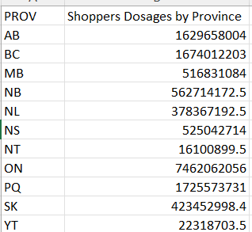
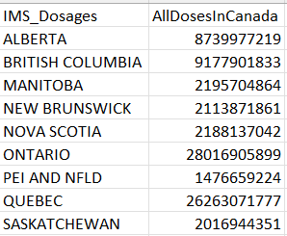
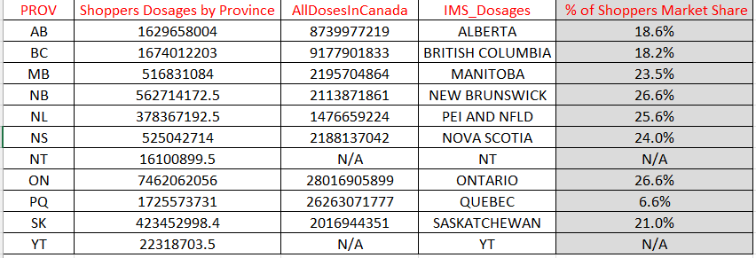
OUT PUT:

Slide 5
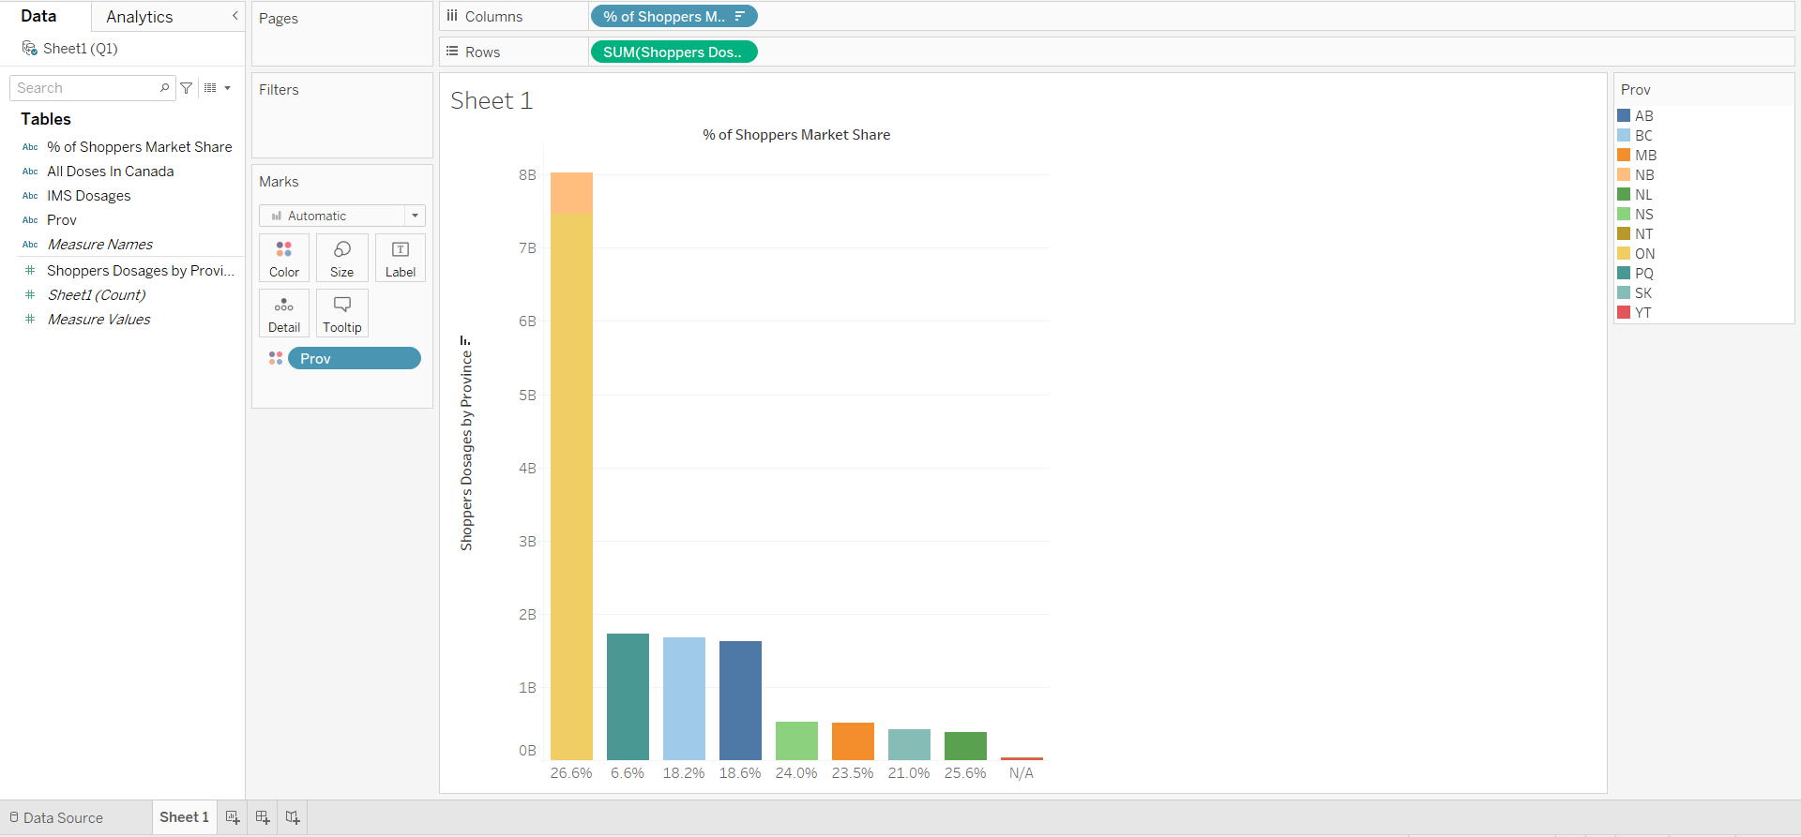

Slide 6
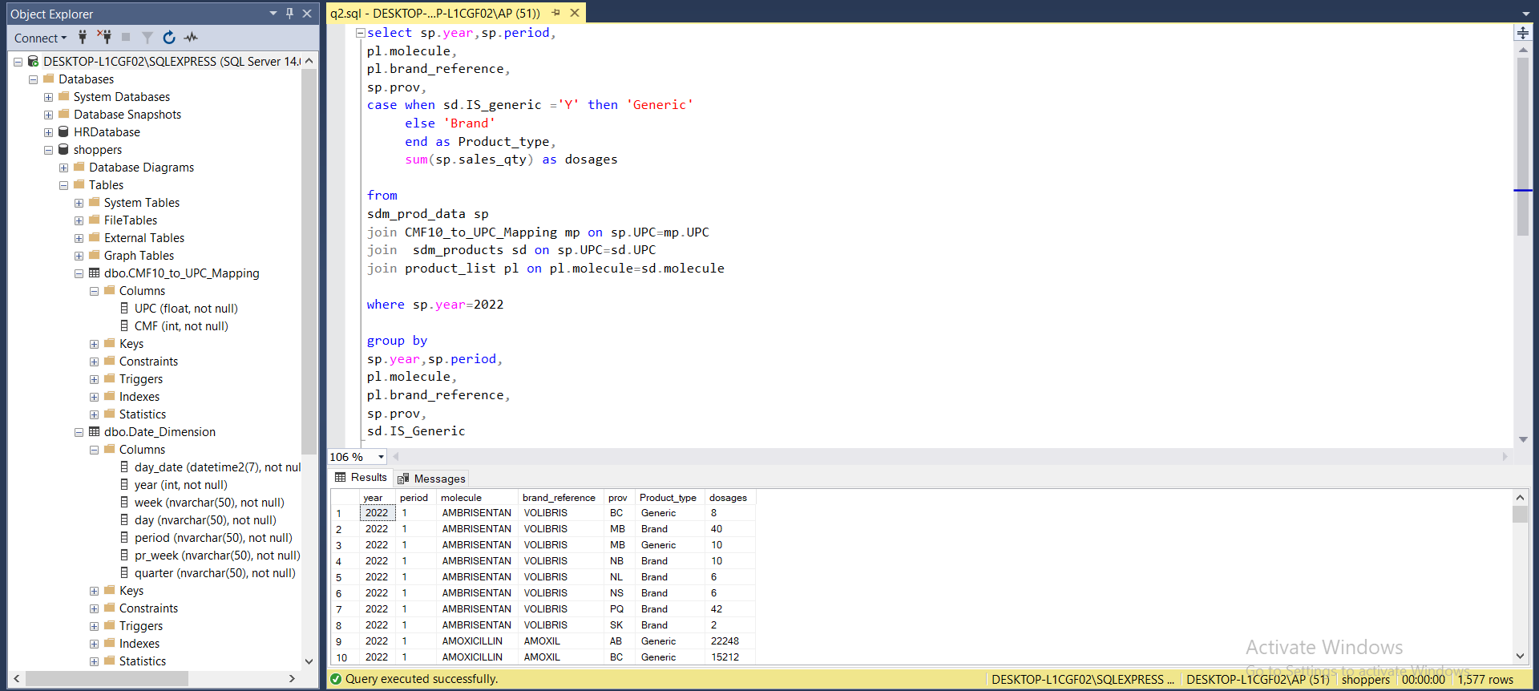
Q2:

Slide 7
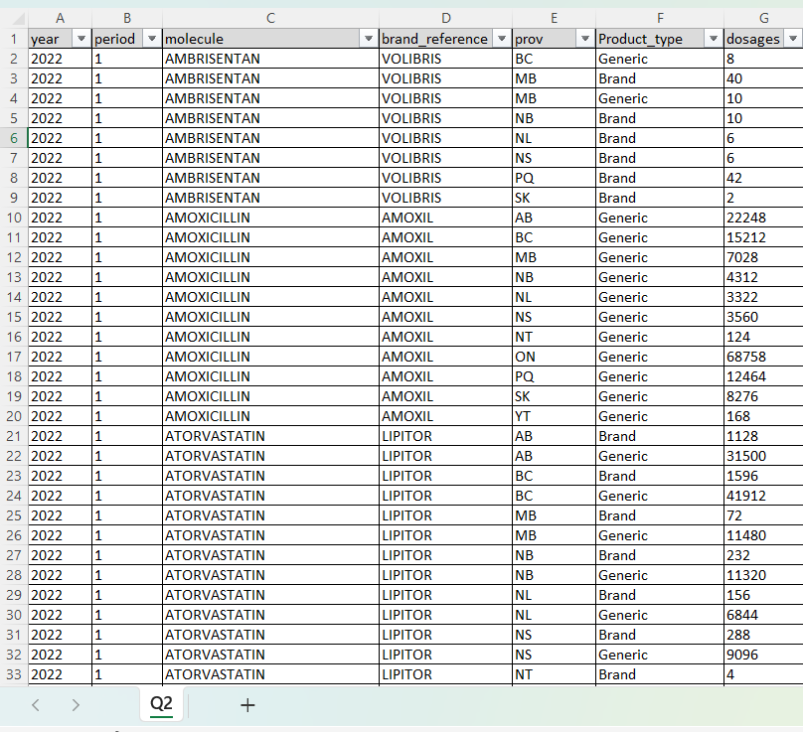
OUT PUT:

Slide 8
