Slide 1
OPEN INNOVATION · PROPOSED HACKATHON MVP
RoadPulse
Smarter Roads.
Safer Journeys.
Data-Driven Repairs.
AI-Powered Road Intelligence and Repair Prioritization.
Conceptual detection overlay
Error 404
Notes:
RoadPulse is a proposed road-intelligence workflow, not a deployed product. The detection overlay is illustrative. GPS-based mapping is part of the proposed workflow, rather than a claim about this photograph.

Slide 2
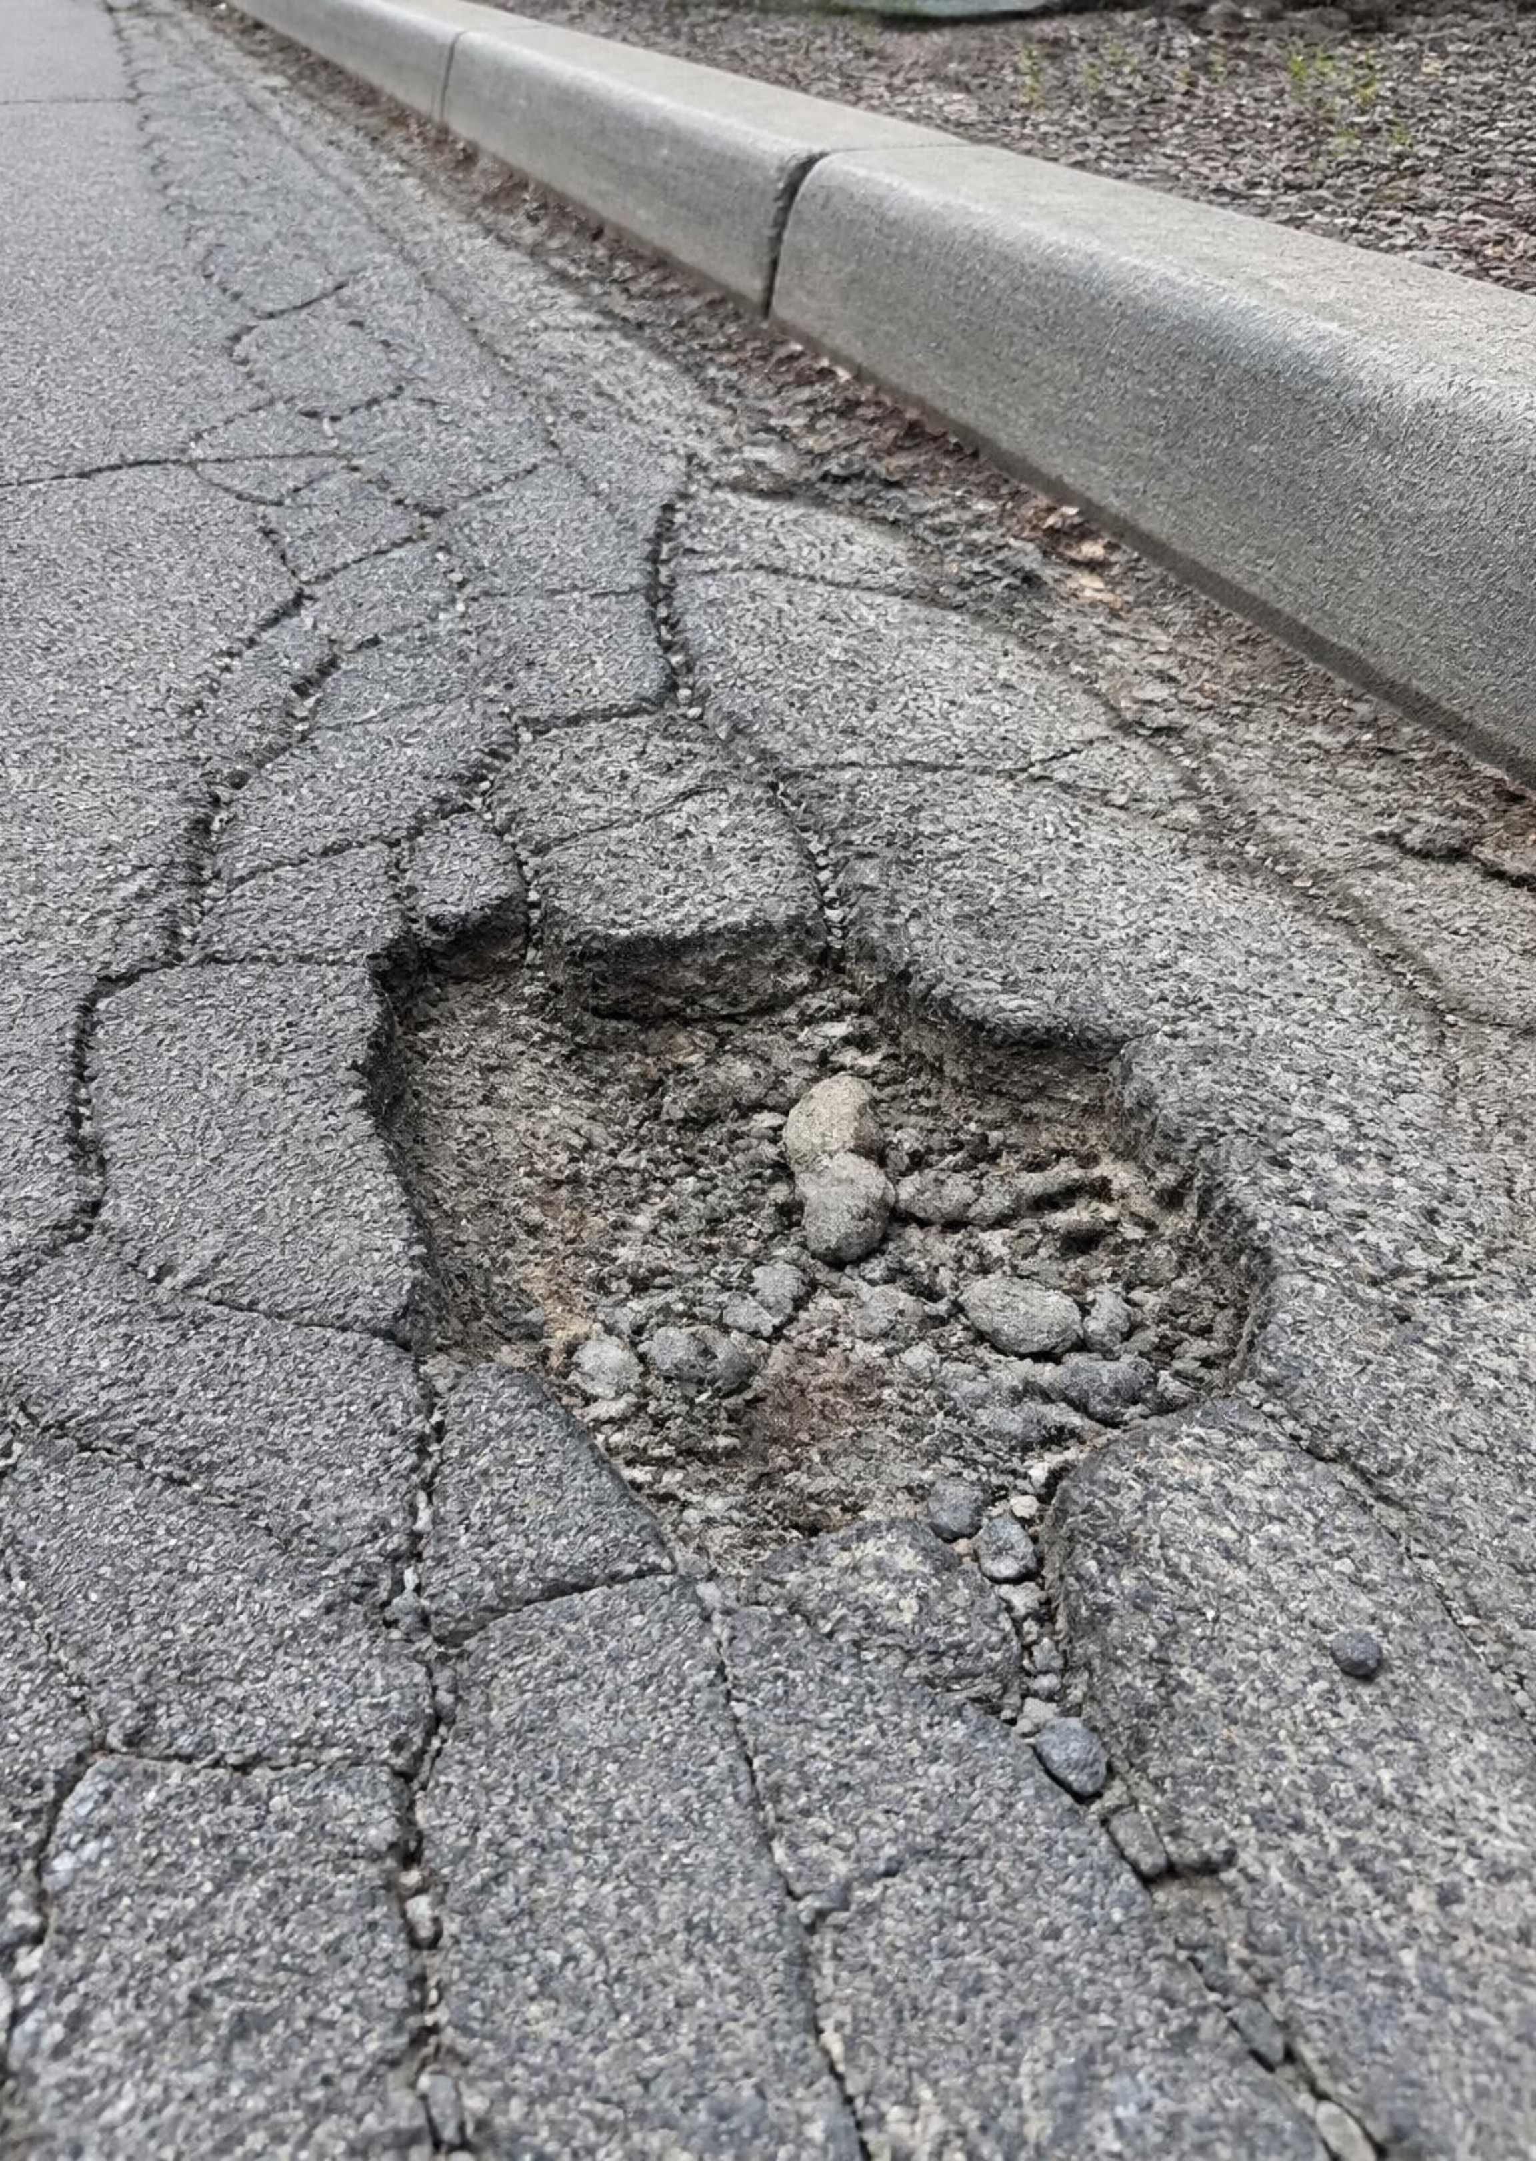
THE PROBLEM
Damaged roads are hard to inspect, report and prioritize
Potholes and cracks create road safety hazards.
Manual inspections are slow, costly and hard to scale.
Citizen complaints may repeat incidents or miss accurate locations.
There is no unified, data-driven way to decide what to fix first.
Limited maintenance budgets force hard trade-offs.

Slide 3
PROPOSED SOLUTION
RoadPulse turns raw road video into repair decisions
One evidence trail, from a detected defect to a human-confirmed repair.
01
02
03
Detect → Map
Prioritize → Report
Repair → Verify
Find potholes, cracks and damaged surfaces; associate evidence with GPS locations.
Explain risk, account for budget and generate an actionable repair report.
Track the work and compare before-and-after evidence with human confirmation.
Proposed workflow · AI supports prioritization; people retain repair decisions.
Error 404

Slide 4








HACKATHON MVP WORKFLOW
How it works: eight steps from upload to verified repair
Upload video
Detect damage
Associate GPS
Merge duplicates
Submit a road inspection recording.
Analyze damage in video frames.
Tie detections to locations.
Create unique incidents.
Rank risk
Optimize budget
Generate report
Record verification
Score damaged locations.
Recommend repair priorities.
Prepare a work order or complaint.
Save status and post-repair evidence.
Error 404
Notes:
Read the flow left to right across the top row, then across the bottom row. Location association requires a usable GPS track or supplied location information; ordinary video alone does not guarantee accurate coordinates.

Slide 5
PROPOSED CAPABILITIES · STILL TO BE IMPLEMENTED
More than a pothole detector
Beyond detection
Explainable risk
Budget-aware choices
Turn visual evidence into repair priorities.
Use severity, road importance and available context.
Identify which repairs fit a fixed budget.
Proposed
Proposed
Proposed
Duplicate removal
Repair verification
Merge repeated detections across frames and reports.
Compare before-and-after evidence, confirmed by a person.
Still to be implemented
Still to be implemented
Error 404

Slide 6
PROPOSED ARCHITECTURE
PLAN OF ACTION
01
02
03
04
Video Upload
Frame Extraction
AI Detection
GPS Association
React + FastAPI accept video and location inputs.
OpenCV samples frames for analysis.
A YOLO-based detector locates damage.
Python aligns detections with location data.
05
06
07
08
Database
Risk Scoring
Budget Optimization
Interactive Dashboard
PostgreSQL or Supabase stores incidents and evidence.
Python combines explainable risk factors.
Google OR-Tools selects a feasible repair set.
React, Leaflet and OpenStreetMap present decisions.
Error 404
Notes:
The backend uses Python and FastAPI. The proposed architecture follows the numbered sequence across both rows. The team must test detector suitability and location alignment on sample material before treating outputs as reliable.

Slide 7
SMART REPAIR BUDGET OPTIMIZER · HYPOTHETICAL EXAMPLE
The best repairs within the budget
Maximize estimated benefit using severity, cost, road importance and exposure, estimated safety benefit and the available budget.
Segment | Cost units | Benefit points
A | 4 | 8
B | 3 | 7
C | 2 | 4
SMALLER BUDGET
LARGER BUDGET
5
9
Repair B + C
Repair A + B + C
Cost 5 units
Benefit 11 points
Cost 9 units
Benefit 19 points
All numbers are hypothetical. Benefit points are illustrative, not measured safety outcomes.
Proposed logic requires validation with real-world data. It does not guarantee accident reduction.
Error 404
Notes:
For the smaller hypothetical budget, B plus C produces 11 benefit points, exceeding A alone at 8 or B alone at 7. At a budget of 9, all three repairs fit. This simplified example assumes independent repairs and additive benefits. Actual cost estimates, benefit weights and operational constraints need validation.

Slide 8
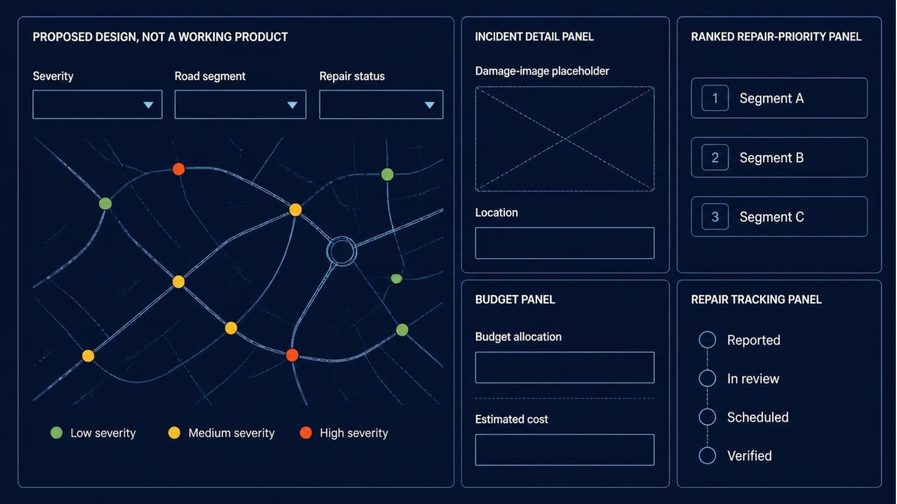
PROPOSED DESIGN · NOT A WORKING PRODUCT
A dashboard built for decisions
Review the evidence, adjust constraints and track each incident through verification.
Error 404

Slide 9




INTENDED BENEFICIARIES · FUTURE EVALUATION
Who benefits, and how we will measure it
Authorities and maintenance teams
Future evaluation indicators
Evidence to support repair planning.
Detection precision and recall
Percentage of duplicate reports removed
Time to generate an inspection report
Agreement with human repair priorities
Percentage of reported repairs verified
Commuters and motorists
Road hazards made visible to planners.
No results yet. No promised safety gains.
Pedestrians and cyclists
Exposure considered in prioritization.
Communities and reporting groups
A clearer reporting and status trail.
Error 404

Slide 10
HACKATHON MVP · PROPOSED BUILD SEQUENCE
A five-phase MVP plan
Working prototype first; end-to-end demo is the delivery target.
Prepare
Locate
Demonstrate
Sample road images and videos; set up detection pipeline.
Map, location association and deduplication.
Dashboard and sample reports; test the end-to-end demo.
1
2
3
4
5
Detect
Prioritize
Video-frame analysis and damage detection.
Explainable risk scoring and basic budget optimization.
Live municipal integration and validated deterioration prediction are out of MVP scope.
Error 404

