Slide 1

Portfolio & Building Analytics
Americas Real Estate Insights

Slide 2
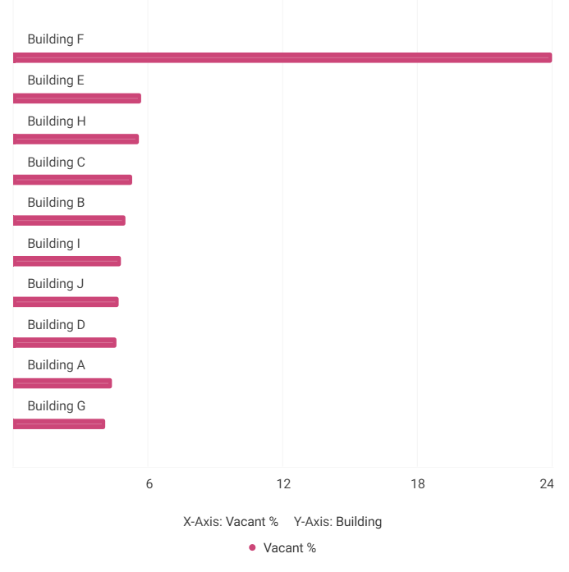
Vacancy Analysis Across Americas Portfolio
24% VACANCY – BUILDING F IS THE OUTLIER
Analyzed 10 buildings across the Americas region
Building F is a clear outlier at 24% vacancy - well above portfolio average
Remaining buildings (E, H, C, B, etc.) mostly below 10% vacancy
Indicates strong space utilization across the region, aside from Building F

Slide 3
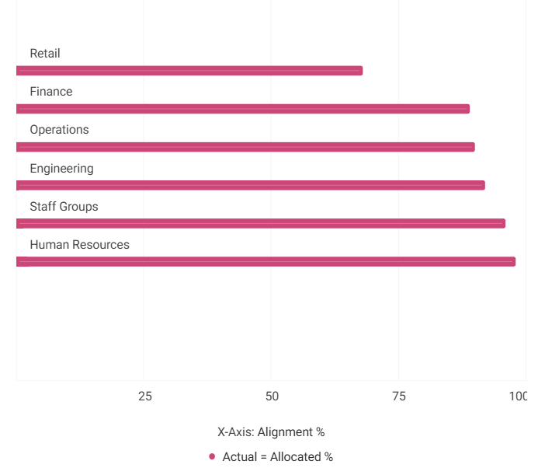
Actual vs Allocated Space Alignment – Building F
68% ALIGNED – RETAIL IS THE OUTLIER
Retail is a clear outlier at 68% alignment (32% misallocated) — nearly 3x the building average
Human Resources leads with 98% alignment — best in building
Engineering, Finance, Staff Groups, Operations all Healthy/Excellent (89–96%)
Recommendation:
Investigate Retail's space misalignment — confirm if intentional (project seating, temp moves) or needs reallocation

Slide 4
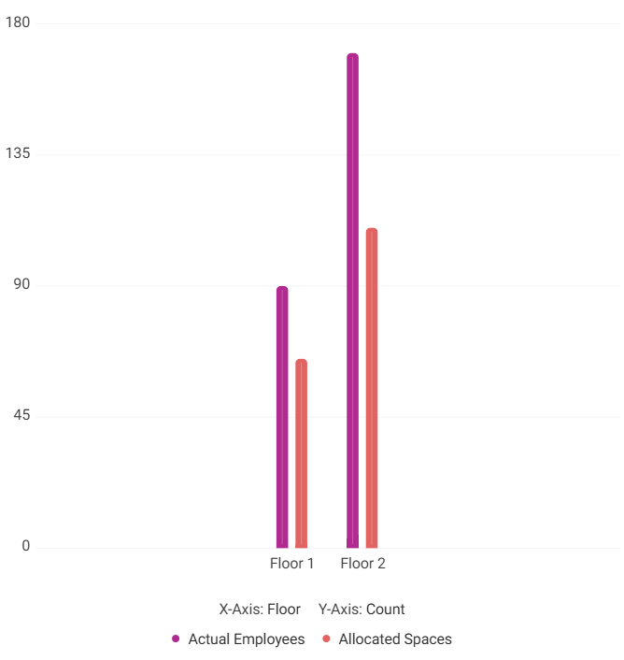
Retail Workspace Allocation by Floor
FLOOR 1 : 72%
FLOOR 2 : 65%
Floor 1: 72% aligned — office-heavy, low flex capacity
Floor 2: 65% aligned — more flex seats, but overflow spills into other orgs' space
Root cause: insufficient Retail-allocated seats on either floor
Recommendation: Consolidate Retail, reallocate surplus from under-used orgs (e.g., Engineering), and add flex seating on Floor 1 — then monitor

Slide 5
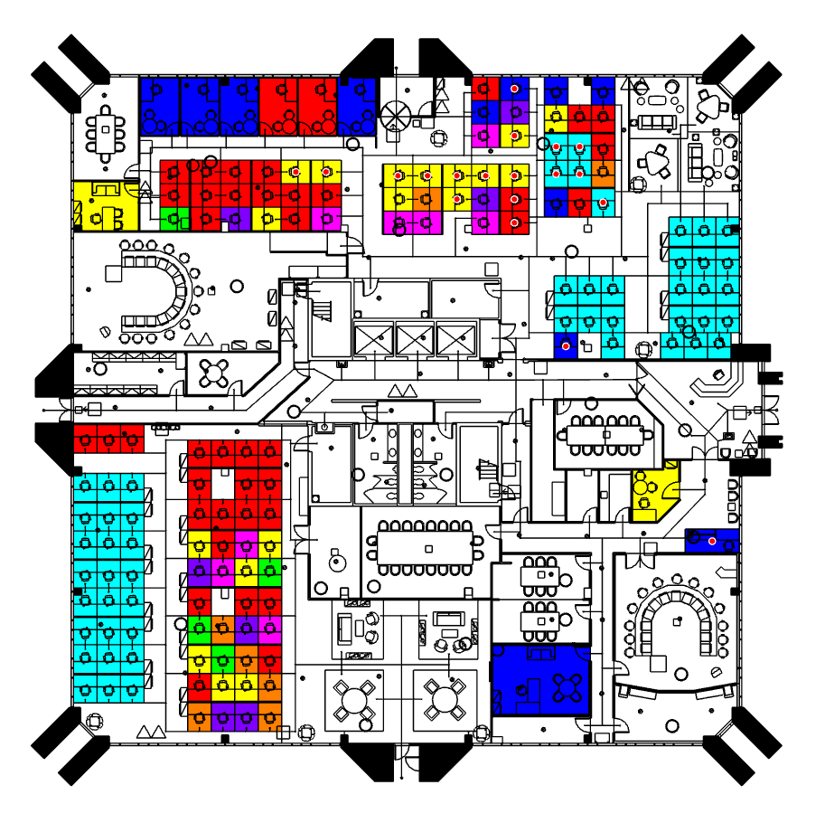
Floor 1 Seating Map – Occupancy by Business Unit
38/53 DESKS OCCUPIED (~72%)
Overall occupancy: 38 of 53 workstations (~72%) — 15 vacant desks remain
Engineering is the biggest under utilizer: only 1 occupied vs. 13 vacant — largest reallocation opportunity
Travel, Technologies, and Staff Groups are fully utilized (14, 9, 8 occupied, 0 vacant) — no spare capacity
Retail and Utilities show minimal presence (0 occupied, 1 vacant each) — negligible footprint on this floor

Slide 6
Action Plan — Building F Space Optimization
1. Investigate Retail Misalignment
Audit the 32% seat misalignment in Retail — determine if project-based seating or temporary moves are the root cause and formalize reallocation if needed.
2. Reallocate Engineering Surplus on Floor 1
With 13 vacant desks and only 1 occupied, Engineering holds the largest unrealized capacity on Floor 1. Redirect these seats to Retail or other capacity-constrained teams.
3. Add Flex Seating on Floor 1
Supplement permanent allocations with touchdown and project/team room seats on Floor 1 to absorb overflow and improve the 72% alignment score. Monitor weekly.

