Slide 1
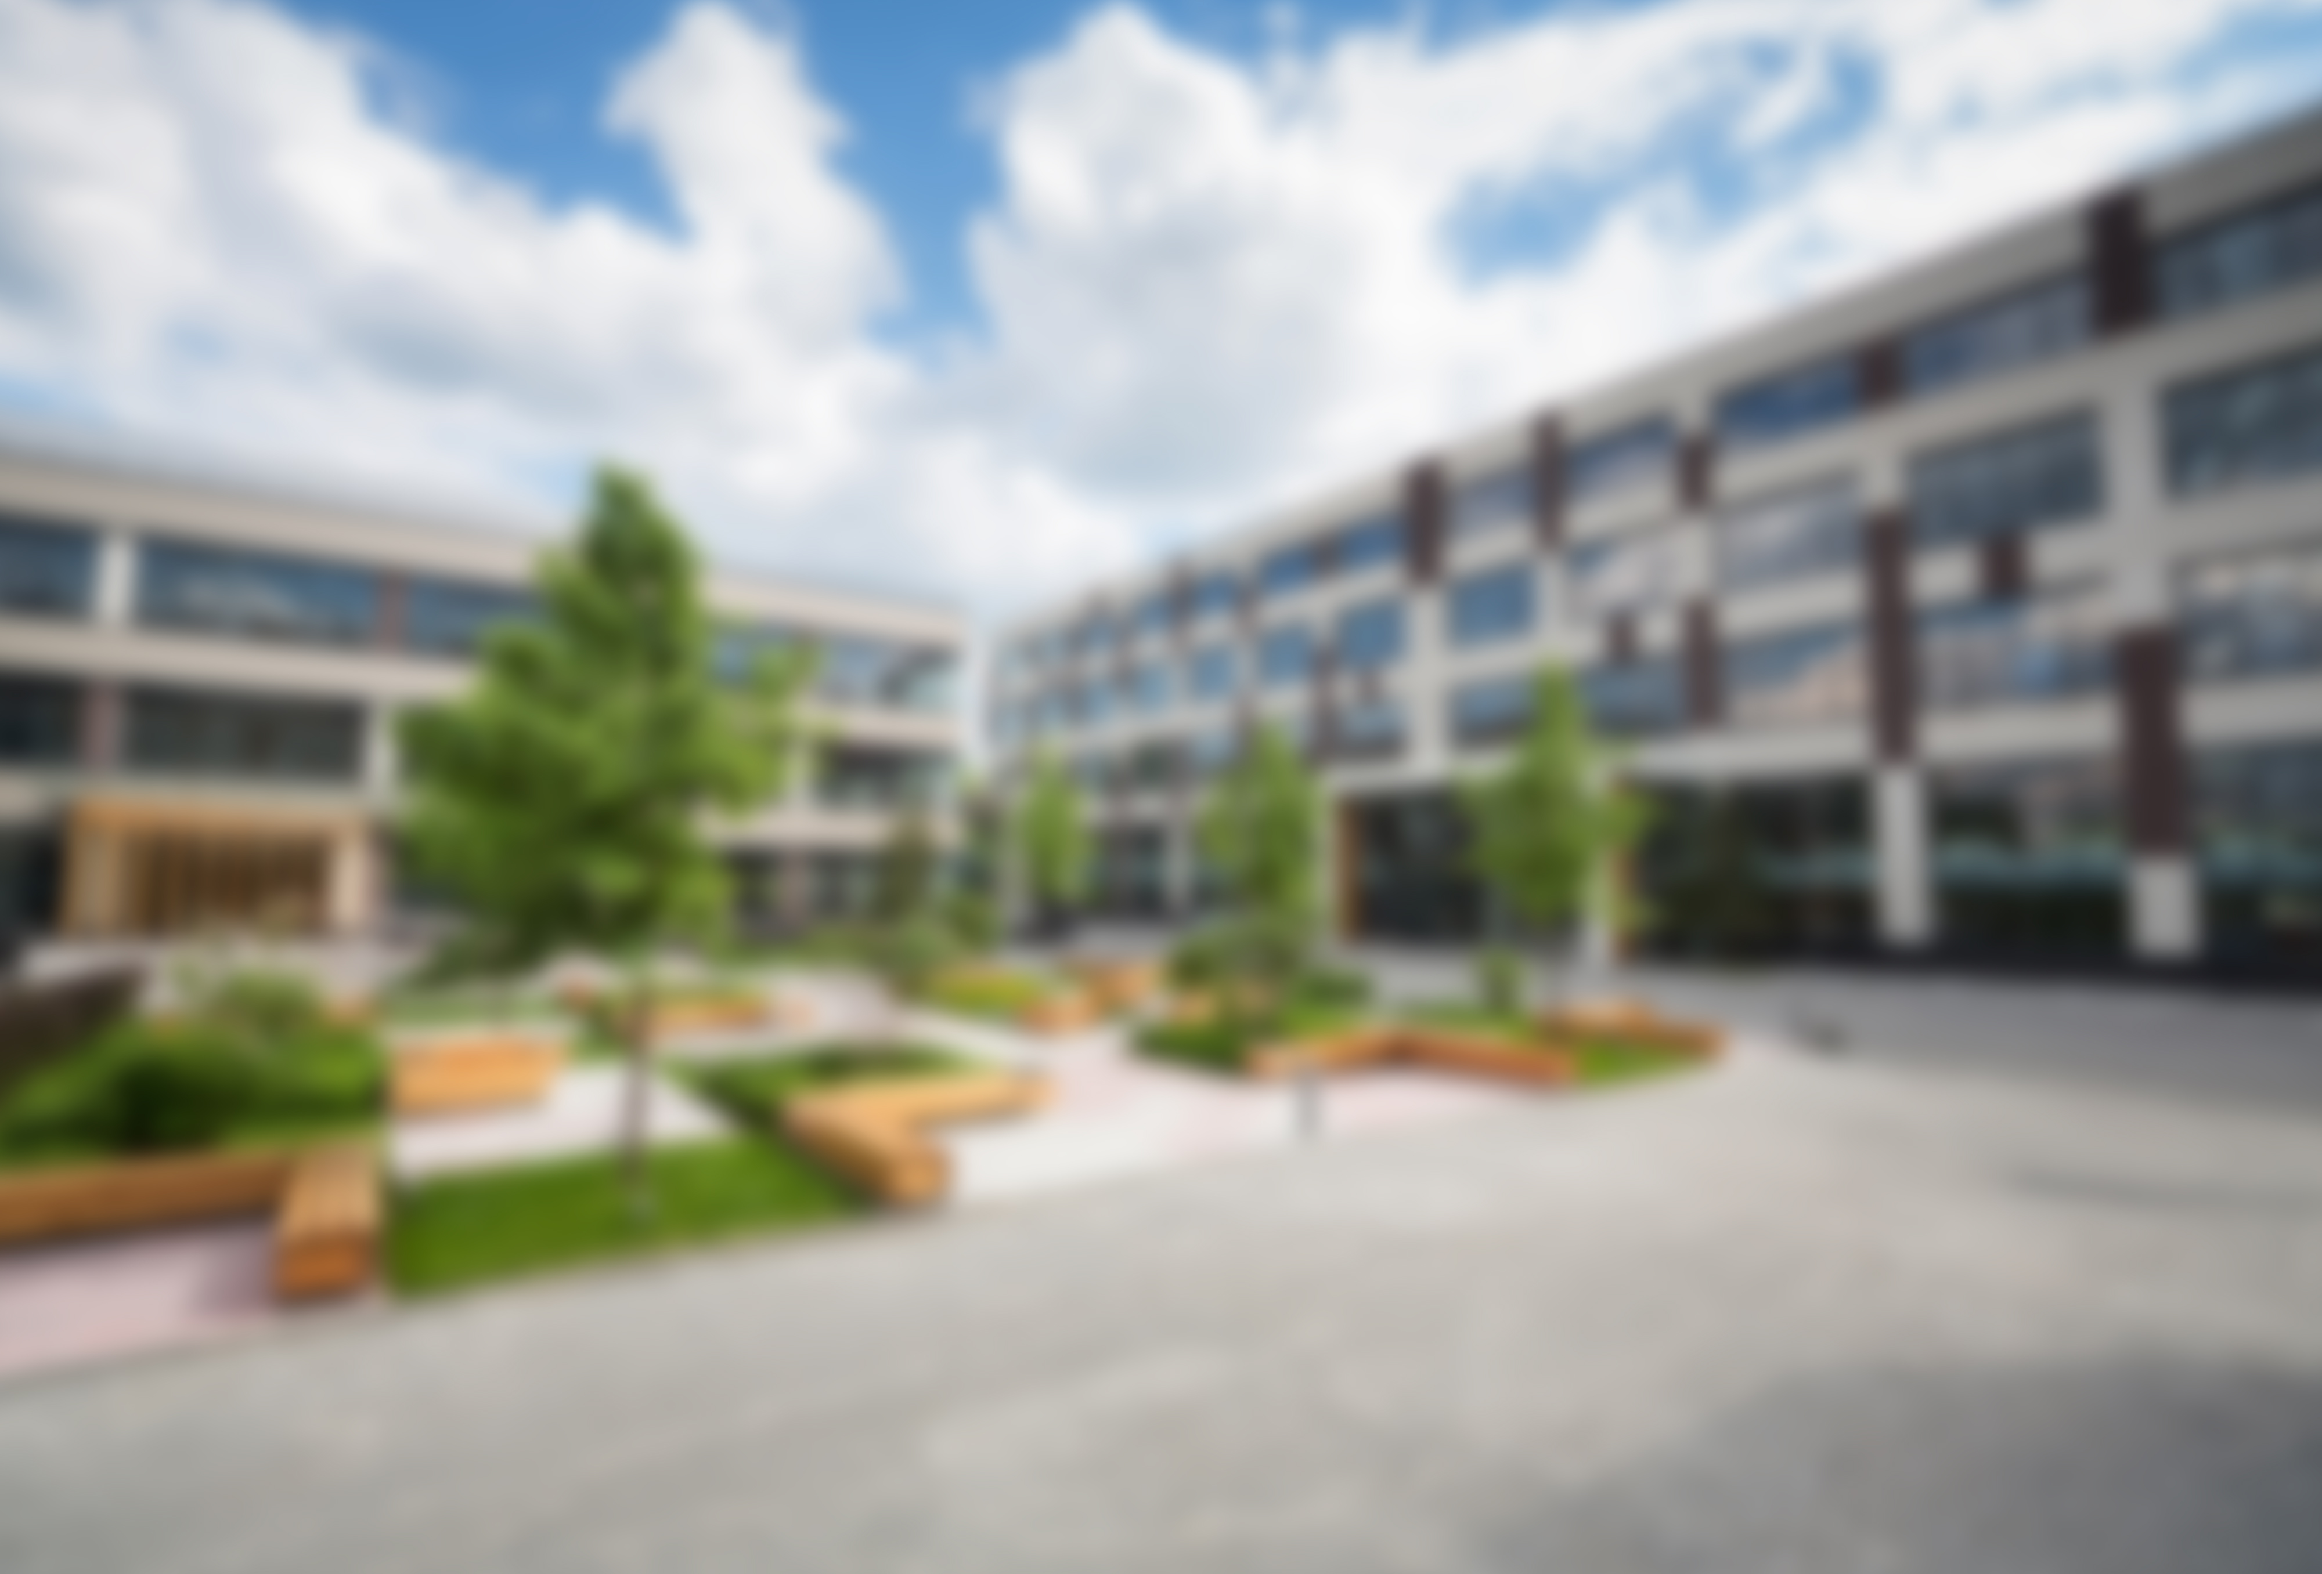
Portfolio & Building Analytics
Americas Real Estate Insights

Slide 2
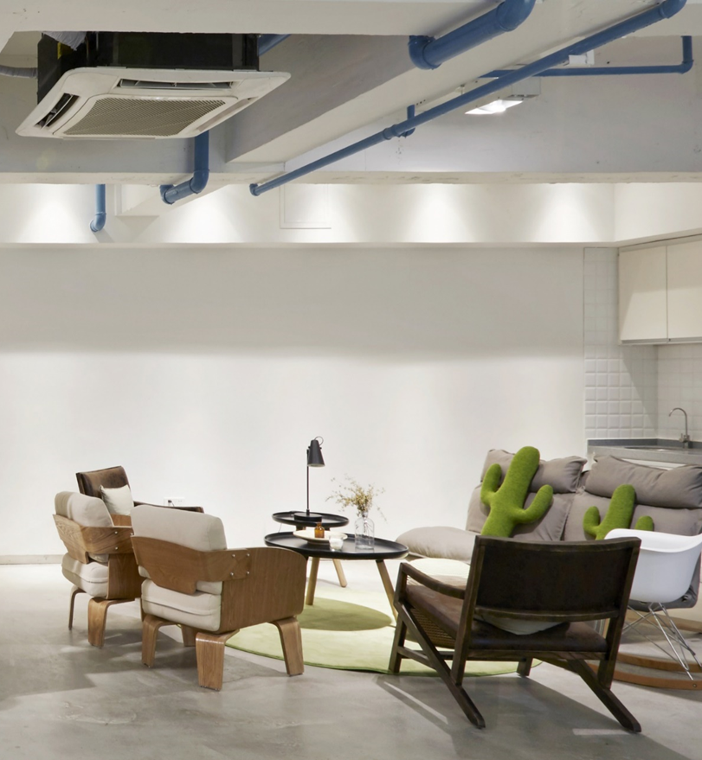
10 buildings analyzed across the Americas.
One critical outlier demands immediate attention.

Slide 3
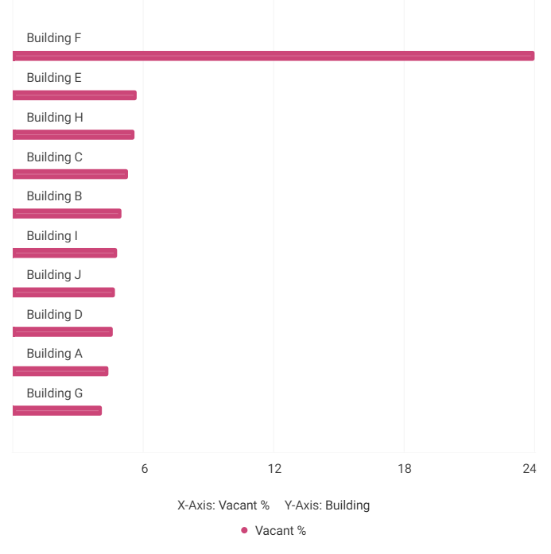
Americas Portfolio — Building-Level Occupancy
Across the 10 Americas buildings, vacancy rates are broadly healthy — most fall between 4% and 6%, reflecting strong space utilization.
Building F is the clear exception at 24% vacancy, a rate nearly 4x the portfolio average and a signal that warrants deeper investigation.
All other buildings are operating efficiently with assigned seats closely tracking program headcount.

Slide 4
Building F vacancy rate — nearly 4x the Americas portfolio average of ~5%
24%

Slide 5
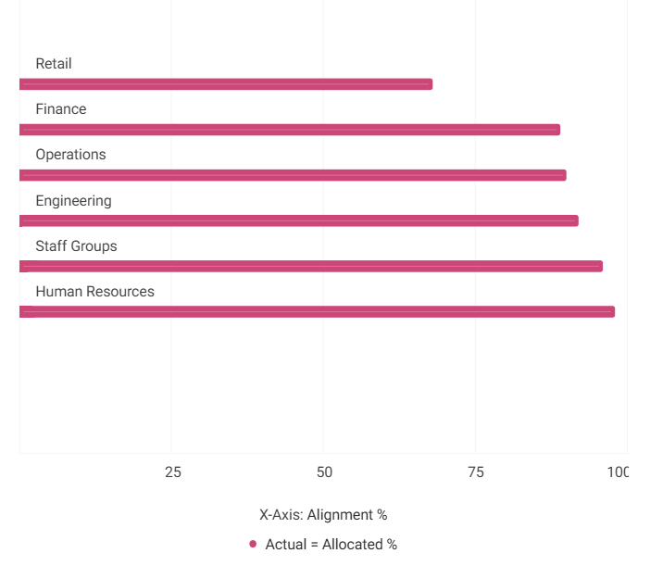
Actual = Allocated % by Business Unit – Building F
Building F's overall alignment sits at 89%, which is healthy. Five of six business units — Engineering, Finance, HR, Staff Groups, and Operations — align between 89% and 98%, all rated Healthy or Excellent.
Retail is the critical outlier at just 68% alignment with 32% of seats misallocated — nearly three times the building average misalignment rate. This single BU is the primary driver of Building F's vacancy anomaly.

Slide 6
Building F — Key Findings & Next Steps
Findings:
HR leads the building at 98% alignment; Staff Groups and Engineering also perform strongly at 96% and 92%, respectively.
Retail's 32% misalignment is the single largest contributor to Building F's vacancy anomaly.
Recommended Action:
Investigate Retail immediately — confirm whether misalignment reflects intentional project seating or temporary moves, or whether formal reallocation is required.

Slide 7
Retail has 260 employees but only 175 allocated seats — an 85-seat shortfall driving systemic overflow into adjacent org space.

Slide 8
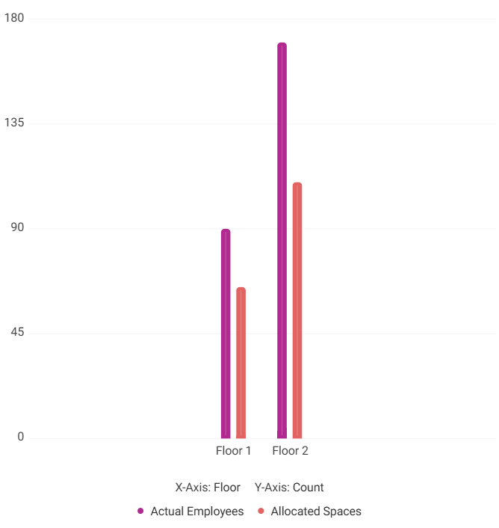
Retail — Actual Employees vs. Allocated Spaces by Floor
Both floors reveal a consistent pattern: actual employee counts significantly outpace allocated spaces.
Floor 1 is 72% aligned with an office-heavy mix and limited flex capacity.
Floor 2 fares worse at 65% alignment, with more flex seats but the majority of overflow spilling into other organizations' space.
The root cause is structural — Retail simply does not have enough allocated seats on either floor to accommodate its current headcount.

Slide 9
Retail — Insights & Consolidation Plan
Findings:
Retail overall: 67% aligned — 85-seat shortfall with 260 employees and only 175 seats.
Floor 1: 72% aligned, office-heavy layout with limited flex capacity for overflow.
Floor 2: 65% aligned — more flex seats, but most overflow bleeds into other orgs' allocated space.
Root cause: neither floor has sufficient Retail-dedicated allocations to cover actual headcount.
Recommended Action:
Consolidate Retail footprint, reallocate surplus seats from under-utilized units such as Engineering, and add flexible seating on Floor 1. Monitor weekly alignment post-change.

Slide 10
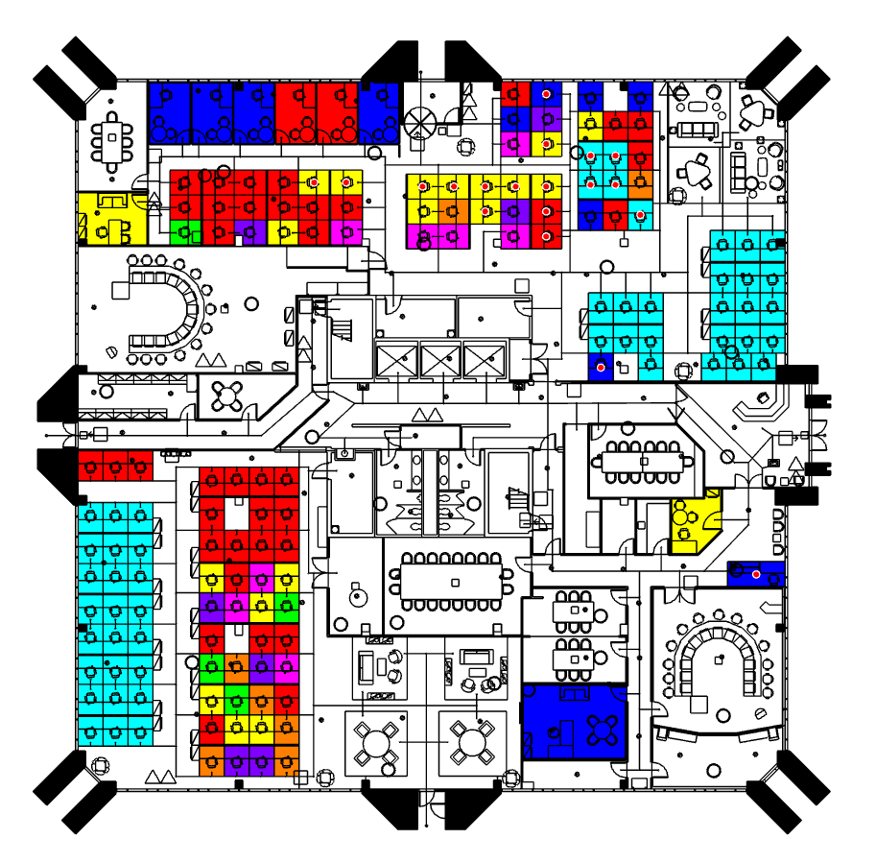
Floor 1 — Highlighted Floorplan with Leaders Legend
Floor 1 shows 38 occupied out of 53 total workstations (~72% occupancy), leaving 15 vacant desks available for reallocation.
Engineering is the largest underutilize with only 1 occupied desk against 13 vacant — presenting the single biggest reallocation opportunity on this floor.
Travel, Technologies, and Staff Groups are fully utilized with zero vacant capacity, indicating no room for absorption without structural change.

Slide 11
Floor 1 — Leaders Legend & Workstation Occupancy 38 occupied of 53 total workstations — 15 vacant desks remain

Slide 12
Action Plan — Building F Space Optimization
1. Investigate Retail Misalignment
Audit the 32% seat misalignment in Retail — determine if project-based seating or temporary moves are the root cause and formalize reallocation if needed.
2. Reallocate Engineering Surplus on Floor 1
With 13 vacant desks and only 1 occupied, Engineering holds the largest unrealized capacity on Floor 1. Redirect these seats to Retail or other capacity-constrained teams.
3. Add Flex Seating on Floor 1
Supplement permanent allocations with touchdown and project/team room seats on Floor 1 to absorb overflow and improve the 72% alignment score. Monitor weekly.

