Slide 1
FreifunkFinder- An Android Application to Find the Closest Freifunk Wi-Fi Nodes
KOM lab – WiSe 2015/2016
Govind Singh (govind.singh@stud.tu-darmstadt.de)
Puneet Arora (puneet.arora@stud.tu-darmstadt.de)
Sooraj Mandotti (sooraj.mandotti@stud.tu-darmstadt.de)
MSc. (Informatik) 2nd Semester
Augmented Reality Wi-Fi finder
‹#›

Slide 2
Motivation
Problem: Directional antennas provide better Wi-Fi reception, but :-
Location and height parameters often ignored
Nodes displayed on a static map
Not so user-friendly
Our Solution: An augmented reality Wi-Fi finder Android application to facilitate direction-oriented & user-friendly displays
Augmented Reality Wi-Fi finder
‹#›

Slide 3
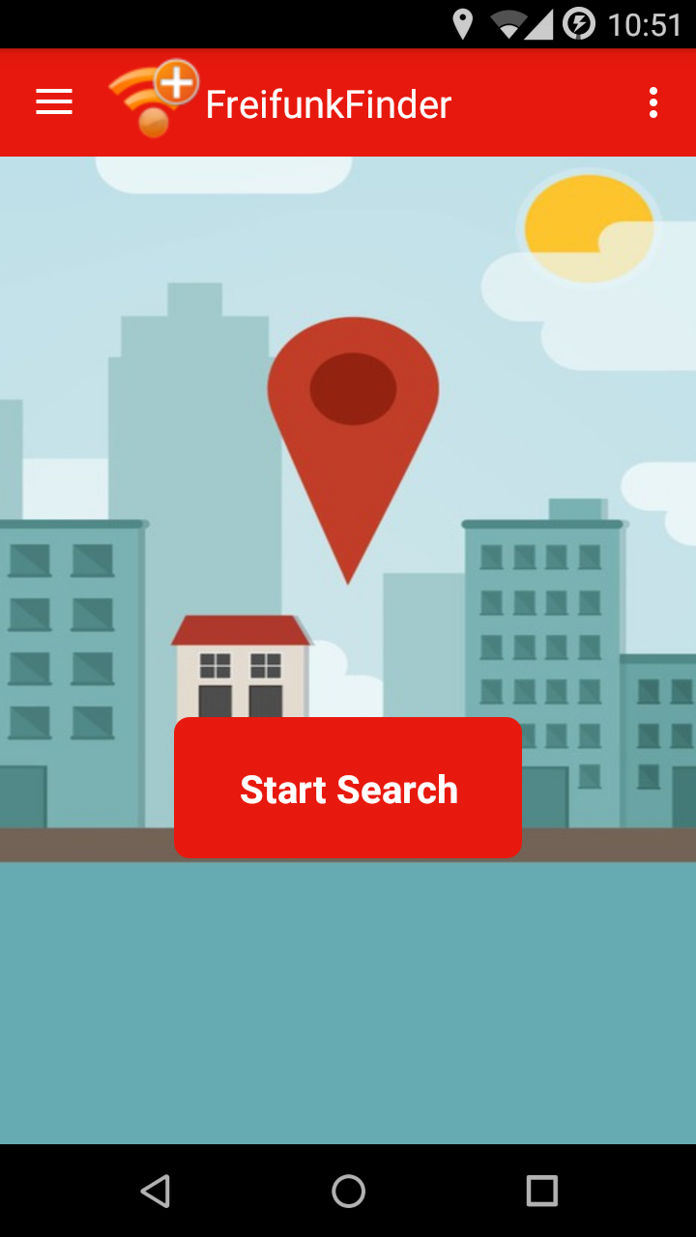
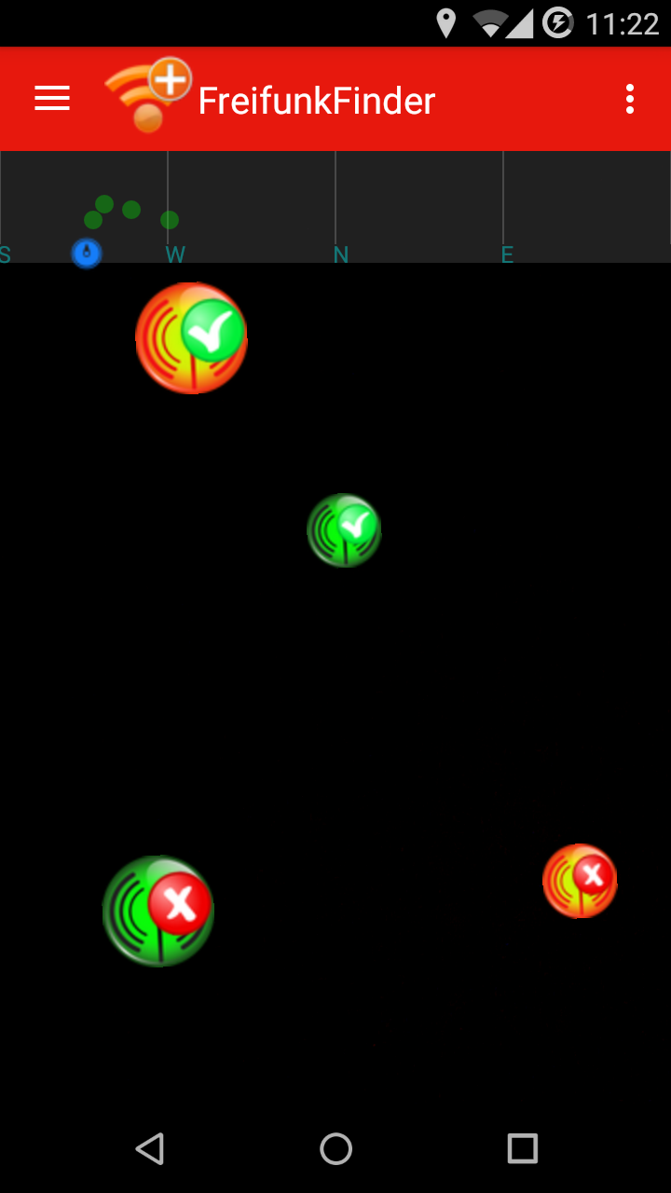
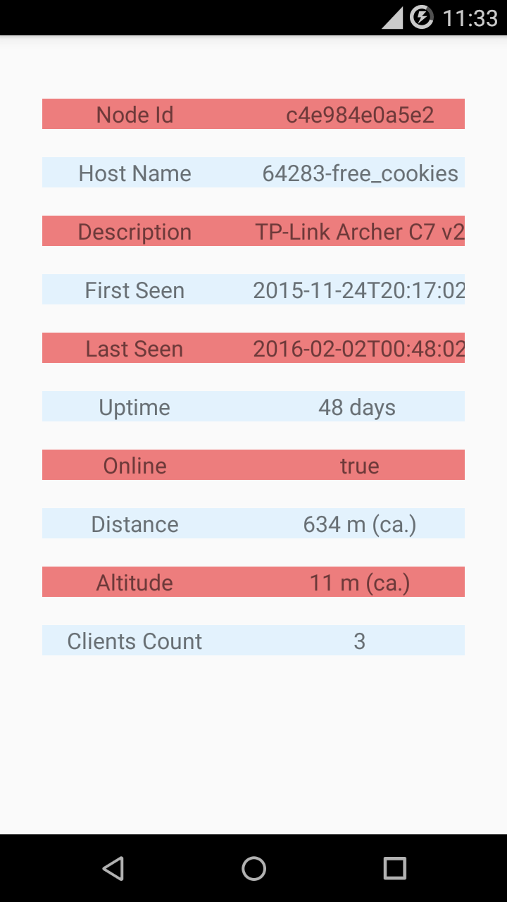
User Interface
Augmented Reality Wi-Fi finder
‹#›

Slide 4




Node Icons
Node is online
- Node is offline
Altitude information is correct
No altitude information available
All above icons vary in size based on if user is closer or farther from the node.
Augmented Reality Wi-Fi finder
‹#›

Slide 5
Future extensions
Dynamic Wi-Fi strength rendering
Sorting based on Wi-Fi strength
Location based information display
Peer-to-Peer Systems Engineering | Prof. Dr. David Hausheer
‹#›

Slide 6
Thank you for your attention!
Questions?
Augmented Reality Wi-Fi finder
‹#›

