Slide 1
Wine Tasting of Various Simulation Code
Zeus-MP, CASTRO and GADGET
Comparison

Slide 2
List of Reference Paper & Book
Paper
ZEUS -2D ( James Stone & Michael L. Norman 1992)
Zeus – MP ( John C. Hayes et al. 2006)
Gadget ( Volker Springel et al. 2001)
Castro ( A.S. Almgren et al. 2010)
The Dominance of Neutrino driven convection in core collapse supernovae (Jeremiah W. Murphy et al. 2013)
Simulations of the formation, evolution and clustering of galaxies and quasars (Volker Springel et al. 2005)
Book
An introduction to astrophysical fluid dynamics (Mcheal J Thompson 2006)

Slide 3
Content
What physics are we simulating ?
Zeus –MP
Features of ZEUS – MP
Simulation by ZEUS –MP
CASTRO
Features of CASTRO
GADGET
Features of GADGET

Slide 4
Why put the 3 code together ?
All of them are trying to solve hydrodynamics in different aspect , from the code paper abstract :
ZEUS-MP(2006)
ZEUS – MP allows advection of multiple chemical (or nuclear species) …….MFD and RHD modules can be used ….. Self gravity can be included
CASTRO (2010)
…….Multicomponent compressible hydrodynamics equations for astrophysical flows including self-gravity, nuclear reactions and radiation ….
GADGET (2001)
GADGET evolves self gravitating collision-less fluids
Notes:
ZEUS – MP allows advection of multiple chemical (or nuclear species …..MHD and RHD modules can be used…… Self gravity can be included

Slide 5
Comparison table
 | ZEUS - MP | CASTRO | GADGET
Physics | MHD, RHD, Gravity, | HD, RHD, Gravity, | Self-gravitation collision-less fluids in Expanding coordinate
Implementation on hydrodynamics | Eularian Finite different Artificial viscosity | Eularian Finite Volume with Adaptive Mesh Refinement | Lagrangian SPH Additional acceleration from expanding coordinate
Implementation on Gravity | GM/r potential Conjugate gradient | Constant Monopole approx for radial Linear solver | Tree algorithm

Slide 6
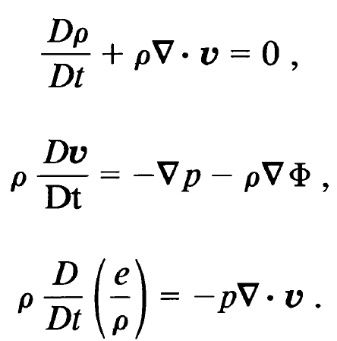
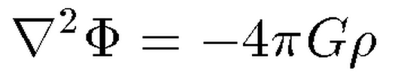
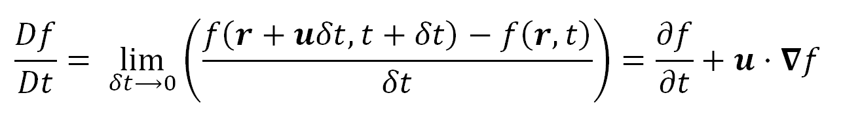
Physics in common
They are playing with fluid and self gravity !
A fluid are continuum description of flow of huge amount of particles, where their mean free path << dimension of system
They will deform upon stress applied on them
We can write down the differential equation which represent the conservation of Mass, Momentum and Energy , as well as the gravitation equation
Notes:
Pressure is find by EOS

Slide 7
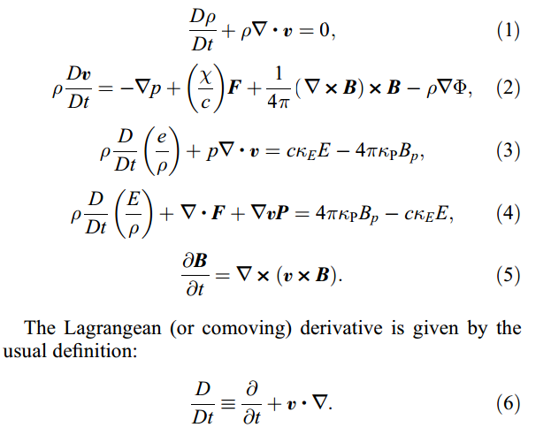
ZEUS – MP : Additional Physics
Magnetic field, Multispecies, radiation
Radiation energy
Ideal MHD
Conductivity is very high

Slide 8
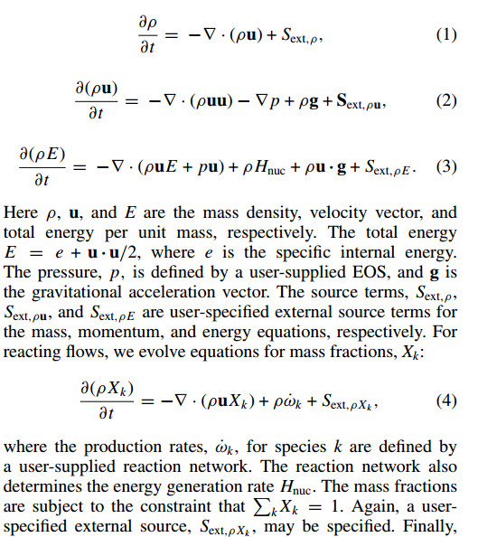
CASTRO : Additional Physics
Nuclear reaction, radiation
S_{ext} are user define source term
Nuclear reaction is written in terms of evolution of mass fraction

Slide 9
GADGET : Additional Physics
The GADGET is aimed at simulating large scale event such as the formation of galaxy or quasar, therefore it have to take care of dark matter, and the expansion of universe
Dark matter that is collisionless and interacts only via gravity, and baryonic material which is a collisional fluid, coupled to dark matter only via gravity
Collisionless fluid dynamics
Expanding universe

Slide 10
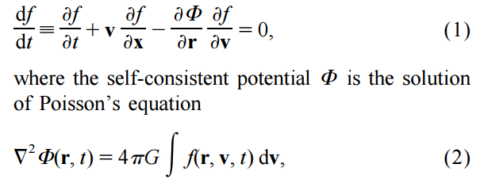
GADGET - Additional Physics
In non equilibrium environment, The collisionless Boltzmann Equation (CBE)
Where f is the mass density in a single-particle phase-space.
The mass distribution function are simulated by N body, this is a Monte Carlo approach

Slide 11

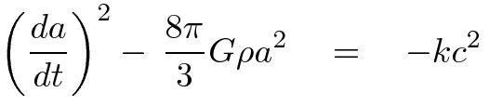
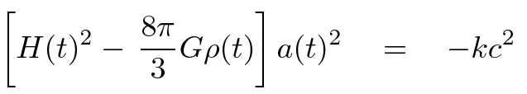
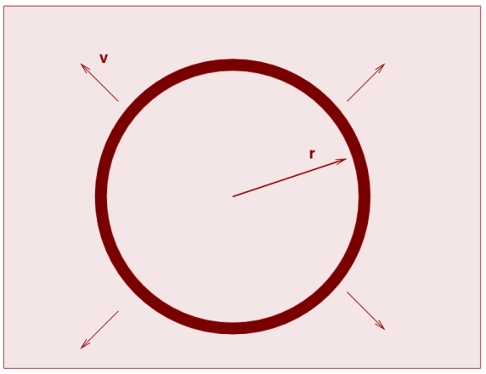
GADGET - Additional Physics
The Friedmann Equation which govern the equation of space

Slide 12

ZEUS – MP
Notes:
ZEUS MP is study in last semester, not discussed throughoutly here

Slide 13
ZEUS – MP on HD
The set of HD equation are hyperbolic PDE, generally difficult to solve, therefore numerical methods are employed
Features to be discussed
Operator Splitting
Staggered Mash

Slide 14
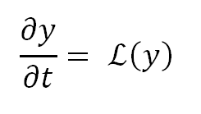

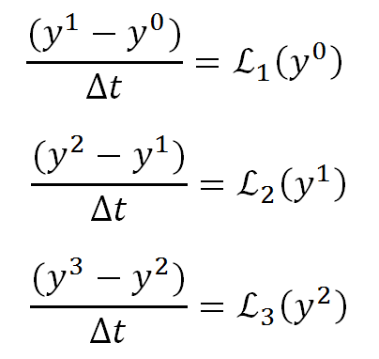
HD – Operator Splitting
Operator splitting break PDEs into parts
E.g. for equation:
We assume that the operator an split into part
y is evaluated :
Notes:
Mention the advantage

Slide 15
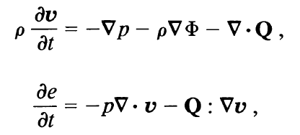
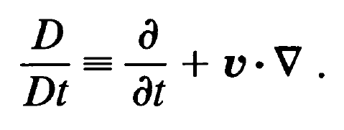
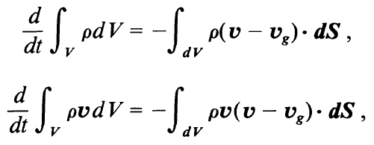

HD – Operator Splitting
The set of HD eqn is then grouped into two step, namely :
Source step :
And transport step
Notes:
Finite Difference Methods are based on a discretization of the differen tial form of the conservation equations

Slide 16
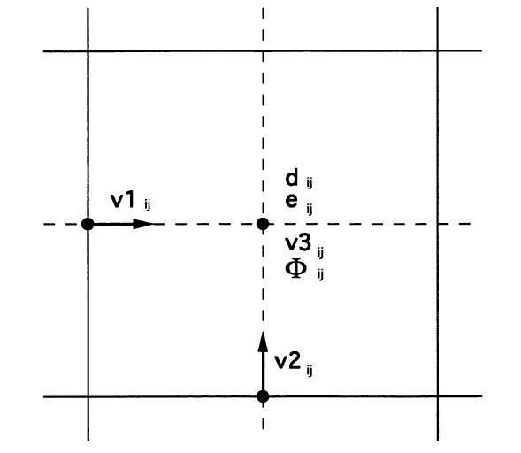
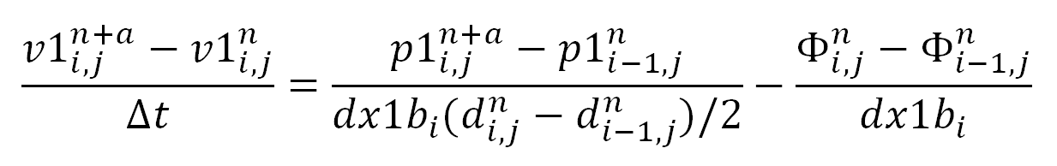
HD – the staggered mesh
Vector from differencing scalar are in centered location between the scalar ,
centered differences are second order accurate
Number of interpolation is reduced for advection equation
The equation is then solved by finite different method: e.g. in the first sub-step of source term:
finite different form:
Position of variable, note that this graph is for ZEUS -2D

Slide 17


HD- the transport step
The transport step is originated from the fluid advection, in 2D :
Where
The value are interpolated to interface and is time centered
Directional split update is carried out as X^{1/2}YX^{1/2} → Y^{1/2}XY^{1/2}→X^{1/2}YX^{1/2}…
Multispecies can be included
This is different from finite volume method !

Slide 18
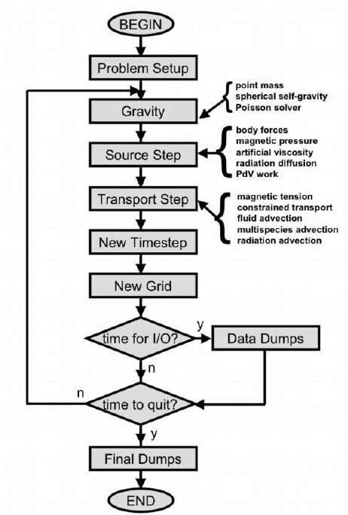
ZEUS- MP - Workflow
Courant condition

Slide 19
BW tube
shock tube with magnetic field
rarefaction
shock
Density against x
Fast rarefaction
Compound wave*
Left : (P,ρ,Bx,By,Bz ) = (1.0, 1.0,0.75,0.6,0.8)
Right : (P,ρ,Bx,By,Bz ) = (0.1, 0.125,0.75,-0.6,-0.8)
Contact discontinuity
Notes:
Cd : pressure continous, differne density/ temperture

Slide 20
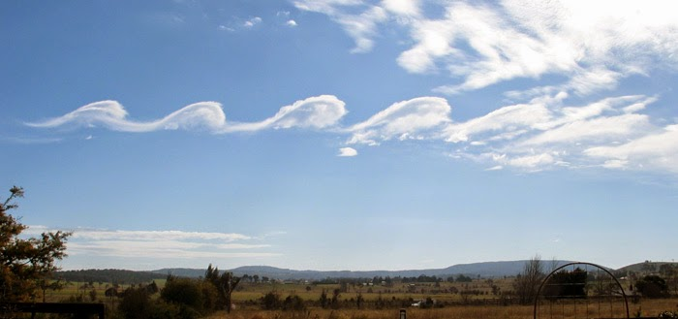
Example-KH instability
Wikipedia
y=0.5
Vy amp = 0.01
y=0.25
x=-0.5
x=0.5
P = 2.5
ρ = 2
Vx = -0.5
P = 2.5
ρ = 1
Vx = 0.5
y=-0.25
y=-0.5
Grid : 200 x 200
Boundary condition : periodic everywhere
ϒ = 1.4 everywhere

Slide 21
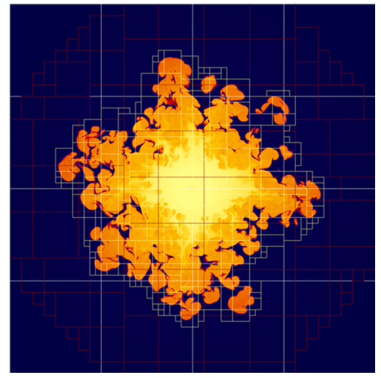
CASTRO

Slide 22
CASTRO on HD
Finite volume, Riemann solver and Adaptive Mesh refinement is introduced
Finite volume
Unlike the Finite Different Method(FDM), the Finite Volume Method (FVM) evolve the integral from of the HD conservation equation.
Grids are considered to be “little box” that store different amount of quantities , of which the total amount are conserved
The flux between boxes are computed by Godunov Method

Slide 23
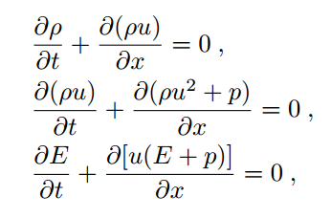
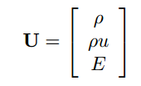
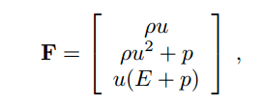

Conservation form for 1D system

Slide 24
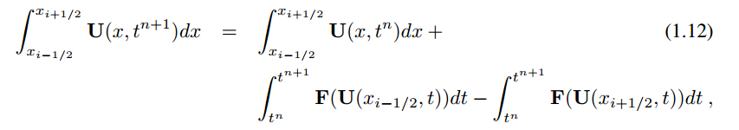
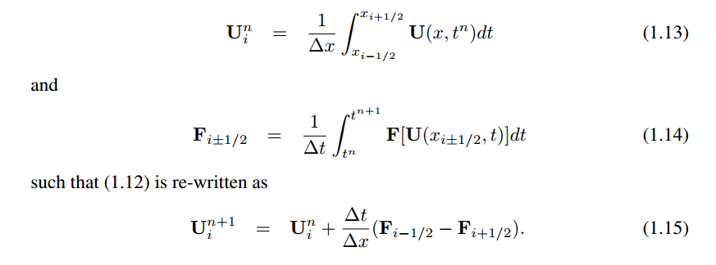
Integration form of conservation law

Slide 25
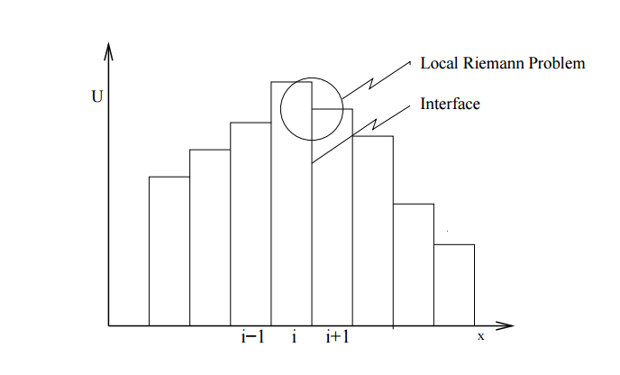
First Order Godunov's scheme
Data is assumed to be constant over the spatial area, i.e. piece-wise constant
The Flux is solved by local Riemann Problem

Slide 26
Similar ?
shock tube with magnetic field
rarefaction
shock
Density against x
Fast rarefaction
Compound wave*
Left : (P,ρ,Bx,By,Bz ) = (1.0, 1.0,0.75,0.6,0.8)
Right : (P,ρ,Bx,By,Bz ) = (0.1, 0.125,0.75,-0.6,-0.8)
Contact discontinuity
Notes:
Cd : pressure continous, differne density/ temperture

Slide 27

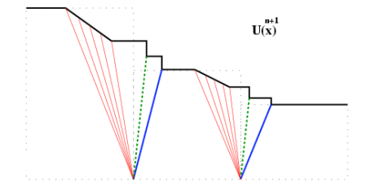
Riemann Solver
The equation is solved locally by Riemann solver
Every cell boundaries at every time level is a Riemann Problem,
Solved by the method of characteristic
The equation is written in a form of eigenvalue problem, which eigenvalue found is characteristic which is speed of different wave

Slide 28
Discussion on Godunov's scheme and Riemann Solver
Exact Riemann solver is expensive, therefore there are approximate Riemann Solver such as the HLL solver
The accurate of Godunov’s method can be improved by changing the piecewise constant function in to linear function or piecewise parabolic method

Slide 29

HD - Castro
The conserved variable in CASTRO is set as
Where C are auxiliary and advected and variable, e.g. electro fraction, angular momentum etc.
The time evolution of U can be written as :
U and S are defined in the cell center, PPM is used to predict the variable at edges and construct F^{n+1/2} by approximate Riemann solver

Slide 30



Castro on HD
1.The reaction network was first evolved at ∆t/2:
2.The solution is advected through
Which time centered Flux, new gravity is computed, new gravity are computed
3. The reaction network was again evolved at ∆t/2:
4. The new time step defined by CFL condition is computed

Slide 31
Constructing the Flux
1. U is written in terms of Q, called the primitive variable
Which is used to calculate flux
2. construct a piecewise parabolic function for Q in cell
3. Q ^{∆t/2} at edges was found
4. approximate Riemann solver is used
Notes:
Extra quantity are calculated by EOS

Slide 32
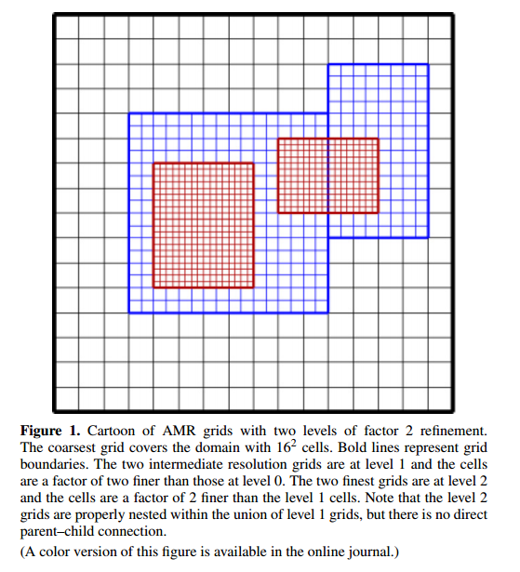
CASTRO : AMR
Adaptive mash refinement allows better resolution and accuracy at interested location
The approach of AMR in CASTRO is called the nested hierarchy, with refinement in both space and time, from the coarsest (l = 0) to the finest (l = l _{finest} ), with a factor of 2 in dimension
The l +1 layer is well nested in the l layer
The refinement is trigged by error above a given tolerance ,which is user defined
Typical error criteria include 1st and 2nd derivatives of state variable

Slide 33
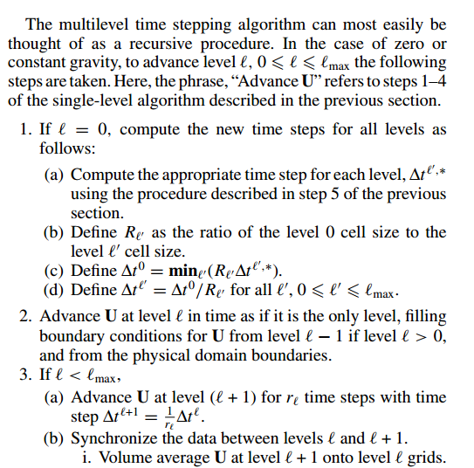
CASTRO : AMR

Slide 34
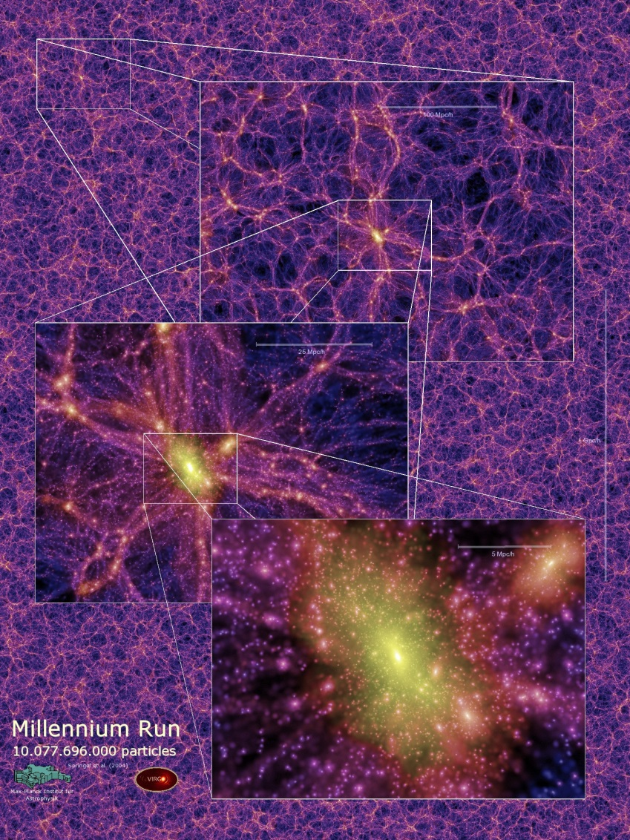
GADGET

Slide 35
GADGET
Gadget evolves self-gravitating collision less fluid, with N-body approach ,which is for the cold dark matter
smoothed particle hydrodynamics are for collision gas (baryon)
A tree algorithm is used to compute gravity

Slide 36
GADGET – On Gravity
Zeus – MP write Poisson equation in linear system, and solve it with CG solver, or solving through FFT
CASRTRO use the method of Multigrid Solver
In GADGET , The BH tree is used
The Barnes and Hut(1986)

Slide 37
Barnes and Hut(1986)
O(N2) → O(NlogN)
Schematic description
Particles are arranged in a hierarchy of groups
Force by distant group are approximated by their multipole moment

Slide 38
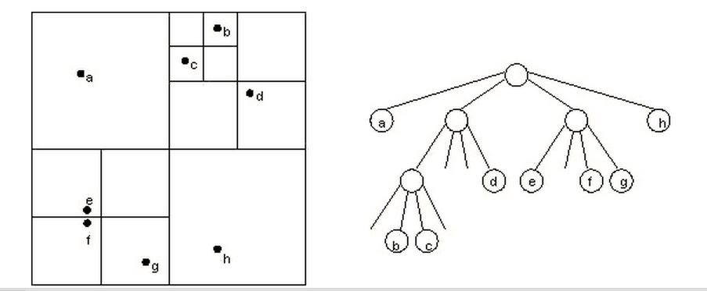
B-H algorithm – Tree construction
Each 3D cube contains eight siblings, each with ½ side length of their parent. Each of them are node of a oct-tree .
Each node contains exactly one particle, or is pergenitor to further nodes
Progenitor carries the monopole and quadrupole moment of all particles that lie inside

Slide 39
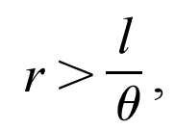
B-H algorithm - Force computation
Walk the tree, and summing up appropriate force contributions from node
The multipole expansion of node is used when
Else its leaf will be examine
r from point of reference to center of mass of cell
I is the size of node
Theta is the accuracy parameter
l
r

Slide 40
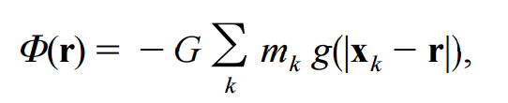
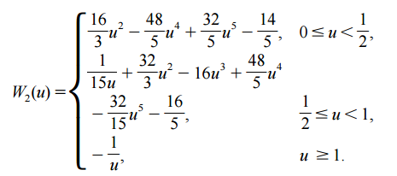
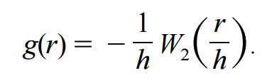
B-H algorithm - Force computation
To approximate the potential at r due to distant bunch of particles with mass m_{i} and coordinated x_{i}
Where
g reduces to 1/r when far away, i.e. Newtonian

Slide 41
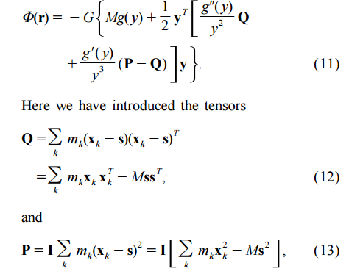
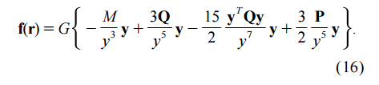
B-H algorithm - Force computation
Let s be the center-of-mass, M be the total of Mass. Define
y = r – s
for expansion of potential , assume |y| >>|x_{k} - s|
l
s
r

Slide 42
B-H algorithm discussion
Single precision floating point is used to store node properties
Multipole moments of node can be recursively computed by its daughter
Tree walk is the most time consuming part
When different species with different softening length interact, take the larger one

Slide 43
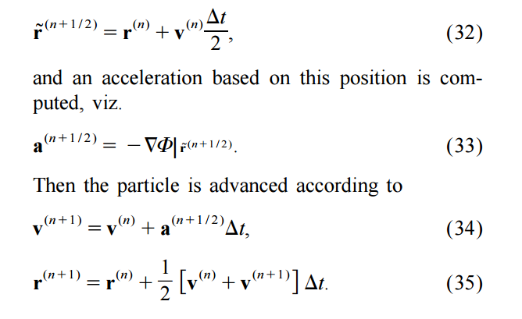

GADGET – individual time integration
Note that each particle has its individual time step base on local properties, usually smaller time step in colder part
Each particle with time t_{i} and (r_{i},v_{i},a_{i})
Practically, Particle are updated in a group, which selected at the lower end of the timeline

Slide 44

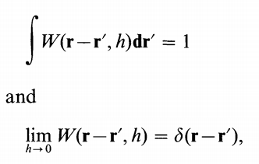

Basic of Smoothed particle hydrodynamics
The SPH is the use of finite set of particle(not a real small particle ) to represent the continuous fluid
The continuous properties are recovered by summation interpolants
Construct function by particles (summation)

Slide 45
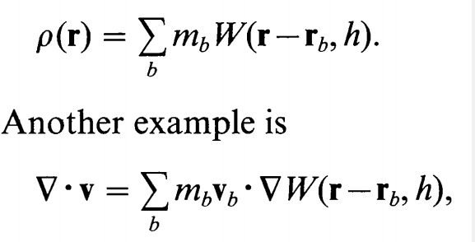

Basic SPH
For example :
The particles position and velocity is related by
$\frac{dr_{i}}{dt}\text{=}{\text{v}}_{i }$
And the momentum equation is that :
$\frac{dv_{i}}{dt}={−(\frac{1}{ρ}∇P)}_{i}+g(r_{i})$
Notes:
Equation of state /?????? Vs P by force ????????

Slide 46
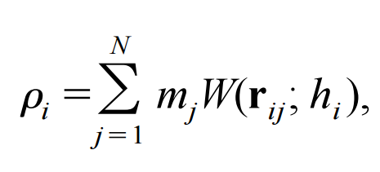
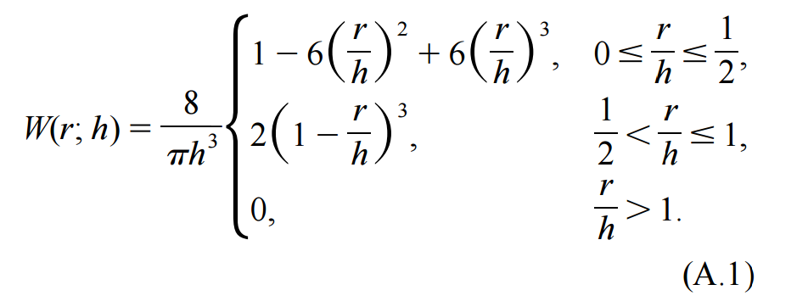

SPH in GADGET
Not all particles are advanced at a single time step, usually a group of particles are updated in a time step
1.In First phase, the active particles index i ( need a force update at current time step)
2. neighboring particle index j inside their smoothing radii are found, which the number, is kept exact(resulting lowest noise, conservation of energy)
3. for passive particles, density, internal energy and smooth length are predicted by their last update . Pressure is then find

Slide 47
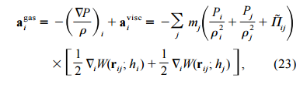
Hydrodynamic Acceleration

Slide 48
Dynamic tree update
Make sure you find all of your neighbor for interaction whenever |r_{ij}| < max (h_{i},h_{j}) ( for momentum conservation)
The particle are stored in a Tree structure
Fraction of particle to be advanced is small , reconstruction of whole tree is expensive in time
Tree node with center of mass position and velocity are predicted instead of tree leaf
Whenever the center of mass of tree node has moved more then a fraction of side length, the node is updated
Full reconstruction is carried out for ~0.1N is updated

Slide 49


In comoving coordinate
Newton equation of motion :
For x is comoving coordinate, in a periodic boundary condition,

Slide 50
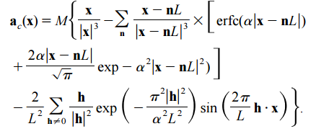
In co-moving coordinate
The physics comes in the form of acceleration

Slide 51
Finite Different vs Finite Volume vs SPH
 | Finite Different | Finite Volume | SPH
Code | Zeus MP , | CASTRO | GADGET
equation | Differential | Integrated | ??
Advantage | Straight forward, easily modified and extended | Keep conserved quantity conserve | Free from geometry Dynamic in range
disadvantage | For specific geometry At discontinuities | Difficult to add physics in general | Not a good way to resolve wave

Slide 52
CCSNe
The CASTRO code was adapted to simulate the Core collapse supernova
To test that if the Shock was driven by the neutrino-driven convection or standing accretion shock instability
Simulation size : largest 10000km with resolution 32km

Slide 53
ΛCDM Simulation
Parameters
N = 2160³ ~1 x 10¹⁰ particles
Mass of particle 8.6 x 10⁸h⁻¹M©
Box size z=127 to present in a cube 500 h⁻¹Mpc
Start with Gaussian random field
Ω_{m}=Ω_{dm}+Ω_{b} = 0.25
Ω _{Λ} = 0.75

Slide 54
The End

Slide 55
Appendix

Slide 56
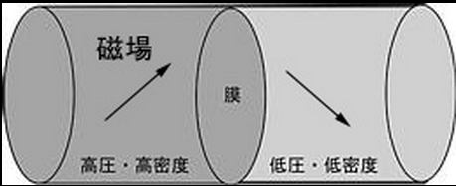
BW tube - background
Brio and Wu proposed this problem in their paper (1988)
Which is a shock tube with magnetic field
This problem in included in the ZEUS –MP code as standard test

Slide 57
BW tube - Setup
The problem is with two discontinuous
1D problem
For γ = 2 gas
Left : (P,ρ,Bx,By,Bz ) = (1.0, 1.0,0.75,0.6,0.8)
Right : (P,ρ,Bx,By,Bz ) = (0.1, 0.125,0.75,-0.6,-0.8)
800 Zone ,run from t = 0 to t = 100
outflow boundary condition

Slide 58
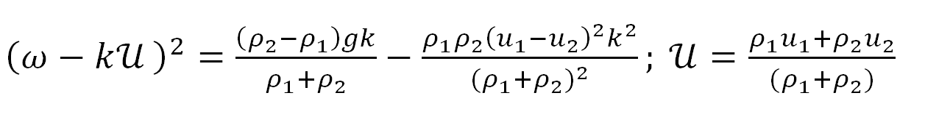
KH instability- background(incomplete)
Occur when there is a velocity difference across interface of two fluids
The proof is not given here, but the step
A scalar flow is used to perturb the velocity of particle at boundary
Only linear terms are kept
the pressure is kept continuous at boundary
Find the dispersion relation

Slide 59

GADGET – N-Body time integration
Practically, Particle are updated in a group, which selected at the lower end of the timeline

Slide 60
B-H algorithm – Tree construction
Technical difficulty when gravity is softened
In high density zone, it is possible that the branch is “closed” when and r<h
Need multipole moments of softened gravitation(???)

Slide 61
GADGET – Neighbor Search
Make sure you find all of your neighbor for interaction whenever |r_{ij}| < max (h_{i},h_{j}) ( for momentum conservation)
Method 1 : find all neighbor of i inside h_{i} and add additional force term for missing interaction term
Disadvantage : all particle needed to update in the time step
Method 2 : Native way
Slow, big-O goes with N²
Method 3 : Range search, search grid scan through the area and establish link list (???)
Slow in clustered distribution, search grid size change a lot
Method 4 : walk a tree again !

Slide 62
GADGET – Neighbor Tree
A cell is opened if it spatial overlap with the rectangular search area,
Walk until one particle, the particle is added to link list,
If the whole cell is inside search range, then all particles are added to the list, branch terminated .

Slide 63
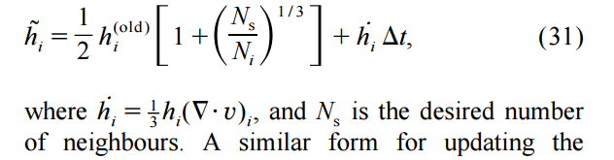
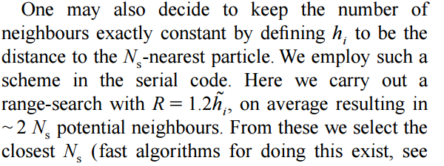
GADGET – Neighbor search

Slide 64

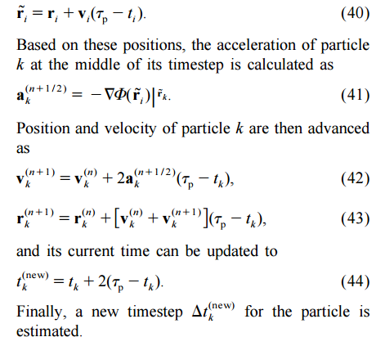
GADGET – N-Body time integration
Predicted time in (first order accuracy)
Definf taup = ,which is the new time of system
Gravitation softening – suppress large angle scattering
Introduces a lower spatial resolution cut-off

Slide 65
How fourier solve gravity?
Big o notation - provides an upper bound on the growth rate of the function

