Slide 1
DATA ANALYSIS BOOTCAMP
PROJECT 3:
WORLDWIDE TOBACCO USE AND SMOKING PREVALENCE
Team 10: Ashton Smith, Matt Barlow, Parris Woods, and Jessica Abrams

Slide 2
OBJECTIVES
To find and analyze data from the World Health Organization on Global Smoking Prevalence, Tobacco use, and Cigarette Prices from 2008-2018
To extract, transform, and load the data into an SQL database
To build a dashboard that displays smoking data via line graph, bar chart, and across a world map.
To create dropdown menus that will allow the user to visualize smoking statistics by Country

Slide 3


ETL PERFORMANCE
Files for each year: 2008, 2010, 2012, 2014, 2016, 2018
General cleaning:
Appended all six years together, and deleted unnecessary rows
Parsed text to have one number for all prevalences
Set prices to USD for comparison purposes:
Sent 2018 data list of currencies through Currency API to get exchange rates.
Merged currency rates onto main data frame and multiplied them by the price to get USD price
Getting latitude and longitude
sent the country name through the Google Map API to obtain a latitude and longitude to use for the map markers
manually fixed countries the Google Maps could not find
merged that data frame onto main dataframe
$

Slide 4


DATABASE / FLASK
What is Flask?
Flask is a web framework, it’s a python module that lets you develop web applications easily.
.connected postgres database to the flask server.
.Created a route on flask server to create our api
.then we created another route on our flask to homepage
.we built the schema for postgres
.imported our csv, made a connection to the database using flask in our app.py file
.then we made a json from the info.
.we needed a dictionary per country that had a) the name name and b) a dictionary for each year's worth of data we had for that country.

Slide 5
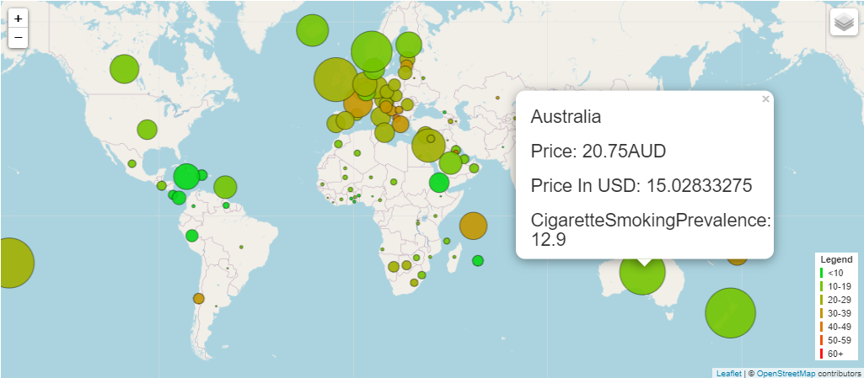
GLOBAL MAP
Markers for each country
sized by price (the one chosen by user)
colored by prevalence
pop-up to include country, price, and selected prevalence
Functions
createMap()
this would create the map using the marker arrays passed into it
createMarkers()
this would create the three marker arrays and passed them into the createMap function when called
colorMarkers()
this was a giant if..else.. statement that brings in the prevalence and assigns it to a color
it is called in the createMarkers function to set the color of the markers

Slide 6
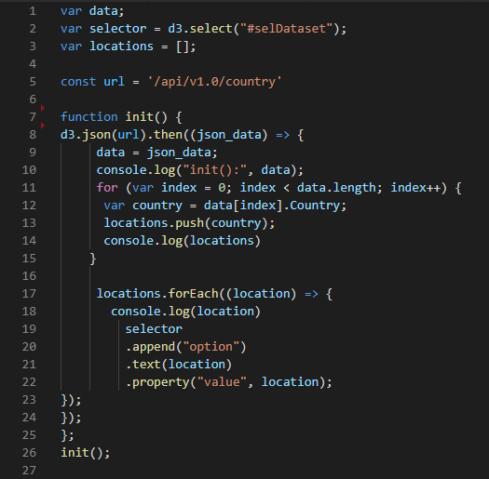
DROPDOWN MENUS
Create init() function
Read data from API with d3.json
Create for loop to push “Country” to empty list
Create for loop to append each “Country” to our dropdown selector
Call init() and verify dropdown selector contains each “Country”

Slide 7
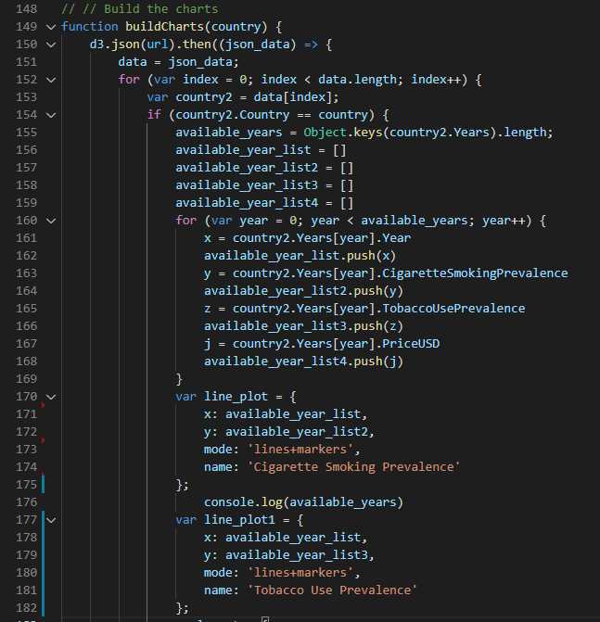
LINE GRAPH / BAR CHART
Create buildCharts() function
Create a for loop that matches the “Country” with our argument country
Create four empty lists to contain yearly data we need for that “Country”
Create our line graph using our filled Year, Cigarette Smoking Prevalence, and Tobacco Use Prevalence lists as x and y variables
Create our bar graph by using our Year and PriceUSD lists x and y variables

Slide 8

DEMONSTRATION

Slide 9

QUESTIONS?

