Slide 1
Homework 2
Sarah Golden
Quinn McIntire
Combined Work

Slide 2
Exercise 1

Slide 3
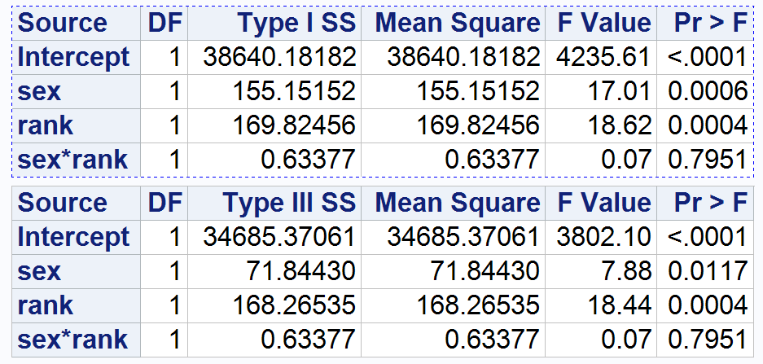
Exercise 1.a)
In terms of salary, both the Type I and Type III show that sex alone is significant and rank alone is significant, both having very low p Values. We reject the null hypothesis that there is no variation caused by those two classification variables (there is variation introduced by sex and rank). However, the interaction between sex and rank appears not to be significant, with a large p Value of 0.7951.
Notes:
Fit a two-way ANOVA model including sex (F, M) and rank (Assistant, Associate) the interaction term. Comment on significance of the model and variation explained. What do the Type I and Type III sums of squares tell us about significance of effects? Is the interaction between sex and rank significant?

Slide 4
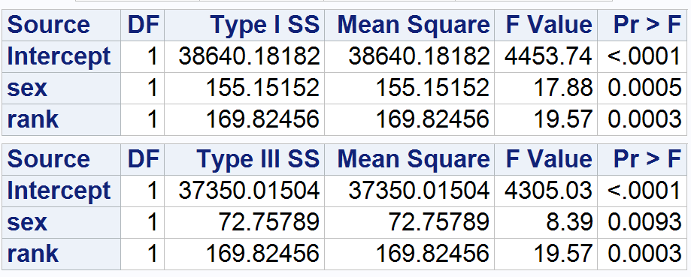
Exercise 1.b)
Refitting the model without the interaction of sex and rank results in even lower p-values under each model (well under the .05 threshold). The null hypothesis is that sex and rank do not impact the variation of the model. We reject the null hypothesis and conclude that sex and rank are significant (they are useful to the model).
Notes:
Refit the model without the interaction term. Comment on significance of the model and variation explained. Report and interpret the Type I and Type III tests of the main effects. Are the main effects of rank and sex significant?

Slide 5
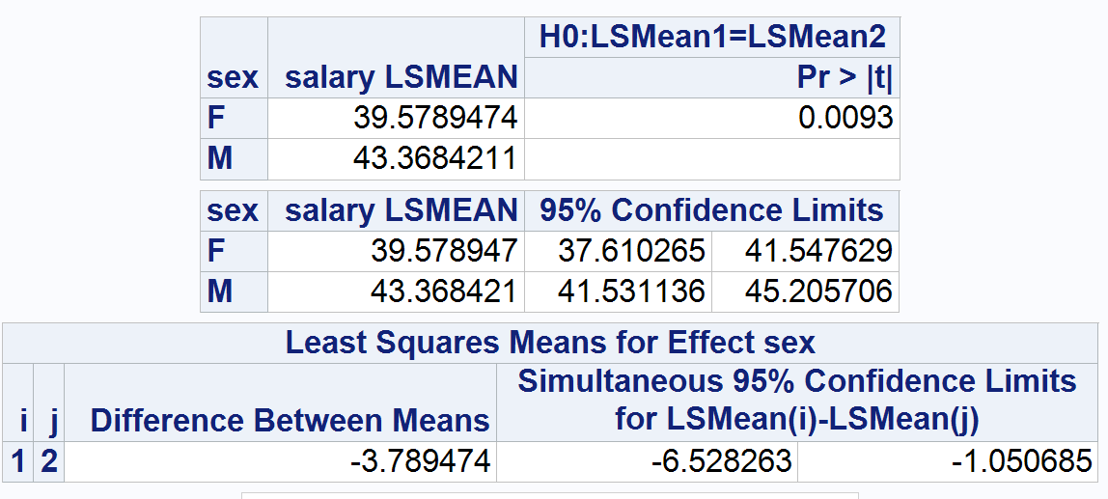
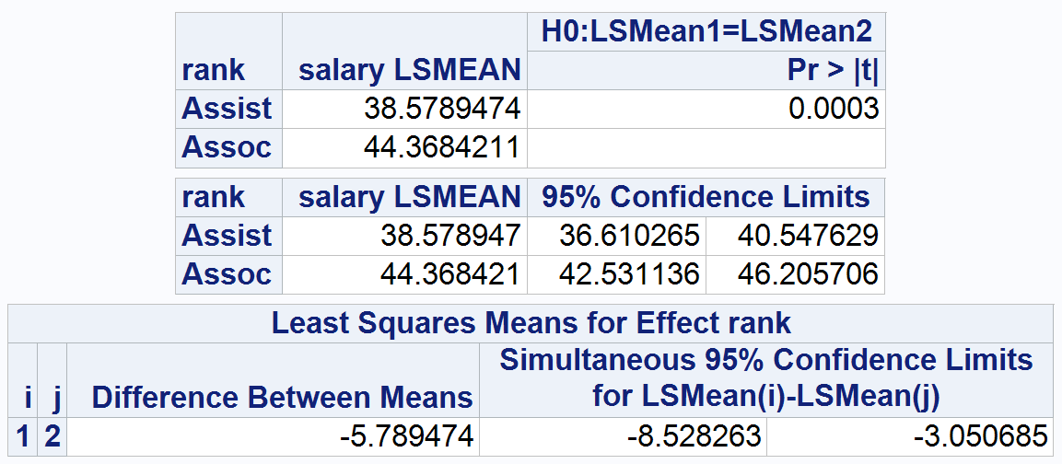
Exercise 1.c)
We chose to include only sex and rank in the model because they do not have a significant interaction.
The model suggests that, on average, women earn $3,789 less than men (undesirable and possibly illegal assuming no other variables). The 95% confidence limit for female professors is $37, 610 - $41,548 and the 95% confidence limit for male professors is $41,531 - $45,206
The model suggests that, on average, assistant professors earn $5,789 per year less than associate professors. It is not unexpected that assistant professors make less. The 95% confidence limit for assistant professors is $36,610 - $40, 548 and the 95% confidence limit for associate professors is $42,531 - $46,206
Notes:
Choose a final model based on your results from parts (a) and (b). State the differences in salary across different main effect groups and interaction (if included) between them. Obtain model diagnostics to validate your assumptions.

Slide 6
Exercise 1.c) (cont.)
In looking at the fit diagnostics for salary, we see that the residuals for projected values almost always fall within the -2 and 2 boundaries, indicating a normal distribution.
Notes:
Choose a final model based on your results from parts (a) and (b). State the differences in salary across different main effect groups and interaction (if included) between them. Obtain model diagnostics to validate your assumptions.

Slide 7
Exercise 2

Slide 8
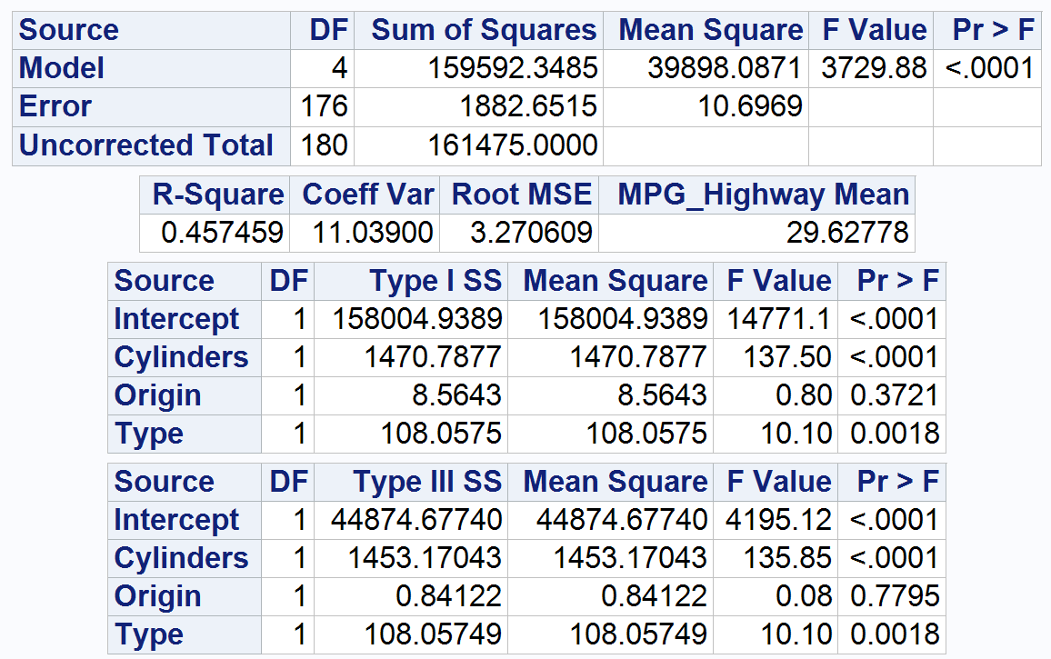
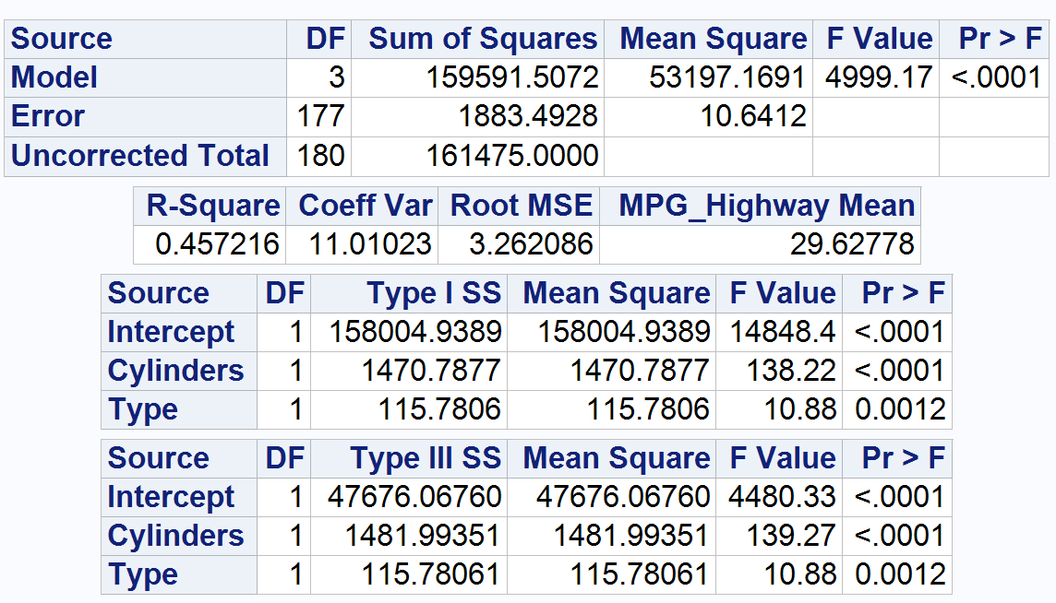
Exercise 2.a)
Upon running the model using mpg_highway as a function of cylinders, origin, and type, we can see that the model is useful because of the small p Value of <.0001. We can also see that cylinders, with a p Value of <.0001, and type, with a p Value of 0.0018, are significant, while origin, with a larger p Value of 0.3721, is not significant.
Removing the origin and running the model again shows that both cylinders and type remain significant.
Notes:
Start with a three-way main effects ANOVA and choose the best main effects ANOVA model for mpg_highway as a function of cylinders, origin, and type for the cars in this set. Comment on which terms should be kept in a model for mpg_highway and why based on Type 3 SS. For the model with just the predictors you decide to keep, comment on the significance of the model and of the terms in the model and comment on how much variation in highway fuel efficiency the model describes.

Slide 9
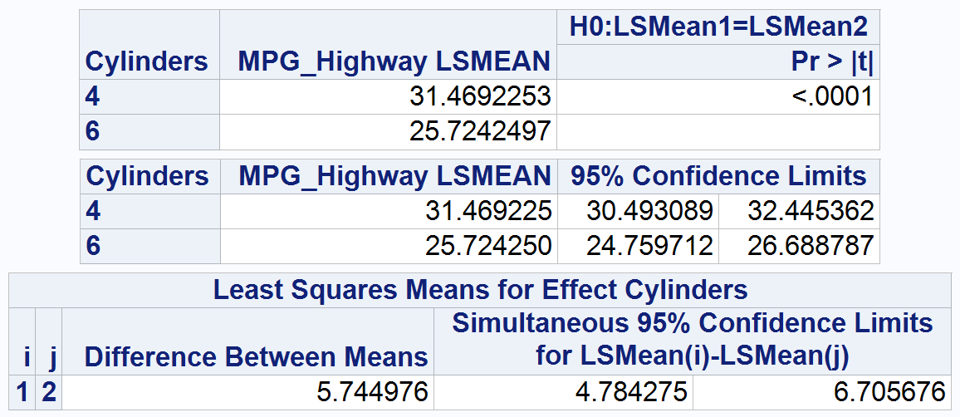
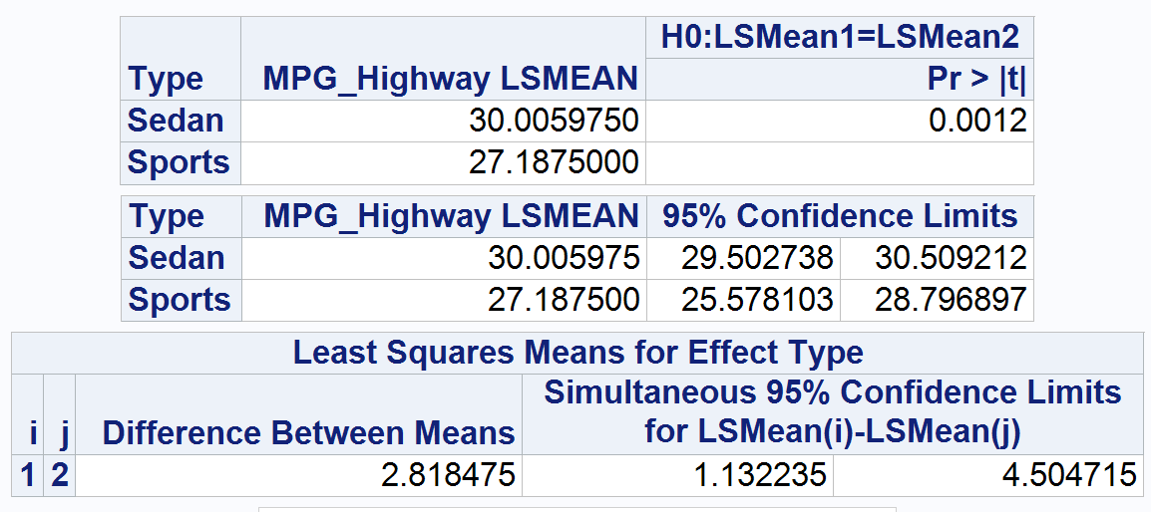
Exercise 2.a) (cont.)
The “type” of car (sedan or sports) accounts for 2.818 MPG difference in the model (sedans having the higher mileage).
The number of cylinders (4 or 6) accounts for 5.475 MPG difference in the model (4 cylinder cars with a mean of 31.469 MPG and 6 cylinder cars having a mean of 25.724 MPG).
Notes:
Start with a three-way main effects ANOVA and choose the best main effects ANOVA model for mpg_highway as a function of cylinders, origin, and type for the cars in this set. Comment on which terms should be kept in a model for mpg_highway and why based on Type 3 SS. For the model with just the predictors you decide to keep, comment on the significance of the model and of the terms in the model and comment on how much variation in highway fuel efficiency the model describes.

Slide 10
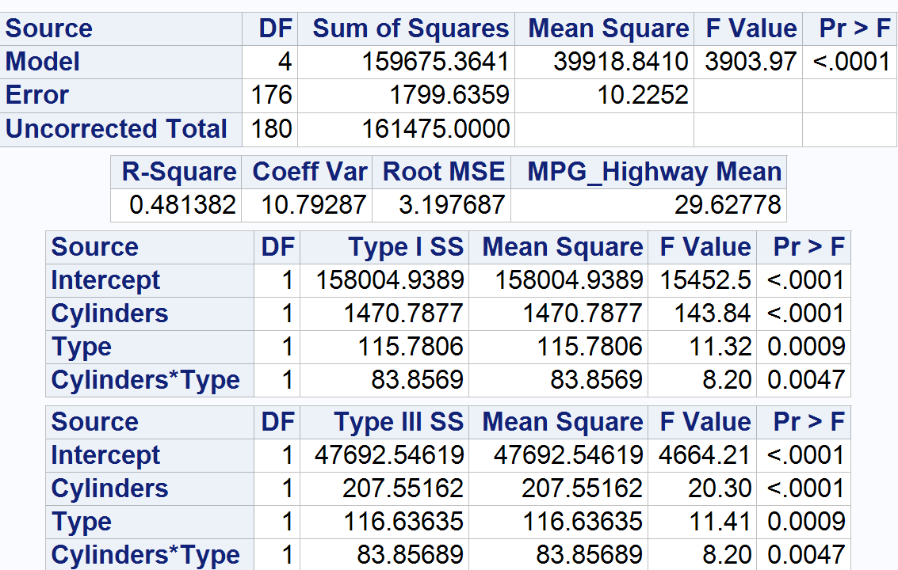
Exercise 2.b)
When the interaction between cylinders and type is added to the model, it reveals that the interaction between these variables is significant, with a small p Value of 0.0047.
The model is useful because the p Value is very small (<.0001). The R-Square shows that about 48.1% of the variance can be explained by the mode.
Notes:
Starting with main effects chosen in part (a), find your best ANOVA model by adding in any additional interaction terms that will significantly improve the model. For your final model, comment on significance of the model and the individual terms in the model, variation explained by the model

Slide 11
Exercise 2.b) (cont.)
Variation by “type”
Variation by cylinders
Type | MPG_Highway LSMEAN | H0:LSMean1=LSMean2
 |  | Pr > |t|
Sedan | 30.0163983 | 0.0009
Sports | 27.1875000
Cylinders | MPG_Highway LSMEAN | H0:LSMean1=LSMean2
 |  | Pr > |t|
4 | 30.4887821 | <.0001
6 | 26.7151163
Type | MPG_Highway LSMEAN | 95% Confidence Limits
Sedan | 30.016398 | 29.523025 | 30.509772
Sports | 27.187500 | 25.609814 | 28.765186
Cylinders | MPG_Highway LSMEAN | 95% Confidence Limits
4 | 30.488782 | 29.317376 | 31.660189
6 | 26.715116 | 25.548789 | 27.881443
Least Squares Means for Effect Type
i | j | Difference Between Means | Simultaneous 95% Confidence Limits for LSMean(i)-LSMean(j)
1 | 2 | 2.828898 | 1.175867 | 4.481930
Least Squares Means for Effect Cylinders
i | j | Difference Between Means | Simultaneous 95% Confidence Limits for LSMean(i)-LSMean(j)
1 | 2 | 3.773666 | 2.120634 | 5.426697
After adding this interaction between Type*Cylinders, the effect of car type is 2.829 MPG and the effect of cylinders is 3.774MPG, improving the accuracy of the model.
Notes:
Starting with main effects chosen in part (a), find your best ANOVA model by adding in any additional interaction terms that will significantly improve the model. For your final model, comment on significance of the model and the individual terms in the model, variation explained by the model

Slide 12
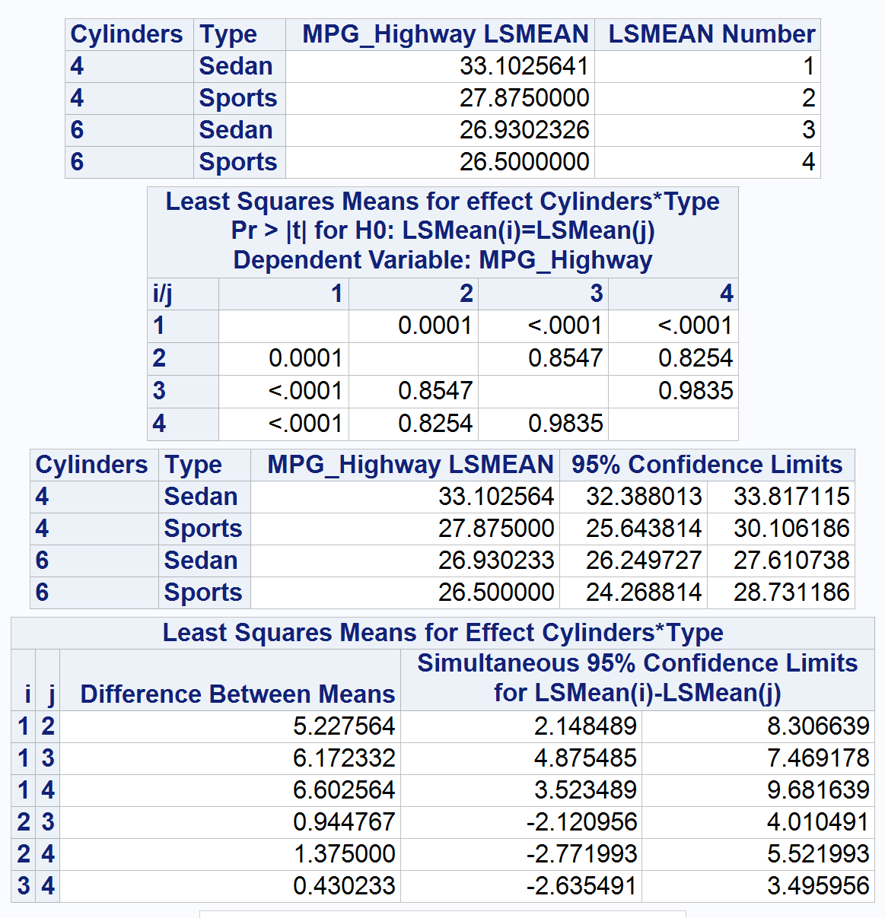
Exercise 2.c)
Looking at the post hoc test, it appears the 4-cylinder Sedan makes a significant difference (the p Value is 0.0001 or smaller) in mpg when compared to all other cylinder/type combinations. No other combination has a small enough p Value to indicate significance.
Notes:
Comment on any significant group differences through post-hoc test. What does this tell us about fuel efficiency differences across cylinders, origin, or type groups? See Hint in Exercise 1.

Slide 13
Exercise 2.c) (cont.)
Parameter | Estimate |  | Standard Error | t Value | Pr > |t|
Intercept | 26.50000000 | B | 1.13055318 | 23.44 | <.0001
Type Sedan | 0.43023256 | B | 1.18196794 | 0.36 | 0.7163
Type Sports | 0.00000000 | B | . | . | .
Cylinders 4 | 1.37500000 | B | 1.59884364 | 0.86 | 0.3910
Cylinders 6 | 0.00000000 | B | . | . | .
Type*Cylinders Sedan 4 | 4.79733154 | B | 1.67519881 | 2.86 | 0.0047
Type*Cylinders Sedan 6 | 0.00000000 | B | . | . | .
Type*Cylinders Sports 4 | 0.00000000 | B | . | . | .
Type*Cylinders Sports 6 | 0.00000000 | B | . | . | .
Looking at the post hoc tests of pairwise comparisons of the effects and interactions, 4 cylinder sedans stand out as the highest contributor to MPG at 4.797.
Notes:
Comment on any significant group differences through post-hoc test. What does this tell us about fuel efficiency differences across cylinders, origin, or type groups? See Hint in Exercise 1.

