Slide 1
Homework 2
Sarah Golden
Individual Work

Slide 2
Exercise 1

Slide 3
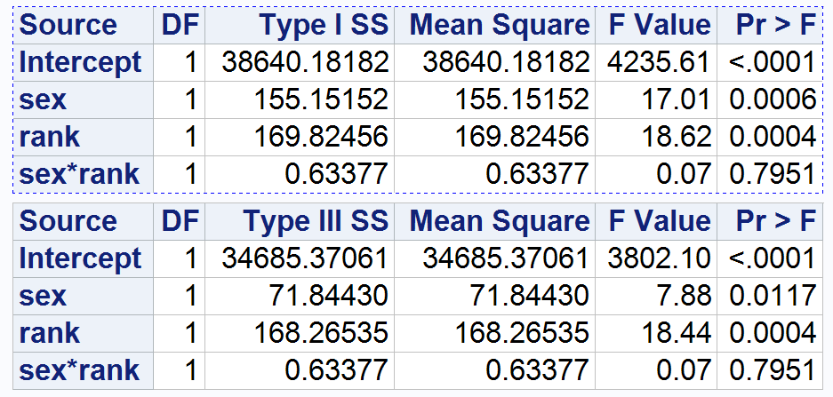
Exercise 1.a)
In terms of salary, both the Type I and Type III show that sex alone is significant and rank alone is significant, both having very low p Values. However, the interaction between sex and rank appears not to be significant, with a large p Value of 0.7951.
Notes:
Fit a two-way ANOVA model including sex (F, M) and rank (Assistant, Associate) the interaction term. Comment on significance of the model and variation explained. What do the Type I and Type III sums of squares tell us about significance of effects? Is the interaction between sex and rank significant?

Slide 4
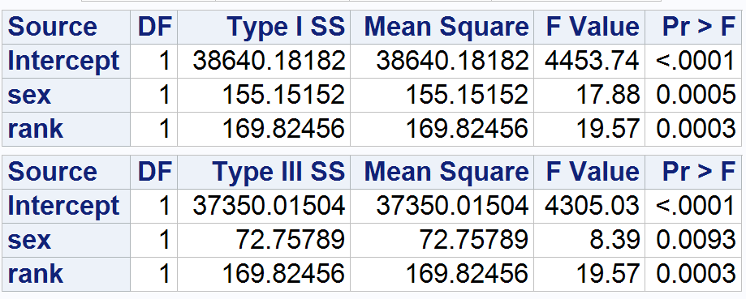
Exercise 1.b)
The main effects of sex and rank are significant in the model for salary.
Notes:
Refit the model without the interaction term. Comment on significance of the model and variation explained. Report and interpret the Type I and Type III tests of the main effects. Are the main effects of rank and sex significant?

Slide 5
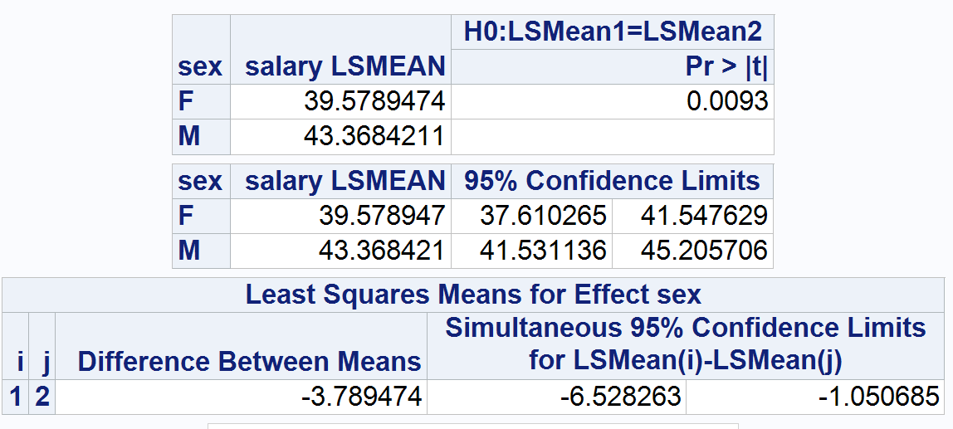
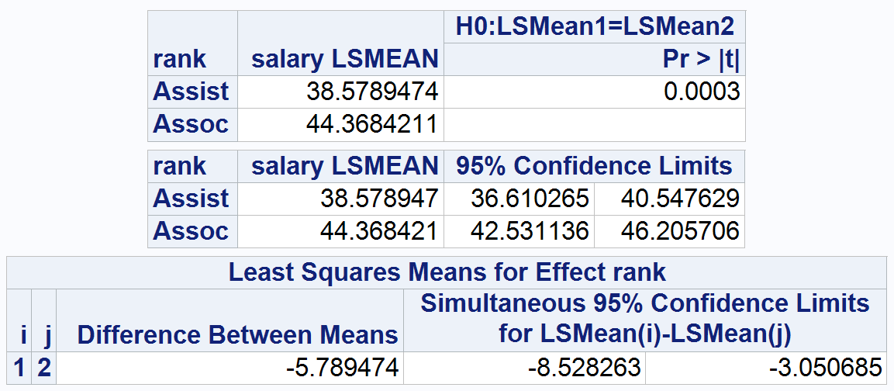
Exercise 1.c)
I chose to include only sex and rank in my model because they do not have a significant interaction.
The post hoc tests show that sex makes a difference of approximately 3.789 thousand dollars difference in salary, and rank makes approximately 5.789 thousand dollars difference.
Notes:
Choose a final model based on your results from parts (a) and (b). State the differences in salary across different main effect groups and interaction (if included) between them. Obtain model diagnostics to validate your assumptions.

Slide 6
Exercise 2

Slide 7
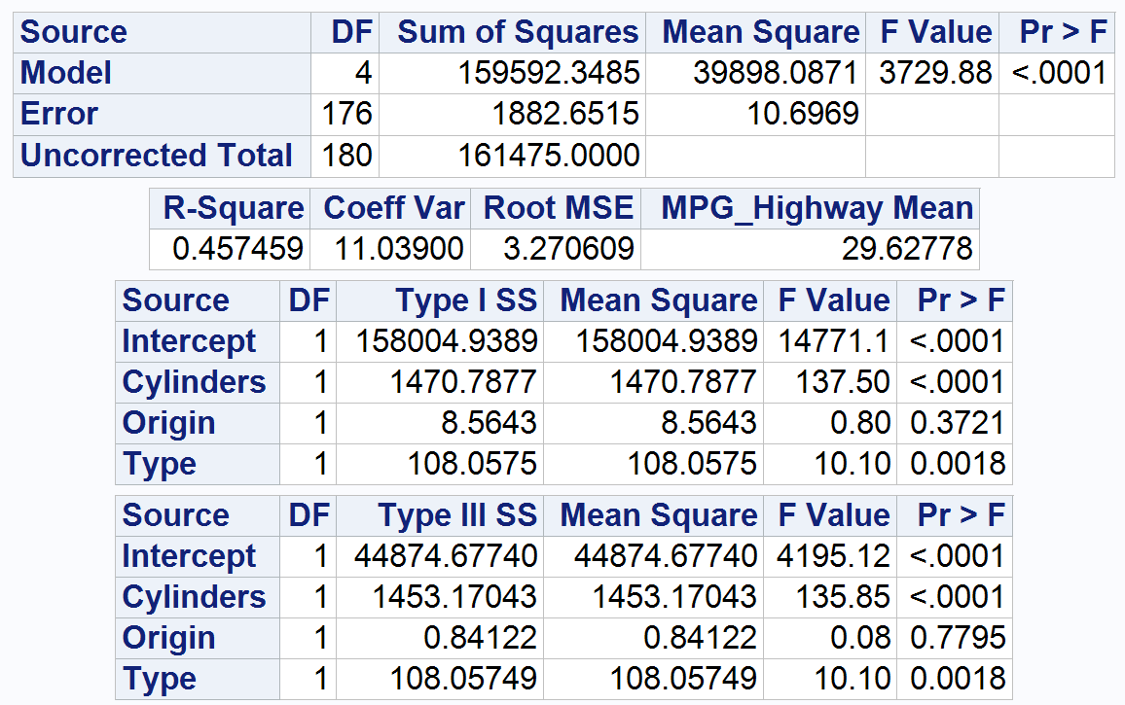
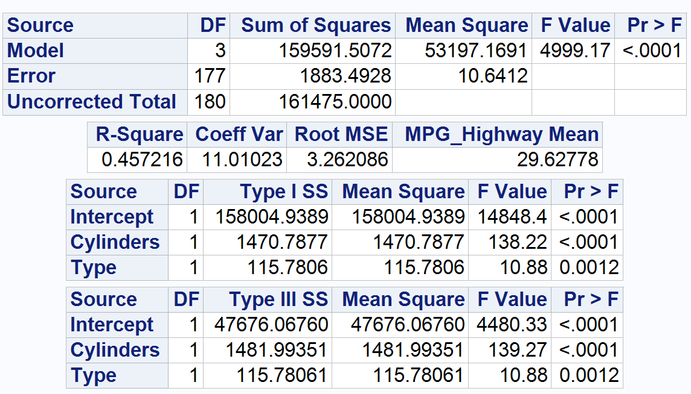
Exercise 2.a)
Upon running the model using mpg_highway as a function of cylinders, origin, and type, I can see that the model is useful because of the small p Value of <.0001. I can also see that cylinders, with a p Value of <.0001, and type, with a p Value of 0.0018, are significant, while origin, with a larger p Value of 0.3721, is not significant.
I removed origin and ran the model again. Both cylinders and type remained significant.
Notes:
Start with a three-way main effects ANOVA and choose the best main effects ANOVA model for mpg_highway as a function of cylinders, origin, and type for the cars in this set. Comment on which terms should be kept in a model for mpg_highway and why based on Type 3 SS. For the model with just the predictors you decide to keep, comment on the significance of the model and of the terms in the model and comment on how much variation in highway fuel efficiency the model describes.

Slide 8
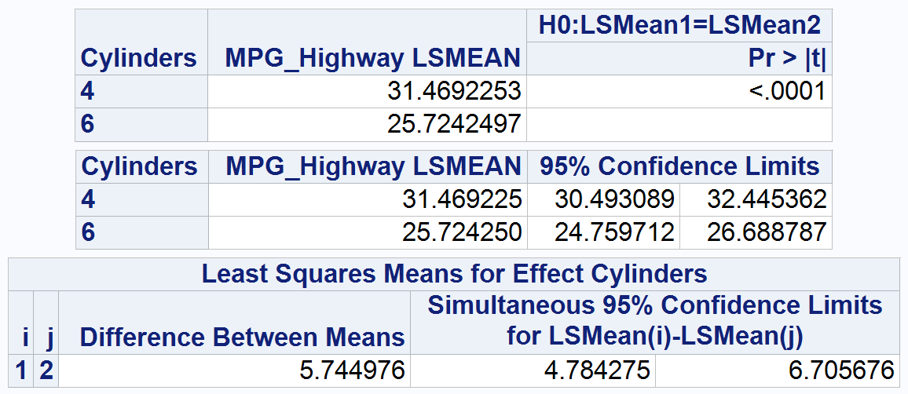
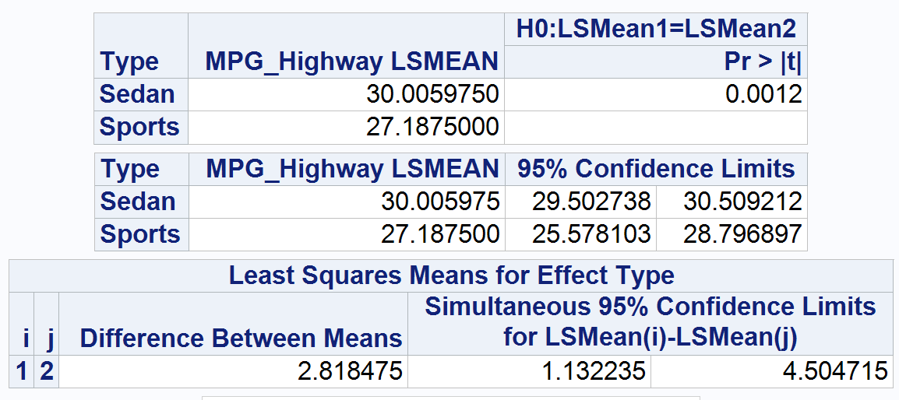
Exercise 2.a) (cont.)
The difference cylinders makes is about 5.745 mpg, and the difference type makes is about 2.818 mpg.
Notes:
Start with a three-way main effects ANOVA and choose the best main effects ANOVA model for mpg_highway as a function of cylinders, origin, and type for the cars in this set. Comment on which terms should be kept in a model for mpg_highway and why based on Type 3 SS. For the model with just the predictors you decide to keep, comment on the significance of the model and of the terms in the model and comment on how much variation in highway fuel efficiency the model describes.

Slide 9
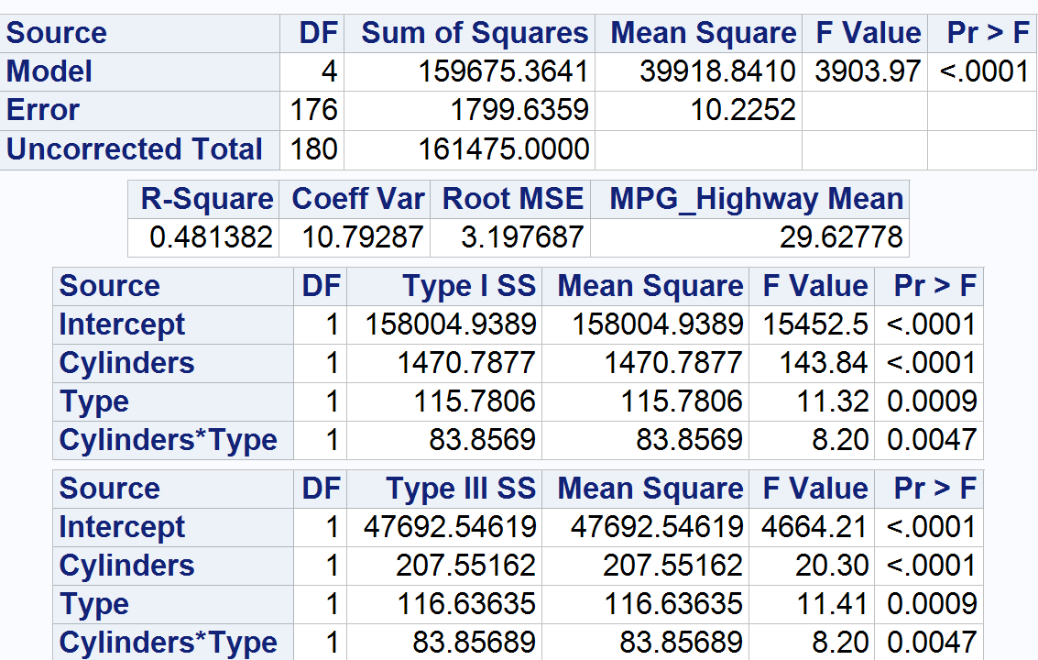
Exercise 2.b)
When the interaction between cylinders and type is added to the model, it reveals that the interaction between these variables is significant, with a small p Value of 0.0047.
The model is useful because the p Value is very small (<.0001). The R-Square shows that about 48.1% of the variance can be explained by the mode.
Notes:
Starting with main effects chosen in part (a), find your best ANOVA model by adding in any additional interaction terms that will significantly improve the model. For your final model, comment on significance of the model and the individual terms in the model, variation explained by the model

Slide 10
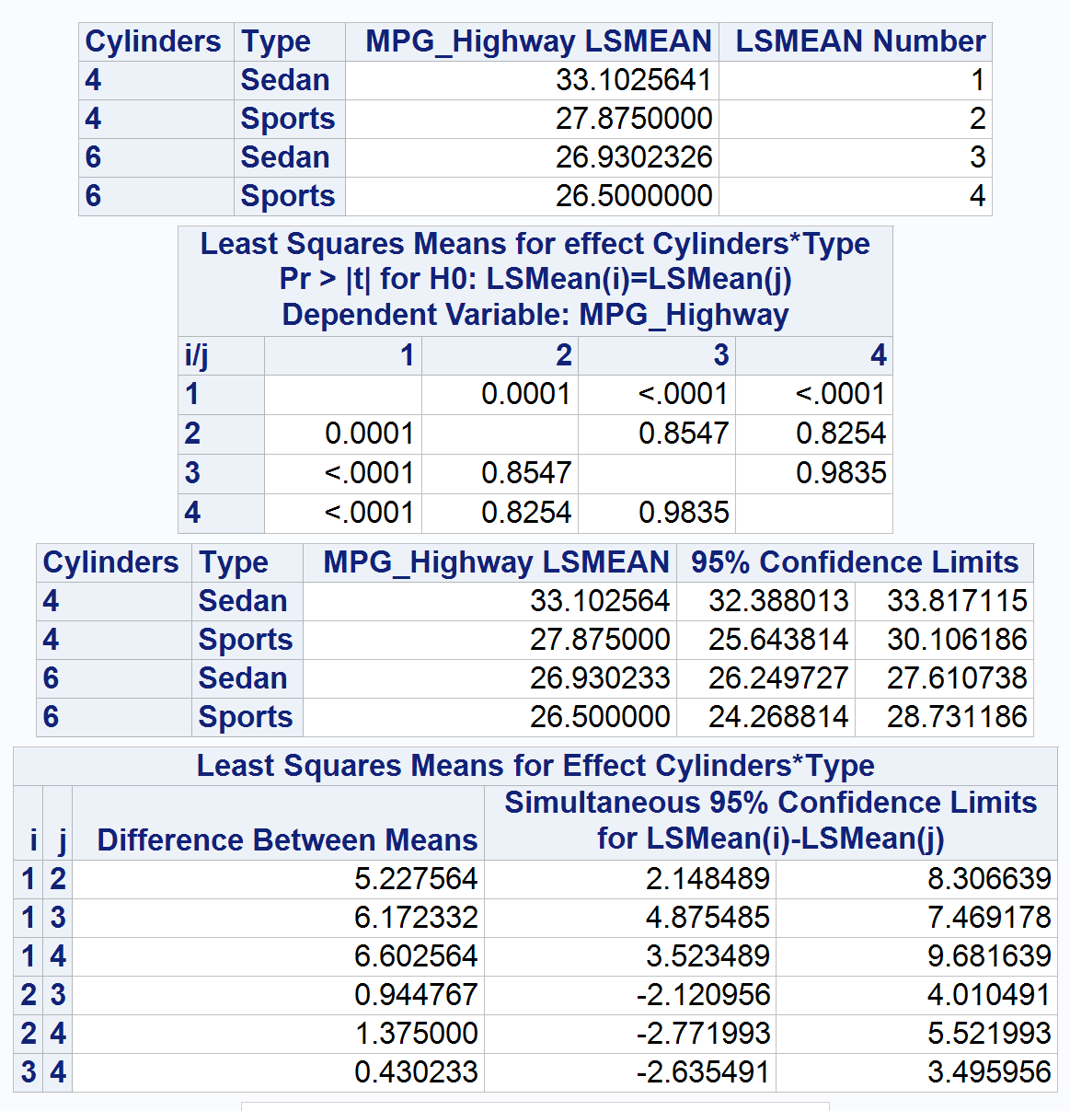
Exercise 2.c)
Looking at the post hoc test, it appears the 4-cylinder Sedan makes a significant difference (the p Value is 0.0001 or smaller) in mpg when compared to all other cylinder/type combinations. No other combination has a small enough p Value to indicate significance.
Notes:
Comment on any significant group differences through post-hoc test. What does this tell us about fuel efficiency differences across cylinders, origin, or type groups? See Hint in Exercise 1.

