Slide 1
Stock Alerts and Recommendation Application
Developed By :- Patel Keval K. (1216BECE31030)
Organization :- Quixom Technology
Internal Guide :- Mr. Vishal Barot

Slide 2
Project Profile
Project Name: Stock Alerts and recommendation system
Project Description :- An easy-to-use android and web app that identifies stock trends and notifies users to “buy,” “sell,” or “hold” recommendations within a customized watchlist.
Front End : HTML, CSS, Bootstrap, Jquery, JavaScript, Phonegap.
Back End : MySQL, Python ,Django Framework
Tools used : Python IDE PyCharm
External Project Guide : Jay Savsani

Slide 3
Project Definition
An easy-to-use app that identifies stock trends and notifies users to “buy,” “sell,” or “hold” recommendations within a customized watch List. Innovative in that the application works in real-time based on current market trends, alerts are sent directly to users’ Mobile Or Email via push notification, to create opportunities for timely NYSE and NASDAQ stock trades and profit maximization.

Slide 4
Scope
The system runs on a self-evolving, predictive model based on a series of technical indicators and a proprietary algorithm that we developed.
System’s mission is focused on providing all traders, whether novice or expert, the ability to proactively manage stock portfolios and maximize trading profits in a simple, effective, and cost-efficient manner.
The system runs on all major browsers, on android device.

Slide 5
Objectives
Bridging the gap between the average investor and institutional investors by bringing the world of automated trading to the finger tips of the everyday trader.
The Individual Stock Page allows users to examine stocks more closely.
In addition to being able to identify trends and patterns visually via the graph, it gives more clear idea which help users to recommend suggestions for stocks.

Slide 6
Existing System
Existing system has limited functionality like Managing watch list and user can view stocks information in the form of static graph.
Users can get the suggestion of “buy”, “sell” or “hold” stocks, but they can’t buy or sell stocks directly from the system.
Support only IOS platform.

Slide 7
Proposed System
A new system has more functionality compare to existing system
The system is developed from scratch.
New Features
User can add up to 20 stocks of their choice into watch List and can view current stock trends like stock price, daily change, and recommendation whether to “buy”, “sell” or keep it on “hold” stocks.

Slide 8
In addition user is able to identify stock trends and patterns via the dynamic graph which allow you to view graph based on different time period like of 6 months, 3 months etc. and also based on the 10 indicators that gives idea whether its stock is overbought, oversold, its recent performance, or even the strength of the current trend.
User can also tweet their opinion related to stocks directly from the system also user can recommend or give suggestion whether to “buy”, “sell” or keep it on “hold”.
User can view List of Top 10 Gainer & Loser of NYSE & NASDAQ stock Exchange and can also add them to their watch List.

Slide 9
User can view overall performance of stock exchange
User can read News feeds about stock exchange and stock trends.
User can buy or sell stocks from the system through their brokerage Account.
User will be notified via push notifications when the indicators detects a change in the trends of any stocks in their personalized watch list, allowing users to maximize their profits.
Above all functionality is available to Desktop users, Android users.

Slide 10
System Modules
Login
This module consist of custom authentication & social authentication.
Watch List
Intuitive and modern, the watch List Page allows you to view your custom made watch List.
You can have access to the price, daily change, and the algorithm generated recommendation.

Slide 11
System Modules
Charts
The Individual chart Page allows you to examine stocks more closely.
In addition to being able to identify trends and patterns visually via the graph, the components of our algorithm are displayed here.
All nine indicators and their recommendations are shown in the individual chart page.
Beyond the algorithmic recommendation displayed in the Home Page, here you can see whether is stock is overbought, oversold, its recent performance, or even the strength of the current trend.

Slide 12
System Modules
Common Utility
This module is consist of custom common function which useful throughout the system like calling Ajax, Global Variable, common UI elements.

Slide 13
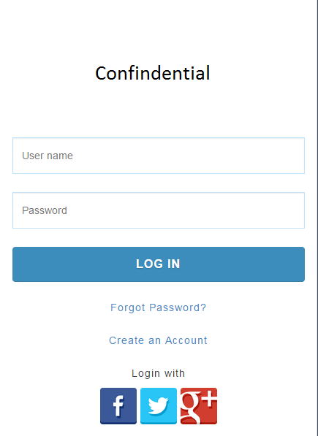
Screenshots
Login Screen

Slide 14
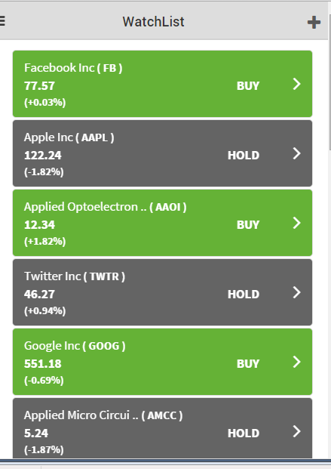
Watchlist

Slide 15
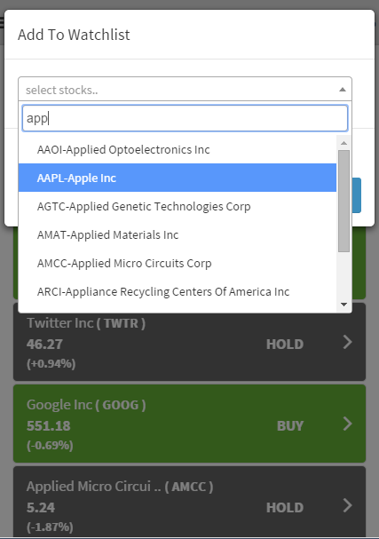
Add Stock to Watchlist

Slide 16
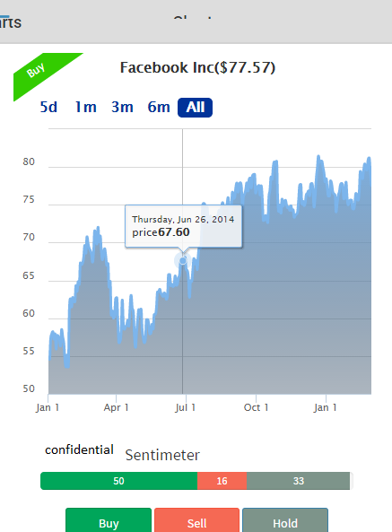
Line Chart

Slide 17
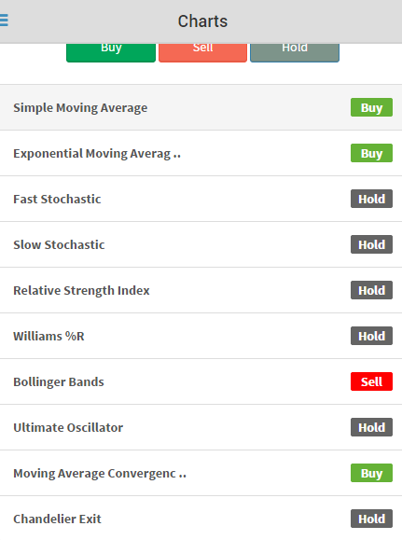
Indicators

Slide 18
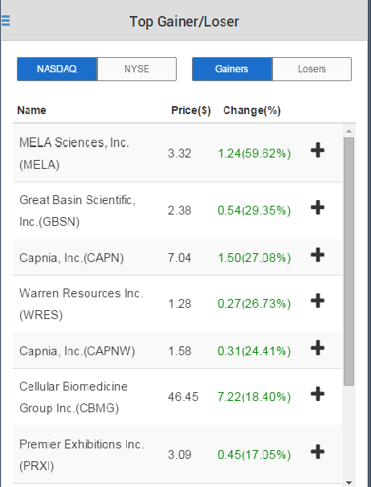
Top Gainer / Loser

Slide 19
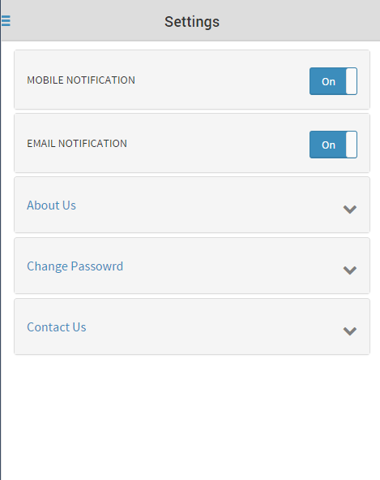
Settings

Slide 20
Thank You.

