Slide 1
Meeting 15.06.2026
Update with Nils and Parsa

Slide 2
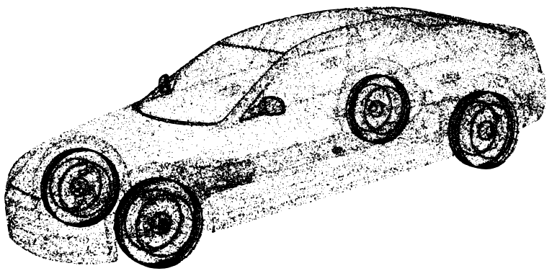
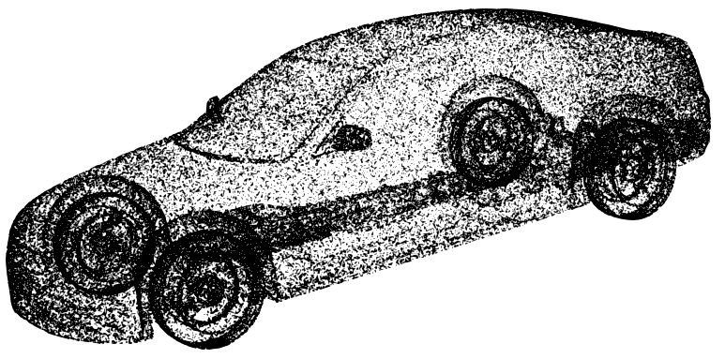
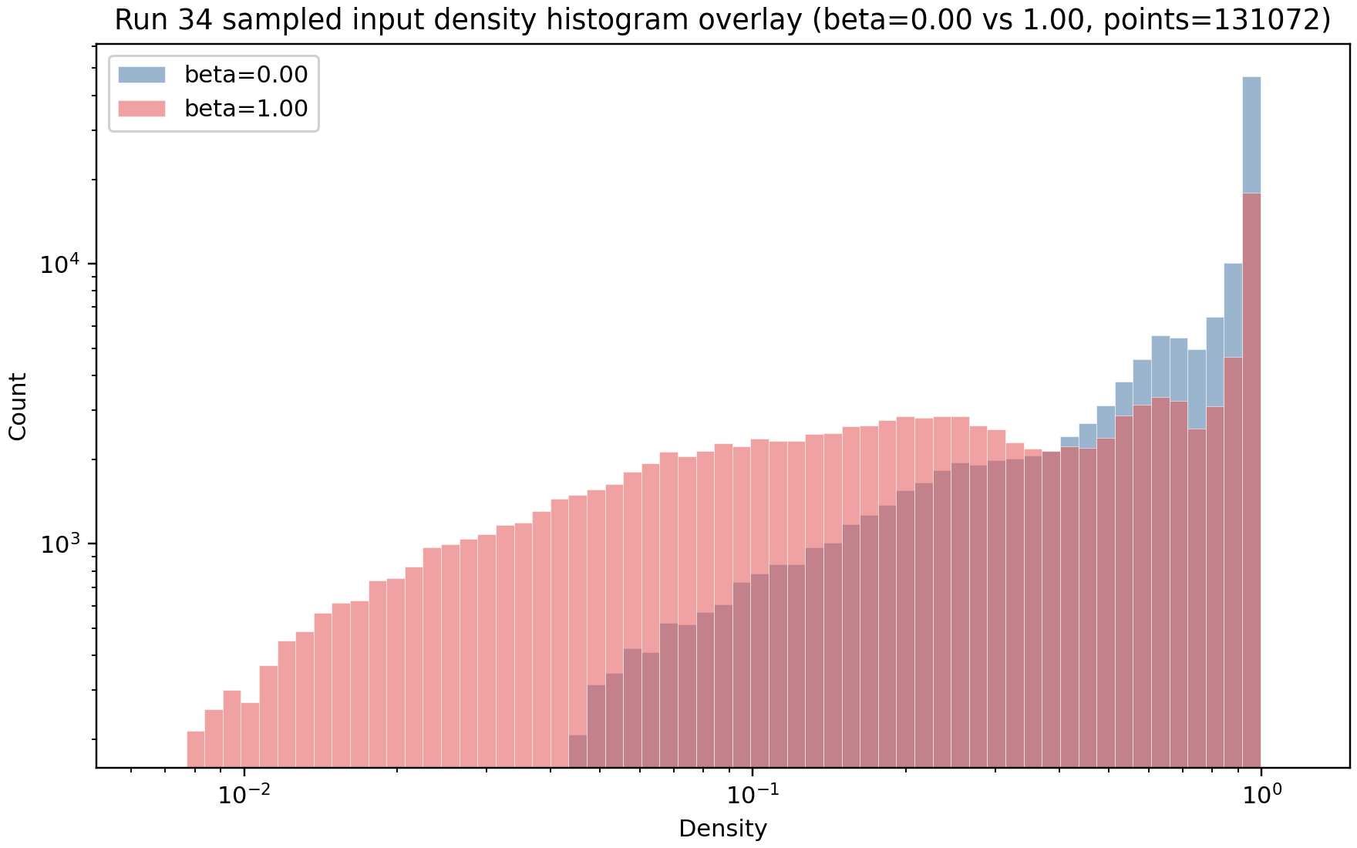

Slide 3
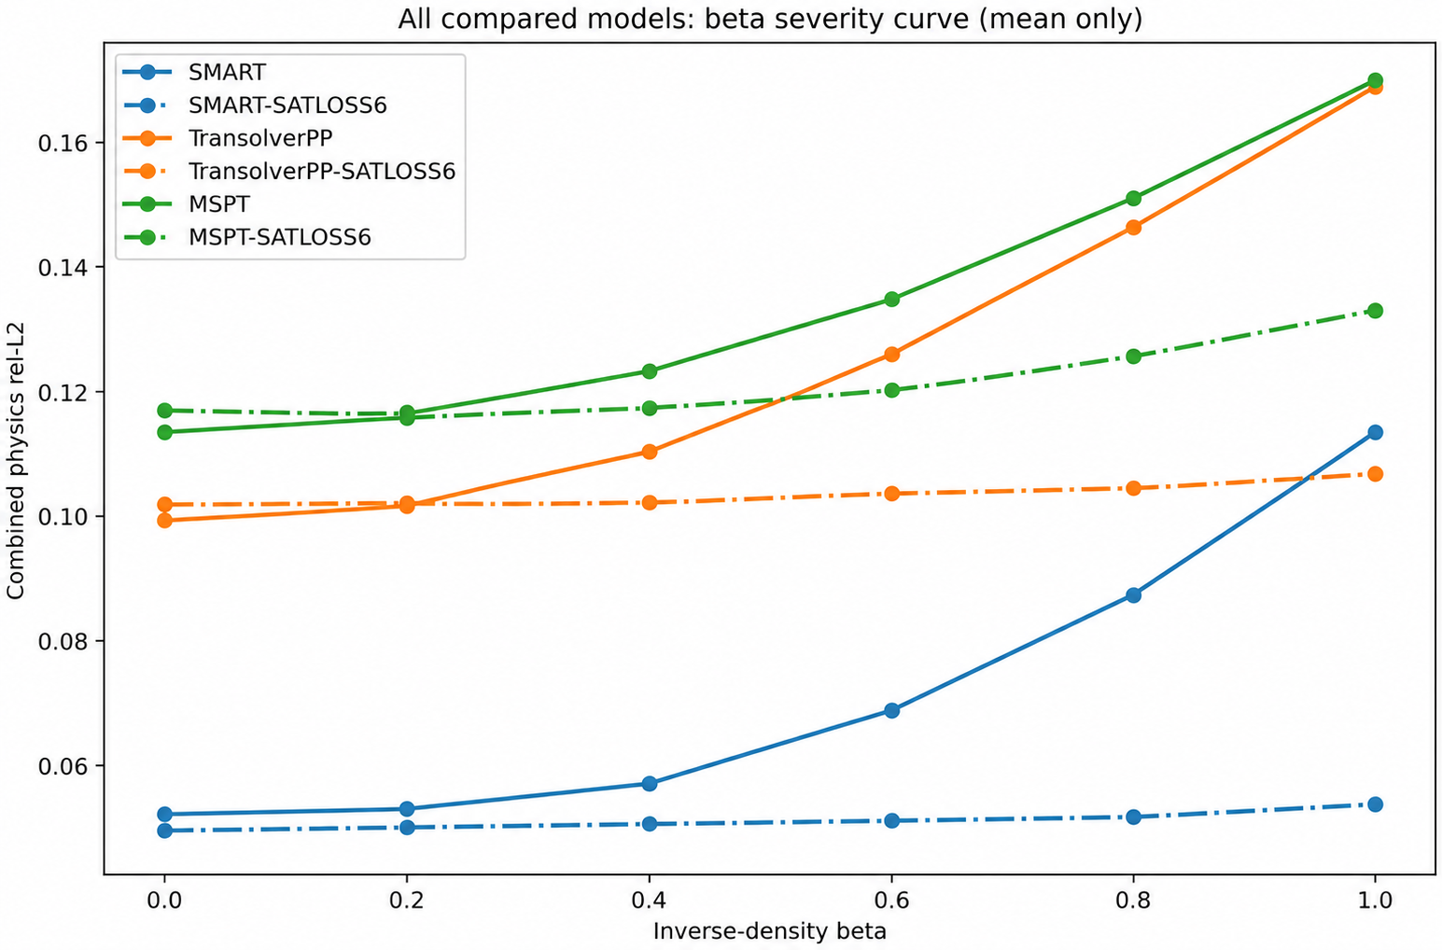
Trying different models – beta test

Slide 4
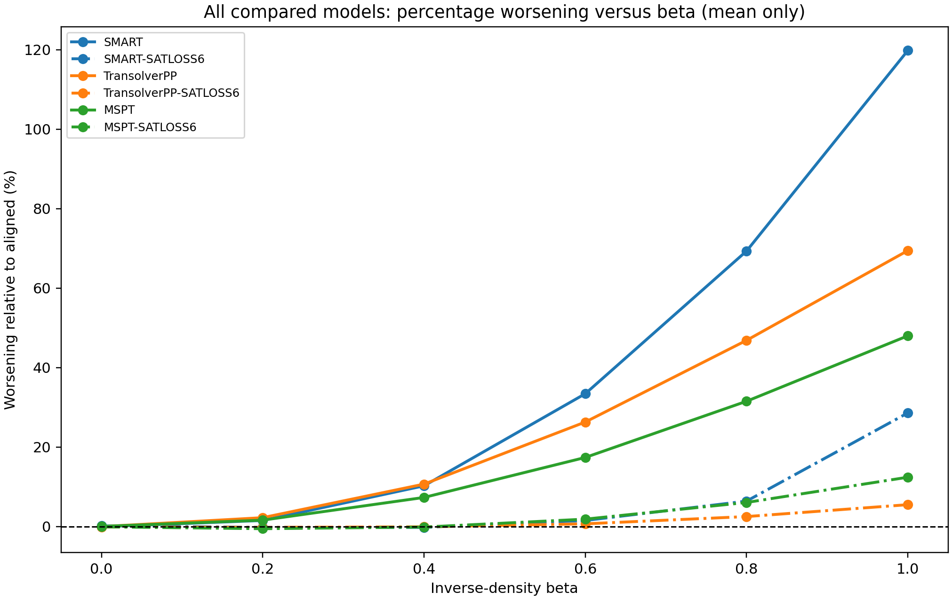
Trying different models – beta test (relative to beta 0)

Slide 5
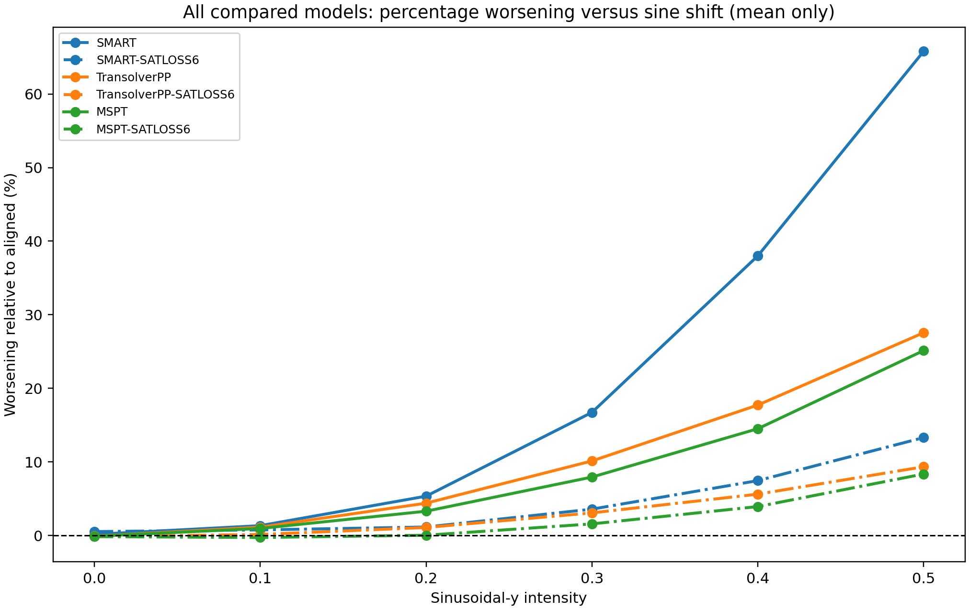
Trying different models – sine test (relative to sine 0)

Slide 6
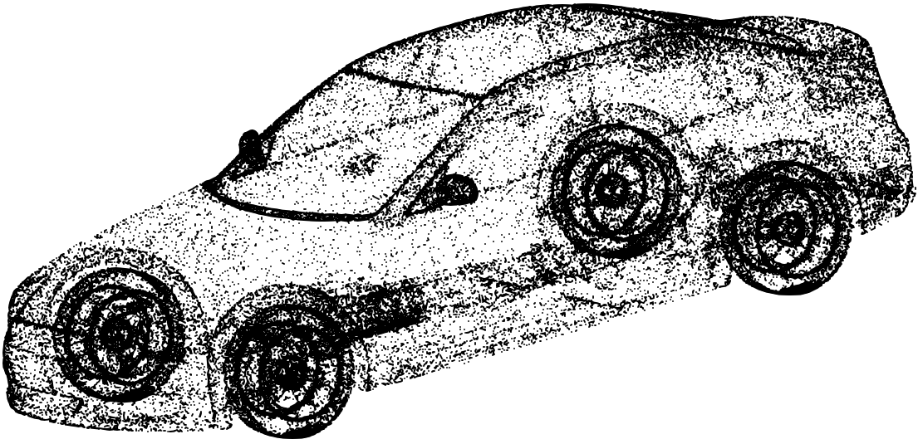
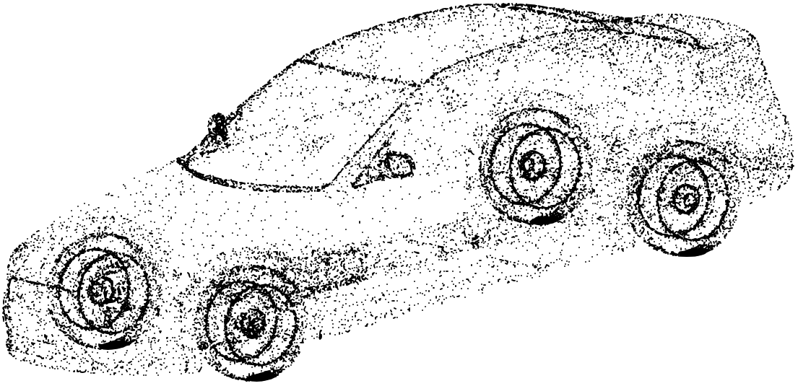
Previous methodology in the literature: Random mask
131k points - view 1
33k points - view 2
Prediction match loss

Slide 7
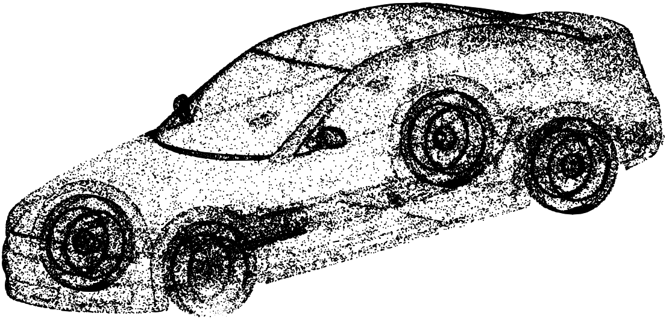
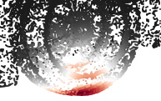
Previous methodology in the literature: Gaussian Ball Mask
131k points - view 1
127k points - view 2

Slide 8
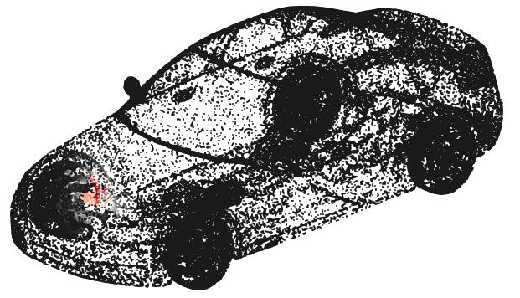
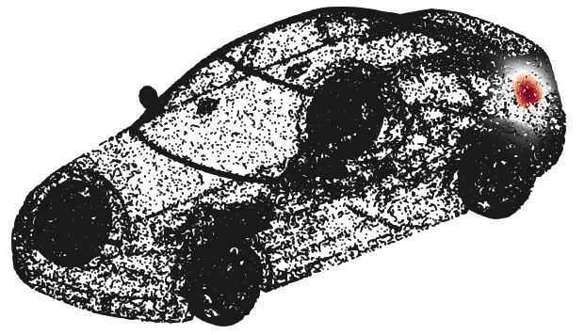
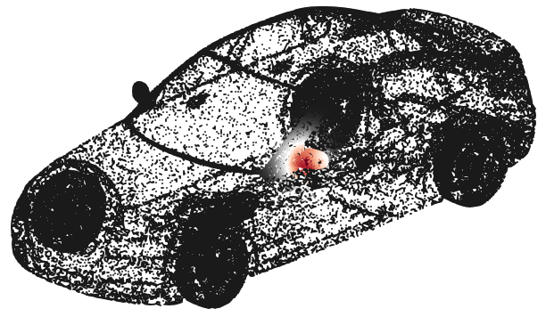
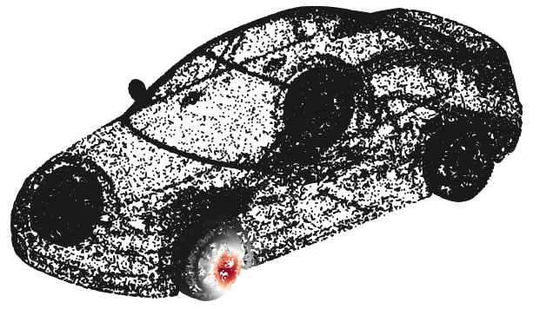
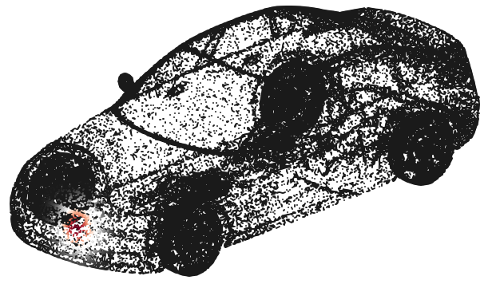
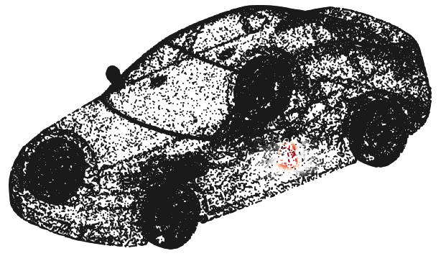
Point sampling Baselines – Gaussian Ball Mask

Slide 9
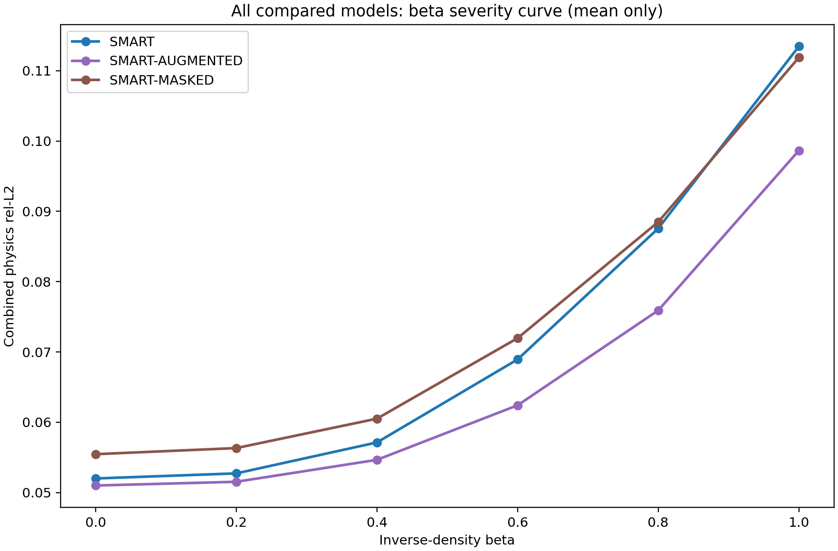
Result of baseline methods - beta
(Random mask)
(Gaussian ball mask)

Slide 10
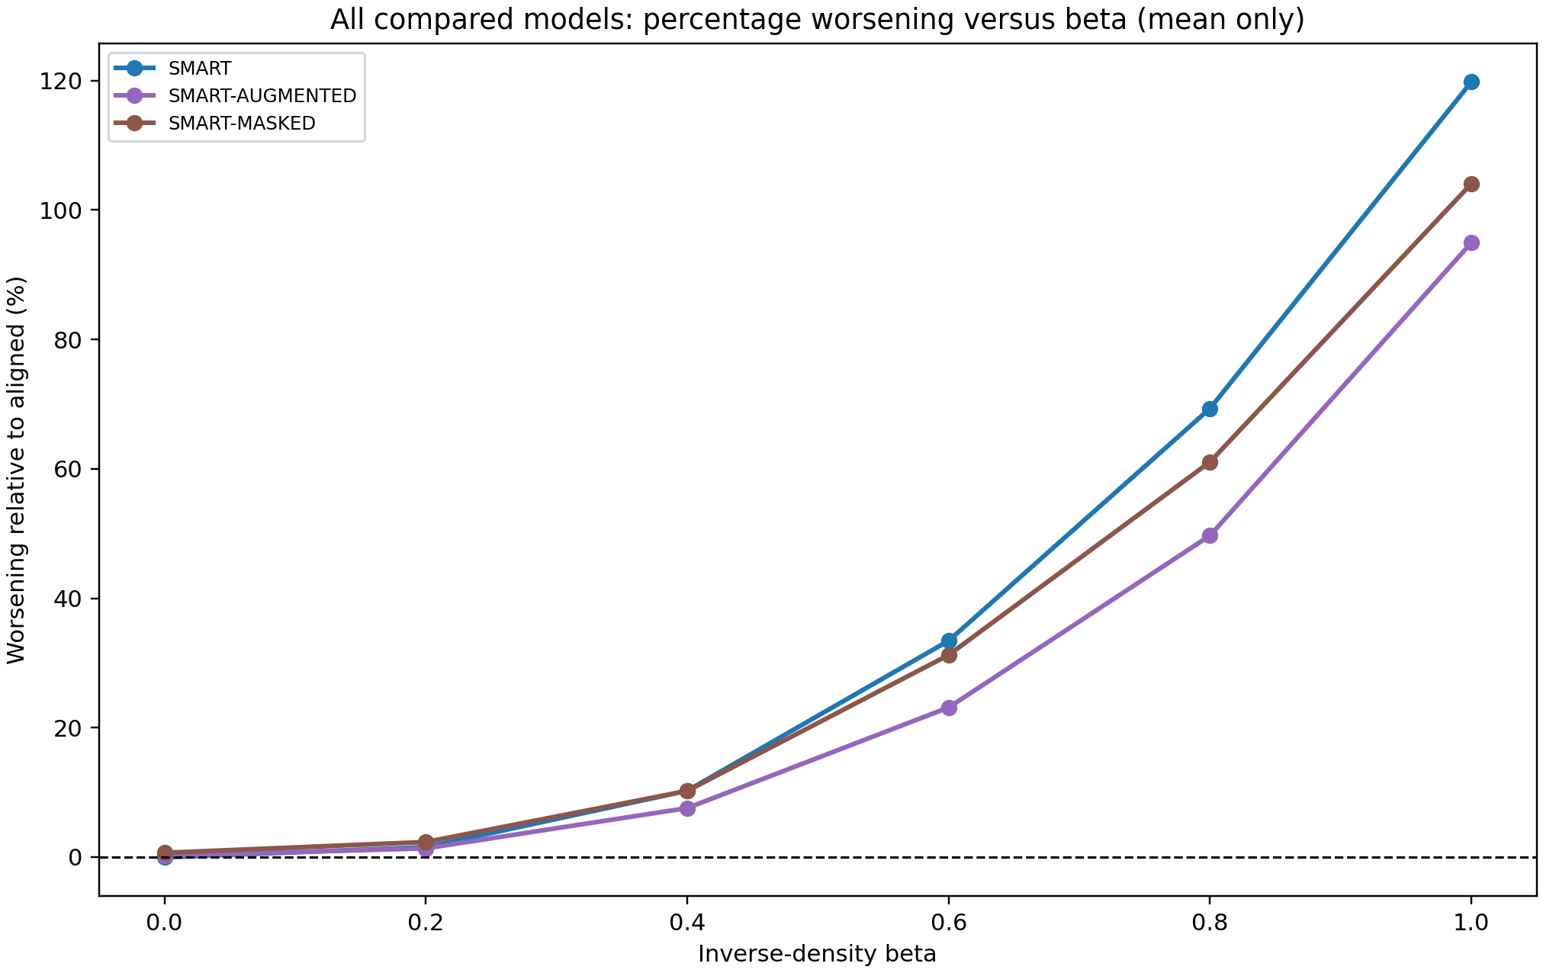
Result of baseline methods- beta (relative to beta 0)
(Random mask)
(Gaussian ball mask)

Slide 11
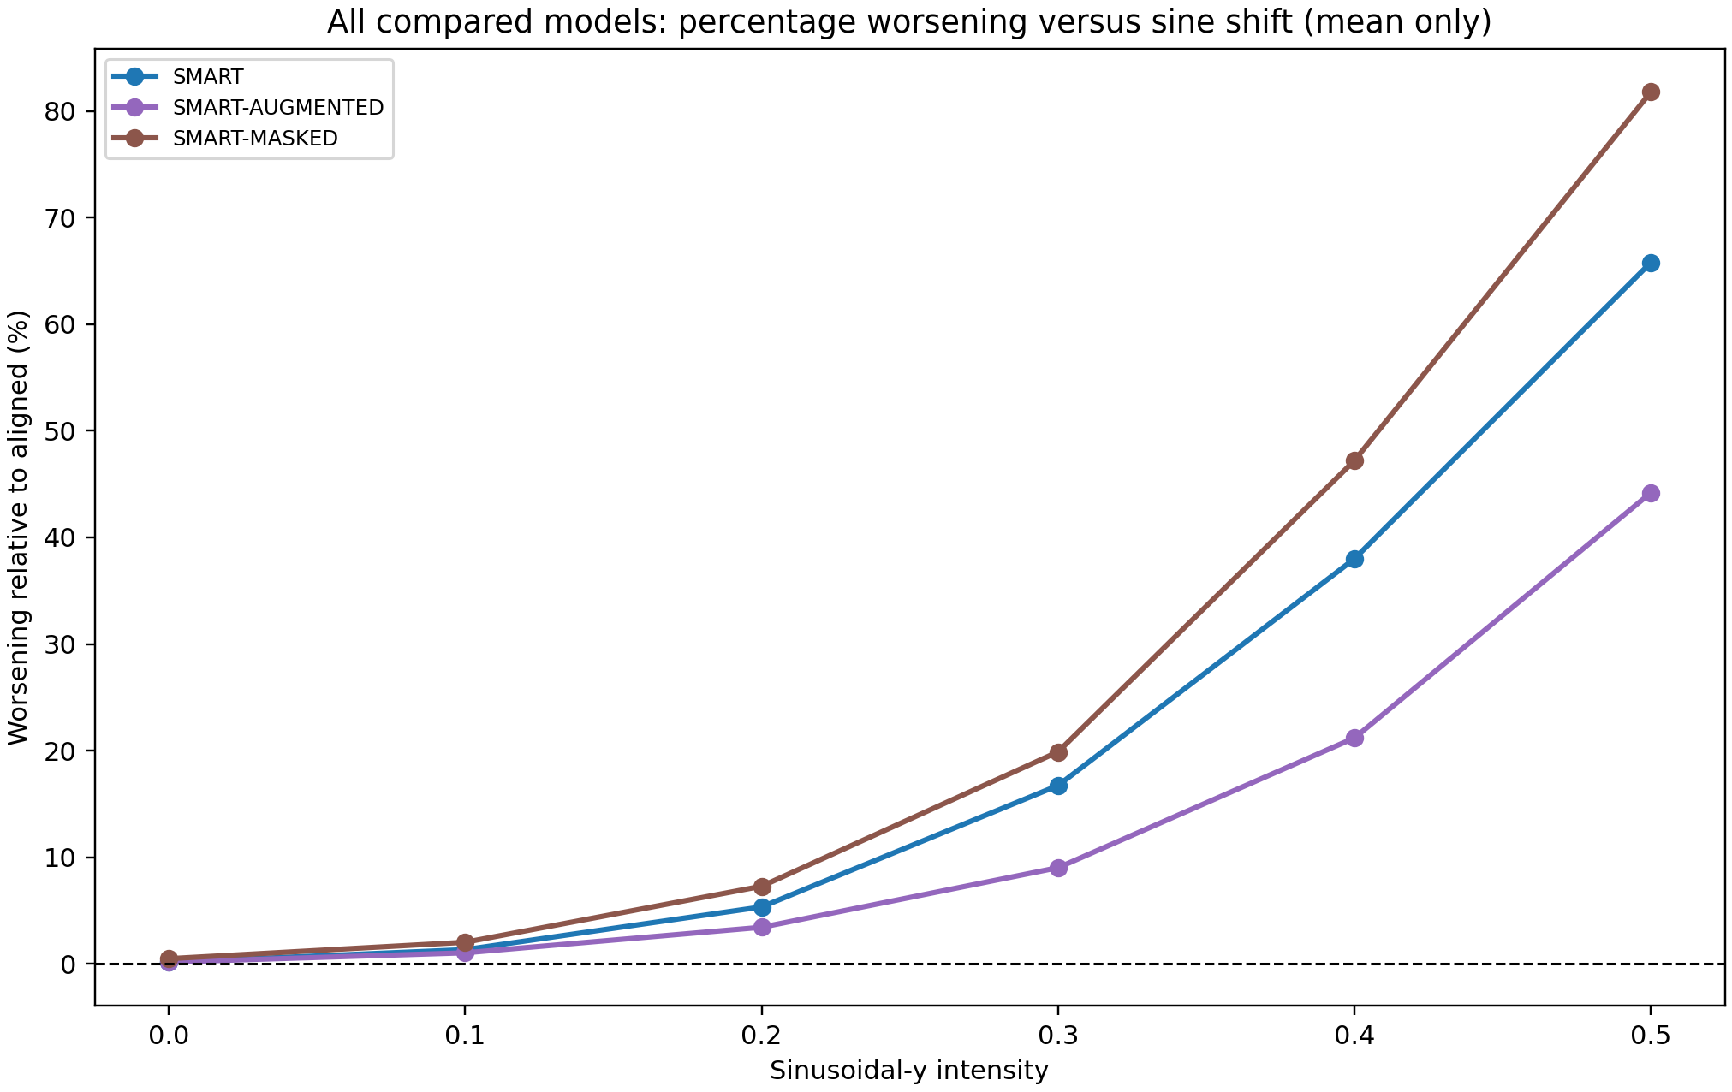
Result of baseline methods- beta (relative to beta 0)
(Random mask)
(Gaussian ball mask)

Slide 12
Backup

Slide 13
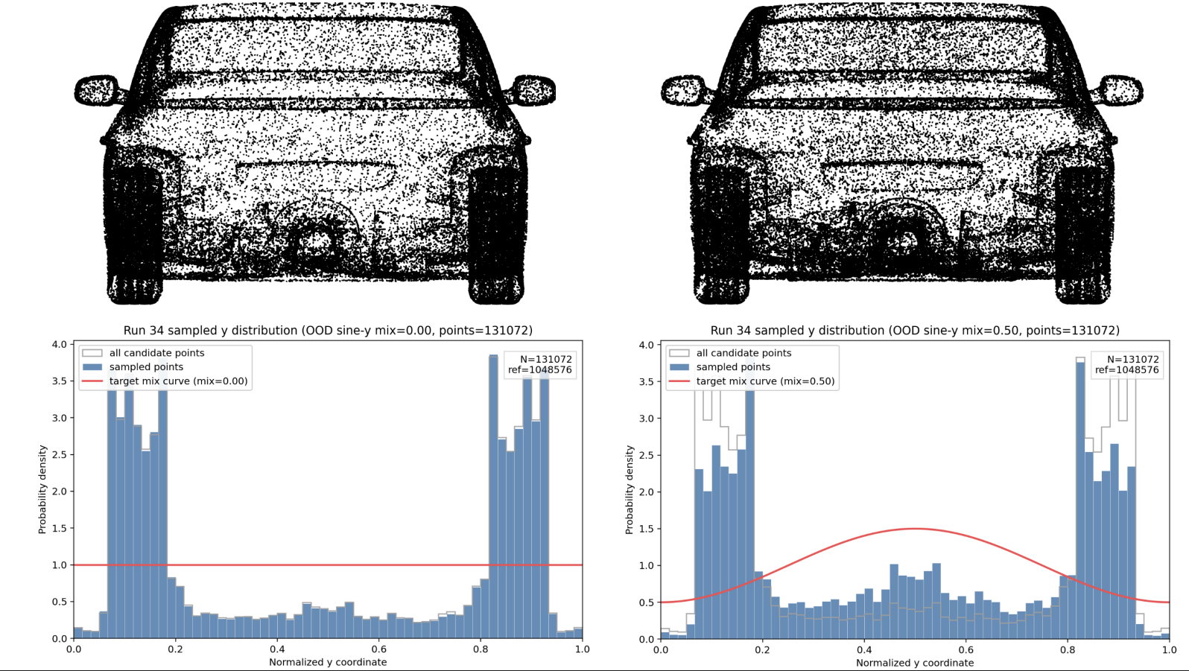

Slide 14
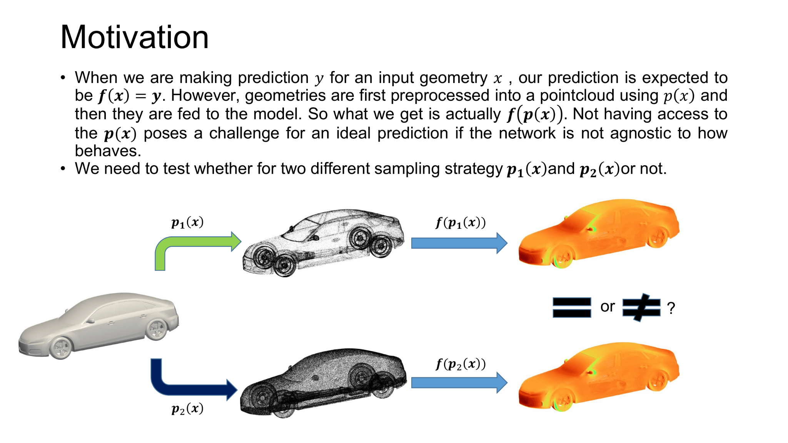

Slide 15
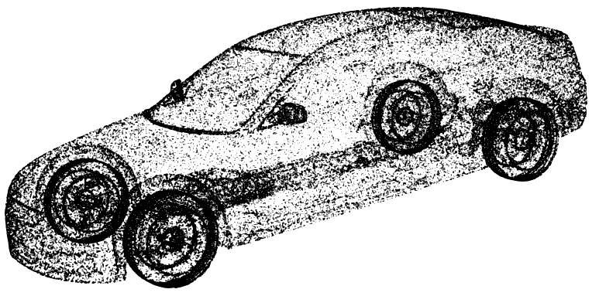



The density-based point sampling
random distribution β=0
Density correction intensity β=0.5
Density correction intensity β=1.0
The algorithm first estimates a log-density for each point based on its local k-nearest neighbors (typically k=24):
Once the log-densities are calculated for all points, the sampling weights and final probabilities are derived:

