Slide 1
Meeting 19.08.2026
Update with Nils

Slide 2
Mathematical Reason behind the sensitivity

Slide 3
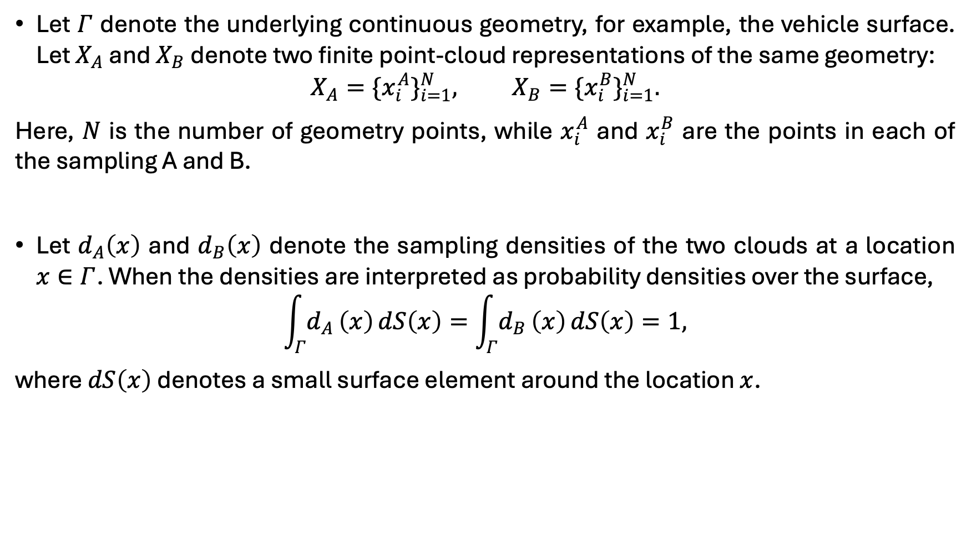
Defining the basics - Input
Let $Γ$ denote the underlying continuous geometry, for example, the vehicle surface. Let $X_{A}$ and $X_{B}$ denote two finite point-cloud representations of the same geometry:
$$X_{A}=\{x_{i}^{A}\}_{i=1}^{N}, X_{B}=\{x_{i}^{B}\}_{i=1}^{N}.$$
Here, $N$ is the number of geometry points, while $x_{i}^{A}$ and $x_{i}^{B}$ are the points in each of the sampling A and B.
Let $d_{A}\left(x\right)$ and $d_{B}\left(x\right)$ denote the sampling densities of the two clouds at a location $x∈Γ$. When the densities are interpreted as probability densities over the surface,
$$\int_{Γ}^{​}{d_{A}}\left(x\right) dS\left(x\right)=\int_{Γ}^{​}{d_{B}}\left(x\right) dS\left(x\right)=1,$$
where $dS\left(x\right)$ denotes a small surface element around the location $x$.

Slide 4
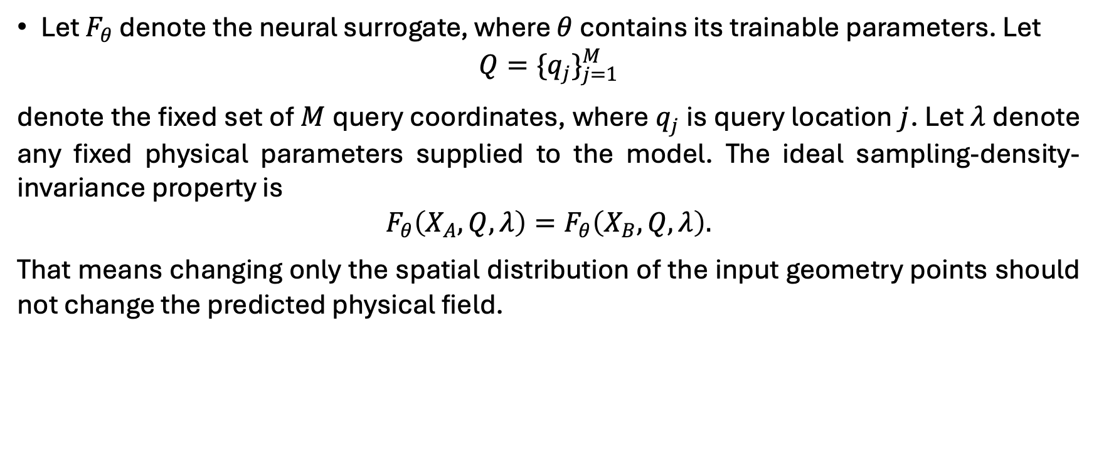
Defining the basics - output
Let $F_{θ}$ denote the neural surrogate, where $θ$ contains its trainable parameters. Let
$$Q=\{q_{j}\}_{j=1}^{M}$$
denote the fixed set of $M$ query coordinates, where $q_{j}$ is query location $j$. Let $λ$ denote any fixed physical parameters supplied to the model. The ideal sampling-density-invariance property is
$$F_{θ}\left(X_{A},Q,λ\right)=F_{θ}\left(X_{B},Q,λ\right).$$
That means changing only the spatial distribution of the input geometry points should not change the predicted physical field.

Slide 5
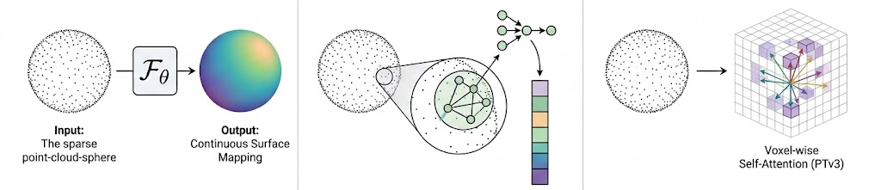

Hypothesis about density sensitivity
We do not claim that every learned model must be sampling sensitive. A constant predictor, for example $F_{θ}\left(X_{A},Q,λ\right)=Constant$ , would basically be invariant.
The relevant statement is narrower and is tested across the most common surrogate architecture categories:
Neural Operator-based: SMART, LNO, Transolver++
Local Aggregation-based: MSPT, PointNet++
Voxelization-based: PointTransformerV3
Neural Operator-based
Local Aggregation-based
Voxelization-based

Slide 6
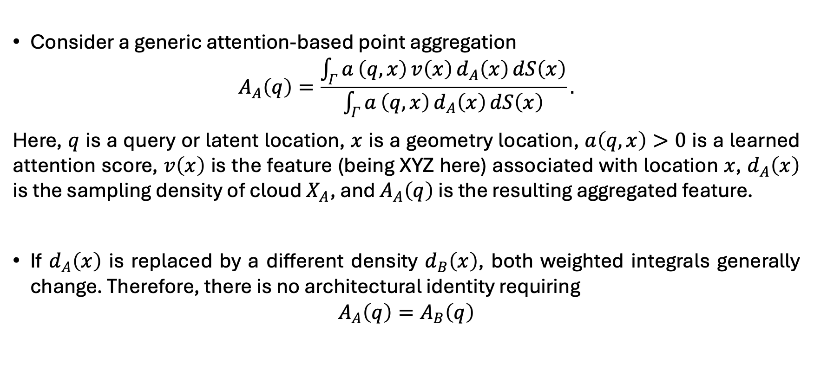
Hypothesis about density sensitivity – Neural Operator
Consider a generic attention-based point aggregation
$$A_{A}\left(q\right)=\frac{\int_{Γ}^{​}{a}\left(q,x\right) v\left(x\right) d_{A}\left(x\right) dS\left(x\right)}{\int_{Γ}^{​}{a}\left(q,x\right) d_{A}\left(x\right) dS\left(x\right)}.$$
Here, $q$ is a query or latent location, $x$ is a geometry location, $a\left(q,x\right)>0$ is a learned attention score, $v\left(x\right)$ is the feature (being XYZ here) associated with location $x$, $d_{A}\left(x\right)$ is the sampling density of cloud $X_{A}$, and $A_{A}\left(q\right)$ is the resulting aggregated feature.
If $d_{A}\left(x\right)$ is replaced by a different density $d_{B}\left(x\right)$, both weighted integrals generally change. Therefore, there is no architectural identity requiring
$$A_{A}\left(q\right)=A_{B}\left(q\right)$$

Slide 7
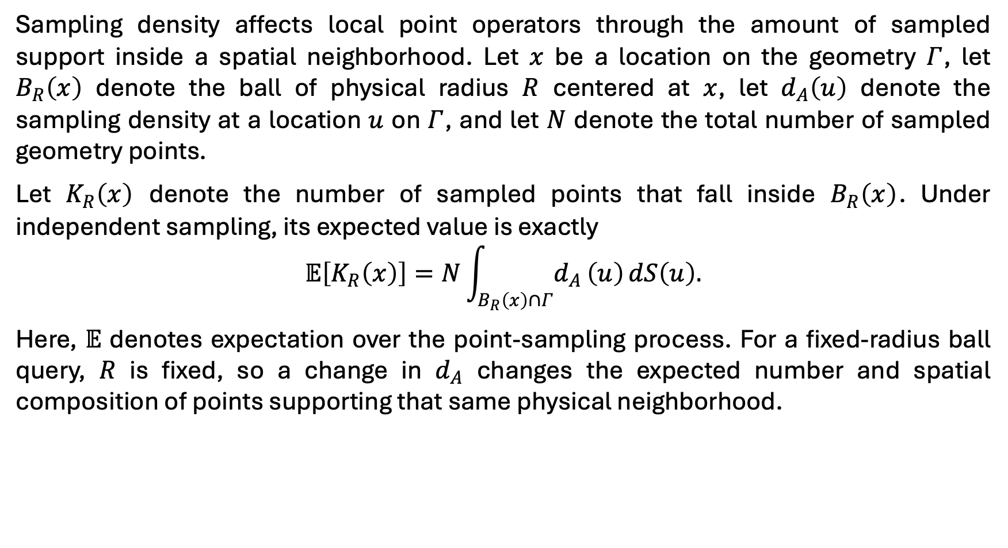
Hypothesis about density sensitivity – Local Aggregation with Ball
Sampling density affects local point operators through the amount of sampled support inside a spatial neighborhood. Let $x$ be a location on the geometry $Γ$, let $B_{R}\left(x\right)$ denote the ball of physical radius $R$ centered at $x$, let $d_{A}\left(u\right)$ denote the sampling density at a location $u$ on $Γ$, and let $N$ denote the total number of sampled geometry points.
Let $K_{R}\left(x\right)$ denote the number of sampled points that fall inside $B_{R}\left(x\right)$. Under independent sampling, its expected value is exactly
$$𝔼\left[K_{R}\left(x\right)\right]=N\int_{B_{R}\left(x\right)∩Γ}^{​}{d_{A}}\left(u\right) dS\left(u\right).$$
Here, $𝔼$ denotes expectation over the point-sampling process. For a fixed-radius ball query, $R$ is fixed, so a change in $d_{A}$ changes the expected number and spatial composition of points supporting that same physical neighborhood.

Slide 8
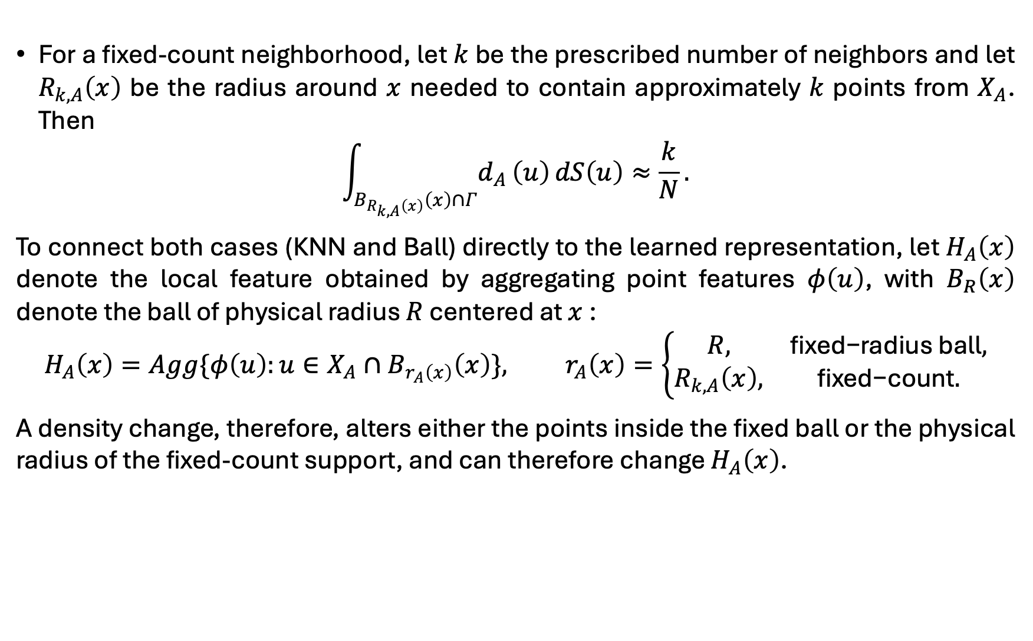
Hypothesis about density sensitivity – Local Aggregation with KNN
For a fixed-count neighborhood, let $k$ be the prescribed number of neighbors and let $R_{k,A}\left(x\right)$ be the radius around $x$ needed to contain approximately $k$ points from $X_{A}$. Then
$$\int_{B_{R_{k,A}\left(x\right)}\left(x\right)∩Γ}^{​}{d_{A}}\left(u\right) dS\left(u\right)≈\frac{k}{N}.$$
To connect both cases (KNN and Ball) directly to the learned representation, let $H_{A}\left(x\right)$ denote the local feature obtained by aggregating point features $φ\left(u\right)$, with $B_{R}\left(x\right)$ denote the ball of physical radius $R$ centered at $x$:
$$H_{A}\left(x\right)=Agg\{φ\left(u\right):u∈X_{A}∩B_{r_{A}\left(x\right)}\left(x\right)\}, r_{A}\left(x\right)=\left\{\begin{matrix}R, & \text{fixed−radius ball}, \\ R_{k,A}\left(x\right), & \text{fixed−count}.\end{matrix}\right.$$
A density change, therefore, alters either the points inside the fixed ball or the physical radius of the fixed-count support, and can therefore change $H_{A}\left(x\right)$.

Slide 9
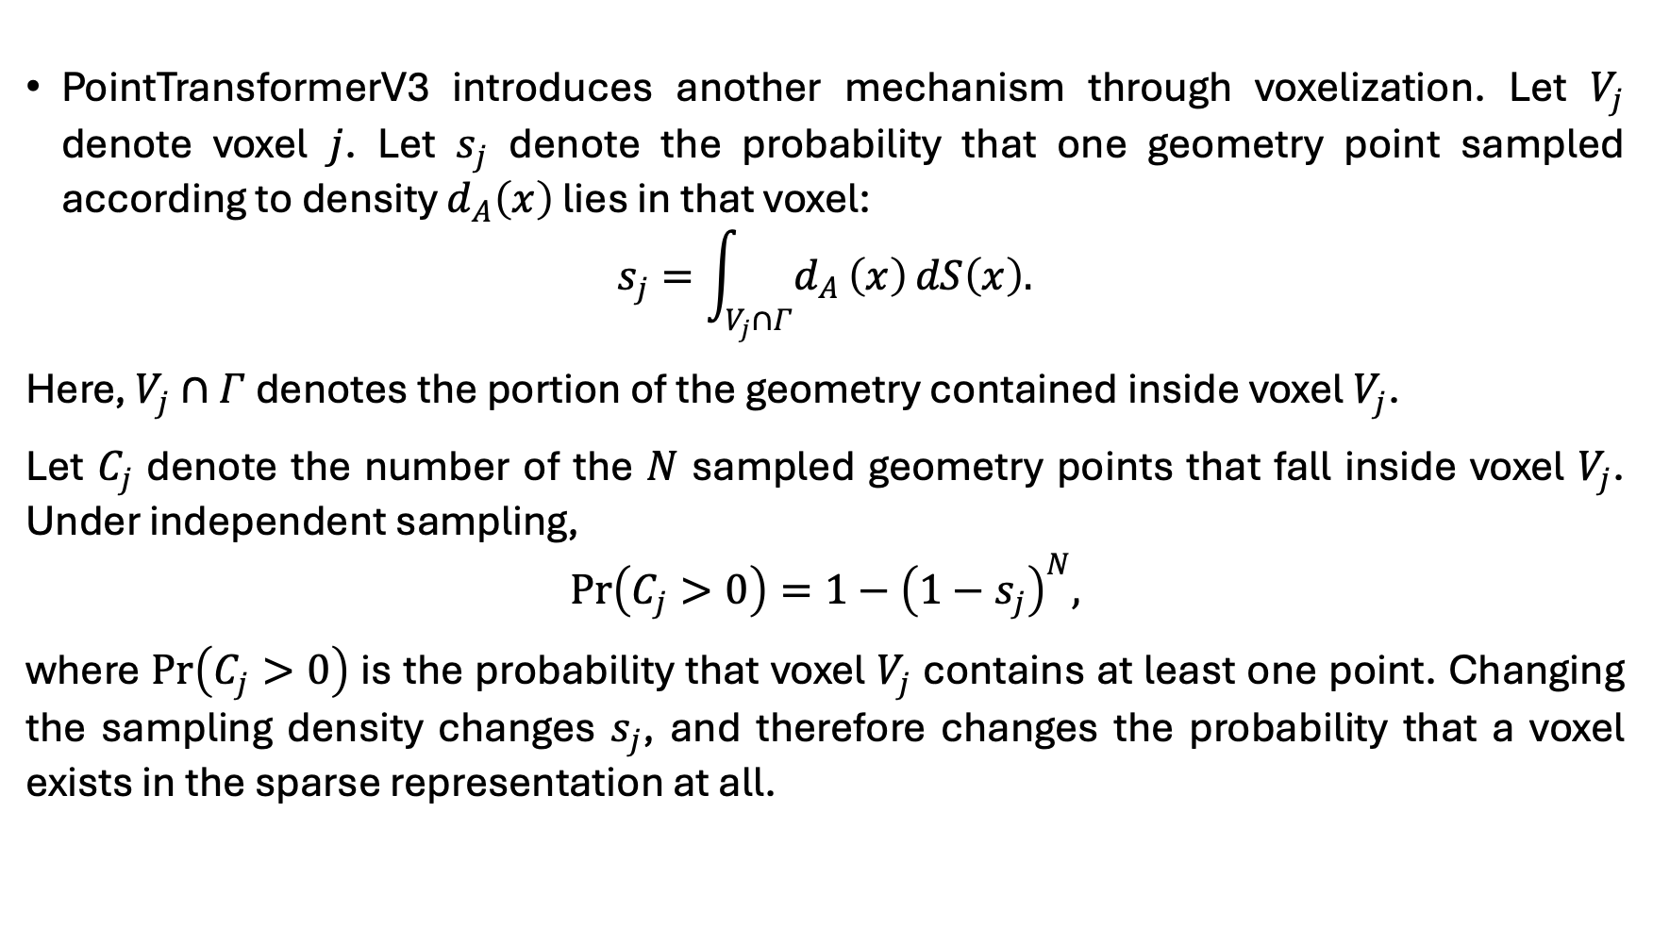
Hypothesis about density sensitivity – Voxelization
PointTransformerV3 introduces another mechanism through voxelization. Let $V_{j}$ denote voxel $j$. Let $s_{j}$ denote the probability that one geometry point sampled according to density $d_{A}\left(x\right)$ lies in that voxel:
$$s_{j}=\int_{V_{j}∩Γ}^{​}{d_{A}}\left(x\right) dS\left(x\right).$$
Here, $V_{j}∩Γ$ denotes the portion of the geometry contained inside voxel $V_{j}$.
Let $C_{j}$ denote the number of the $N$ sampled geometry points that fall inside voxel $V_{j}$. Under independent sampling,
$$Pr\left(C_{j}>0\right)=1−{\left(1−s_{j}\right)}^{N},$$
where $Pr\left(C_{j}>0\right)$ is the probability that voxel $V_{j}$ contains at least one point. Changing the sampling density changes $s_{j}$, and therefore changes the probability that a voxel exists in the sparse representation at all.

Slide 10
Proposed solution

Slide 11
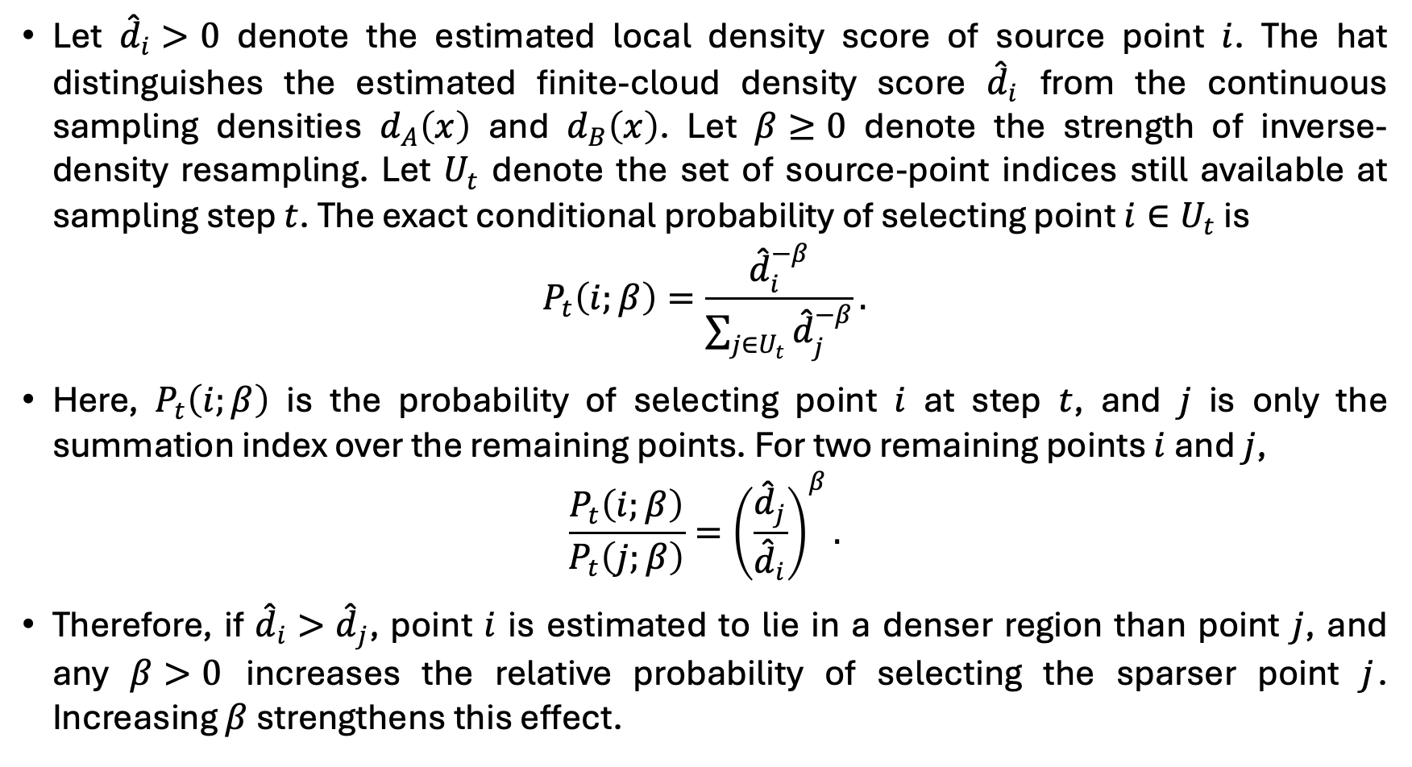
Proposed solution
Let ${\hat{d}}_{i}>0$ denote the estimated local density score of source point $i$. The hat distinguishes the estimated finite-cloud density score ${\hat{d}}_{i}$ from the continuous sampling densities $d_{A}\left(x\right)$ and $d_{B}\left(x\right)$. Let $β≥0$ denote the strength of inverse-density resampling. Let $U_{t}$ denote the set of source-point indices still available at sampling step $t$. The exact conditional probability of selecting point $i∈U_{t}$ is
$$P_{t}\left(i;β\right)=\frac{{\hat{d}}_{i}^{−β}}{\sum_{j∈U_{t}}^{​}{{\hat{d}}_{j}^{−β}}}.$$
Here, $P_{t}\left(i;β\right)$ is the probability of selecting point $i$ at step $t$, and $j$ is only the summation index over the remaining points. For two remaining points $i$ and $j$,
$$\frac{P_{t}\left(i;β\right)}{P_{t}\left(j;β\right)}={\left(\frac{{\hat{d}}_{j}}{{\hat{d}}_{i}}\right)}^{β}.$$
Therefore, if ${\hat{d}}_{i}>{\hat{d}}_{j}$, point $i$ is estimated to lie in a denser region than point $j$, and any $β>0$ increases the relative probability of selecting the sparser point $j$. Increasing $β$ strengthens this effect.

Slide 12
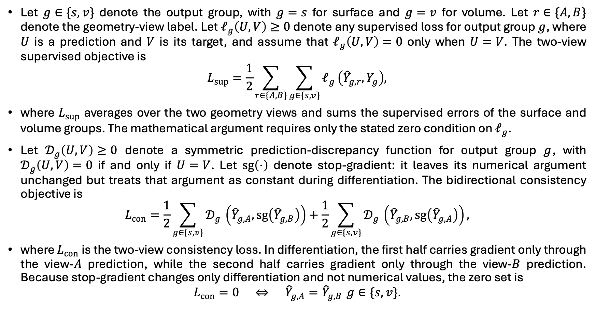
Proposed solution
Let $g∈\{s,v\}$ denote the output group, with $g=s$ for surface and $g=v$ for volume. Let $r∈\{A,B\}$ denote the geometry-view label. Let $𝓁_{g}\left(U,V\right)≥0$ denote any supervised loss for output group $g$, where $U$ is a prediction and $V$ is its target, and assume that $𝓁_{g}\left(U,V\right)=0$ only when $U=V$. The two-view supervised objective is
$$L_{sup}=\frac{1}{2}\sum_{r∈\{A,B\}}^{​}{\sum_{g∈\{s,v\}}^{​}{𝓁_{g}}}\left({\hat{Y}}_{g,r},Y_{g}\right),$$
where $L_{sup}$ averages over the two geometry views and sums the supervised errors of the surface and volume groups. The mathematical argument requires only the stated zero condition on $𝓁_{g}$.
Let $𝒟_{g}\left(U,V\right)≥0$ denote a symmetric prediction-discrepancy function for output group $g$, with $𝒟_{g}\left(U,V\right)=0$ if and only if $U=V$. Let $sg\left(⋅\right)$ denote stop-gradient: it leaves its numerical argument unchanged but treats that argument as constant during differentiation. The bidirectional consistency objective is
$$L_{con}=\frac{1}{2}\sum_{g∈\{s,v\}}^{​}{𝒟_{g}}​\left({\hat{Y}}_{g,A},sg\left({\hat{Y}}_{g,B}\right)\right)+\frac{1}{2}\sum_{g∈\{s,v\}}^{​}{𝒟_{g}}​\left({\hat{Y}}_{g,B},sg\left({\hat{Y}}_{g,A}\right)\right),$$
where $L_{con}$ is the two-view consistency loss. In differentiation, the first half carries gradient only through the view-$A$ prediction, while the second half carries gradient only through the view-$B$ prediction. Because stop-gradient changes only differentiation and not numerical values, the zero set is
$$L_{con}=0 ⇔ {\hat{Y}}_{g,A}={\hat{Y}}_{g,B} g∈\{s,v\}.$$

Slide 13
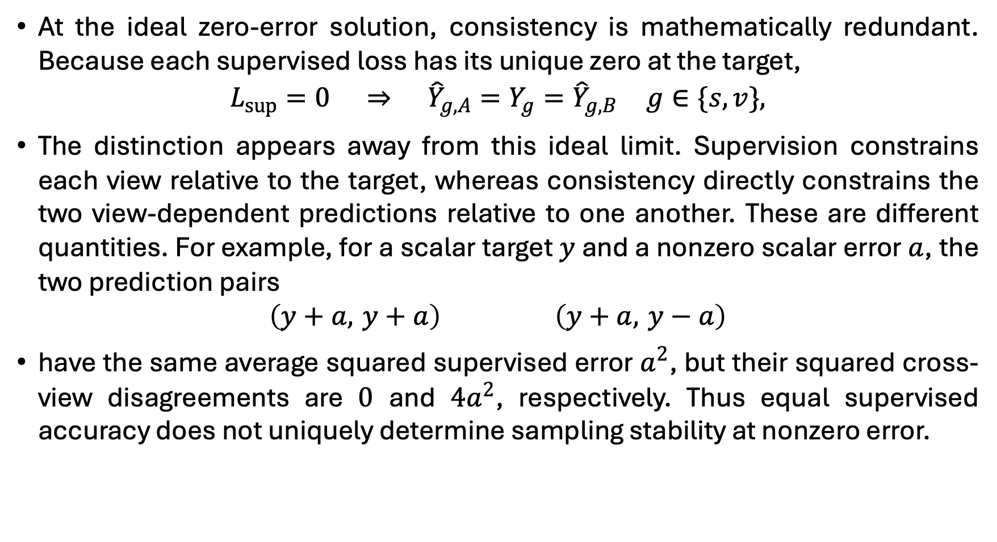
If both views are supervised, why is consistency needed?
At the ideal zero-error solution, consistency is mathematically redundant. Because each supervised loss has its unique zero at the target,
$$L_{sup}=0 ⇒ {\hat{Y}}_{g,A}=Y_{g}={\hat{Y}}_{g,B} g∈\{s,v\},$$
The distinction appears away from this ideal limit. Supervision constrains each view relative to the target, whereas consistency directly constrains the two view-dependent predictions relative to one another. These are different quantities. For example, for a scalar target $y$ and a nonzero scalar error $a$, the two prediction pairs
$$\left(y+a, y+a\right) \left(y+a, y−a\right)$$
have the same average squared supervised error $a^{2}$, but their squared cross-view disagreements are $0$ and $4a^{2}$, respectively. Thus equal supervised accuracy does not uniquely determine sampling stability at nonzero error.

Slide 14
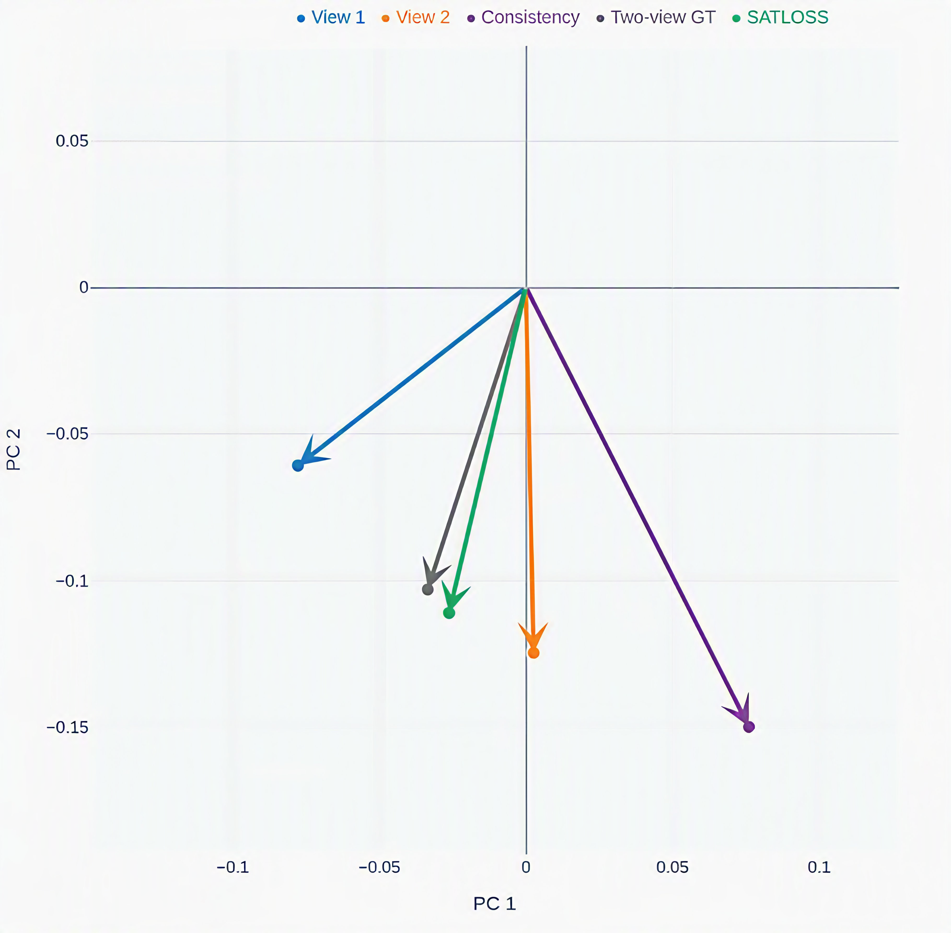
Example of the gradient provided by each of the losses during training Worth noting that this is PCA, and the size of each of the vectors doesn’t represent the actual size of the gradient. It‘s clear that the consistency loss (purple) is not aligned with views 1 (blue) and view 2 (orange). It also shifts the average of their gradients toward itself Green is the gradient with consistency loss, and black is without consistency loss.

Slide 15
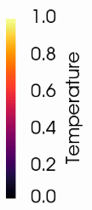
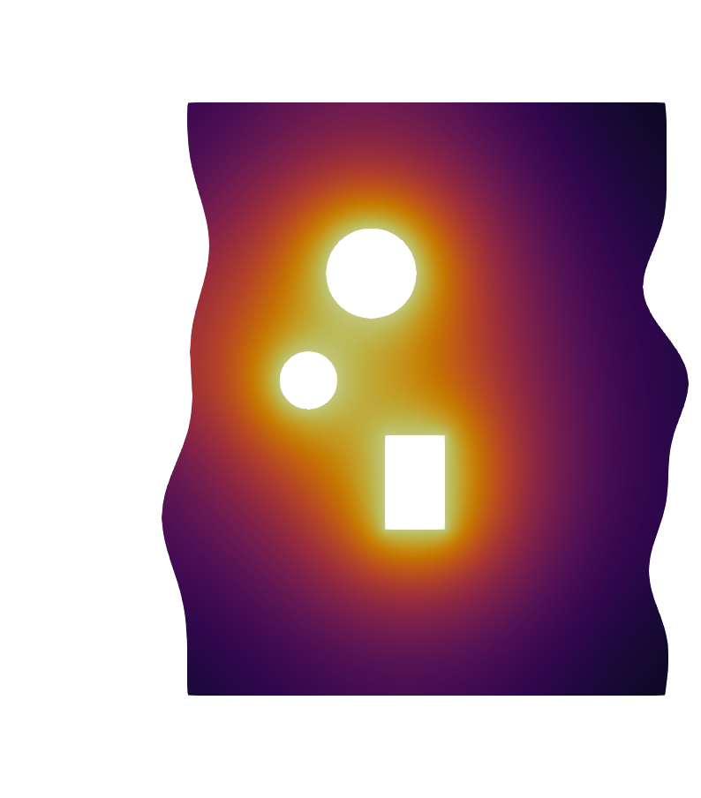
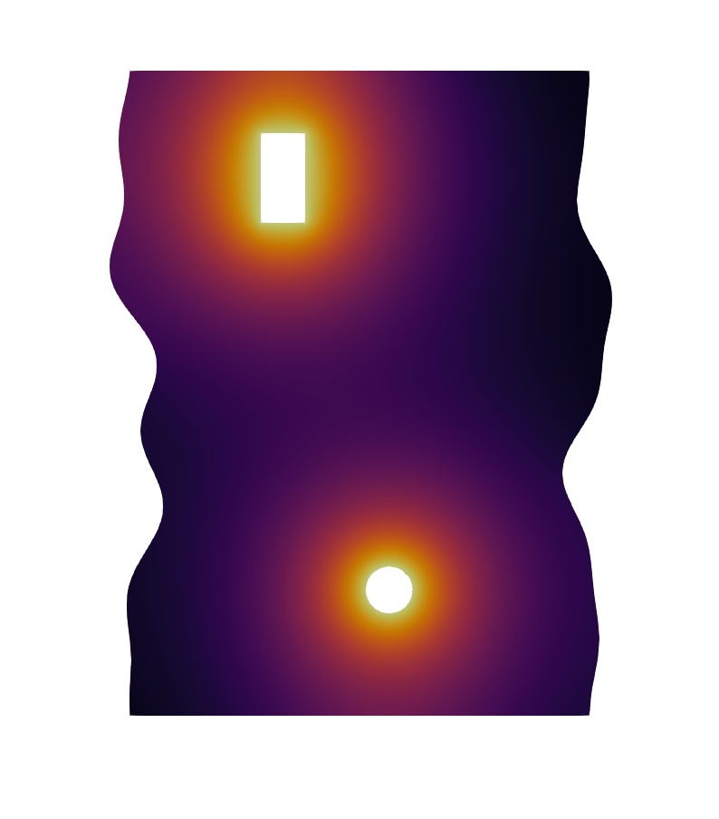
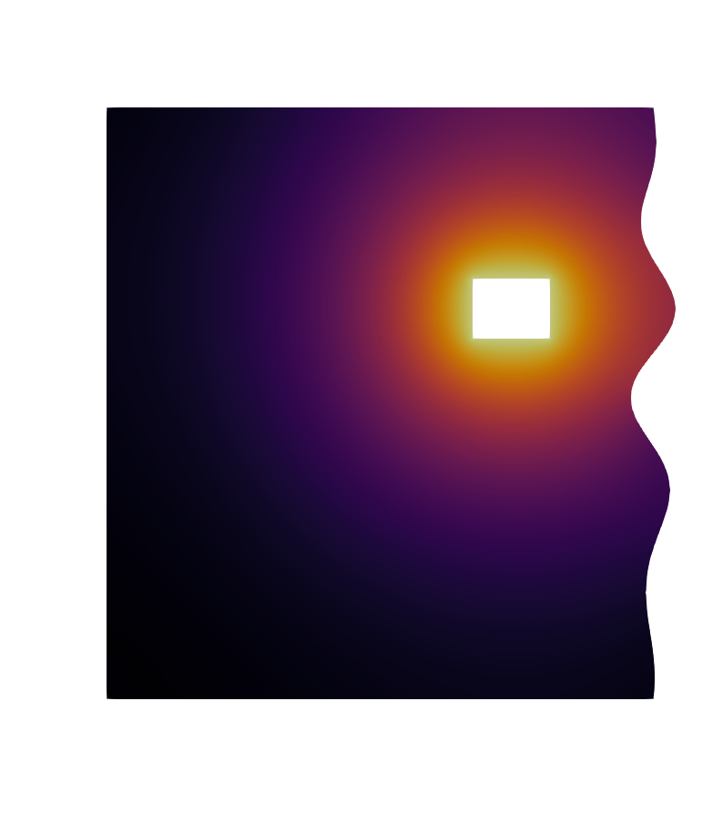
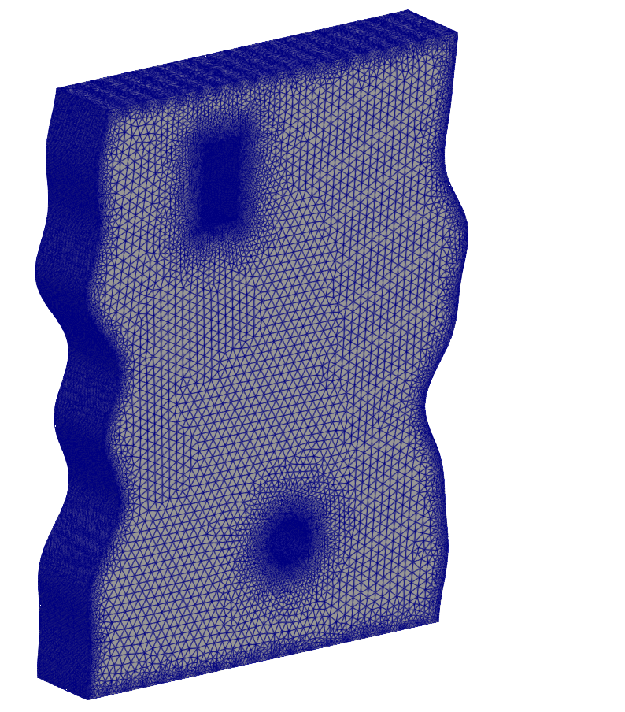
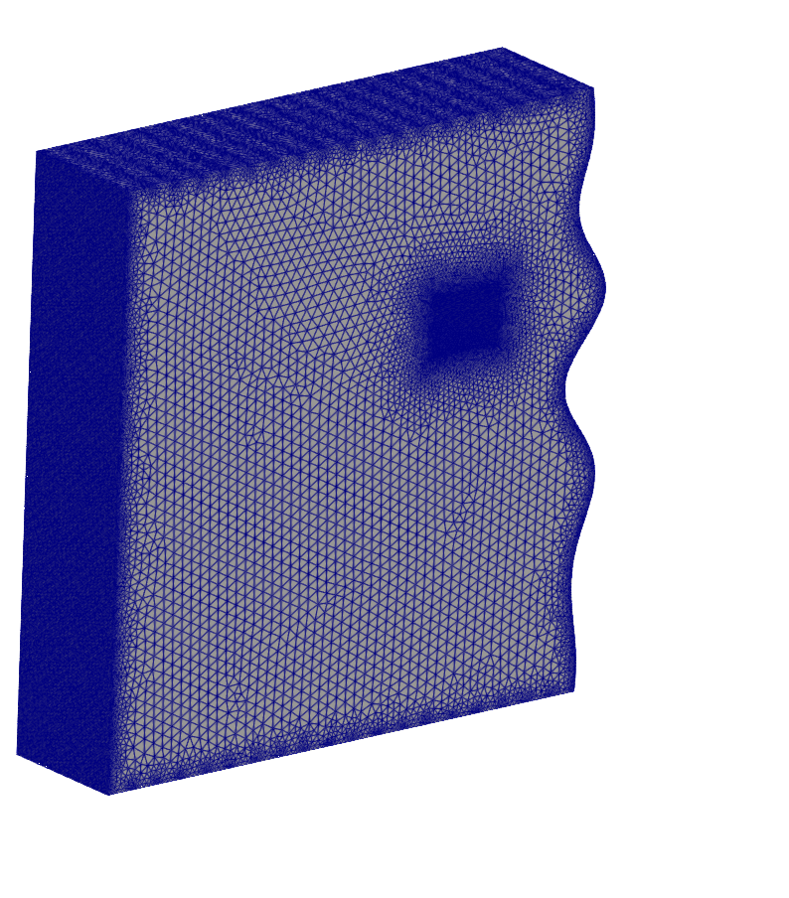
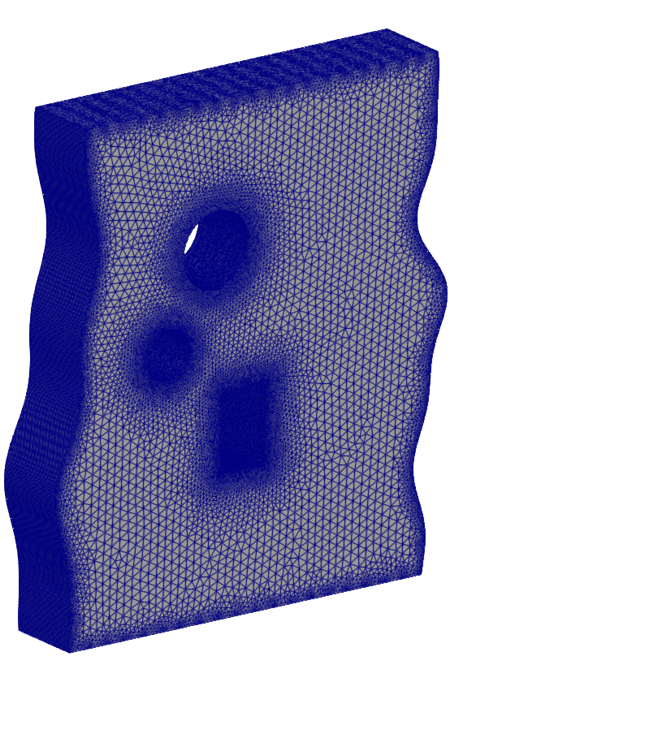
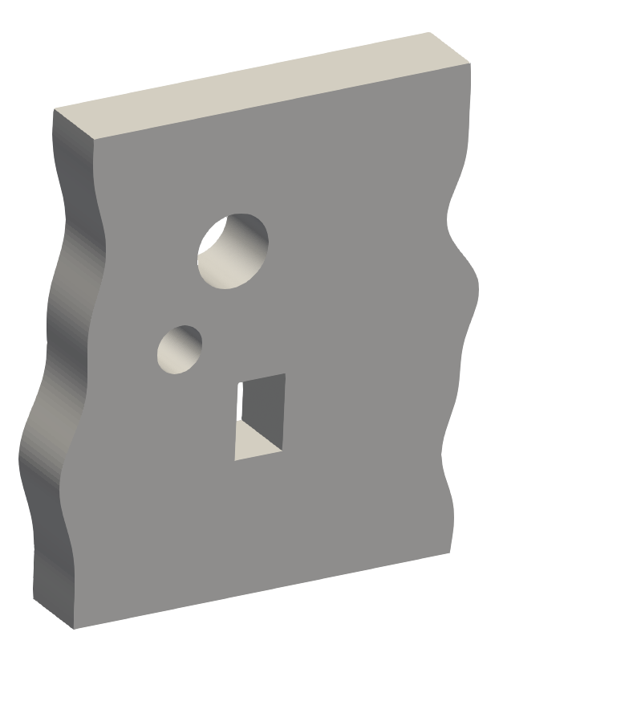
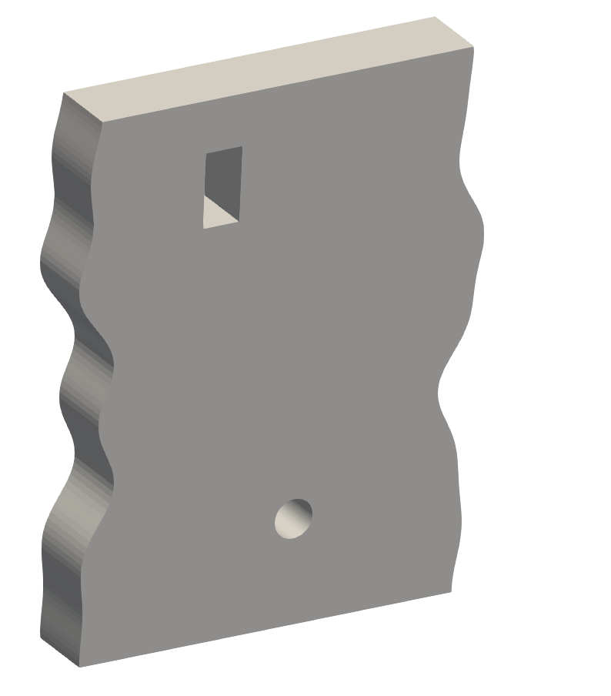
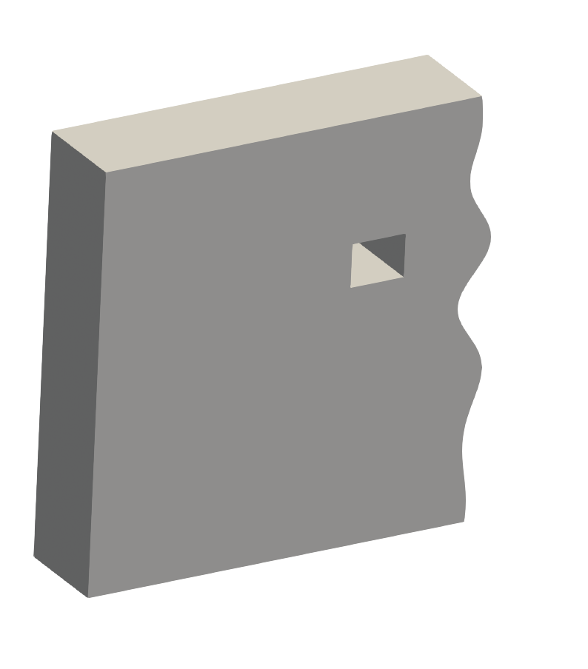
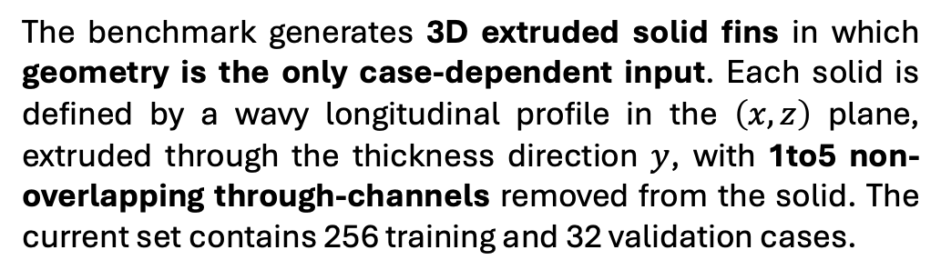
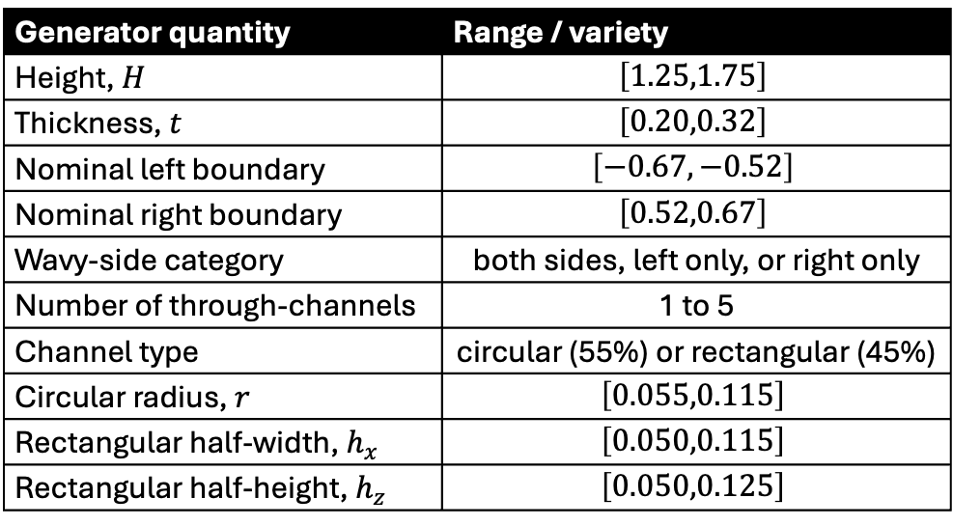
Toy Case – Heat Exchanger Plate
Temperature
The benchmark generates 3D extruded solid fins in which geometry is the only case-dependent input. Each solid is defined by a wavy longitudinal profile in the $\left(x,z\right)$ plane, extruded through the thickness direction $y$, with 1to5 non-overlapping through-channels removed from the solid. The current set contains 256 training and 32 validation cases.
Geometry and mesh
Generator quantity | Range / variety
Height, $H$ | $$\left[1.25,1.75\right]$$
Thickness, $t$ | $$\left[0.20,0.32\right]$$
Nominal left boundary | $$\left[−0.67,−0.52\right]$$
Nominal right boundary | $$\left[0.52,0.67\right]$$
Wavy-side category | both sides, left only, or right only
Number of through-channels | 1 to 5
Channel type | circular (55%) or rectangular (45%)
Circular radius, $r$ | $$\left[0.055,0.115\right]$$
Rectangular half-width, $h_{x}$ | $$\left[0.050,0.115\right]$$
Rectangular half-height, $h_{z}$ | $$\left[0.050,0.125\right]$$

Slide 16
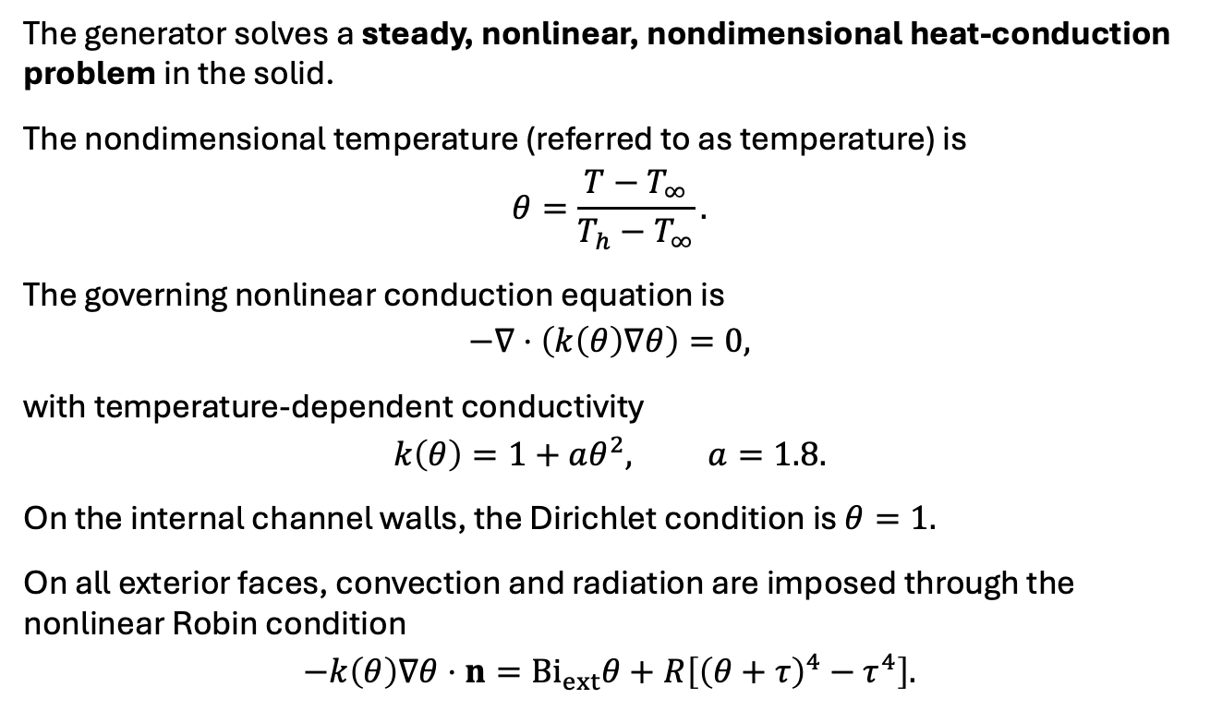
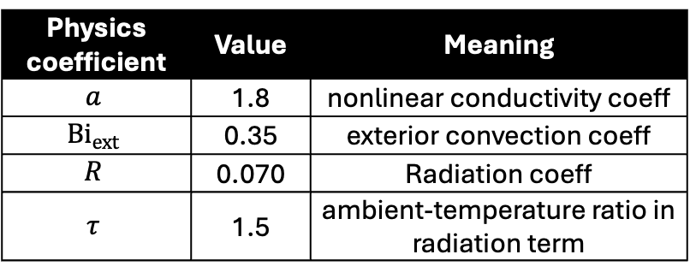
Toy Case – Heat Exchanger Plate
The generator solves a steady, nonlinear, nondimensional heat-conduction problem in the solid.
The nondimensional temperature (referred to as temperature) is
$$θ=\frac{T−T_{∞}}{T_{h}−T_{∞}}.$$
The governing nonlinear conduction equation is
$$−∇⋅\left(k\left(θ\right)∇θ\right)=0,$$
with temperature-dependent conductivity
$$k\left(θ\right)=1+aθ^{2}, a=1.8.$$
On the internal channel walls, the Dirichlet condition is $θ=1.$
On all exterior faces, convection and radiation are imposed through the nonlinear Robin condition
$$−k\left(θ\right)∇θ⋅n={Bi}_{ext}θ+R\left[{\left(θ+τ\right)}^{4}−τ^{4}\right].$$
Physics coefficient | Value | Meaning
$$a$$ | 1.8 | nonlinear conductivity coeff
$${Bi}_{ext}$$ | 0.35 | exterior convection coeff
$$R$$ | 0.070 | Radiation coeff
$$τ$$ | 1.5 | ambient-temperature ratio in radiation term

Slide 17
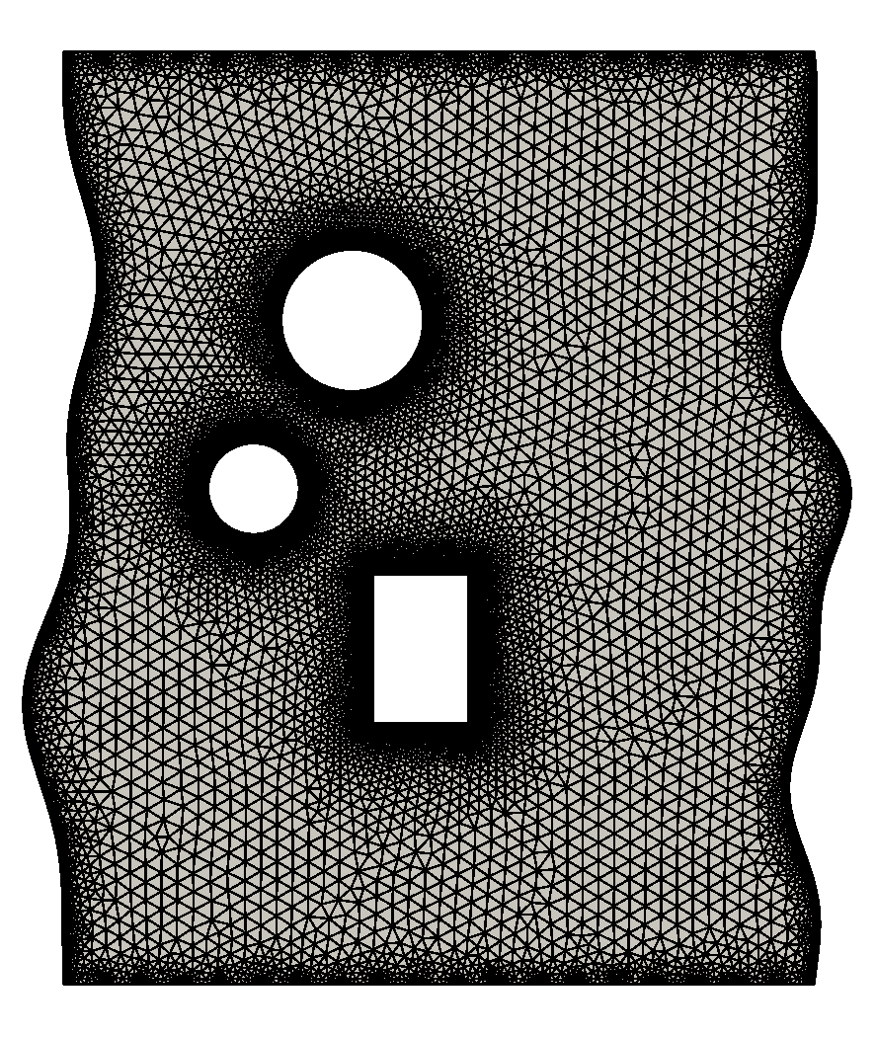
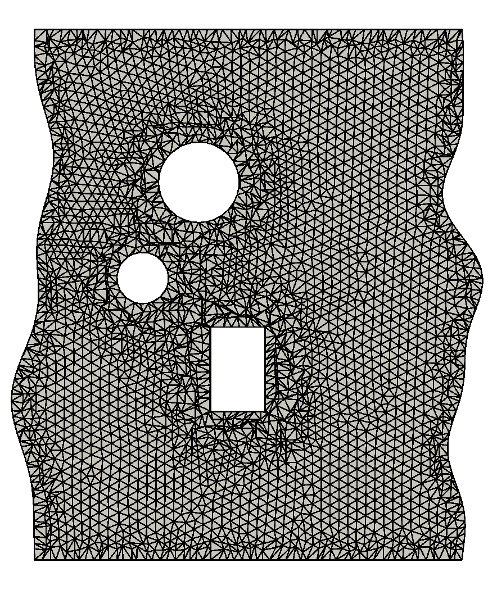
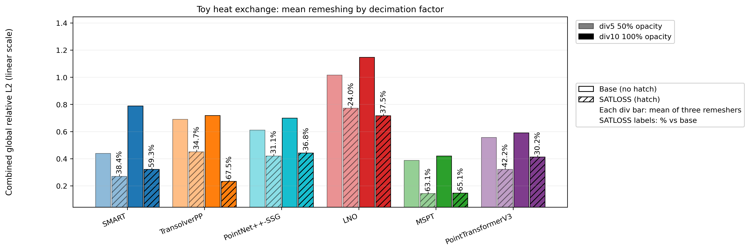
SATLOSS Performance
Original mesh
Decimated mesh

