Slide 1
CIS212 Lab Week #6
Creating Your Own Data Type – Structs & Debugging Structs

Slide 2
CIS212 Lab Week #6
Creating Your Own Data Type – Structs & Debugging Structs

Slide 3
What is a Struct?
A struct is a user defined data type.
“Composite” data type
Allows the user to group items of different types into one type.
Why would we want that?
Just imagine having to do project 2G without structs!

Slide 4
Uses of Structs in Functions
There would be no point in creating a struct if you don’t use it in your functions!
Some good ways to know whether you truly need a struct:
Are the attributes the same type?
Are you essentially making a Dictionary entry?
Do you want to make your life easier?

Slide 5
Defining a Struct (Option 1)
struct <StructName>
{
<type1> var1;
<type2> var2;
.
.
.
};
One possible way to define a struct! (Not the one Hank uses in 2G. Why?)

Slide 6
Defining a Struct (Option 2)
typedef struct
{
<type1> var1;
<type2> var2;
.
.
.
} <StructName>;
Allows you to define this struct as a type and use it as a type, without having to say struct all the time.

Slide 7
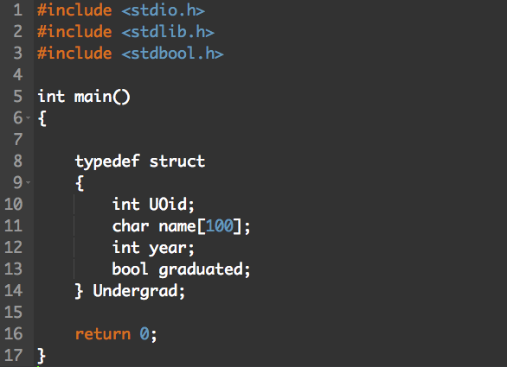
Some Examples!
What is the scope of the struct?

Slide 8
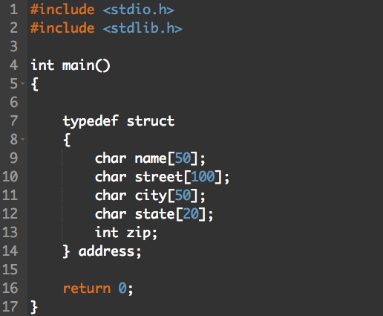
Some Examples!

Slide 9
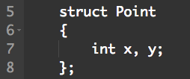
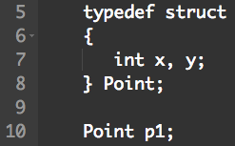
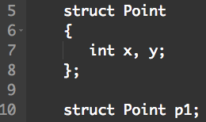
Defining a Struct
Two primary ways to define a struct.
Option #1
Option #2
Option #2 is generally the better approach

Slide 10
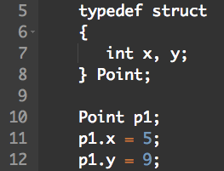
Accessing Struct Contents
To access any member of a struct, use the member access operator (.).

Slide 11


Pointing to a Struct
We can create a pointer to a struct.
Also requires some special symbols to access the members! (Why?)

Slide 12
Assignment and Equality with Structs
#include <stdio.h>
/* Define a type point to be a struct with integer members x, y */
typedef struct {
int x;
int y;
} Point;
int main() {
Point p = { 1, 3 };
Point q;
/* Set q “equal” to p */
q = p;
/* Check struct equality */
if (p == q)
printf(“p equals q\n”);
/* Change the member x of q to have the value of 3 */
q.x = 3;
if (p.x != q.x)
printf("The members are not equal! %d != %d", p.x, q.x);
}
Copies that value of all fields
No equality operator for structs

Slide 13
How C Stores a struct in Memory
typedef struct
{
<type1> var1;
<type2> var2;
.
.
.
} <StructName>;
A single, contiguous piece of memory
Determining the size (in bytes) of a struct:
sizeof(<StructName>) = sizeof(type1) + sizeof(type2) + …
No storage overhead

Slide 14
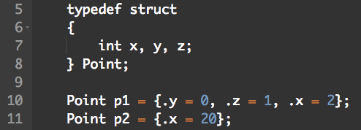
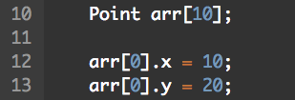
Tricks (& Treats!)
Assign values all at once at declaration:
Create an array of structs:

Slide 15
Let’s Play a Game...
Pick the right type
I will name something I am trying to represent in my program.
You tell me the type you would use to represent it
Valid Choices: struct, primitive, array of <X> objects, etc.

Slide 16
Picking the Right Type
Book
struct
Bookshelf
Array of Book objects
Array index
unsigned int
Library
struct

Slide 17
CIS212 Lab Week #6
Creating Your Own Data Type – Structs & Debugging Structs

Slide 18
Seriously, GDB Again?
Despite the fact that structs are useful and make life easier, a lot can go wrong fast.
Possible issues you may encounter:
Segmentation faults
Not populating of the struct’s fields
Writing to the wrong field
So, time for some GDB again!

Slide 19
Quick Review of Commands
Start your (loaded) program
run <args> or r <args>
Restart the program’s execution
r then y
Step (into) line by line (your code only)
step or s
Step (over) line by line
next or n
Run to the next breakpoint
continue or c
Step (out) of the function, i.e., run to the function’s end:
finish (not f though)

Slide 20
Additional GDB Commands
Display the current line and function and the stack of calls
where
Print the value of a variable
print <expr> or p <expr>
Change a variable’s value
print <varName> = <newValue>

Slide 21
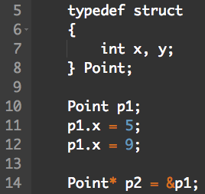
GDB with Structs
We can print out the values of all fields in the struct:
print p1 or p p1
{x = 5, y = 9}
The instance of the struct is accessed via a pointer, the GDB command changes slightly:
print *p2 or p *p2

Slide 22
GDB with Structs
Printing the value of a specific field in the Struct:
print p1.x or p p2->y
Changing the specific field’s value:
print p1.x = 10 or p p2->y = 6

Slide 23
Other GDB Commands
Print the struct definition of the struct:
ptype <TypeName>
Get information about a variable including :
Variable type including whether it is a pointer
List of struct fields, including each field’s types and values
explore <varName>

Slide 24
Start the Exercise…
Do not use printf to answer the lab questions. Use solely GDB and man.

