Slide 1
CIS212 Lab Week #1
Lab Syllabus, Virtual Machines
& Unix Introduction

Slide 2
CIS212 Lab Week #1
Lab Syllabus, Virtual Machines,
& Unix Introduction

Slide 3
Lab Syllabus
Lab syllabus is available on Canvas.
Brief review of lab policies and procedures.

Slide 4
CIS212 Lab Week #1
Lab Syllabus, Virtual Machines
& Unix Introduction

Slide 5
Virtualization Introduction
Quick Poll: Who has used a virtual machine or virtualization?
Trick Question: You all have even if you did not know it. The cloud and most of the internet relies on virtualization.

Slide 6
Mental Model of Virtualization
Basic Idea: Running a computer inside another computer
We need to go deeper…

Slide 7
Key Terminology
Virtual Machine: The inner computer
Inception Equivalent: “The dream inside the dream”
Hypervisor – Computer software and/or hardware that creates and runs virtual machines (i.e., the inception computer)
VirtualBox – Free hypervisor software developed by Oracle
Download: https://www.virtualbox.org/wiki/Downloads

Slide 8
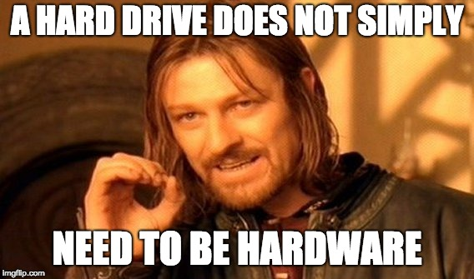
Creating the VM
Two Options:
Create a VM from scratch
Using a VM Image (what we will do in this class)
*.vmdk - Virtual Machine Disk
Mental Model: “A software hard disk”

Slide 9
Procedure to Create a VM using VirtualBox
Click “New” to create the VM
Give the VM a name
Select the OS (What should this be?)
Allocate the VM’s RAM (How do you determine the right amount?)
Select your existing VMDK file
Note: VM password is “me”

Slide 10
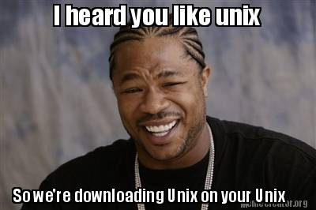
Everyone should use the class VM
Student submissions will be tested by the TA on the class VM
Different Unix builds can run and build code differently
Recommendation: Even if you develop on another Unix system (e.g., MacOS), verify your code on the class VM

Slide 11
CIS212 Lab Week #1
Lab Syllabus, Virtual Machines
& Unix Introduction

Slide 12
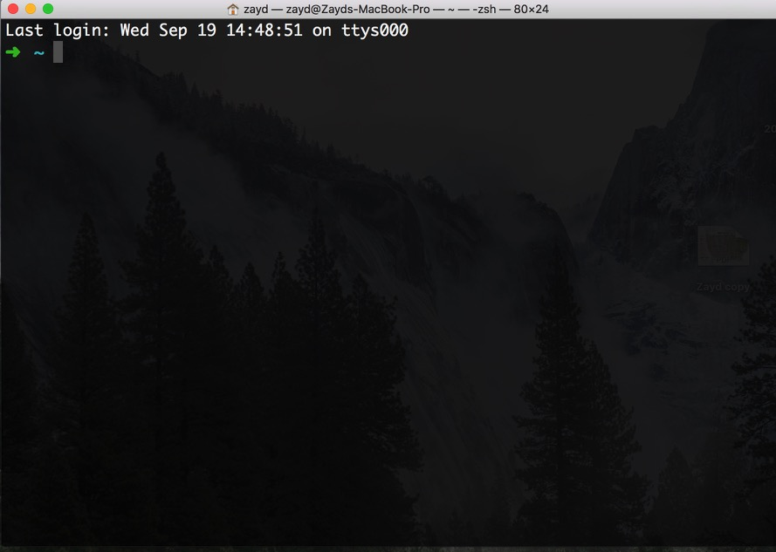
Terminal
Used to issue commands to the OS
Terminals run a shell
Shell – Program that actually runs the commands and returns the output
Question: What are some common shells?
Answer: BASH, ZSH, DASH, CSH
What does a terminal look like?

Slide 13
Basic Unix Commands Review
cd – Change directory
ls – List directory contents
mkdir – Make a new directory
touch – Create empty file or update modified date

Slide 14
Unix Command Structure
[sudo] <Command> [-Options] [Args]
sudo: Acronym for “super user do.
Needed on some OS for commands that require greater permissions
Command Name: Unix command itself
Dash Options: Optional modifiers to the command’s operation.
Defined by the command itself.
Command Arguments: Arguments (if any) to the command

Slide 15
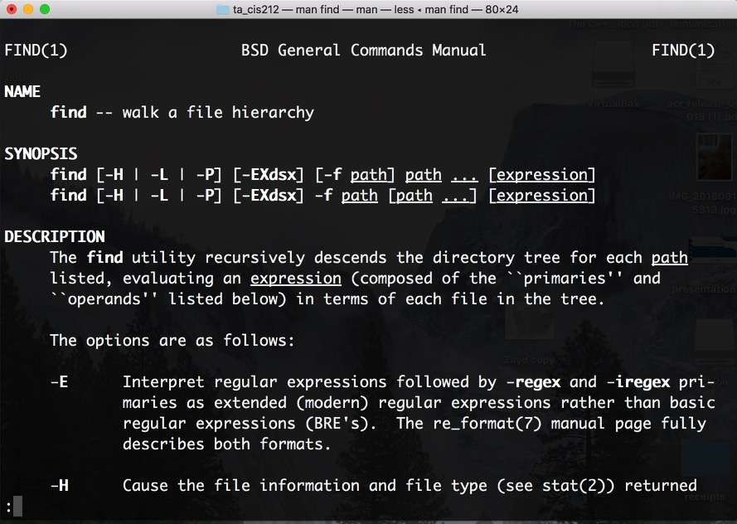
Getting Unix Documentation
Use: man <Command>
What command was used for the image below?

Slide 16
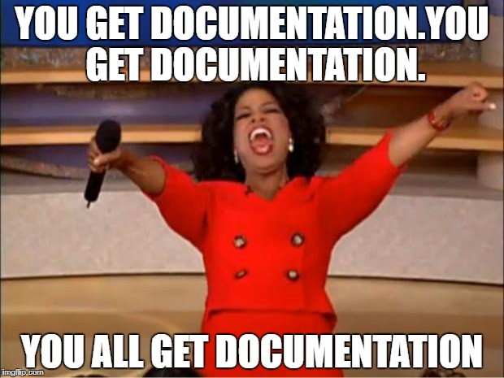
Make man your Friend
Almost every command has a man

Slide 17
Text Editors in the Terminal
vi & emacs – Two common terminal-based text editors
Example file creation:
touch <filename> – Create file named <filename>
vi <filename> – Open file <filename>
Press i – Begin editing <filename>
Press esc – Stop editing
Type :wq – Save file and exit
wc <filename> – Print the word count of <filename>
rm <filename> – Delete file <filename>
Everyone should follow vimtutor outside of this lab

Slide 18
Text Editors in the Terminal
vi & emacs – Two common terminal-based text editors
Example file creation:
touch <filename> – Create file named <filename>
vi <filename> – Open file <filename>
Press i – Begin editing <filename>
Press esc – Stop editing
Type :wq – Save file and exit
wc <filename> – Print the word count of <filename>
rm <filename> – Delete file <filename>
Everyone should follow vimtutor outside of this lab

Slide 19
Package Manager
Terminal operation to automatically install external tools and libraries
Exact package manager varies by OS
Use Google to find your OS’ package manager commands
On any new system, always update the package manager first
Ensures remote sources are up to date

Slide 20
MacOS Package Manager
Unlike other Unix OS, no package manager is bundled with MacOS
Good Option: Homebrew
Install Instructions: https://brew.sh/
Updating Homebrew:
brew update
Installing a Package:
brew install git
In the lab, you will need to determine the package manager for the VM
Hint: You will need to use sudo with the package manager command

Slide 21
Creating a Zip File
Why is this important?
Most homework submissions must be in a zip file.
Zipping Individual Files
zip <ZipName>.zip file1 file2 …
Zipping Directories
zip –r <ZipName>.zip directory1 …

Slide 22
Tarballs
Alternate compression format
Most Common File Format: *.tar.gz
Combines tarball with gzip
tar - Single UNIX command to compress and decompress tarball
Question: How does the shell determine whether to compress or decompress?
Answer: The dash options

Slide 23
Start the Exercise…
Heads Up: You will need to use Google and man to find the answer to some of the lab exercises

