Slide 1
CIS212 Lab Week #3
Debugging – Exit Status Codes & GDB

Slide 2
CIS212 Lab Week #3
Debugging – Exit Status Codes & GDB

Slide 3
This Code Does Not Follow Best Practices – What’s Wrong?
#include <stdio.h>
int main() {
printf(“Hello World\n”);
}
Here’s a hint
We are supposed to return something

Slide 4
Let’s Fix It
#include <stdio.h>
int main() {
printf(“Hello World\n”);
return 0;
}
Why are we returning 0?

Slide 5
Standard C Exit Status Codes
Exit status codes are standard in Unix.
0 – Defined by C-standard as successful exit
1 – Defined by C-standard as a failure
Rule of Thumb: Exit status codes range from 0 to 255 (how many bits is that?)
Anything other than 0 indicates an error or failure occurred

Slide 6
Checking the Exit Status Code
Run your code
./a.out <params>
Check the exit status code
echo $?
You must call echo immediately following running the program. Calling any command in between will print that other command’s exit code.

Slide 7
printf – What really happens
By default, all printf statements are buffered by the operating system.
The OS decides when the statements actually get written to the screen.
It can be longer after the call to printf is made.
If the program crashes, print statements in the buffer may never be printed to the screen.
This makes printf a potentially misleading debug tool.

Slide 8
CIS212 Lab Week #3
Debugging – Exit Status Codes & GDB

Slide 9
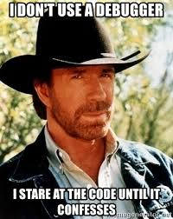
Debugging – Maybe the Most Important Topic in this Class

Slide 10
Quick Poll
Question: Who has used a debugger before?
Most modern programming languages have debug capability.
Two primary forms of debugger:
GUI-based, e.g., built into IDE
Terminal Based, e.g., GDB

Slide 11
Features of a Debugger
Monitor (and change!) the state of a program while its running
Step through code line by line
Insert breakpoints
User specified points in the code where the program pause its execution
Can be conditional
Check the state/value of a variable
Generate a backtrace
Set of all function calls that lead to the failure
Modify the state of your program, including variable values

Slide 12
What is GDB?
GDB – The GNU Project Debugger
A command line-based debugging tool
Behaves like a normal interpreter
Supports many languages including C/C++
Cross platform for Mac, PC, Unix, Linux even in your browser

Slide 13
Basic GDB commands
Open GDB (from the shell)
gdb
Closing GDB
quit or q
Select the file to debug
file <CompiledBin>.out

Slide 14
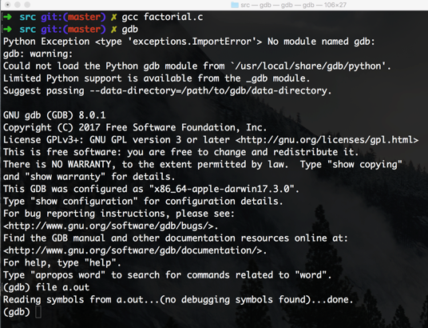
Let’s look at factorial.c (on Canvas)
Compile to binary (gcc …)
Open GDB (gdb)
Select the binary (file …)
Huh?

Slide 15
Compiling for Debugging
gcc strips out all debugging information during compilation.
Normally, this is good since it improves program efficiency and reduces the file size
We need all that information when debugging
GDB (and all debuggers) require a special dash option during compilation:
gcc -g <filename>.c

Slide 16
Additional GDB Commands
Set a breakpoint at start of function
break <funcName> or b <funcName>
Set a breakpoint on a specific line:
break <filename>.c:<line#>
View a file
list <FirstLine#>, <LastLine#>
Run your (loaded) program
run or r
Step to next line in the program
next or n

Slide 17
Additional GDB Commands
Print the value of a variable
print <varName> or p <varName>
Change a variable’s value
print <varName> = <newValue>
Run to the end of the program
continue
Restart the program’s execution
r then y

Slide 18
Live Coding – GDB

Slide 19
Start the Exercise…
As always, you may use Google and man to help you answer any of the questions!

