Slide 1
A PARALLEL SOLUTION TO MAXIMAL INDEPENDENT SET PROBLEM USING CUDA
Project of Multi-core Computing Course

Slide 2
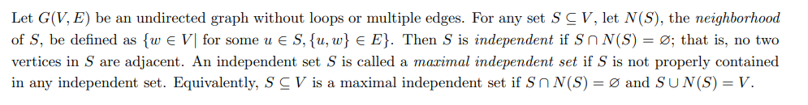
Maximal Independent Set

Slide 3
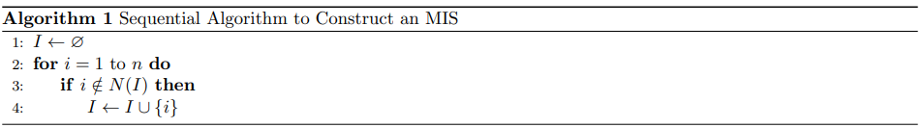
Sequential Algorithm

Slide 4
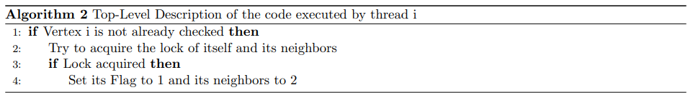
Parallel Algorithm

Slide 5
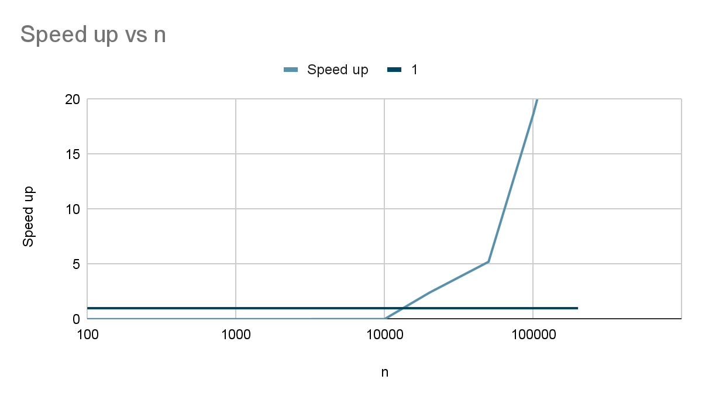
Results

