Slide 1

Pangenome in the Genome Browser
August update
Parsa Eskandar
1
Notes:
Goal: HPRC release 2 usable inside the UCSC Genome Browser. August: everything became end-to-end on the dev browser.

Slide 2
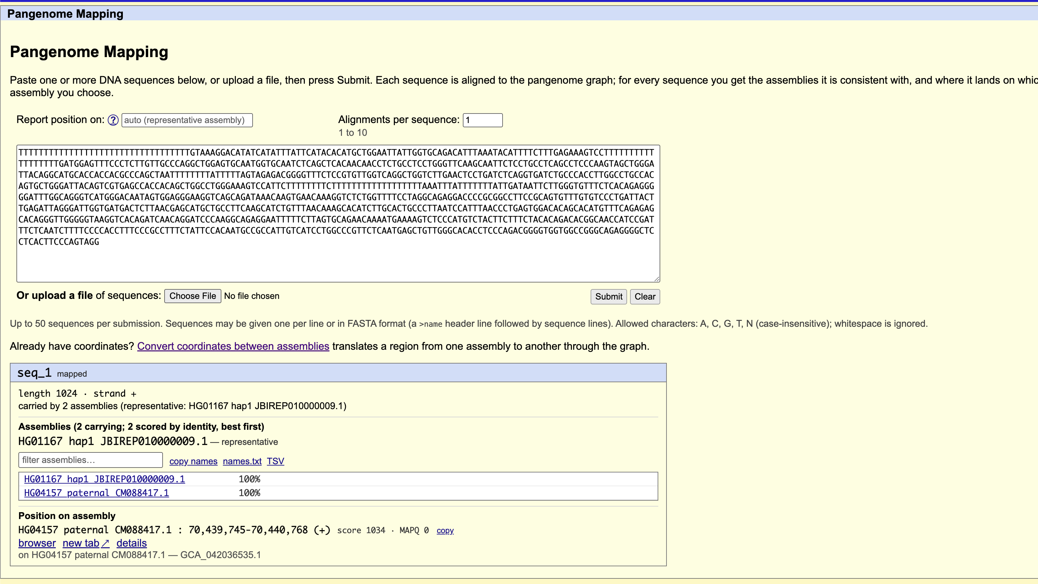
Pangenome Mapping: which haplotypes carry my sequence?
hgwdev-seeskand.gi.ucsc.edu
2
Notes:
Mapped once with vg giraffe. All 464 haplotypes scored by identity. Click any haplotype: re-surject, no remapping.

Slide 3
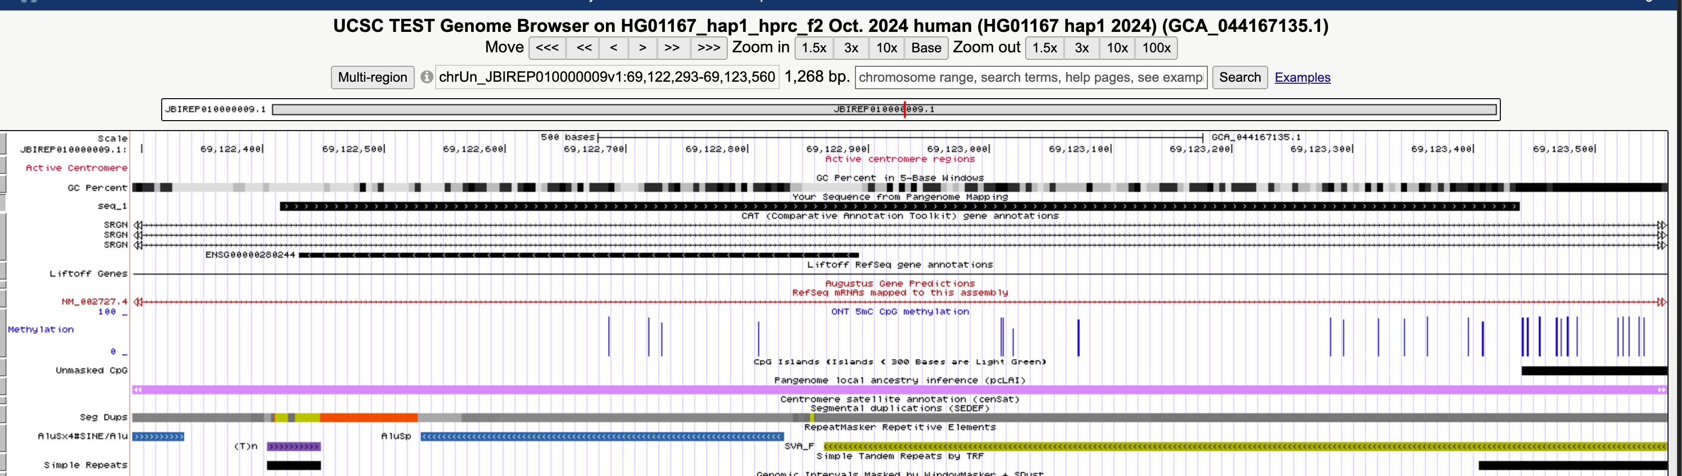
The hit lands as a native track
hgwdev-seeskand.gi.ucsc.edu
3
Notes:
Pangenome Seq track on HG01167 hap1, BLAT-style base-level differences. Just another track.

Slide 4
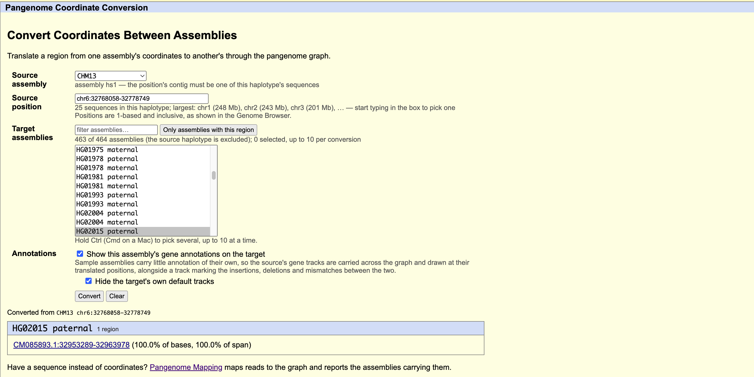
Convert coordinates between any two of 466 assemblies
hgwdev-seeskand.gi.ucsc.edu
4
Notes:
CHM13 chr6:32,768,058-32,778,749 to HG02015 paternal, 100% of bases, ~20 ms. Picker can list only assemblies containing the region.

Slide 5
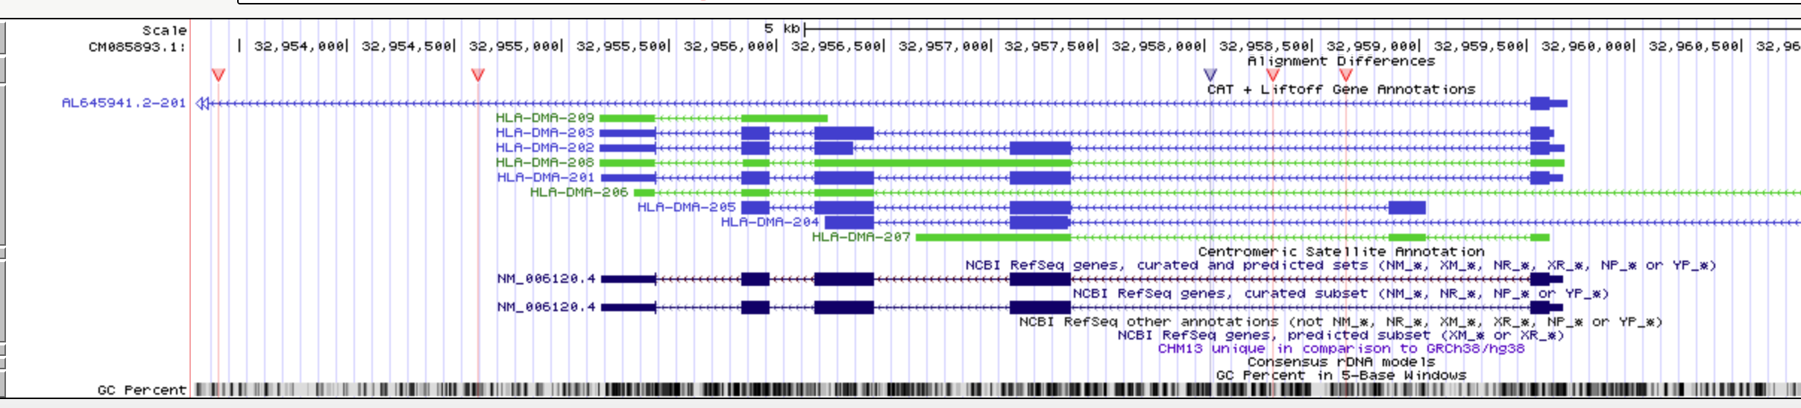
Annotations follow you: a QuickLift chain built per request
hgwdev-seeskand.gi.ucsc.edu
5
Notes:
HG02015 paternal showing CHM13's CAT/Liftoff genes (HLA-DMA), RefSeq, CenSat, under an Alignment Differences track. Chain built in ~1 s from translation blocks; two-phase widening so panning works.

Slide 6
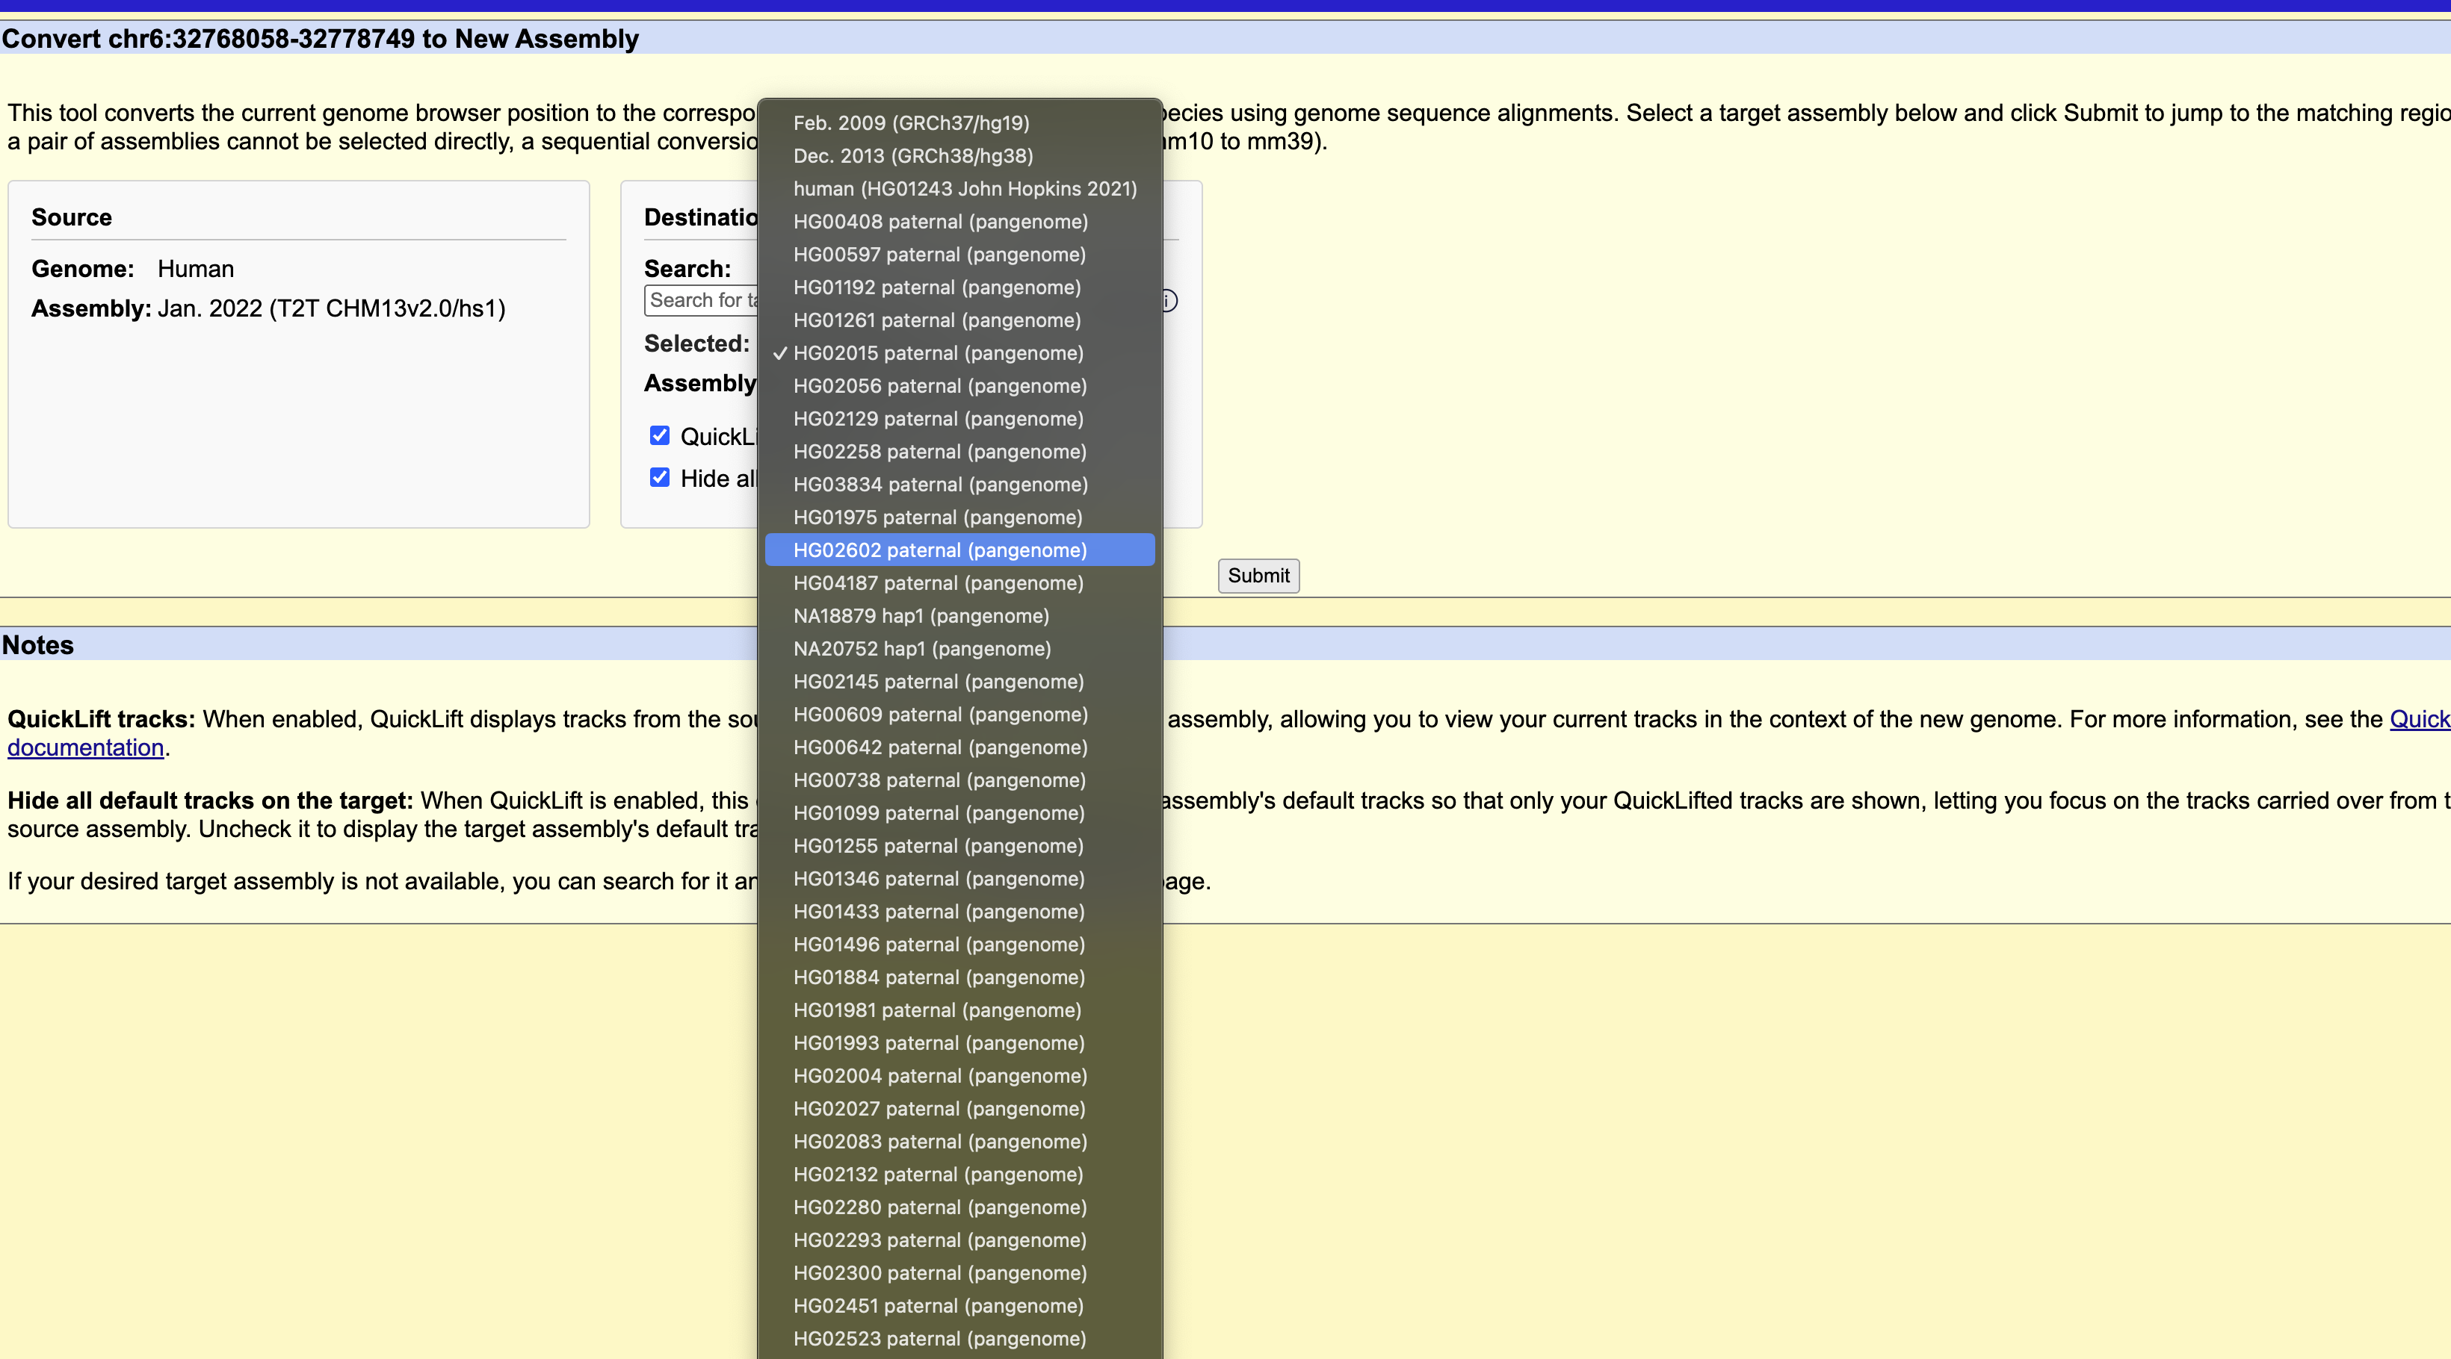
Also inside the stock hgConvert
hgwdev-seeskand.gi.ucsc.edu
6
Notes:
Pangenome assemblies in the normal menu; picking one dispatches through the graph. 3 files / 15 lines changed in kent core; 385 tests.

Slide 7
Numbers
7
Notes:
~20 ms gene-scale; 0.6 s at 100 kb; 4.3 s at 1 Mb. 9.6x at 8 threads after the GIL release. Routing table: 1.78 GB, 35 min, zero failure modes (naive: 17.2 TB).

Slide 8
Next
Fix the audit items (hub write race, extendChain test, trash cleanup)
Deploy concurrency on the service; persistent chain cache if we want it
HPRC 2026: poster done, 15-minute talk slot, record a 20 s demo
Need: sign-off on the one-line hdb.c change; OK to redeploy the service.
8
Notes:
Ask explicitly for the hdb.c sign-off and the redeploy.

