Slide 1
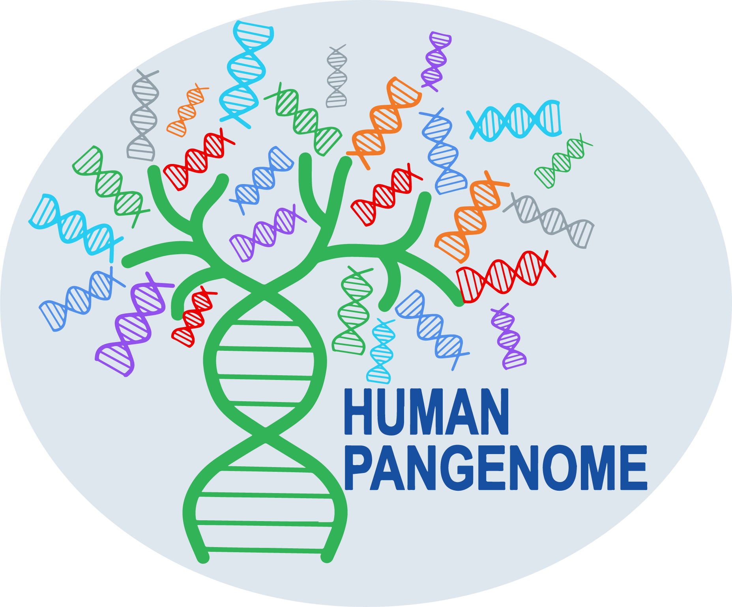

HPRC 2026
A pangenome sequence search and coordinate
translation service for the UCSC Genome Browser
Parsa Eskandar • Jouni Sirén • Benedict Paten
UC Santa Cruz Genomics Institute
1
Notes:
Talking points: - who you are, joint work with Jouni and the Genome Browser team

Slide 2

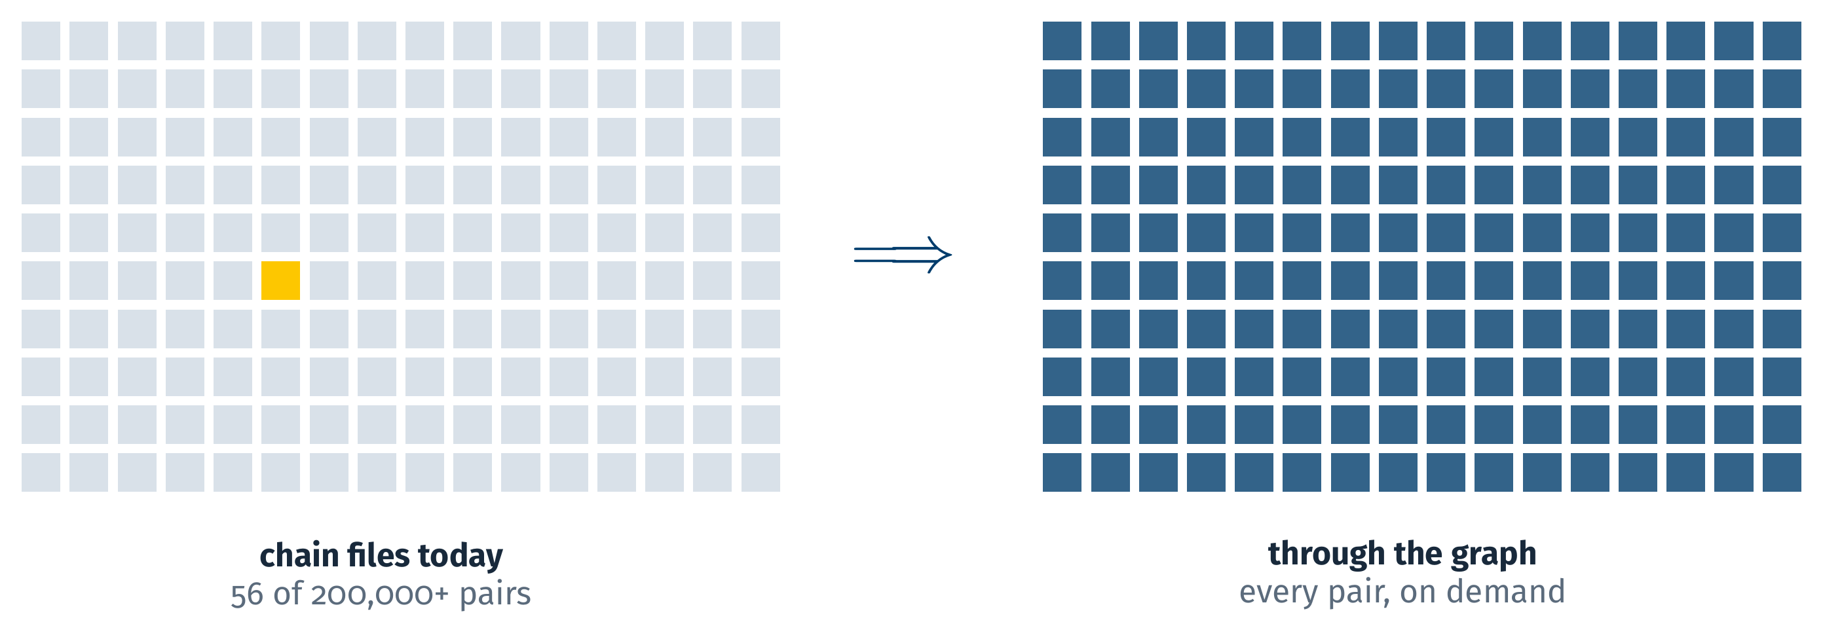
Not possible in the Genome Browser today
Search a sequence across all 464 HPRC haplotypes
today: BLAT, one assembly at a time
Move a locus onto any HPRC haplotype
today: only between the few assembly pairs with a prebuilt chain
464 haplotypes make 200,000+ assembly pairs. Chains exist for 56 of them.
See the reference's annotation on an HPRC haplotype
today: only for those same few pairs
2
Notes:
Talking points: - what a researcher cannot do here today - no search across haplotypes: BLAT is one assembly at a time - no lift-over to a haplotype without a prebuilt chain: 56 chains, 200,000+ pairs - the graph aligns all 464 already; nothing in the browser uses it

Slide 3


Two use cases
1
2
Sequence search
Coordinate translation
A sequence that is not in GRCh38.
A gene on GRCh38.
Which of the 464 haplotypes carry it?
Show it on HG02015, with its annotation.
3
Notes:
Talking points: - use case 1: a sequence not in the reference; which haplotypes carry it, and where - use case 2: a locus known on GRCh38; see it on another haplotype with the annotation

Slide 4
Use case 1: sequence search
demo
Screen recording: Pangenome Mapping
drop scenario1.mp4 into talk/figures/videos and rebuild, or Insert > Video here
4
Notes:
Talking points: - paste, map once to the whole graph - results: which haplotypes, ranked by identity - click one: the sequence as a track on that haplotype

Slide 5
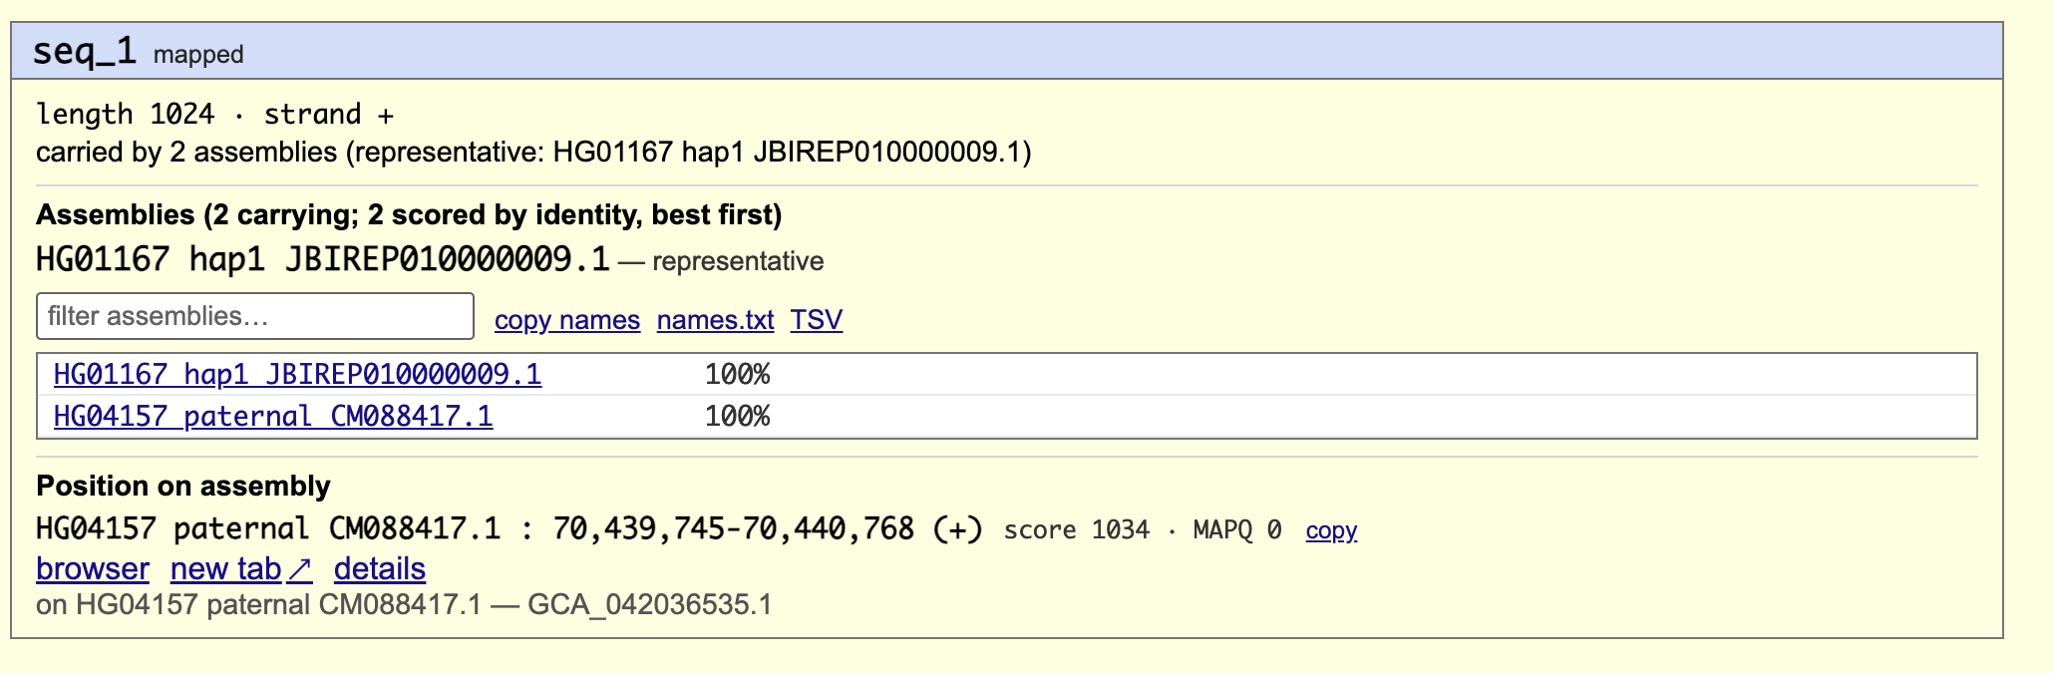
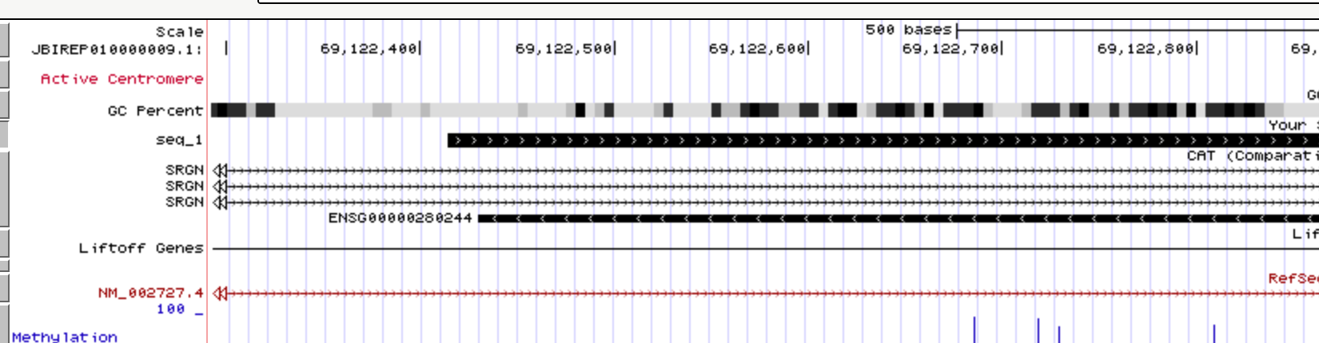
Two of 464 haplotypes carry it
Use case 1
genome.ucsc.edu
GRCh38 is not one of them.
5
Notes:
Talking points: - HG01167 hap1 and HG04157 paternal; not GRCh38 - one search instead of 464 - MAPQ is 0 by design in a graph this redundant; identity and coverage carry the ranking

Slide 6
Use case 2: coordinate translation
demo
Screen recording: coordinate translation
drop scenario2.mp4 into talk/figures/videos and rebuild, or Insert > Video here
6
Notes:
Talking points: - source: the gene on the reference; target: HG02015 paternal, any of 464 - about 100 ms - landing: reference tracks drawn on HG02015; differences marked

Slide 7
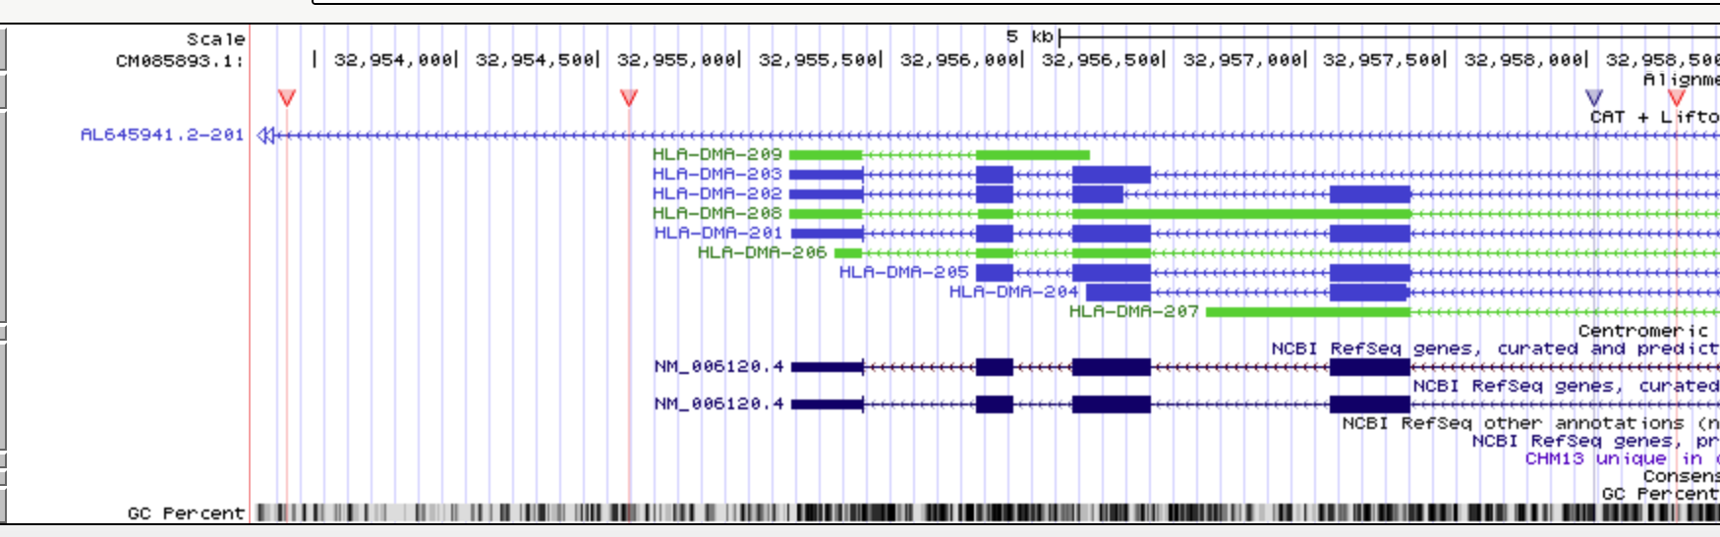
The reference's tracks, on HG02015
Use case 2
genome.ucsc.edu
No chain existed for this pair. The alignment was built for this region when the page loaded.
7
Notes:
Talking points: - genes, ClinVar, your own tracks, drawn on a haplotype that had no chain - Alignment Differences track: insertions, deletions, mismatches, base by base - any of the 464 as the target

Slide 8
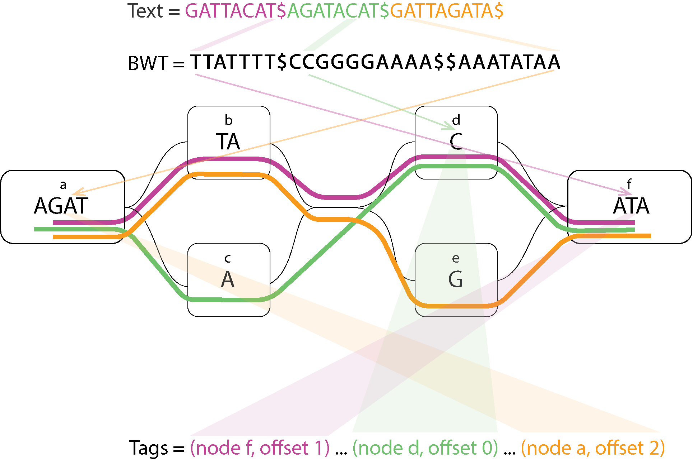
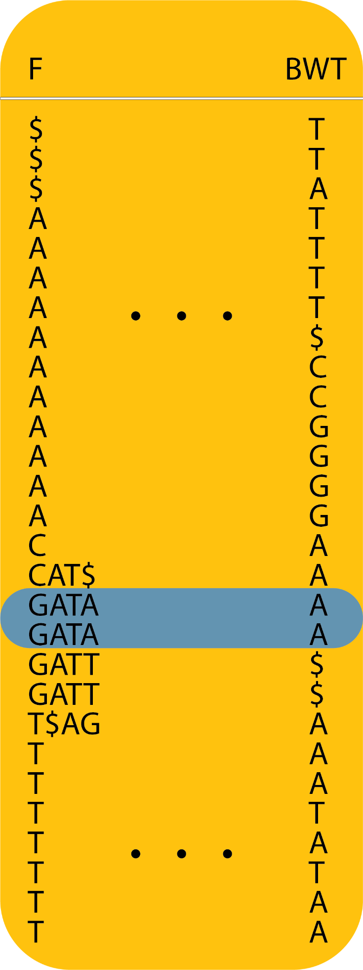
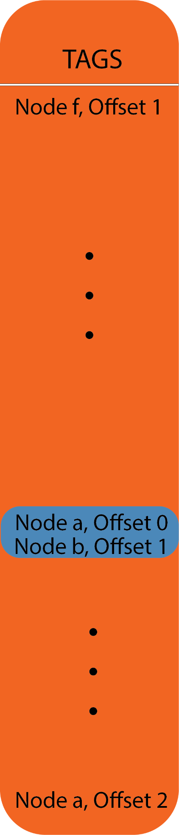
How: one index over the whole graph
Tag arrays
Every BWT position carries a tag: its node and offset in the graph.
Eskandar, Paten, Sirén. Lossless pangenome indexing using tag arrays. WABI 2025; Algorithms for Molecular Biology 2026.
8
Notes:
Talking points: - one FM-index over all 464 haplotypes; a sequence is found once - the tag: which node and offset each BWT position came from, so a match is a graph position - from a node, every haplotype passing through it and where; that is what moves a locus - no pairwise anything: any haplotype to any other

Slide 9
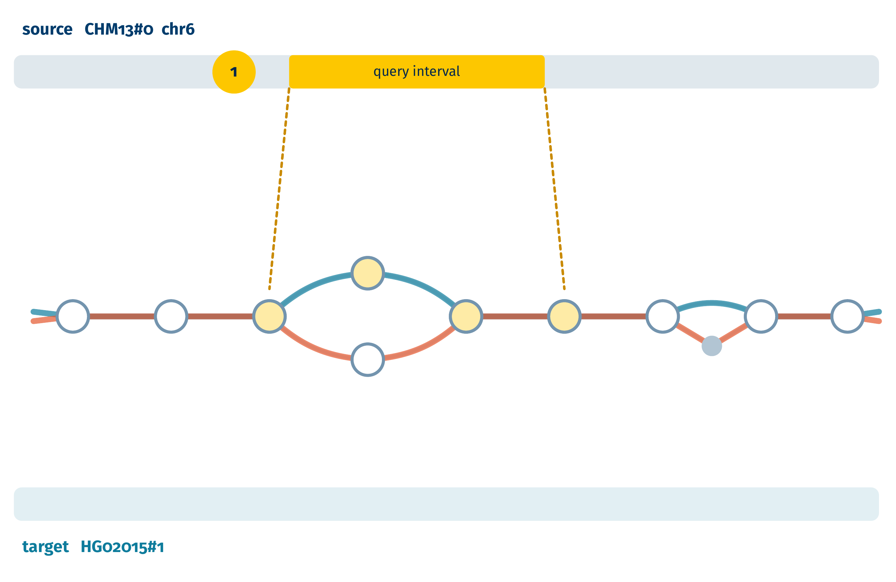
Translating a region
step 1 of 4
1
Find the query's nodes on the source path.
9
Notes:
Talking points: - the query interval, projected onto the source haplotype's path

Slide 10
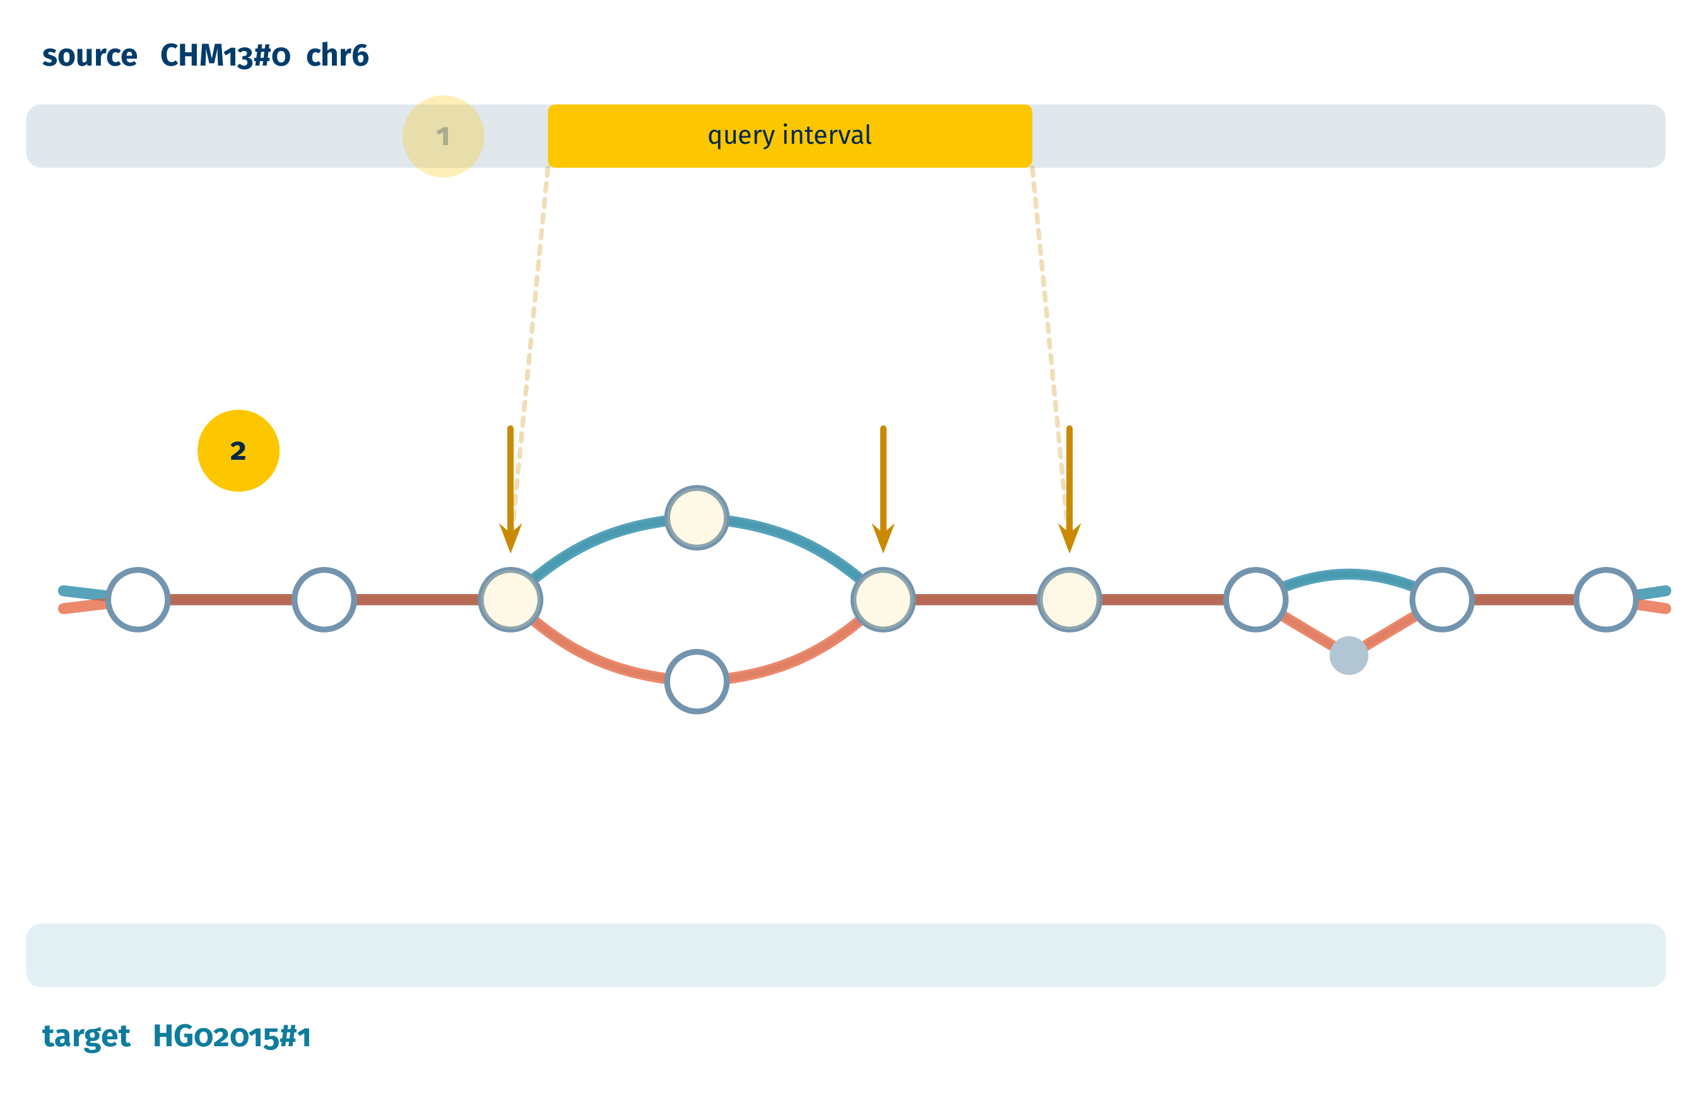
Translating a region
step 2 of 4
1
Find the query's nodes on the source path.
2
Ask the tag arrays who else is here.
10
Notes:
Talking points: - at those nodes: every haplotype standing there, target included

Slide 11
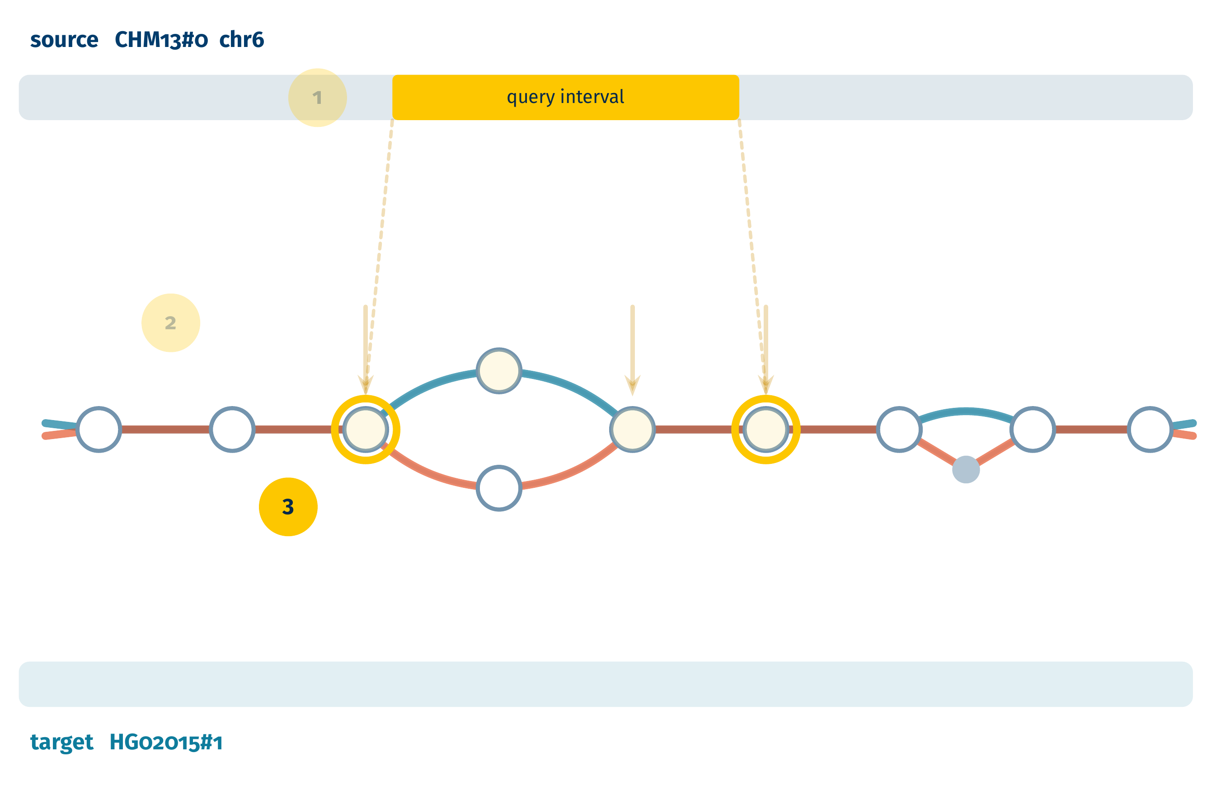
Translating a region
step 3 of 4
1
Find the query's nodes on the source path.
2
Ask the tag arrays who else is here.
3
Nodes both visit exactly once: anchors.
11
Notes:
Talking points: - a node both paths visit exactly once cannot be a false anchor; orthology comes from the graph

Slide 12
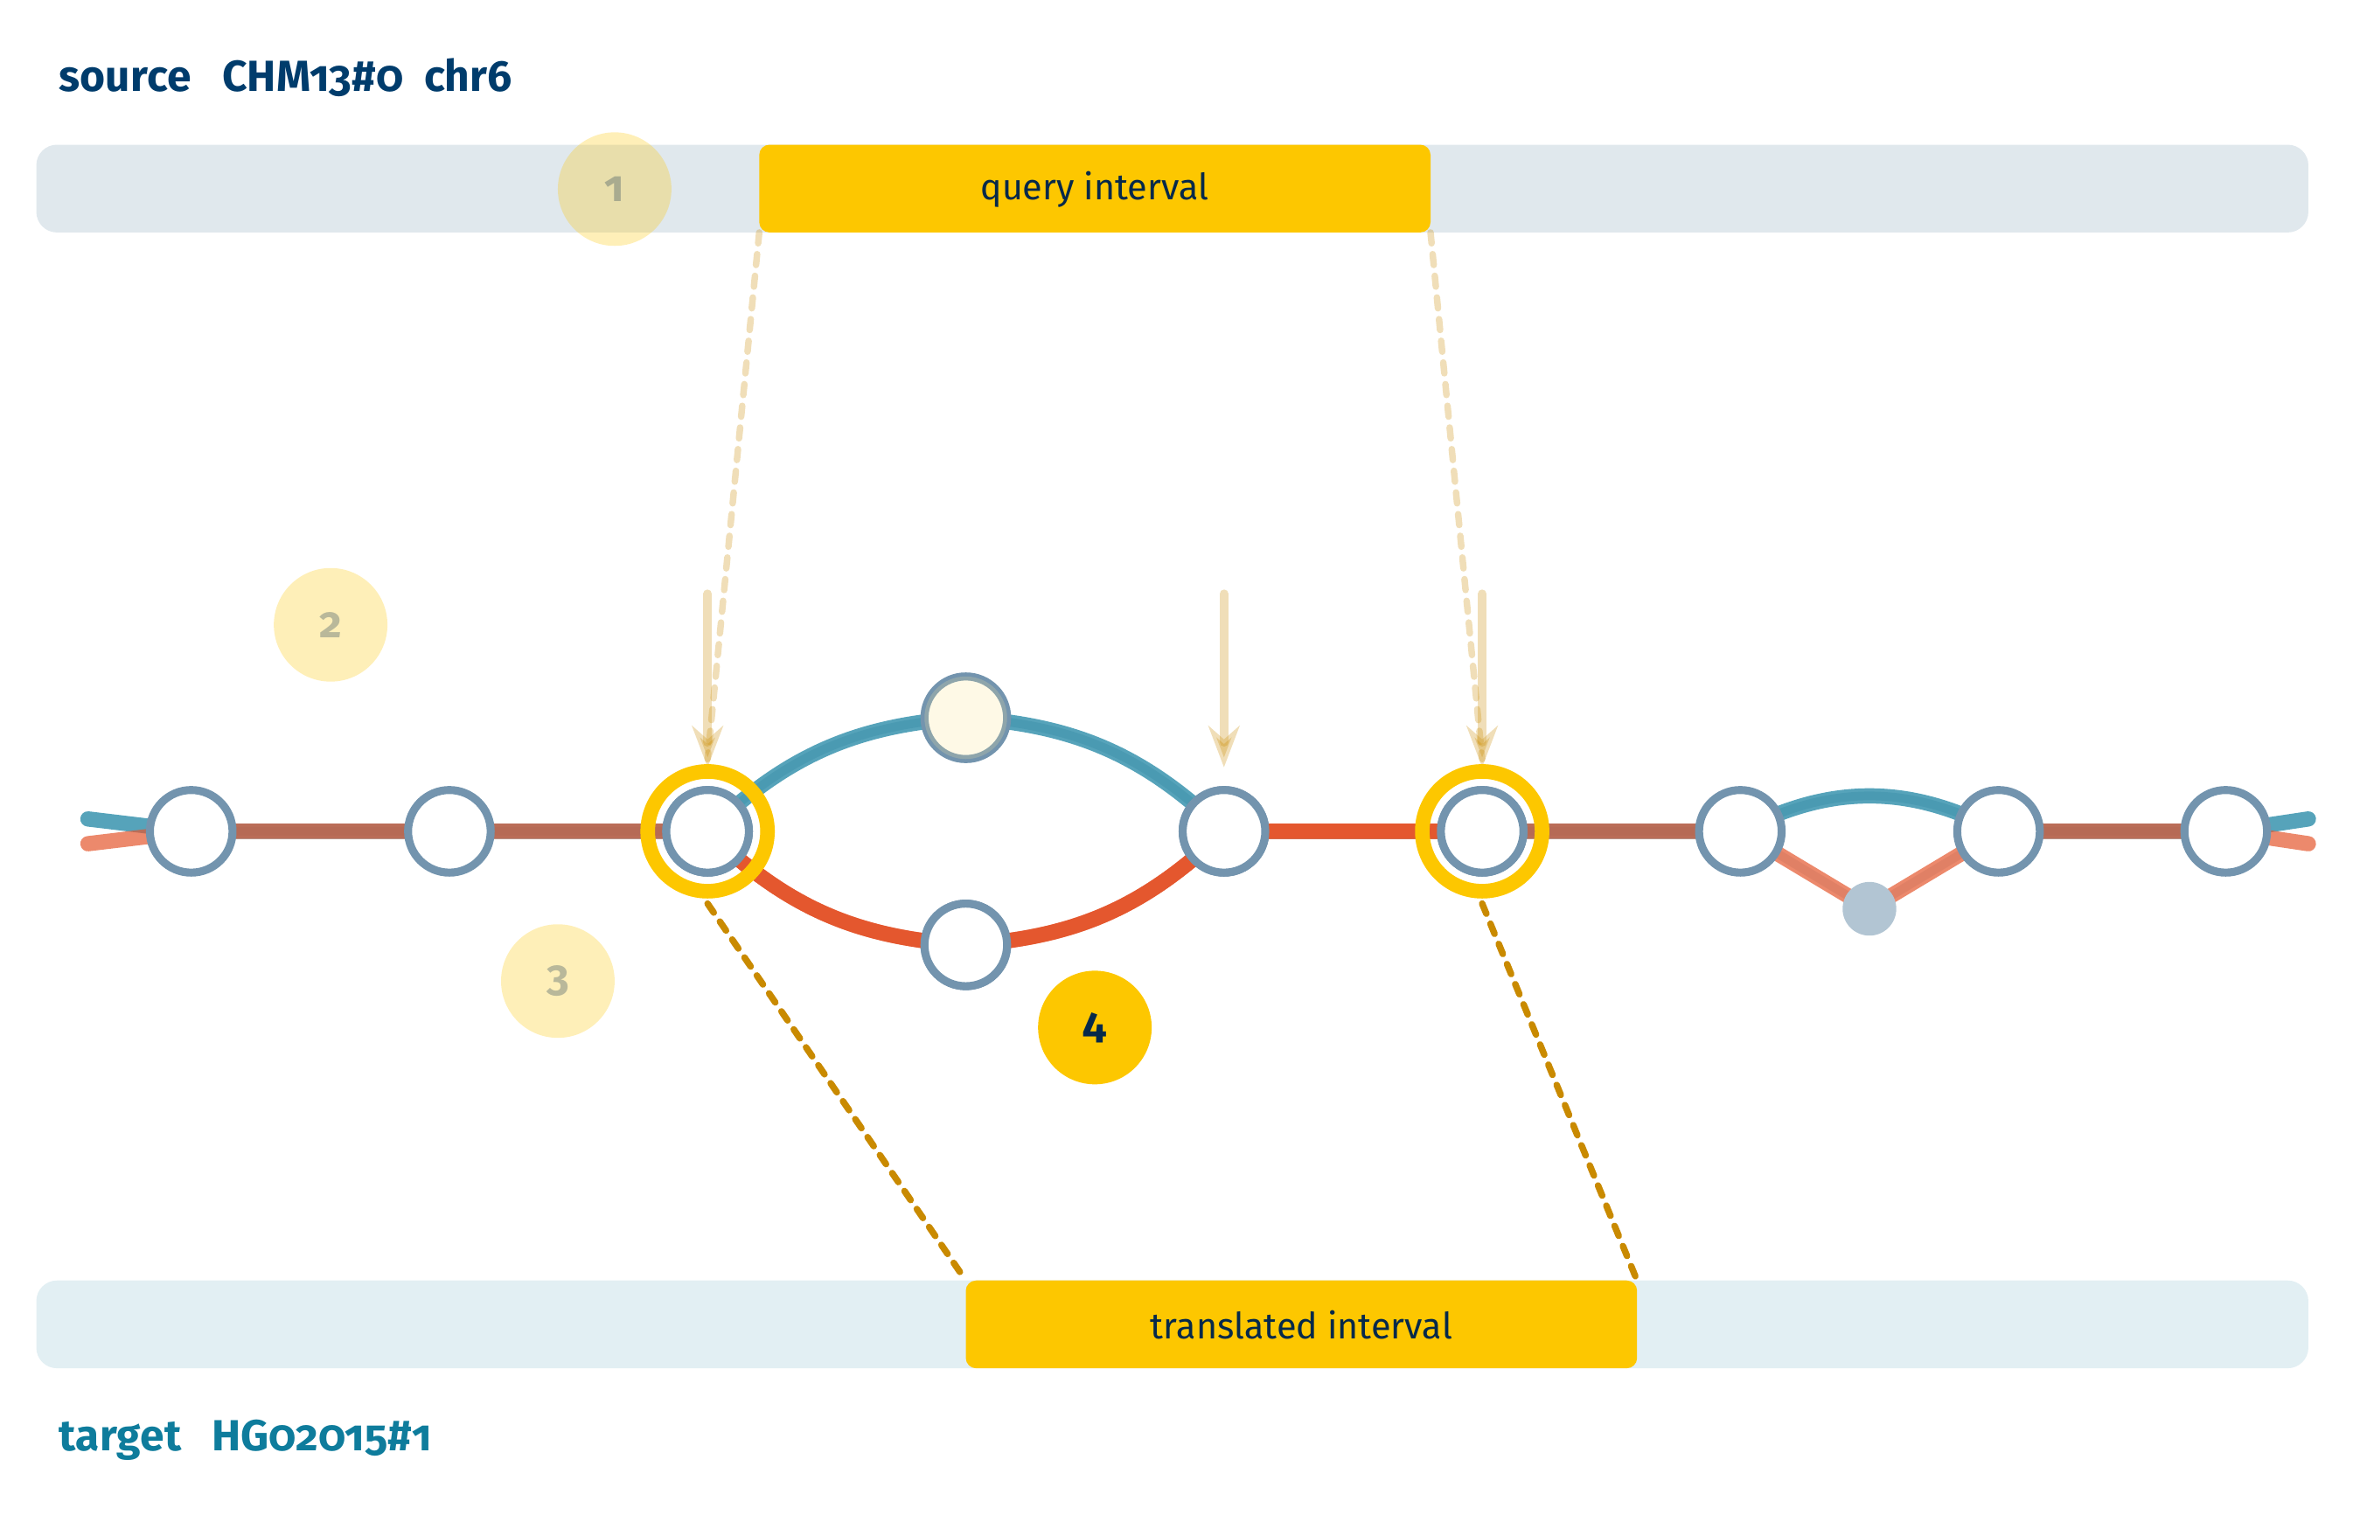
Translating a region
step 4 of 4
1
Find the query's nodes on the source path.
2
Ask the tag arrays who else is here.
3
Nodes both visit exactly once: anchors.
4
Walk between anchors; shared offsets become chain blocks.
12
Notes:
Talking points: - walk base by base; a block breaks on an indel, never a SNP; the output is a chain, and the browser knows chains - missing positions are possible, invented ones are not

Slide 13
Fast enough for a web page
Translation latency, median (log scale)
up to 1 kb
~20 ms
10 kb
115 ms
100 kb
0.6 s
1 Mb
4.3 s
10 ms
100 ms
1 s
10 s
About 60 queries per second on one server.
13
Notes:
Talking points: - a gene in a tenth of a second; a megabase in seconds - about 60 queries a second per server - everything is built when the page loads; nothing is precomputed per pair

Slide 14
Roadmap
Public release in the UCSC Genome Browser
Translation that just works: tracks follow you across haplotypes, no conversion step
Click an HPRC variant on GRCh38, see which release 2 haplotypes carry it, go there
Mapping results colored by local ancestry (pclai)
14
Notes:
Talking points: - release: both tools in the public browser; development browser today - translation already flows from In Other Genomes; it should be invisible everywhere - HPRC variant tracks on GRCh38: click a variant, see its release 2 carriers, go there - pclai local ancestry: color the carriers; helps pick which haplotypes to look at

Slide 15

Thank you
seeskand@ucsc.edu
github.com/parsaeskandar/pangenome-index
Jouni Sirén • Benedict Paten
UC Santa Cruz Computational Genomics Lab: Adam Novak, Glenn Hickey, Zia Truong, Mark Diekhans
The UCSC Genome Browser team • The Human Pangenome Reference Consortium
15
Notes:
Talking points: - thanks

Slide 16
Backup
16
Notes:
Backup slides follow.

Slide 17
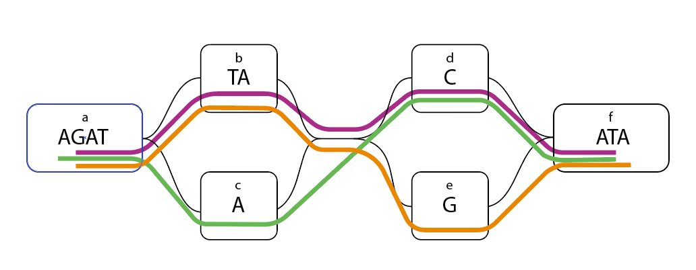
Backup: translation on a toy graph
Tag arrays
1
Walk the source interval with the r-index; collect the sampled tags: nodes b, e, f.
2
Each tag lists every haplotype at that graph position. Purple stands on b and f.
3
Nodes both visit exactly once anchor the paths: b and f.
4
Walk between anchors; orange 5 sits on node e, which purple never visits: no position, never a wrong one.
17
Notes:
Backup: the worked toy example from the paper.

Slide 18
Backup: by the numbers
148M
464
2.6 Tbp
26 B
nodes in the HPRC v2.0 Minigraph-Cactus graph
haplotypes indexed, CHM13 and GRCh38 included
bidirectional sequence in the index
tag array runs (4.9 B BWT runs)
149 GiB
~250 GB
~60 / s
~100 ms
tag array index; 23 GiB sampled tag array
RAM for the running service
translation queries per second on one server
to translate a 10 kb gene to any haplotype
18
Notes:
Backup: sizes and costs for questions about what it takes to run this.

