Slide 1
Fusion!
Parsa Sharifi

Slide 3

Humans are multi-modal!

Slide 4

Humans are multi-modal!
Device-directed speech detection (DDSD)

Slide 5
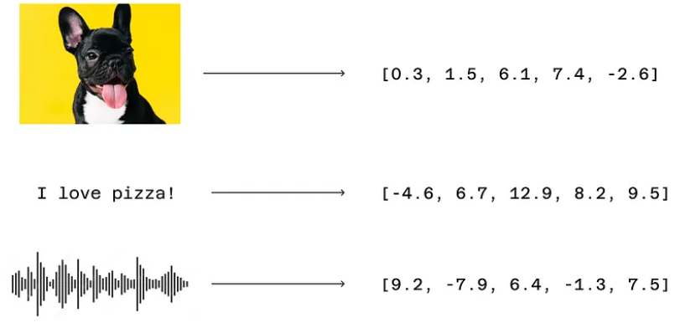
Embeddings!
Embeddings provide a uniform way for models

Slide 6
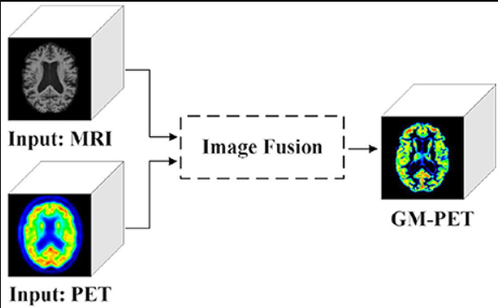
Early fusion
Intermediate fusion
Late fusion

Slide 7
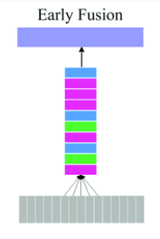
Early fusion
Combining at input level
No processing
Single modality
Not enough info!

Slide 8

Intermediate fusion
latent representation
Most used
Further process
Attention mechanisms
Extra processing

Slide 9
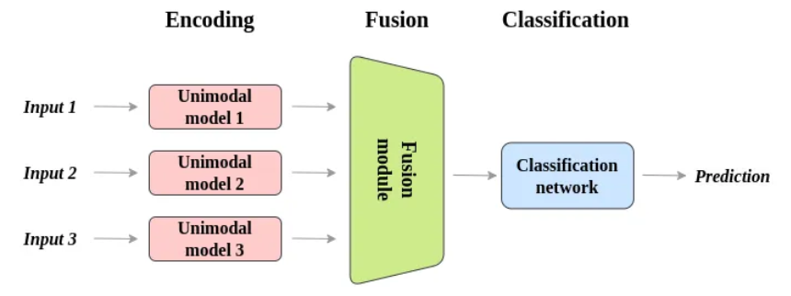
Late fusion
Close to ensemble model
Processed independently
Video content and genre
Not complex modal interactions!

Slide 10
https://medium.com/@raj.pulapakura/multimodal-models-and-fusion-a-complete-guide-225ca91f6861
https://ieeexplore.ieee.org/document/9207961
https://www.researchgate.net/figure/Fusion-model-Left-Late-Fusion-Middle-Early-Fusion-Right-Slow-Fusion-The-red_fig6_320395034

