Slide 1
Multi modal contrastive learning
Parsa Sharifi

Slide 2
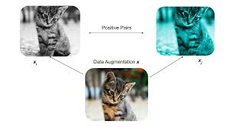
What is contrastive learning

Slide 3
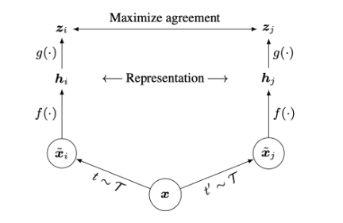
Contrastive learning architecture

Slide 4

Contrastive learning loss

Slide 5
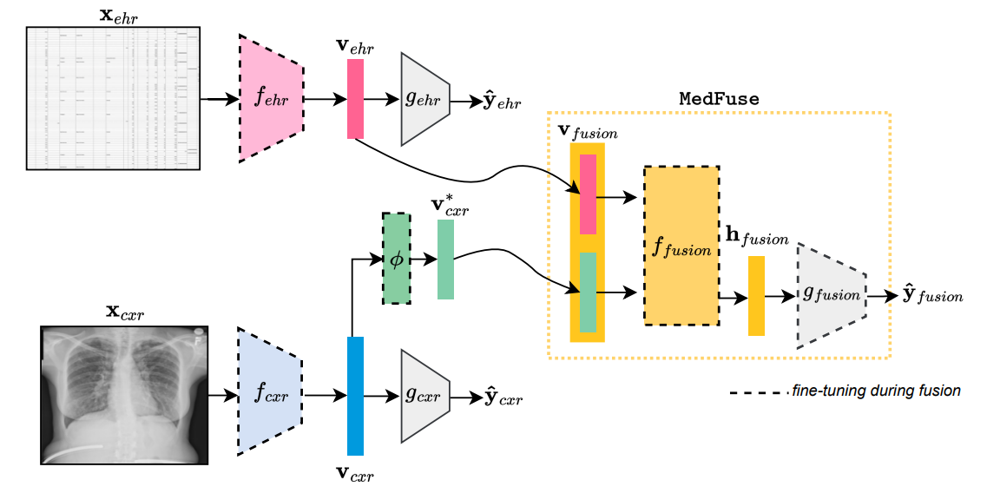
Multi modal methods

Slide 6
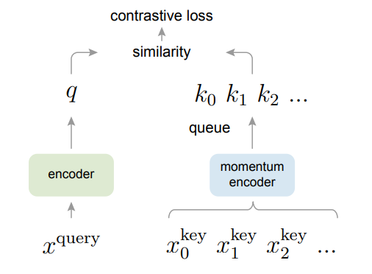
Momentum Contrast

Slide 7

Momentum Contrast
M ∈ [0, 1) is a momentum coefficient
θq are by back-propagation
θk more smoothly

Slide 8
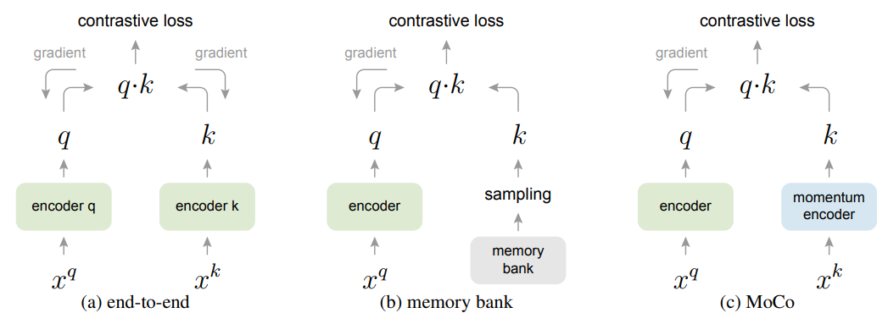
Momentum Contrast

Slide 9
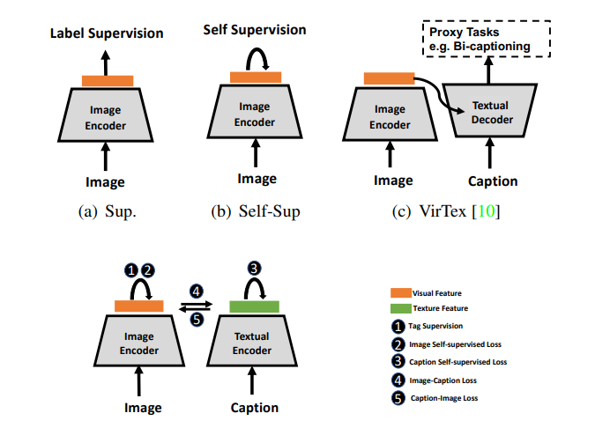
Learning methods

Slide 10
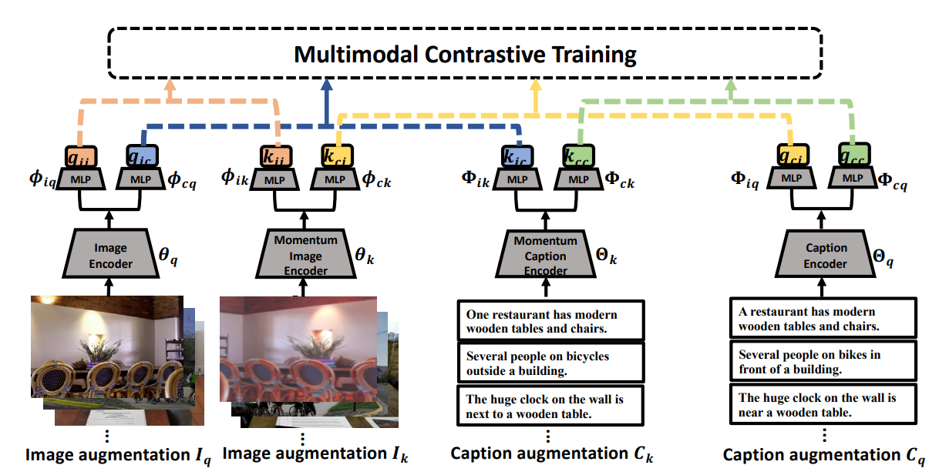

Slide 11
https://arxiv.org/abs/2002.05709
https://arxiv.org/abs/2104.12836
https://arxiv.org/abs/1911.05722

