Slide 1

Adobe systems incorporated
By: parsa ahmadi nasab Emran
Section: 005

Slide 2
history
an American multinational computer software company
was founded in December 1982 by John Warnock and Charles Geschk who established the company after leaving Xerox PARC in order to develop and sell the PostScript page description language
best known for Photoshop, an image editing software, Acrobat Reader, the Portable Document Format (PDF) and Adobe Creative Suite, as well as its successor Adobe Creative Cloud

Slide 3
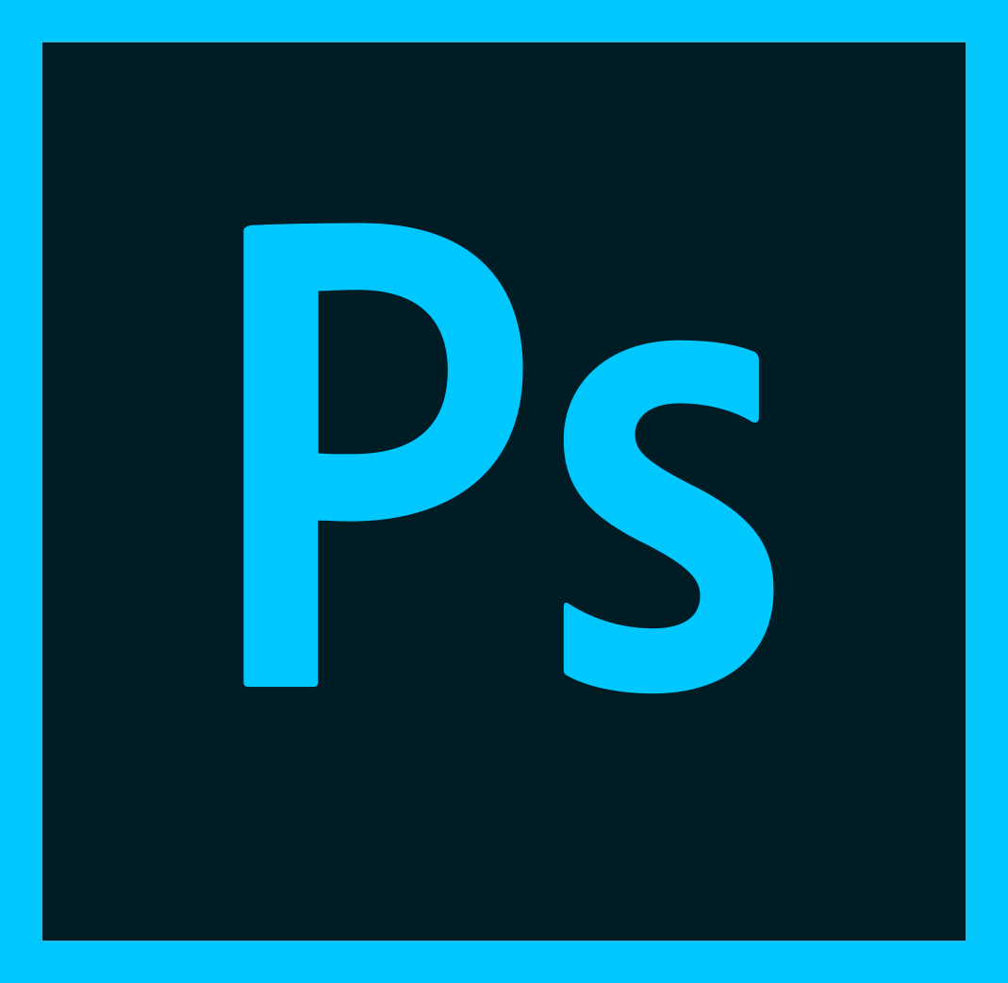



Products
Photoshop
Acrobat reader
Creative cloud
Flash player

Slide 4
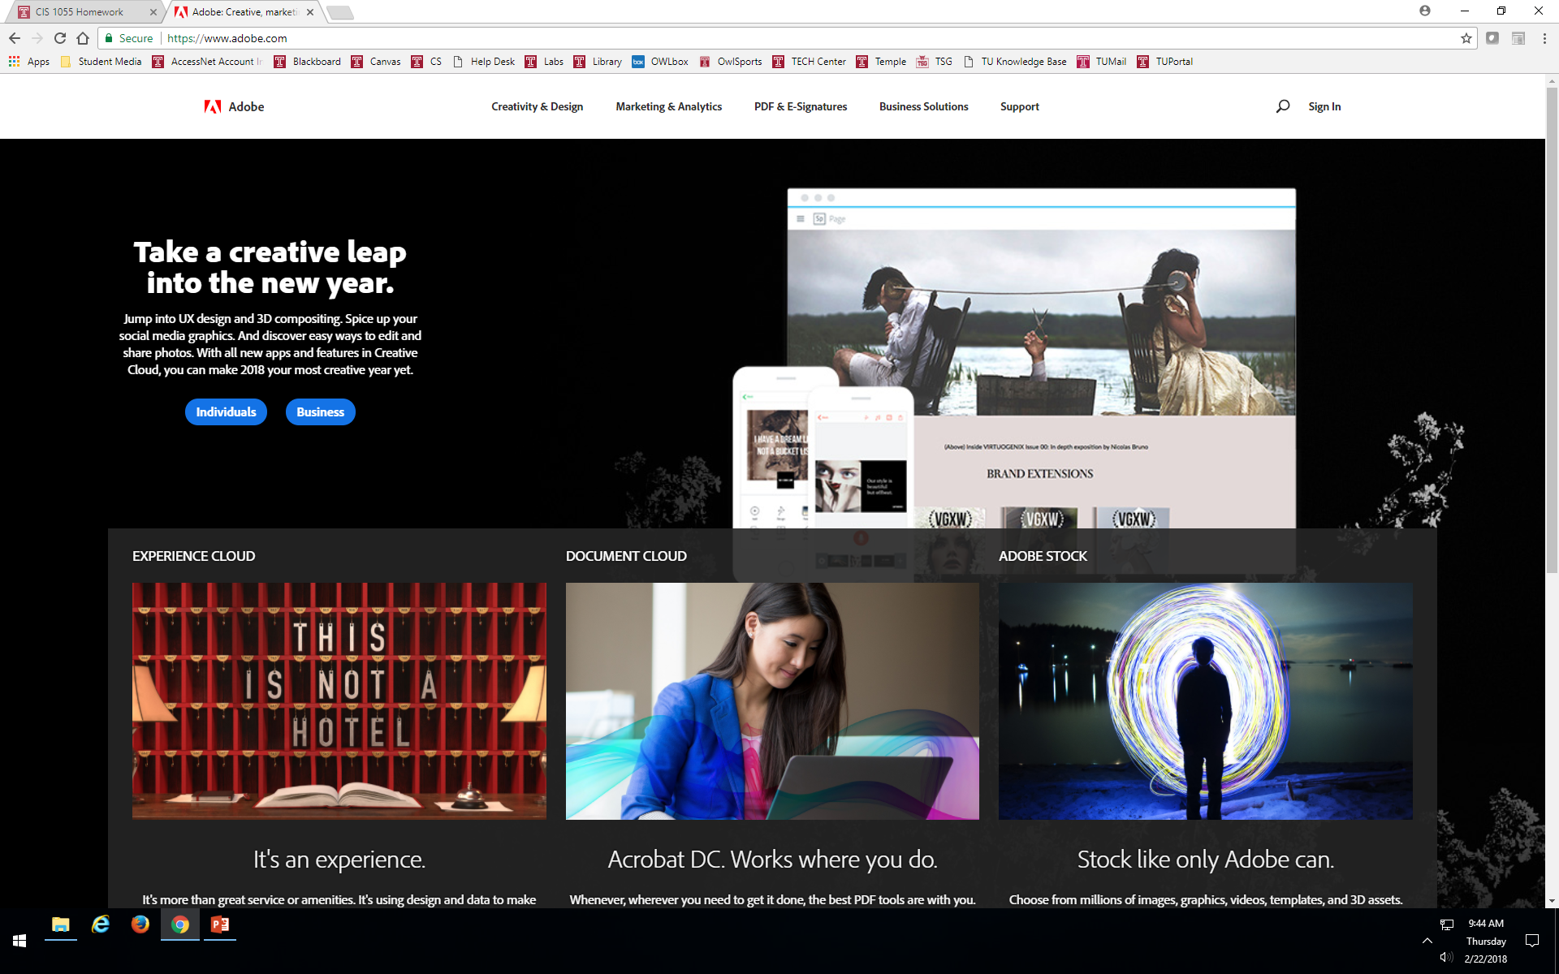
Overview of website

Slide 5
Interesting facts
operates as a diversified software company worldwide
Its Digital Media segment provides tools and solutions that enable individuals, small and medium businesses, and enterprises to create, publish, promote, and monetize their digital content
This segment (Creative Cloud) serves traditional content creators, Web application developers, and digital media professionals, as well as their management in marketing departments and agencies, companies, and publishers

Slide 6
Interesting facts continued
Valid as of 2/22/2018
Stock price: $203.81
Headquarter(s): San jose, CA
Founder(s): john warmock, Charles Geschke

Slide 7
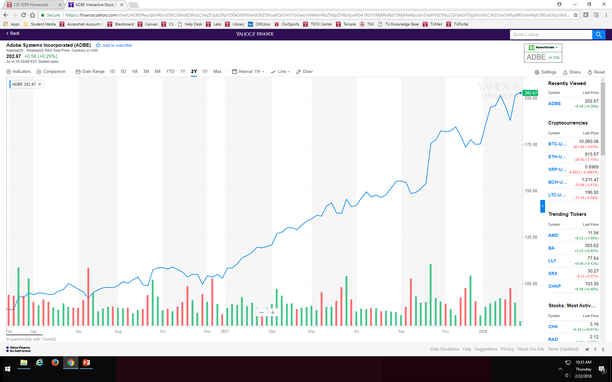

Slide 8
Shantanu Narayen
James E. Daley
Charles M. Geschke
John E. Warnock

Slide 9
Thank you for watching
Click here to visit us on the web

