Slide 1
Predicting EPC Energy Ratings
for Oxford's domestic stock
A leakage-aware ordinal-classification pipeline with SHAP-driven retrofit recommendations
COM6003 • Buckinghamshire New University • 2025-26
Author: Muhammad Omer Hussain (22509495)

Slide 2
Agenda
Roadmap of the talk: from data and methods to modelling and insights
From the raw EPC register to retrofit recommendations for Oxford.
DATA AND METHOD
ANALYTICS AND FINDINGS
• Dataset origin and background
• Data limitations and biases
• Feature engineering
• Data wrangling pipeline (leakage-aware)
• Descriptive and diagnostic analytics
• Predictive modelling: setup and results
• Feature importance and interpretation
• Conclusion and key takeaways
COM6003 • Oxford EPC Analysis
2 / 18

Slide 3
Why this matters
EPCs are the evidence base for retrofit policy and finance
• UK net-zero by 2050 → domestic buildings ≈ 17% of UK emissions (CCC, 2023).
• EPC rating drives lender retrofit lending, MEES enforcement, ECO grant routing.
• Oxford: 30.4% of dwellings built before 1900: almost double the England-wide share (ONS, 2023).
• Question: which physical features drive Oxford's rating, and where should retrofit £ go first?
17%
Domestic share of UK emissions
30.4%
Oxford dwellings built pre-1900
~5
SAP-point inter-assessor variance
COM6003 • Oxford EPC Analysis
3 / 18

Slide 4
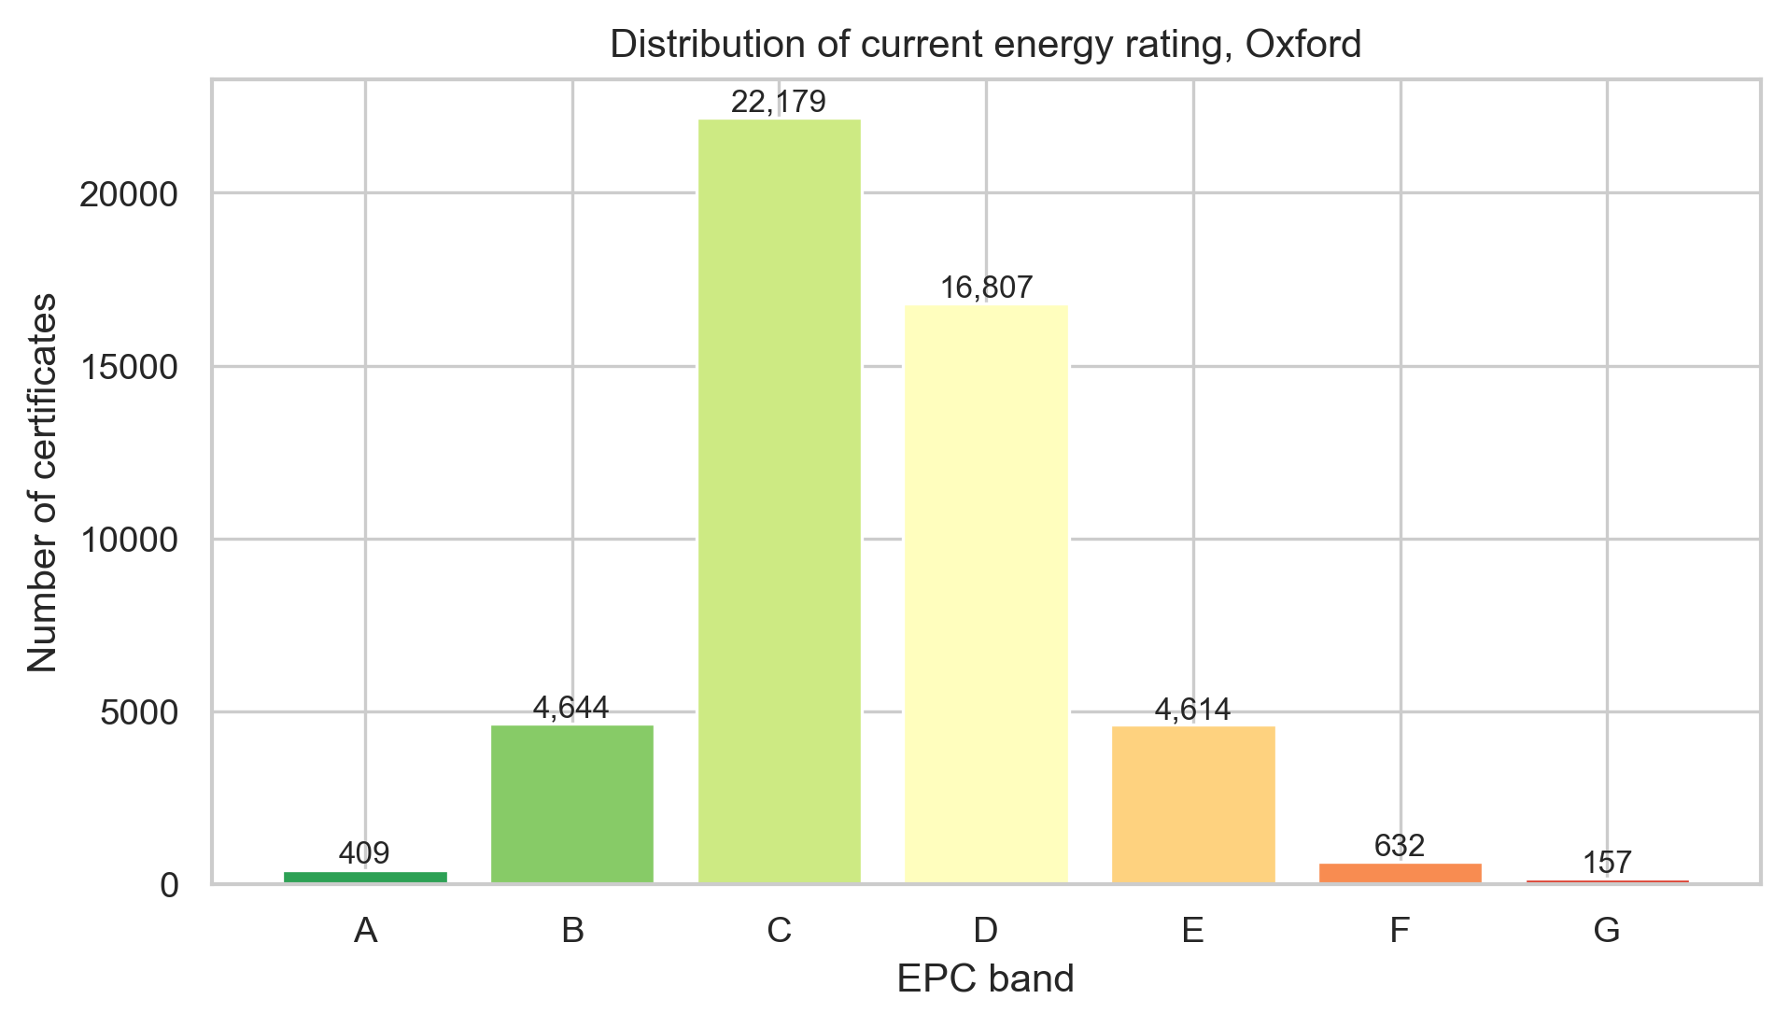
Dataset origin and background
Energy Performance of Buildings Register: Oxford (E07000178)
• Source: DLUHC / MHCLG, EPB Register; OGLv3 + restricted Ordnance Survey / Royal Mail address licence.
• Raw certificates for Oxford: 76430 rows × 93 columns.
• After cleaning + dedup-per-UPRN: 49,442 certificates.
• Two tables linked by LMK_KEY: certificates (one row per lodgement) + recommendations.
• Targets: CURRENT_ENERGY_RATING (ordinal A-G, primary); CURRENT_ENERGY_EFFICIENCY (1-100, secondary).
COM6003 • Oxford EPC Analysis
4 / 18

Slide 5
Data limitations and biases
What the EPC register can and cannot tell us
• EPCs are RdSAP-modelled, not measured: inter-assessor variance is about plus or minus 5 SAP points (Few et al., 2023; Hardy and Glew, 2019).
• Lodgement-event selection bias: only sold, let or new-build dwellings appear, under-representing long-tenure owner-occupiers (Crawley et al., 2019).
• Methodology drift: SAP 10 (2022) means certificates from different years are not strictly comparable, so we use a temporal split.
• Geographic specificity: findings are calibrated to Oxford's pre-1900-heavy stock and should not be extrapolated unmodified.
• Address-level fields are excluded under GDPR Article 5 data-minimisation.
±5
SAP points assessor variance
SAP 10
2022 methodology break
OGL v3.0
open licence (address fields restricted)
COM6003 • Oxford EPC Analysis
5 / 18

Slide 6
Feature engineering
Nineteen features from building physics, each with a hypothesised sign
Domain knowledge turned into leak-free model inputs, tested in the diagnostic and predictive sections.
NUMERICAL FEATURES
BOOLEAN FABRIC FLAGS (regex on descriptions)
• CONSTRUCTION_AGE_NUM (band midpoint year)
• LOG_FLOOR_AREA, AREA_PER_ROOM
• HEATED_ROOM_RATIO, LOFT_INSULATION_MM
• FLOOR_LEVEL_NUM (signed storey)
• INSPECTION_YEAR / QUARTER (methodology drift)
• POSTCODE_DISTRICT (outward code, non-PII)
• FLAG_CAVITY_INSULATED, FLAG_SOLID_BRICK_BARE
• FLAG_NO_LOFT_INSULATION, FLAG_LOFT_270MM
• FLAG_GAS_BOILER, FLAG_ELECTRIC_HEATING, FLAG_HEAT_PUMP
• FLAG_SINGLE_GLAZED, FLAG_TRIPLE_GLAZED
• Heat-pump flag deliberately ambiguous (SAP is cost-based)
COM6003 • Oxford EPC Analysis
6 / 18

Slide 7
Pipeline
Leakage-aware, reproducible, every step a pure function
Typed loader
Leakage filter
Dedup-per-UPRN
Feature engineering
ColumnTransformer
HistGB regression-to-band
SHAP + calibration + fairness
explicit dtypes, parsed dates
drop SAP-engine outputs
latest EPC per dwelling
19 engineered features
fit only on train fold
with SAP-cohort routing
audit every result
Train ≤ 2022-12-31 → Hold-out ≥ 2023-01-01 (temporal split)
COM6003 • Oxford EPC Analysis
7 / 18

Slide 8
The single biggest pitfall: and how we avoided it
Leakage audit on the SAP-derivative columns
• The target is *derived* from the SAP/RdSAP calculation: many columns in the CSV are *outputs* of the same engine.
DROPPED: would leak
KEPT: physical reality only
• POTENTIAL_ENERGY_RATING / EFFICIENCY
• ENVIRONMENTAL_IMPACT_*
• ENERGY_CONSUMPTION_*
• CO2_EMISSIONS_*
• LIGHTING_COST_*, HEATING_COST_*, HOT_WATER_COST_*
• Per-element *_ENERGY_EFF stars (kept for diagnostics, not features)
• PROPERTY_TYPE, BUILT_FORM, CONSTRUCTION_AGE_BAND
• WALLS_DESCRIPTION, ROOF_DESCRIPTION, WINDOWS_DESCRIPTION
• MAIN_FUEL, MAIN_HEATING_CONTROLS, MAINS_GAS_FLAG
• TOTAL_FLOOR_AREA, NUMBER_HABITABLE_ROOMS, …
• Engineered: FLAG_CAVITY_INSULATED, FLAG_LOFT_300MM, …
• Dedup-per-UPRN: same dwelling never crosses the split
COM6003 • Oxford EPC Analysis
8 / 18

Slide 9
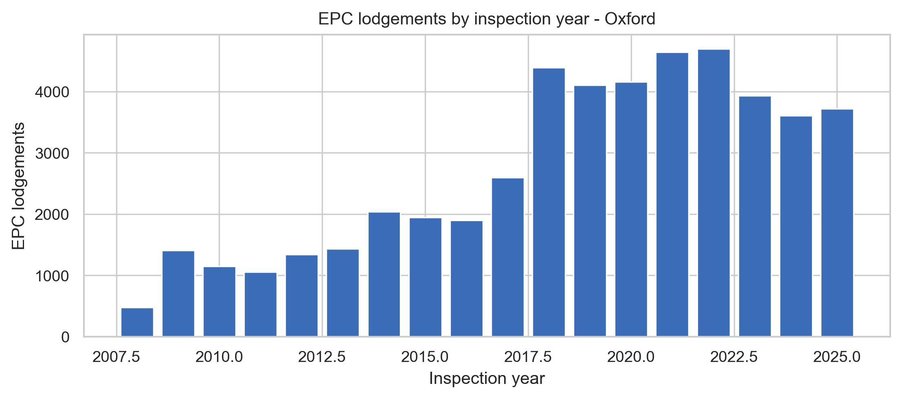
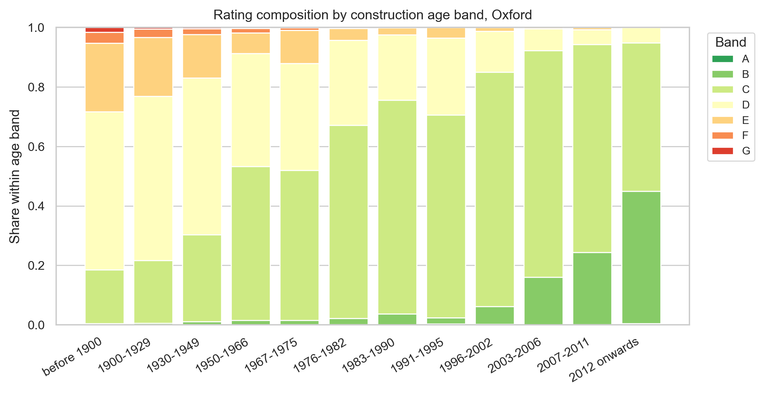
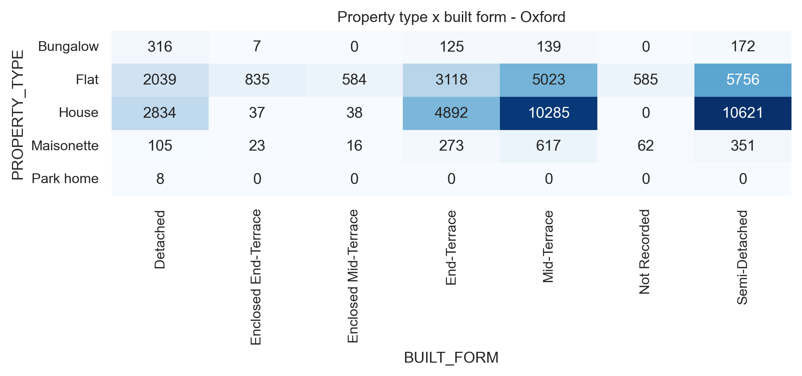
EDA: what we found
Class imbalance and a clear age-band gradient
COM6003 • Oxford EPC Analysis
9 / 18

Slide 10
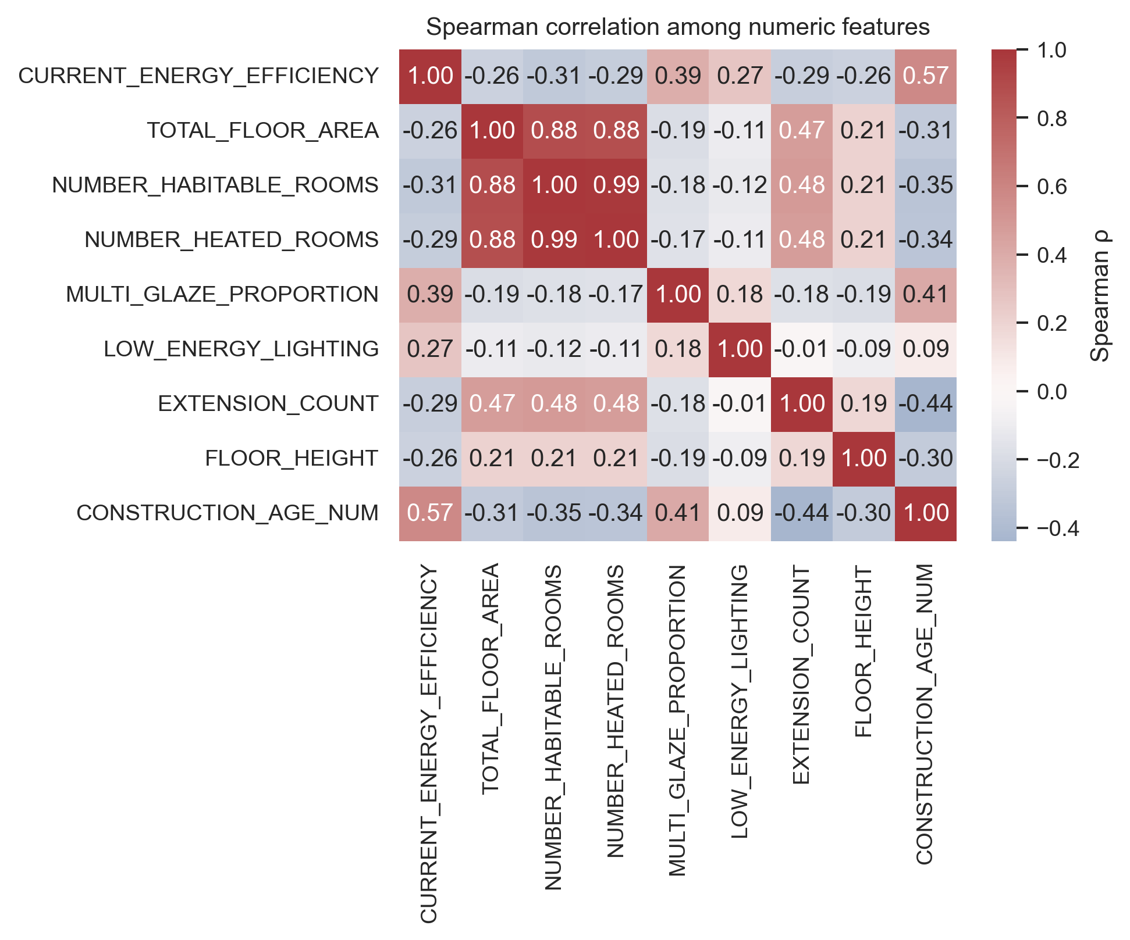
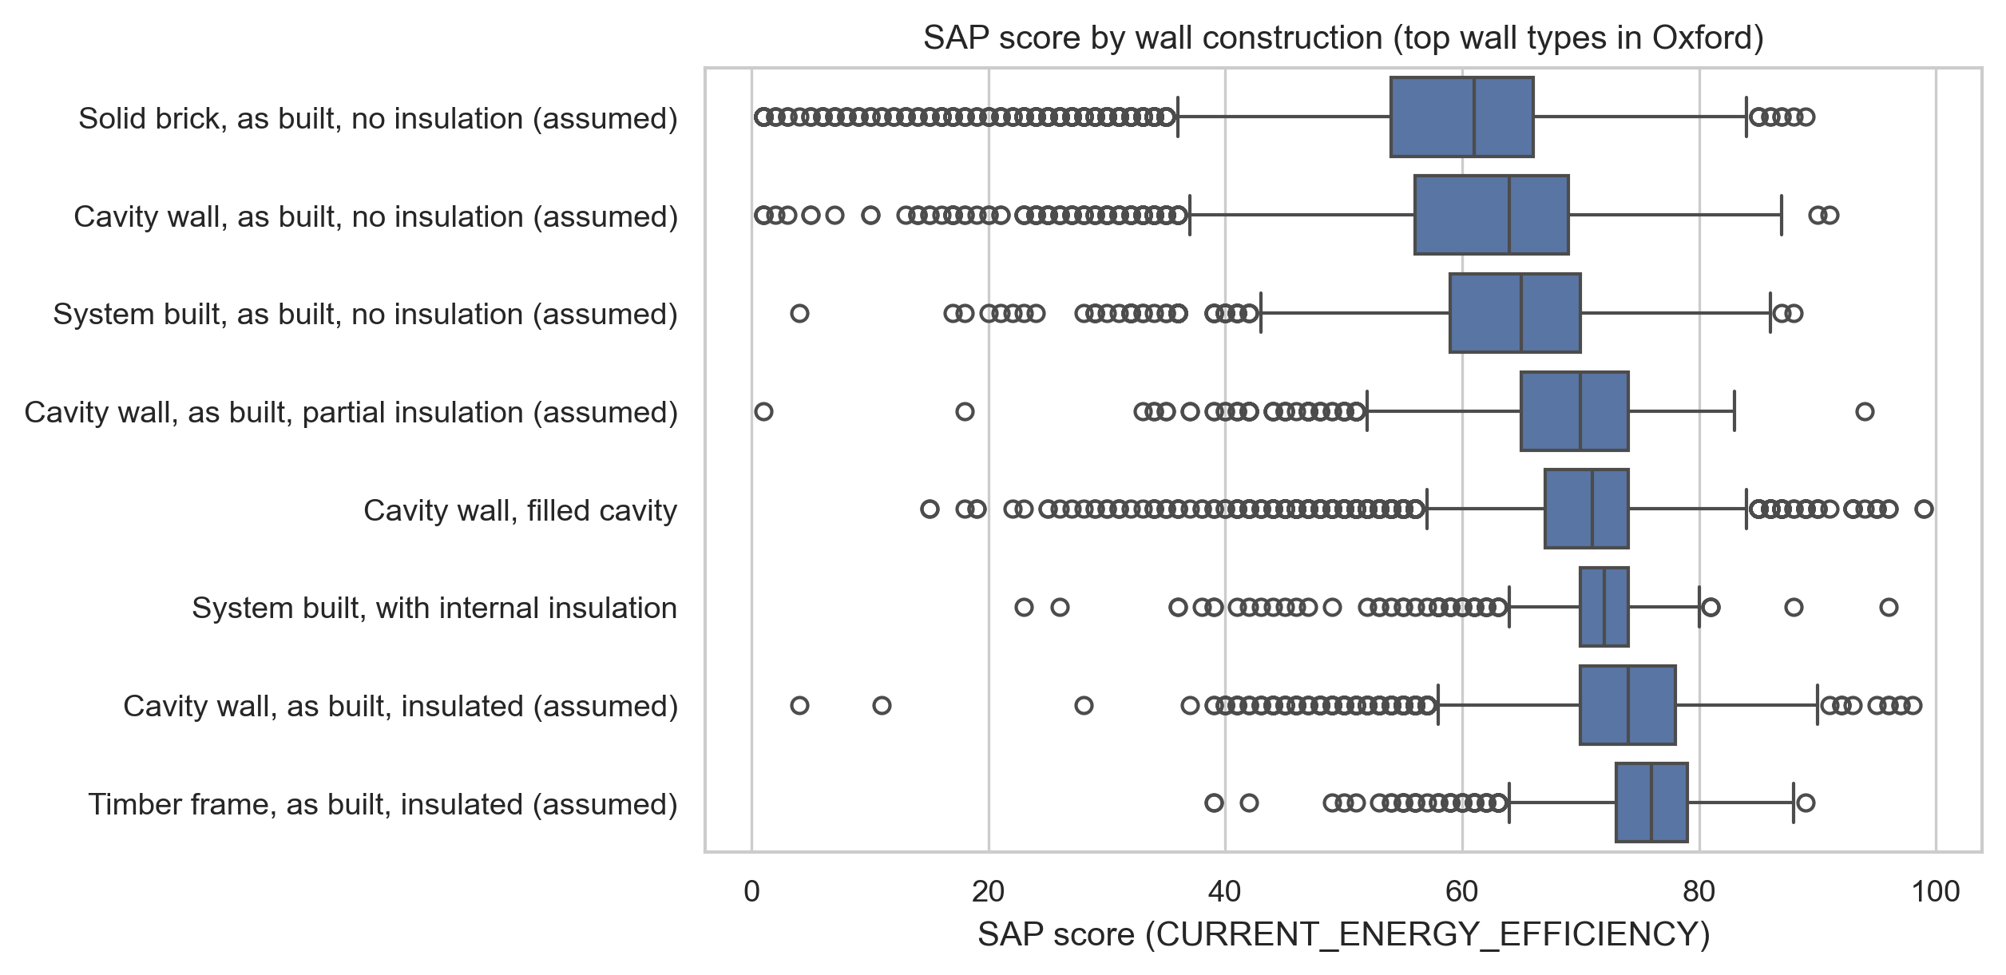
Diagnostic analytics: why ratings vary
Correlation heatmap and association statistics: walls and age dominate
Test statistics (hold-out)
Spearman ρ: age vs SAP
0.618
Spearman ρ: multi-glaze vs SAP
0.209
Cramér's V: walls vs rating
0.407
Cramér's V: main fuel vs rating
0.318
Cramér's V: age band vs rating
0.366
Cramér's V: built form vs rating
0.091
COM6003 • Oxford EPC Analysis
10 / 18

Slide 11
Model comparison
Quadratic Weighted Kappa: 5-fold GroupKFold (no UPRN leakage)
Model
QWK
± std
Logistic regression (full)
0.40
Random Forest (group split)
0.840
± 0.003
HistGB classifier (group)
0.840
± 0.002
LightGBM + expected-value
0.867
± 0.005
Regression-to-band (champion)
0.863
Ensemble (RF+HGB+LGBM mean proba)
0.860
COM6003 • Oxford EPC Analysis
11 / 18

Slide 12
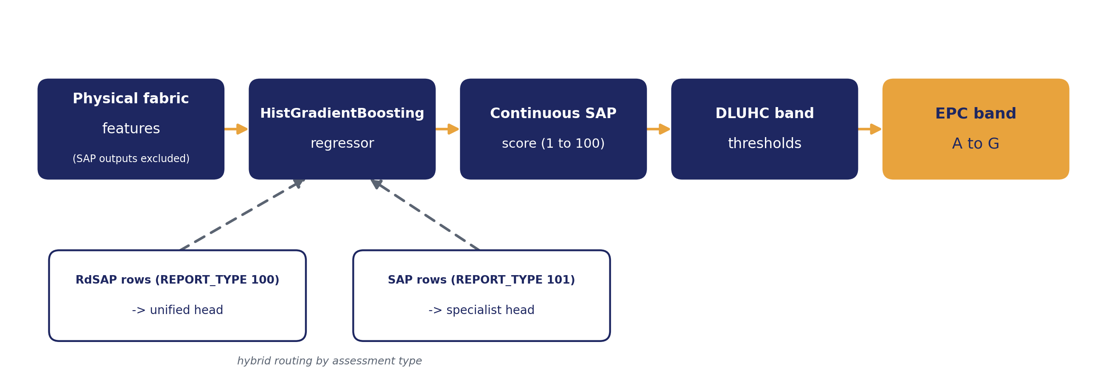
How the champion turns features into a band
Regression-to-band with SAP-cohort routing
EPC bands are a deterministic discretisation of the SAP score, so predicting the score and then thresholding is statistically consistent (Pedregosa et al., 2017) and supports counterfactual retrofit queries a discrete classifier cannot express.
COM6003 • Oxford EPC Analysis
12 / 18

Slide 13
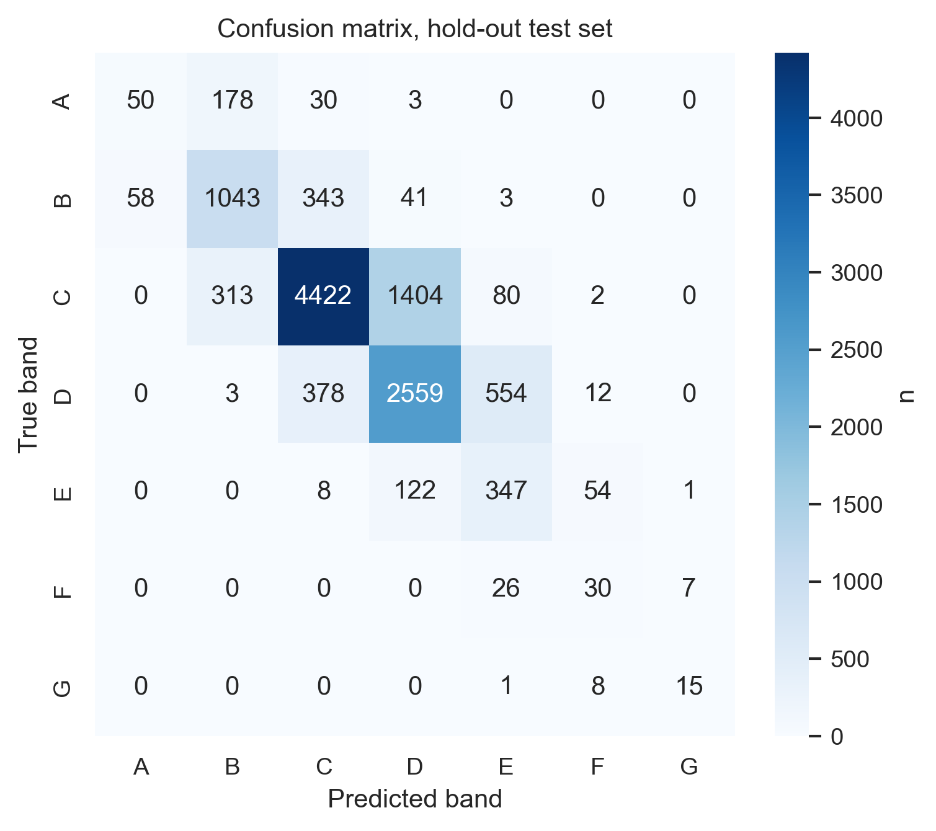
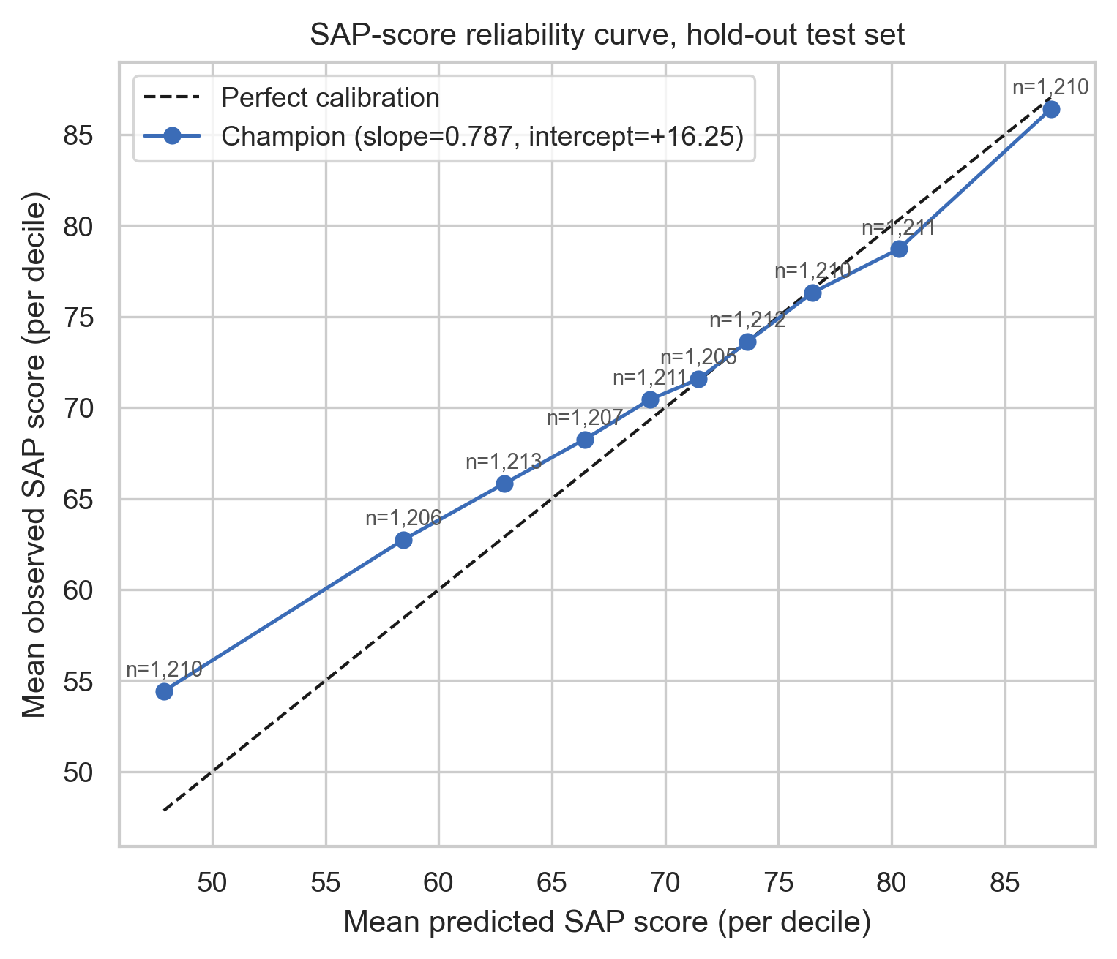
Champion: SapStratifiedRegressor hybrid
Regression on SAP score + SAP-cohort specialist; evaluated once on inspections from 2023+. Multi-seed: 0.7714 ± 0.0019 across seeds 42/123/2026.
0.7696
0.584
0.550
4.05
Quadratic Weighted Kappa
Balanced accuracy
Macro-F1
SAP MAE (vs ~5-pt assessor noise floor) | 97.7% within 15 SAP pts (ONS DSC national: 93%)
COM6003 • Oxford EPC Analysis
13 / 18

Slide 14
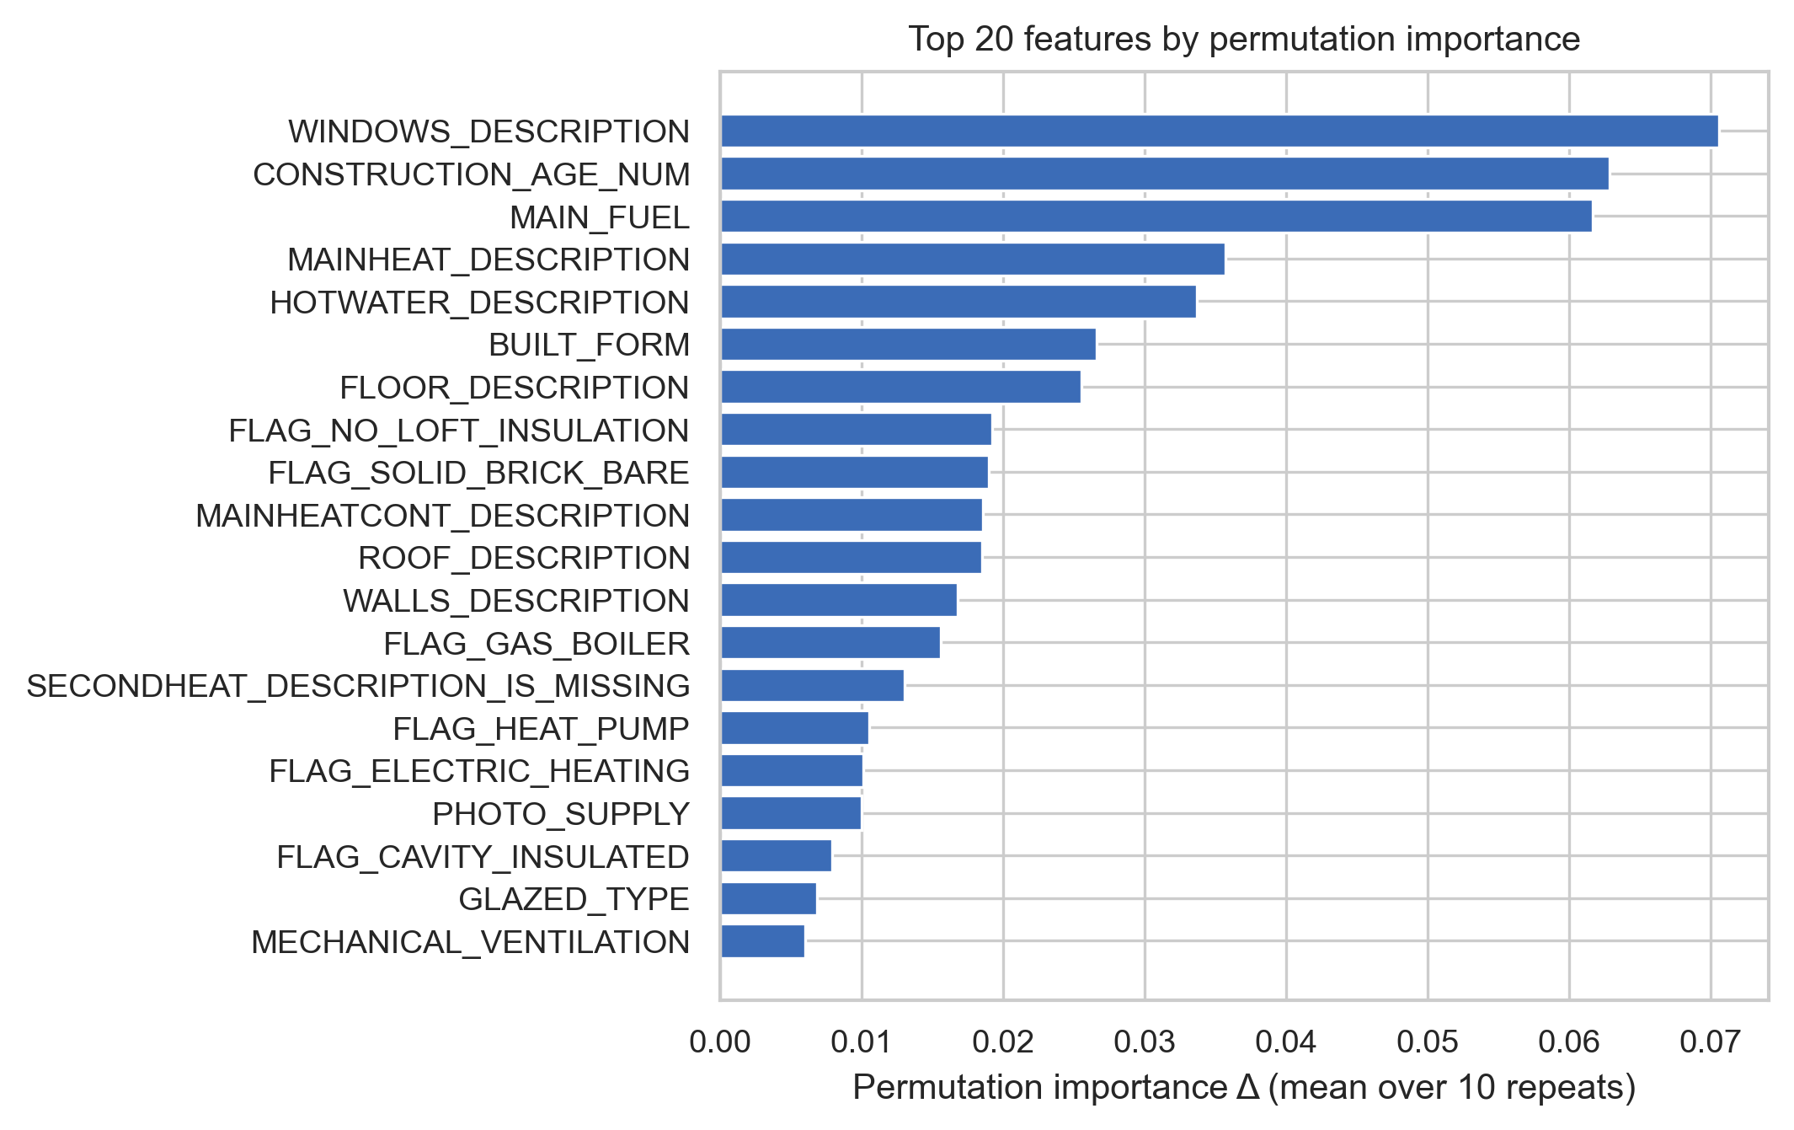
What drives the rating
Windows, construction age and main fuel dominate by permutation importance
• Windows: single-glazed dwellings carry the largest negative SHAP contributions; multi-glazed the largest positive. Top feature by permutation importance (Δ-QWK +0.071 on shuffle).
• Construction age: monotonic gradient reflecting four decades of Part L revisions (Spearman ρ 0.62 vs SAP).
• Main fuel and heating type: gas / condensing-boiler dwellings score higher; heat pumps do not improve the rating because SAP is cost-based and electricity is ≈ 3× more per kWh.
• Walls: solid-brick uninsulated drives negative SHAP; cavity-with-insulation positive (FLAG_SOLID_BRICK_BARE in top 10).
• Permutation importance and SHAP agree on the top features → robust signal, not algorithmic artefact.
COM6003 • Oxford EPC Analysis
14 / 18

Slide 15
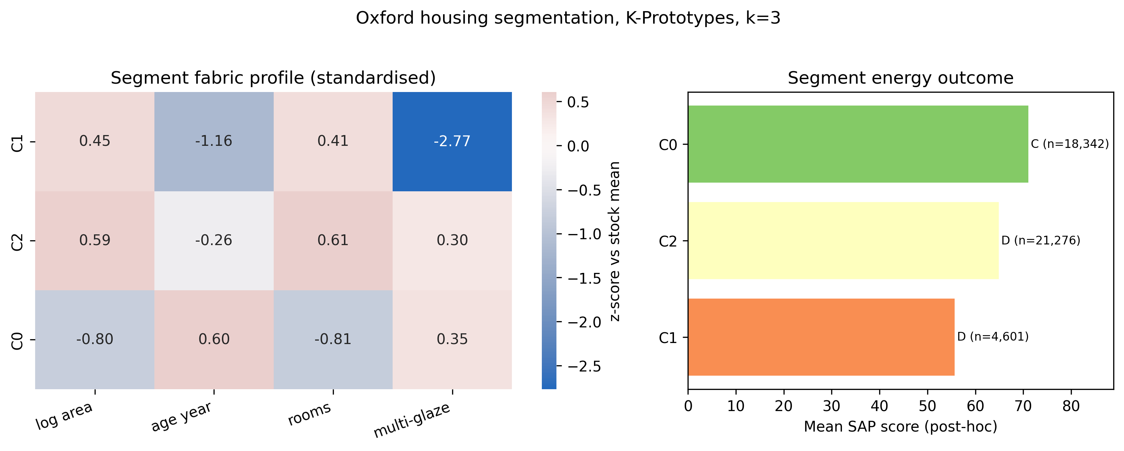
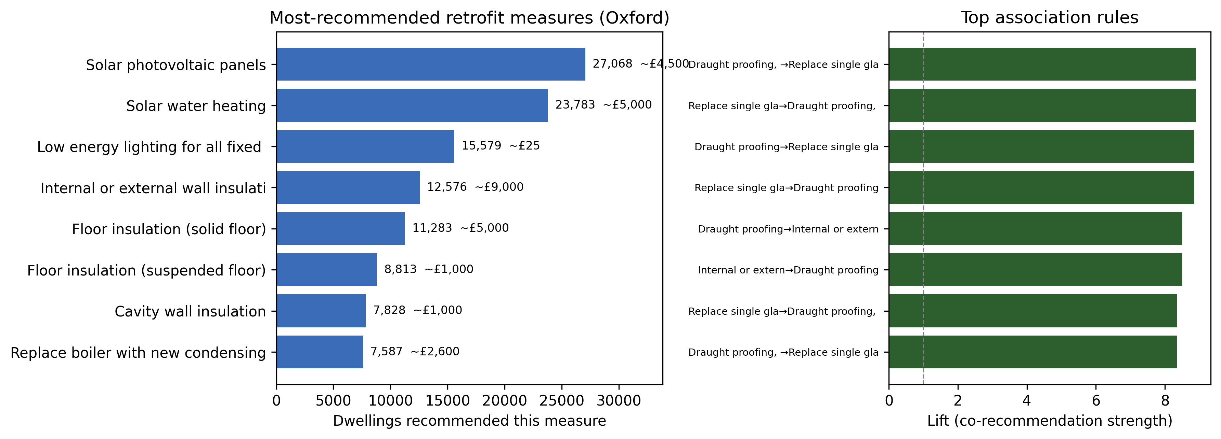
Unsupervised segmentation and retrofit recommender
Three fabric archetypes (K-Prototypes, k = 3) and an Apriori + content-based k-NN recommender
k = 3
0.24
8.9
0.97
K-Prototypes segments
Gower silhouette (soft archetypes)
Top Apriori rule lift
Recommender hit-rate (precision@5 +0.08 vs popularity)
COM6003 • Oxford EPC Analysis
15 / 18

Slide 16
Recommendations
For Oxford City Council and registered providers
1.
Solid-wall insulation in pre-1929 stock
Largest single physical lever; £4-14k per dwelling; SAP-engine corroborates.
2.
Loft insulation top-ups to ≥ 270 mm
Cheapest material intervention; positive SHAP across nearly all bands.
3.
Replace single glazing in 1900-1949 cohort
Concentration of FLAG_SINGLE_GLAZED; immediate comfort benefit.
4.
Communicate the heat-pump SAP caveat
SAP is cost-based; tariff differential blunts rating gain: manage expectations.
5.
Geographic targeting: OX1 / OX2 / OX4
Highest density of pre-1900 stock; district-weighted subsidies. Operational deliverable: reports/predictions_oxford.csv (76,400 per-UPRN predictions + confidence proxy).
COM6003 • Oxford EPC Analysis
16 / 18

Slide 17
Conclusion and key takeaways
A leakage-controlled, interpretable EPC predictor for retrofit targeting
• EPC band is predictable from physical fabric alone: QWK 0.7696 on a strict temporal hold-out, leakage-controlled.
• Windows, construction age and main fuel are the dominant levers; wall construction is the largest categorical driver.
• Predictions are honest about uncertainty (score MAE 4.05, at the assessor-noise floor) and carry a confidence proxy.
• Output is operational: a 76,400-row per-UPRN file for ECO4, MEES and geographic targeting.
• Fully reproducible: 95 automated checks (25 data + 70 model) all pass.
0.7696
Quadratic Weighted Kappa
97.7%
within 15 SAP points
95
automated checks pass
COM6003 • Oxford EPC Analysis
17 / 18

Slide 18
Limitations & questions
Honest about the ceiling: not all variance is reducible
Model ceiling and ethical use
• Score MAE = 4.05 sits at the irreducible assessor-noise floor (about 5 SAP points), so the model is near the achievable ceiling rather than under-fitting.
• Sparse A, F and G bands carry wide confidence intervals; the reliability curve shows mild compression (slope 0.79), correctable by isotonic regression.
• SAP-only cohort (REPORT_TYPE 101) hold-out QWK = 0.578 despite the hybrid lift: its predictions cluster near band boundaries (98.8% within 15 SAP points).
• Not for individual valuation, mortgage underwriting, or automated decisions with legal effect (GDPR Article 22).
Questions?

