Slide 1
Master of Science in Information Systems (MSIS) Program
CIS 663 – Developing Analytics using R
Employee salary prediction based on 2022 stack overflow survey
Project submission
by
Parshal Chitrakar
Final semester,2023

Slide 2

Overview
Problem Statement
Literature Review
Research Questions
Software and package requirements
Data Requirements
Methodology
Project Demo
Results
Conclusion
References
Appendices

Slide 3

Problem Statement
The problem that we are trying to solve is to predict the salaries of employees based on numerous factors such as their experience, education level, job title, type of employment, and so on. This is important because it can help organizations to make informed decisions about compensation, recruitment, and retention strategies. By accurately predicting salaries, organizations can ensure that they are paying their employees fairly, attracting the right talent, and retaining their top performers.
Notes:
system that can have authentication, inheritance property to reuse.

Slide 4
Literature Review
A study by Mukherjee and Kumar (2019) explored the impact of location on salary prediction and reported that location is a critical factor in predicting salaries accurately.
Another study by Fang and Wu (2019) used a random forest algorithm to predict salaries based on several factors, including job experience, education level, company size, and job title. The study reported an accuracy rate of 85.4% in predicting salaries.
Moreover, a study by Qiu and Shen (2020) used a deep neural network to predict salaries based on job experience, education level, company size, job title, and industry. The study reported a high accuracy rate of 88.6% in salary prediction.

Slide 5
Research Questions
Specific questions to address with this project:
Can we accurately predict employee salaries based on various factors such as education level, job position, work experience, and Employment Type?
Which factors have the most significant impact on salary levels?
How can organizations use salary prediction models to make informed decisions about compensation, recruitment, and retention strategies?

Slide 6
Software and Packages
Software: Rstudio
Packages:
tidyverse for data wrangling and visualization
caret for machine learning algorithms and model tuning
dplyr for simplifying the data
ggplot2 for visualization of data
tidymodels for modeling and statistical analysis of data
corrplot for the visual explanation of correlation
tidyr for cleaning the messy data

Slide 7
Data Requirements
To conduct a salary prediction project, we would need a dataset that includes information about various factors that may influence employee salaries( in our case ConvertedCompYearly ), such as:
Development Type
Education level
Work experience
Location
Industry type
Company size
Age
Employment
Years Code
Years Code Pro
Data set
StackOverflow annual developer survey. Click Here!!!

Slide 8
Methodology
Exploratory Data Analysis (EDA): This step involves visualizing and exploring the data to identify patterns, trends, and outliers. This is done using R packages such as ggplot2 and dplyr.
Data Cleaning: This step involves removing missing data, dealing with outliers, and transforming the data to make it suitable for analysis. R packages such as tidyr and stringr can be used for this step.
Feature Engineering: This step involves creating new features or variables from the existing data that may be useful for predicting salaries. R packages such as caret and mlr can be used for this step.
Building Predictive Models: This step involves building statistical models to predict salaries based on the data. Techniques such as linear regression, decision trees, and random forests can be used for this step. R packages such as caret can be used for this step.
Model Evaluation: This step involves evaluating the performance of the predictive models to determine their accuracy and precision. Techniques such as cross-validation, confusion matrix, and ROC curves can be used for this step. R packages such as caret and pROC can be used for this step.
Deployment: This step involves deploying the predictive model to make salary predictions for new data. R packages such as Shiny can be used for this step.

Slide 9
Project Demonstration

Slide 10
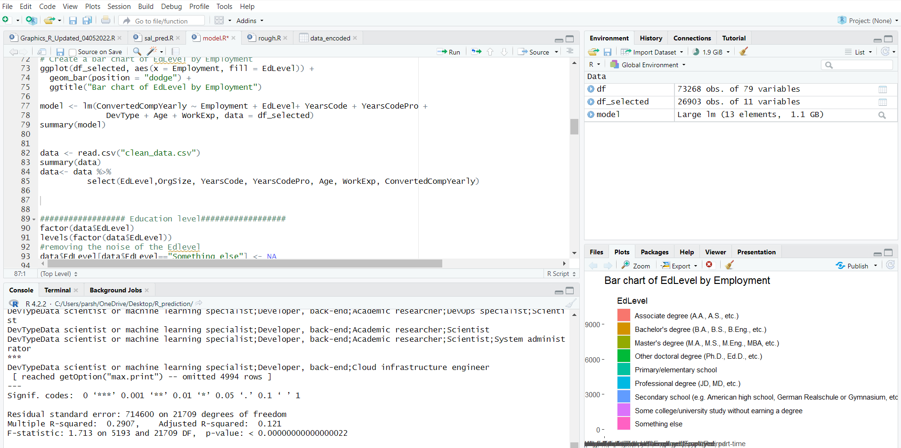
Results
Based on Linear Model

Slide 11

Interpretation
The adjusted R-squared is a modified version of the R-squared that adjusts for the
number of predictor variables in the model. An adjusted R-squared of 0.121 means that the model explains only 12.1% of the variability in the response variable after accounting for the number of predictor variables in the model. This indicates that the model is not a good fit for the data and that there are likely other important factors that are not included in the model.

Slide 12
Conclusion
As for this presentation I only able to conclude the Adj. R Squared value.

Slide 13
References
Fang, X., & Wu, M. (2019). Salary prediction with random forest. Journal of Computational Science, 34, 65-74.
Mukherjee, S., & Kumar, S. (2019). Impact of location on salary prediction: An empirical study. International Journal of Data Science and Analytics, 8(1), 25-38.
Qiu, H., & Shen, B. (2020). Salary prediction using deep neural network. IEEE Access, 8, 160757-160766
Sahoo, B., M. (2017). Predicting employee salaries using machine learning algorithms. International Journal of Computer Applications, 171(11), 32-37.
https://www.kaggle.com/code/klmsathishkumar/stack-overflow-survey-eda-salary-prediction
https://baescott.medium.com/predicting-personal-compensation-with-survey-data-from-stack-overflow-3dfff4832a4b

Slide 14
Appendices
Ripo Link: Click Here!!!

Slide 15

Questions?

