Slide 1
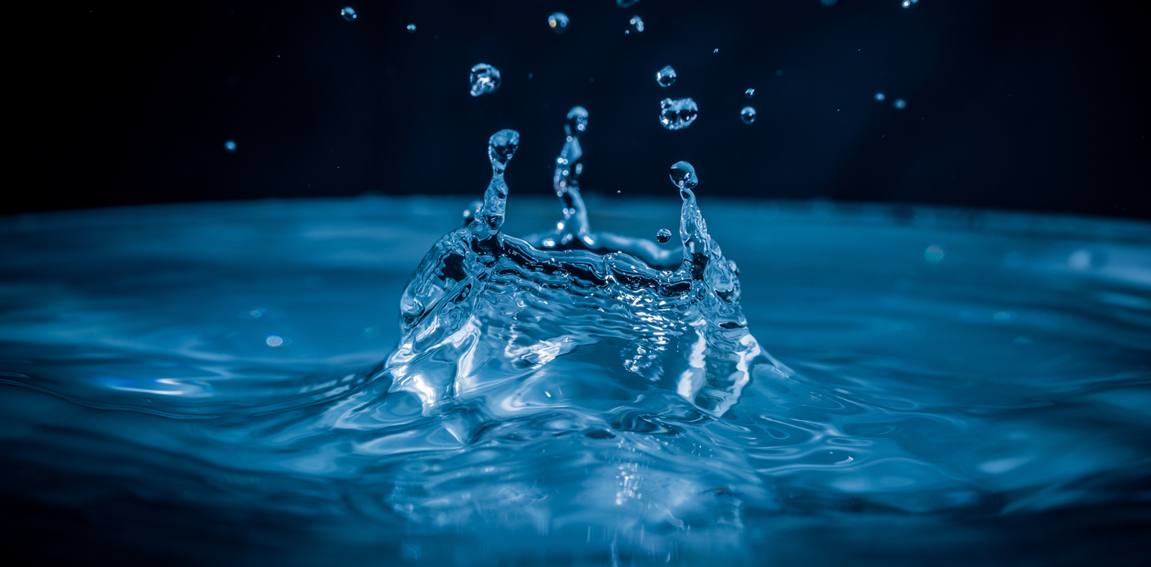
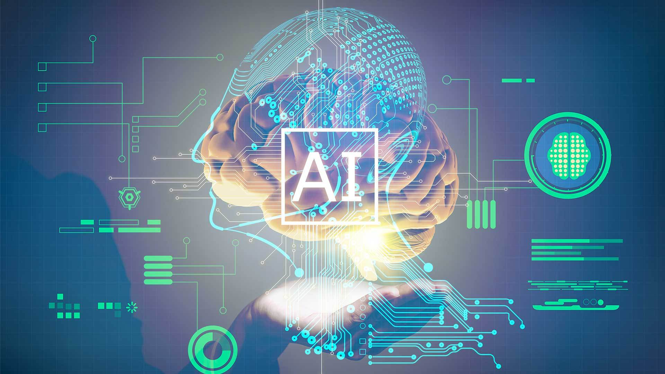
Reimagining Methods to rehash waste water

Slide 2
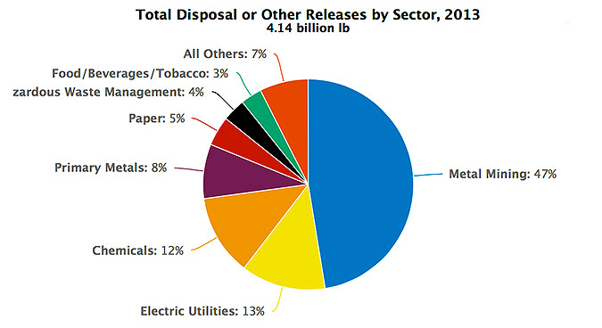
Autonomous water Rehash system.
Everyday million gallons of water is being wasted by the industries and discharged into water bodies.

Slide 3
So, how can we solve this major and most discussed problem … ?

Slide 4
Approaching the problem statement.
We can test the polluted water for toxic compounds in it, which are hazardous for humans and water bodies, and then suggest the industry with filtration methods, accordingly.
Instead of manually testing it, we can use cutting edge technology.

Slide 5
How..??
Using Artificial intelligence, By training the Model on top of previous pollutant data, we can predict the pollutants level in the water, without any manual effort.
This would be completely an autonomous system
Linear Regression Algorithm.
Data is trained until we get the minimum error and maximum accuracy.
This idea would be very beneficial as same model would be used for the industries in the same category.

Slide 6
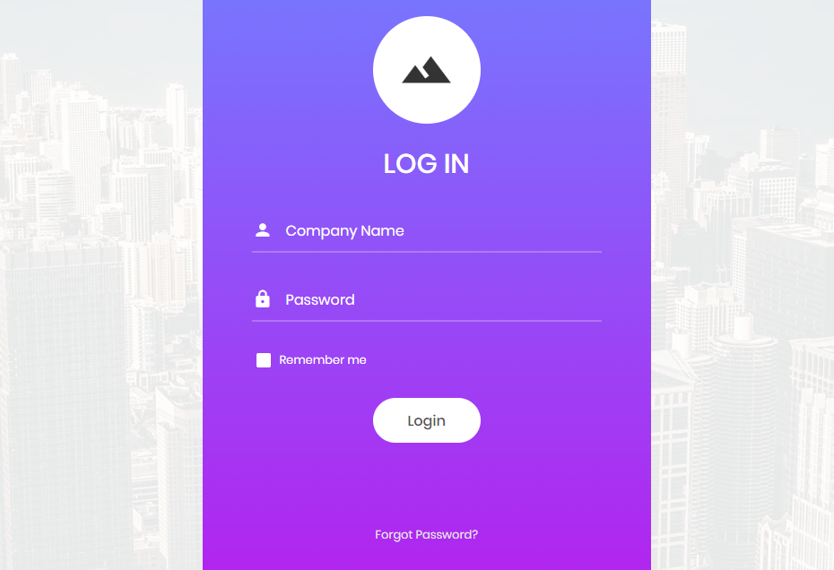

Slide 7
Enter quantity of waste water:
Import Dataset:

Slide 8
Output:
Zinc Amount:
BOD Amount:
PH Amount:
COD Amount:

Slide 9
Environmental benefits..
Water will be recycled, which can be again used by the industry.
Eutrophication can be stopped which leads to healthy water bodies.
Economical benefits..
This Idea can be extended to increase the business. AI can be trained to predict the amount industries are saving by reusing and recycling.
And the reused can be traded as well with other industries.

Slide 10
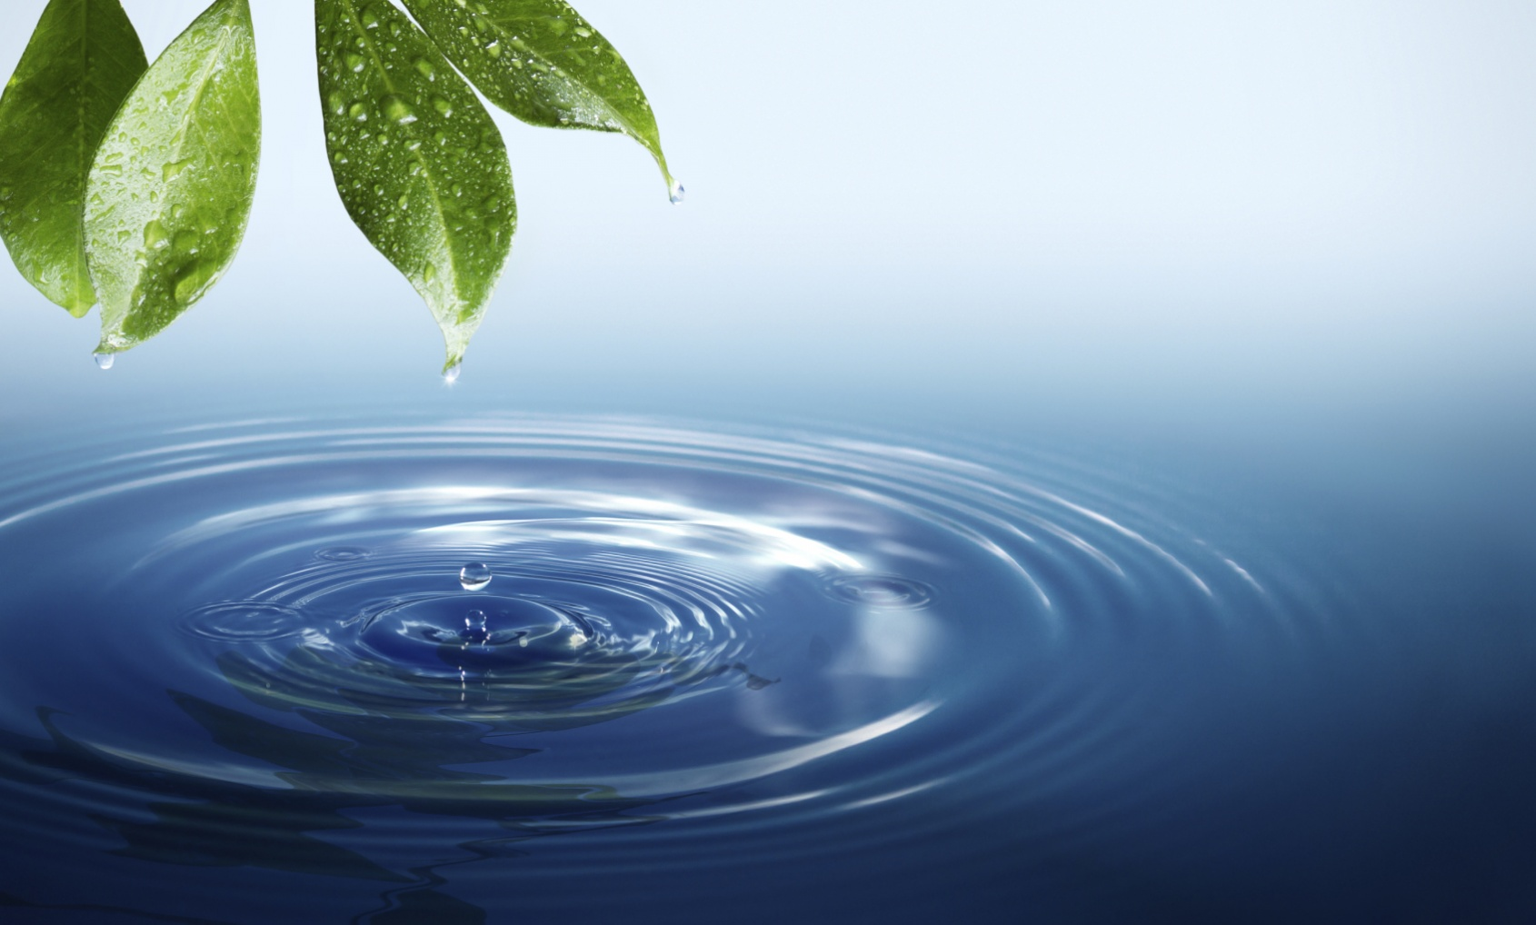
Life depends on water
The reservoir depends on you.

Slide 11
Questions.??

Slide 12
Thank you..
HAck elite.

