Slide 1



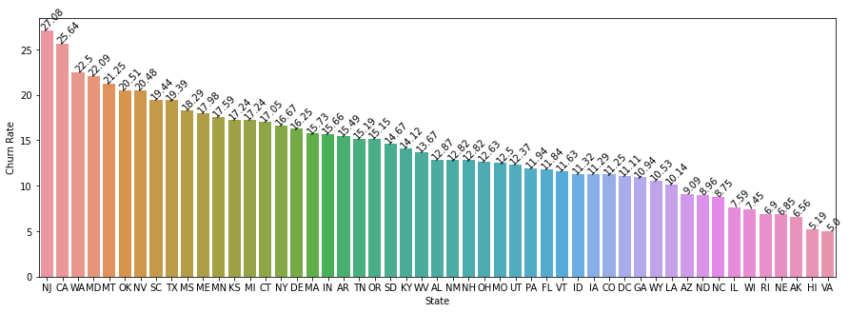
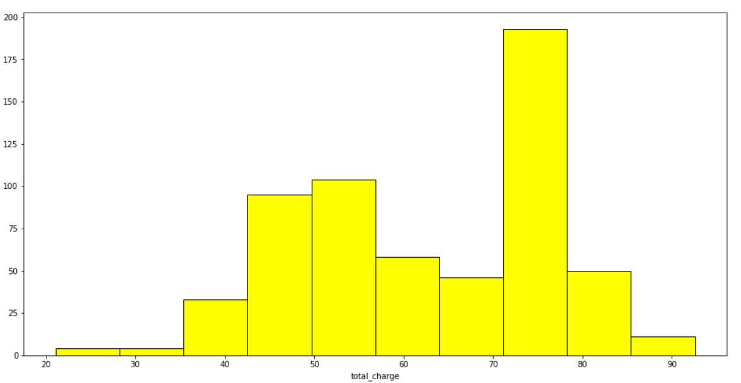
Customer Churn: Predicting whether a customer will change telecommunications provider
Problem statement -
Identify the reasons for customer churning out and provide insights and solutions
Key questions to be answered-
Which are the factors leading to the churn ?
How to predict if the customer will churn or not?
What are the measures the company should take in order to reduce the churn in future ?
Track Name – Analytics using Python ( Track B )
Primary research –
We searched on the net for the best dataset available for the telecommunication data churn.
We finally landed on Kaggle where we found the perfect dataset for our research.
Data consisted of 4250 rows and 20 columns.
Data was clean with no missing values.
Our dependent variable is “churn” which is a categorical Boolean variable with yes
and no as values.
Team Name – MIND BENDERS
Secondary research –
The target variable “churn” is imbalanced.
Most of the numerical data follows a normal distribution.
There are many columns which are inter corelated which will lead to multi collinearity.
A column named number – Vmail messages has most of the entries as “0”.
We have divided this data into training & testing in the ratio of 7:3.
Parshva Shah – E-Business
Tanuja Daswani – Core
Gaurav Mohane – E-Business
Himanshu Trivedi - Core
Aditya Raj - Core
Rohit Prajapati - RBA
Solution
We did a deep dive into the data and filtered out the most important columns for our model.
We also did some feature engineering and derived new features for model optimization.
Finally we created 2 models using Logistic regression and random forest algorithms.
We were able to get an accuracy of 97.17% with random forest search algorithm.
The output variable “churn” was highly imbalanced. Number of “yes” accounted for only 598 and number of yes accounted for 3652.
Therefore in such situations the model generally predicts very well on the “no” but does a poor prediction on “yes”.
But our random forest algorithm did a very good job and highly reduced the type 1 and type 2 errors. This means this model is predicting very well on both the classes.
Graphs
Insights
People having an international plan are churning at a rate of 42%.
When the number of service call is increasing beyond 4, the churn rate increases significantly(goes above 50%).
Regions of New jersey and California are witnessing maximum churning, hence these states should be prioritized followed by Washington, Maryland and Montana.
Most of the customers churn when they cross a spend between 70 to 80 dollars.
Way Ahead ?
Using our model telecom companies can first identify the set of churning customers to target for retention campaign.
Make sure that the customer is not facing a bad service issue. Bad services include less internet connectivity, rising costs, unstable network etc. This can also be focused in the top states that have the maximum churning and other important factors that are mentioned above.
Once the issue is identified the company should ensure that it is resolved.
Another strategy can be to offer incentives to customers from time to time and throw up long term offers. Some examples of long term offers include:
Subscribing at an annual plan and getting 2 months of free subscription.
Cashbacks on monthly recharges.
Offering competitive pricing based on other service providers.

