Slide 1
Green Technologies
How green are they?

Slide 2
Introduction
Eco-friendly: produce much less pollution per unit compared to previous generation technologies
Eco-efficient: utilize lesser natural resources
These technologies thought to bring about decline in environment degradation decline
Technology is seen as panacea for countering the present environmental problems
With such optimism on technology there is a belief that economic growth can happen sustainably without affecting environment

Slide 3
Technology and Environment
Link between environment and technology is greatly visible within the proponents of Ecological Modernization Theory
Ecological Modernization Theory (EMT): The argument of this theory assumes that ‘green’ technology developed and commercialized in core countries (which develop, produce and distribute) will benefit, or at-least have the capacity to benefit all people universally
Use of advanced technology is the principal component of EMT
Globalization influences technology innovation and implementation

Slide 4
Ecological Modernization Theory
Adoption of new technologies (green and clean/eco-friendly and eco-efficient) will help to reduce societal impact on the environment
Inference from EMT:
With adoption of new technologies, increase economic activity will no longer necessarily degrades environment
Advances in green technology are neutral in nature and universally beneficial
Increase in adoption of such technologies will bring greater resource conservation
Such technologies are seen as ‘magic bullets’, assumption is that there is no need to change the consumption pattern or reduction in economic activity

Slide 5
Critiques to EMT
In systems thinking ‘green’ technologies are visualized as commodities as they are derived from particular natural resources
Commodities in general are related to inequality and exploitation
Therefore, green technologies too imply relations of inequality and exploitation
It implies that green technologies may bring benefits to core nations, may also bring environment degradation, violence and social disruption on countries which mainly provide resources for technology production

Slide 6
Inequality of green technologies
Does ‘green’ technology benefit one group of people than other?
Technological development is social
Those with greater power- increased capacity to develop technologies that best suits to their needs and interests
For access to natural resources- states act violently to dispose people from their land
States violently supress environment protest movements

Slide 7
Case studies
To understand:
Sources and sinks of ‘green’ technologies
Nature of world-economic system in the process of ecological modernization
Outcomes and impacts of ‘green’ technologies on the world
Three case studies are discussed:
Automobile catalytic convertors
Bio-fuels
Hybrid cars

Slide 8
Ecological modernization of automobiles
Catalytic convertors installation started in 1970s by American automobile manufacturers
Optimism on this technology towards environment benefits
Catalytic convertors:
Reduce amount of hydrocarbons, carbon monoxide and nitrogen oxide
Trigger chemical reactions which transform harmful emissions into benign compounds
These convertors have reduced amount of such gases by 90% compared to 1970 levels (McCarthy 2007)

Slide 9
Catalytic convertors
Convertors have group of minerals known as ‘platinum group metals (pgms)’
These include palladium, platinum and rhodium
Platinum and palladium are essential for reduction of hydrocarbons and carbon monoxide emissions
Rhodium for reducing nitrogen oxide emissions
Sources for pgms – South Africa and Russia
Implementation of catalytic convertors in America and Europe (societies structured around automobile transportation)

Slide 10
Sources-impacts
In both South Africa and Europe, platinum mining has serious environmental consequences for local people
In Limpopo region of SA
People displaced from their farms
Had to loose right over ownership of their land
Contamination of rivers and wells used by locals for drinking water
In Russia,
Majority of palladium extraction is from Norilsk, Siberia
One of the most polluted places in the world, source of acid rain pollution

Slide 11
Sources- impacts
1.9 million tons of sulphur dioxide
4 million tons of heavy metals released
It is believed that Norilsk is surrounded by 18-30 miles ‘dead zone’
Platinum group mining is strongly associated with violence and deprivation of people’s human rights in South Africa and Russia
General Motors and Ford hired miners to work in apartheid conditions to meet new demands in 1975, apartheid government in SA had a new source of revenue
For more reading go to page: http://basementgeographer.com/norilsk-the-worlds-most-northerly-and-most-polluted-major-city/
http://www.amusingplanet.com/2014/06/the-depressing-industrial-city-of.html

Slide 12
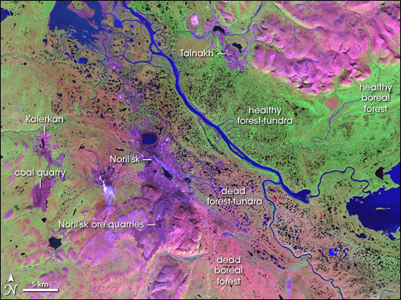
NASA Earth Observatory image of Norilsk and environs. Pink and purple areas represent bare ground; areas stripped of vegetation for mining and/or so polluted that the vegetation has died. From downtown Norilsk it is 48 kilometres to the nearest tree.

Slide 13
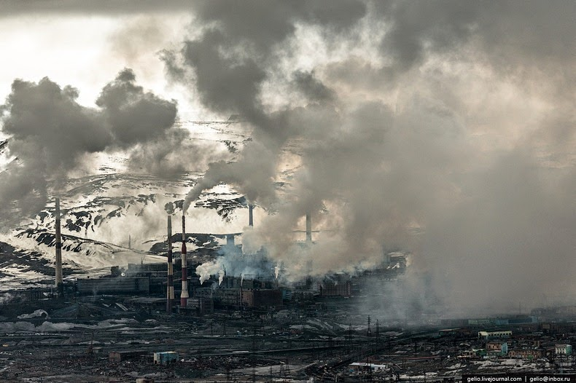

Slide 14
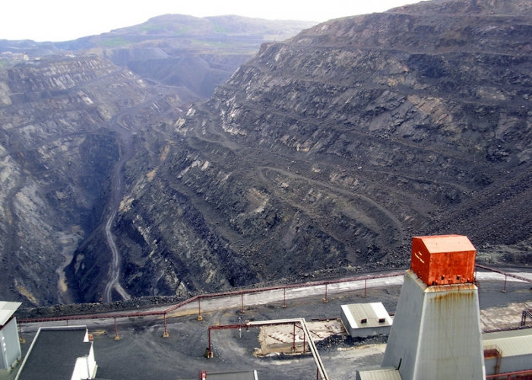

Slide 15
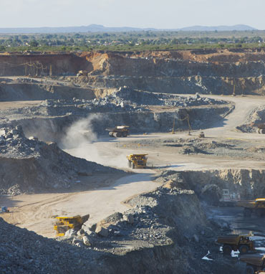
Mining in Mothotlo, South Africa
Source: http://www.angloamerican.com/~/media/Images/A/Anglo-American-
PLC-V2/content-images/products/platinum/mogalakwena.jpg?h=382&la=en&w=370

Slide 16
Sources- impacts
SA forced 1000 households at Mothotlo village for multinational mining corporations
Towns people in Mothotlo refused to leave home- were tear-gassed and forced out by armed police
SA police have violently supressed protests over platinum mining expansion, shooting protestors with live and rubber bullets was also seen
Similarly, in Russia, forced labor were used for mining platinum group mining
Freedom of speech restricted in Norilsk region- ‘closed’ area-journalists need to ask for state permission to report there

Slide 17
Learning from catalytic convertor case
Catalytic convertors resulted in significant environment improvements in US and other nations who used them
Benefits are unequal- SA and Russian regions saw greater environmental damage for the people there
SA and Russia used violence and infringed on persons’ rights in order to facilitate mining
Benefits are disproportionate- core nations are benefitted at the expense of people in peripheral zones

Slide 18
Case 2- Biofuels
Alternate fuels from organic sources such as corn, sugar, palm oil etc.
Hailed as a technology which could dramatically reduce green house gas emissions from automobiles
In addition, dependency on foreign oil

Slide 19
Impact of Biofuels
Farmers produce crops for fuel instead of food- food security is issue, high price of food
In Malaysia and Indonesia, it is observed that there is heavy deforestation because of export of palm oil to Netherlands
In Malaysia, 9.4 Million acres of rainforest have been cleared and planted with palm oil since 1996 (Knudson 2009)
Around 5 million indigenous people may have been displaced by palm oil development in Indonesia (BBC 2007)

Slide 20
Impact of Biofuels
In Malaysia and Indonesia, governments have facilitated deforestation and displacement
In Indonesia, villages were bulldozed, that too, under supervision and protection of soldiers

Slide 21
Inference from case 2
Questions technological solution to environment problems
In highly unequal but interdependent world economy- technical solutions like the use of biofuels are not feasible
Displacement, environment degradation happens at source- conflicts, violence etc. cannot be ruled out
Benefits accrue to wealthier nations but the cost of their environment amelioration is paid by the poorer nations.

Slide 22
Case 3- Hybrid cars
utilize both electric motors and internal combustion engines
hybrid vehicle - improved efficiency as it uses its electric motor in city traffic, recharging its battery(s) each time the brakes are applied
could result in environmental gains for wealthy car-dependent nations
technologies seen as “green” technologies anticipated by ecological modernization theory

Slide 23
Production
Full cost of production should acknowledge that it would require resources that may degrade environment and may show society disruption
the electrical wiring, rechargeable battery system, and electric motor of hybrid vehicles uses 12 kilograms more copper than conventional vehicles, along with significantly more nickel (National Research Council 2008)
Copper and nickel mining result in substantial environmental degradation - many governments in nations producing these minerals have often used violence to facilitate the minerals’ extraction.

Slide 24
Impact of production
What will be the result of greater adoption of hybrid vehicles?
Grasberg mine in West Papua, Indonesia- one of the largest copper reserve
Mines owned by MNC‘s- Freeport-McMoRan and Rio Tinto
Total mine waste covers 90 square miles
Wetlands and estuaries are affected which were most productive fisheries in the world
Freeport-McMoRan and the Indonesian government protect the Grasberg mine and suppress any protest that may threaten production
The local people protested and rioted in response to mining activities

Slide 25
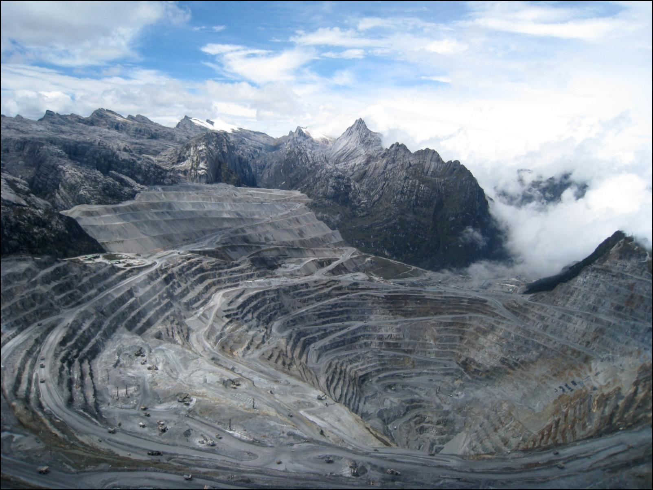
Grasberg Mine
Source: https://westpapuabackground.files.wordpress.com/2012/03/superbig_grasberg.jpeg

Slide 26
Impact of production
Freeport gave at least $20 million in direct payments to the military and police to protect the mine, in addition to spending another $35 million on military infrastructure, including barracks, headquarters, roads, and vehicles (Perlez and Bonner 2005).
Indonesian state works to keep West Papua off limits to foreigners, including journalists
Nickel mining and smelting produces severe and extensive environmental degradation

Slide 27
Green Capitalism
The ecological crisis is not some future and indeterminate event- we are in the first stage of ecological collapse
EMT- the system can continue to expand by creating a new ‘sustainable’ or ‘green capitalism’, bringing the efficiency of the market to bear on nature and its reproduction
‘green capitalism’ is about technological innovation and expanding markets while keeping the existing institutions of capitalism intact

Slide 28
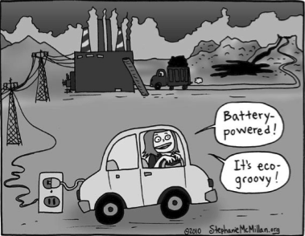

Slide 29
Green Capitalism
More specifically, ‘green capitalism’ involves:
appeals to nature (and even the crisis) as a marketing tool;
the development of new sources of energy such as solar, nuclear and wind, thereby creating new markets;
the massive development of biofuels, which involves diverting land from food production;
the carbon trading regime enshrined in the Kyoto Protocols.
‘greenwash’ – to persuade us of the efficacy of such strategies.
Greenwash – ‘disinformation disseminated by an organization so as to present an environmentally responsible public image’
evident in much corporate sustainability reporting as part of their presentation of a benign image of themselves

Slide 30


Slide 31
The current emphasis of organizations is on how sustainability can increase profitability or “can add value to a company”
it has been claimed that the climate crisis represents “a lucrative entrepreneurial opportunity”. This is congruent with the treatment of disasters (often ecological) as exciting market opportunities, or ‘disaster capitalism’
as ecological breakdown accelerates, the dominant classes will survive, living in

Slide 32
Fortress world: Fortress World is a planetary apartheid system, gated and maintained by force, in which the gap between global rich and global poor constantly widens and the differential access to environmental resources and amenities increases sharply. It consists of bubbles of privilege amidst oceans of misery
as ecological breakdown accelerates, the dominant classes will survive, living in fortress world

Slide 33
Conclusion
“Green” technologies in core nations is often accompanied by severe environmental degradation in the periphery or semi-periphery.
“green” automobile technologies is associated with state violence and abuses of human rights
“green” technologies and their transfer from the relatively poor to the relatively wealthy constitutes a variety of ecologically unequal exchange
“green” technologies has the potential to create new, more serious, or at least different environmental and humanitarian problems for less wealthy and less powerful groups of individuals across the globe

Slide 34
Conclusion
There is spread of the most barbaric forms of class rule, as the imperialist powers fight among themselves and with the global south for continued control of the world’s diminishing resources.

