Slide 1



GPGPU-Sim 3.x A Performance Simulator for Many-Core Accelerator Research
Website
gpgpu-sim.org
Tor M. Aamodt
Wilson W. L. Fung
Tayler Hetherington
University of British Columbia
Version of simulator corresponding to these slides = GPGPU-Sim 3.1.2

Slide 2
Tutorial Goals
Make you more effective in your research using GPGPU-Sim
Feel free to ask questions when you have them
After this tutorial, you will be able to:
Describe what GPGPU-Sim simulates
Setup GPGPU-Sim and run CUDA applications on it
Do simple performance analysis on CUDA applications with AerialVision
Extend GPGPU-Sim for your own research

Slide 3
Quick Survey
How many of you are:
Graduate students?
Faculty members?
Working for government?
Working for industry?
Have you written a CUDA or OpenCL program before?
Have you used GPGPU-Sim?

Slide 4
Overview
1 | Brief Background on GPU Computing | 40mins
2 | GPGPU-Sim Overview | 30mins
3 | Demo 1: Setup and Run | 15mins
Coffee Break (10:00 – 10:30am)
4 | Microarchitecture Timing Model | 85mins
Lunch (12:00 – 1:00pm)
5a | Software Organization | 25mins
5b | Timing Model (Software) | 50mins
5c | Power Model - GPUWattch | 45mins
Coffee Break (3:00 – 3:30pm)
6 | The GPU Design Space | 10mins
7a | Demo 2: Debugging Tool | 15mins
7b | Demo 3: Visualizing Performance | 30mins
8 | Extending GPGPU-Sim (with GPUWattch) | 30mins
9 | Wrap Up and Discussion | 15mins

Slide 5
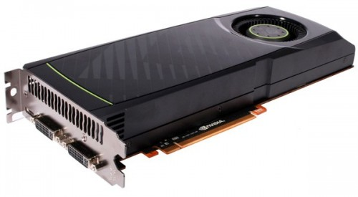
What is a GPU?
GPU = Graphics Processing Unit
Optimized for Highly Parallel Workloads
Highly Programmable
Commodity Hardware (“Desktop Supercomputing”)
Nvidia’s GTX580: 16 x 32-wide multiprocessors
512 ALUs
24,576 concurrent threads

Slide 6
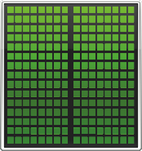
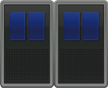
GPU Computing
4 core CPU + 1536 core GPU
Heterogeneous computing

Slide 7
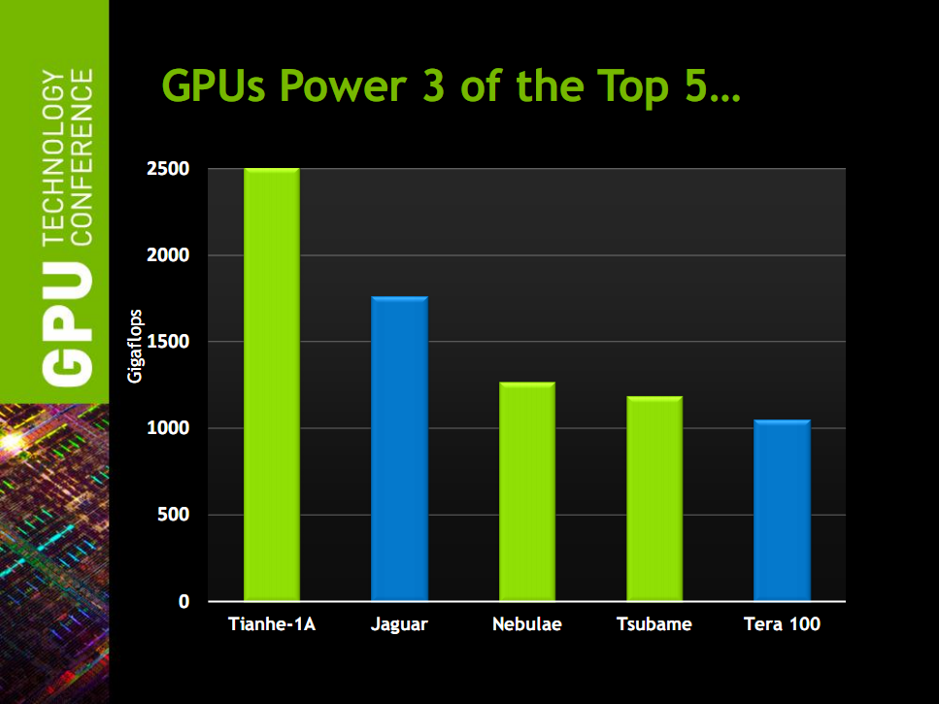
Why GPU?
*Slide from GTC 2011, GPU Computing: Past, Present and Future, David Luebke, NVIDIA

Slide 8
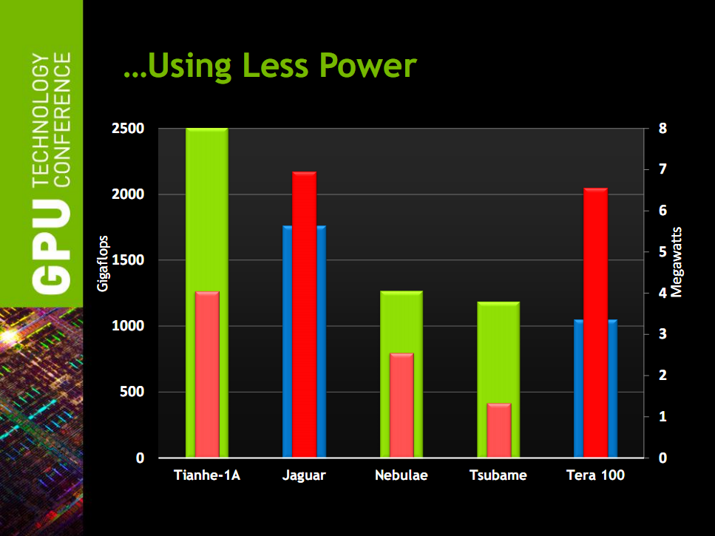
Why GPU?
*Slide from GTC 2011, GPU Computing: Past, Present and Future, David Luebke, NVIDIA

Slide 9
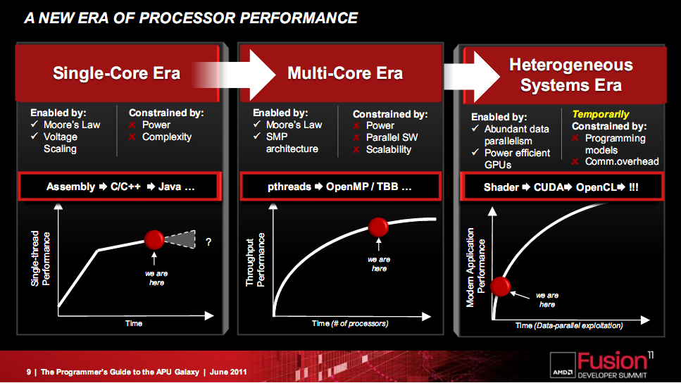
Why GPU?
*Slide from AFDS 2011, The Programmer’s Guide to the APU Galaxy, Phil Rogers, AMD

Slide 10
Why GPU?
OpenCL supported GPUs (besides AMD and NVIDIA)
AdrenoTM 3xx GPU from Qualcomm
MaliTM-T600 Series GPUs from ARM
HD 4000 on Intel’s Ivy Bridge
Intel Xeon Phi (Knights Corner)
GPU Computing is gaining broad industry support.

Slide 11
Programming Model
Traditional viewpoint
CPU offload data parallel code sections onto the GPU
Correct viewpoint? (if you want 100x speedup)
GPU = computation workhorse
CPU = sequential code “accelerator” and I/O offload engine

Slide 12
GPU Microarchitecture Overview (10,000 feet)
Single-Instruction, Multiple-Threads
GPU
SIMT Core Cluster
SIMT Core Cluster
SIMT Core Cluster
SIMT
Core
SIMT
Core
SIMT
Core
SIMT
Core
SIMT
Core
SIMT
Core
Interconnection Network
Memory
Partition
Memory
Partition
Memory
Partition
GDDR3/GDDR5
GDDR3/GDDR5
Off-chip DRAM
GDDR3/GDDR5

Slide 13
CUDA and OpenCL
Extensions of C to support coprocessor model
GPGPU-Sim support both
This tutorial focus on CUDA
More applications today
Notes:
Next few slides:
Brief introduction to CUDA programming model
Why? GPU microarchitecture is designed for CUDA programs.
The programming model has driven design decisions in GPGPU-Sim.

Slide 14
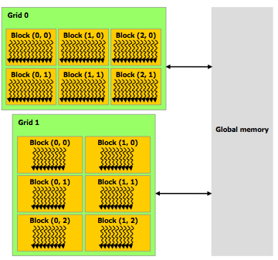
CUDA Thread Hierarchy
Kernel Launch = Grid of Blocks of Threads
Threads are scalar threads
Source: CUDA programming manual

Slide 15
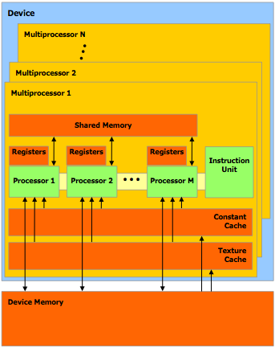
CUDA Memory Model
Memory Spaces
Shared
Global
Local
Constant
Texture
Source: CUDA programming manual

Slide 16
SIMT Execution Model
Programmers sees MIMD threads (scalar)
GPU HW bundles threads into warps and runs them in lockstep on SIMD hardware
foo[] = {4,8,12,16};
A
T1
T2
T3
T4
A: v = foo[tid.x];
B: if (v < 10)
C: v = 0;
else
D: v = 10;
E: w = bar[tid.x]+v;
B
T1
T2
T3
T4
C
Time
T1
T2
D
T3
T4
E
T1
T2
T3
T4
Notes:
MIMD = multiple-instruction, multiple-data

Slide 17
CUDA Syntax Highlights
Declaration specifiers to indicate where things live
__global__ void foo(...); // runs on GPU, callable from CPU
__device__ void bar(...); // function callable from a GPU thread
Parallel kernel launch
foo<<<500, 128>>>(...); // 500 blocks, 128 threads each
Special variables for thread identification in kernels
dim3 threadIdx; dim3 blockIdx; dim3 blockDim;

Slide 18
CUDA Example Code
High performance computing with CUDA, SC09 Tutorial, David Luebke, NVIDIA
Standard C Code
void saxpy_serial(int n, float a, float *x, float *y)
{
for (int i = 0; i < n; ++i)y[i] = a*x[i] + y[i];
}
// Invoke serial SAXPY kernel
saxpy_serial(n, 2.0, x, y);
CUDA code
__global__ void saxpy_parallel(int n, float a, float *x, float *y)
{
int i = blockIdx.x*blockDim.x + threadIdx.x;
if(i<n)
y[i]=a*x[i]+y[i];
}
main() {
… // omitted: allocate and initialize memory
// Invoke parallel SAXPY kernel with 256 threads/block
int nblocks = (n + 255) / 256;
saxpy_parallel<<<nblocks, 256>>>(n, 2.0, x, y);
… // omitted: transfer results from GPU to CPU
}
Notes:
saxpy = single precision ax + y

Slide 19
GPGPU-Sim in a Nutshell
Microarchitecture performance model of contemporary GPUs
New: Power Model: GPUWattch
Runs unmodified CUDA/OpenCL
BSD License
Focus of this tutorial: GPGPU-Sim version 3.1.2 and later

Slide 20
GPGPU-Sim 3.1.2
Since GPGPU-Sim 2.1.1b:
Refactored for C++ Object-Oriented Implementation
Redesigned Timing Models
SIMT Core model, Cache models, GDDR5 timing … (later)
Asynchronous Kernel Calls
Concurrent Kernel Execution
Support for CUDA 3.1
Since GPGPU-Sim 3.0.1:
Updated timing model to model Fermi more accurately
Much more robust SASS support
Support for CUDA 4.0 and later; OpenCL with newer drivers
Power Model: GPUWattch

Slide 21
Accuracy
Similarity Score
copyChunks_kernel()
Back Propagation
bpnn_layerforward_CUDA()
HotSpot
calculate_temp()

Slide 22
Accuracy
Notes:
Outliers:
BackPropagation – bpnn_layerforward_CUDA (Too Slow)
BackPropagation – bpnn_adjust_weights_cuda (Too Slow)
HotSpot– last calculate_temp (Too Fast)
HeartWall – kernel (Too Slow)
SingularSimilarity – copyChunks_kernel (Too Fast)

Slide 23
Accuracy (Average Power)

Slide 24
Dependencies
Linux
CUDA Toolkit (3.1 / 4.0 / 4.2)
Standard Development Environment
GCC, Make, etc.
No GPU Hardware for CUDA
Notes:
Optional: For OpenCL only
- CUDA capable GPU Hardware (Local/Remote)

Slide 25
Citation
If you use GPGPU-Sim (either 2.x or 3.x) in your publication, please cite our ISPASS 2009 paper:
Please indicate which version of GPGPU-Sim you used / extended
E.g. “GPGPU-Sim version 3.1.2”
Ali Bakhoda, George L. Yuan, Wilson W. L. Fung, Henry Wong, Tor M. Aamodt, Analyzing CUDA Workloads Using a Detailed GPU Simulator, In proceedings of the IEEE International Symposium on Performance Analysis of Systems and Software (ISPASS), pp. 163-174, Boston, MA, April 26-28, 2009.

Slide 26
Session Summary
GPU Computing
CUDA Programming Model Concepts
Thread Hierarchy
Memory Spaces
SIMT Execution Model
GPGPU-Sim: Timing + power simulator of modern GPUs
Good accuracy
Runs on systems without HW GPUs

Slide 27
Overview
1 | Brief Background on GPU Computing | 40mins
2 | GPGPU-Sim Overview | 30mins
3 | Demo 1: Setup and Run | 15mins
Coffee Break (10:00 – 10:30am)
4 | Microarchitecture Timing Model | 85mins
Lunch (12:00 – 1:00pm)
5a | Software Organization | 25mins
5b | Timing Model (Software) | 50mins
5c | Power Model: GPUWattch | 45mins
Coffee Break (3:00 – 3:30pm)
6 | The GPU Design Space | 10mins
7a | Demo 2: Debugging Tool | 15mins
7b | Demo 3: Visualizing Performance | 30mins
8 | Extending GPGPU-Sim (with GPUWattch) | 30mins
9 | Wrap Up and Discussion | 15mins

