Slide 1
Overview
1 | Brief Background on GPU Computing | 40mins
2 | GPGPU-Sim Overview | 30mins
3 | Demo 1: Setup and Run | 15mins
Coffee Break (10:00 – 10:30am)
4 | Microarchitecture Timing Model | 85mins
Lunch (12:00 – 1:00pm)
5a | Software Organization | 25mins
5b | Timing Model (Software) | 50mins
5c | Power Model: GPUWattch | 45mins
Coffee Break (3:00 – 3:30pm)
6 | The GPU Design Space | 10mins
7a | Demo 2: Debugging Tool | 15mins
7b | Demo 3: Visualizing Performance | 30mins
8 | Extending GPGPU-Sim (with GPUWattch) | 30mins
9 | Wrap Up and Discussion | 15mins

Slide 2
Outline
What GPGPU-Sim simulates
Functional model for PTX/SASS + CUDA/OpenCL
Timing model for the compute part of a GPU
New: Power model: GPUWattch
Interface with CUDA applications
What is new in GPGPU-Sim 3.1.2?
Roadmap

Slide 3
Session Objective
After this session, you will be able to:
Summarize what GPGPU-Sim simulates
Describe how GPGPU-Sim interfaces with CUDA applications and supports SASS
Summarize the advances between GPGPU-Sim 2.1.1b and 3.1.2

Slide 4
What GPGPU-Sim Simulates
Functional model for PTX/SASS
PTX = Parallel Thread eXecution
A scalar low-level, data-parallel virtual ISA defined by Nvidia
SASS = Native ISA for Nvidia GPUs
Not DirectX, Not shader model N, Not AMD’s ISA, Not x86, Not Larrabee. Only PTX or SASS.
Timing model for the compute part of a GPU
Not for CPU or PCIe
Only model microarchitecture timing relevant to GPU compute
Power model for the compute parts
Other parts idle when GPU is running compute kernels

Slide 5
Functional Model (PTX)
Low-level, data-parallel virtual machine by Nvidia
Instruction level
Unlimited registers
Parallel threads running in blocks; barrier synchronization instruction
Scalar ISA
SIMT execution model
Intermediate representation in CUDA tool chain:
G80
.cu
NVCC
GT200
PTX
ptxas
Fermi
.cl
OpenCL Drv
Kepler

Slide 6
Functional Model (PTX)
// some initialization code omitted
$Lt_0_6146:
bar.sync 0;
setp.le.s32 %p3, %r7, %r1;
@%p3 bra $Lt_0_6402;
ld.shared.f32 %f3, [%rd9+0];
add.s32 %r9, %r7, %r1;
cvt.s64.s32 %rd18, %r9;
mul.lo.u64 %rd19, %rd18, 4;
add.u64 %rd20, %rd6, %rd19;
ld.shared.f32 %f4, [%rd20+0];
setp.gt.f32 %p4, %f3, %f4;
@!%p4 bra $Lt_0_6914;
st.shared.f32 [%rd9+0], %f4;
$Lt_0_6914:
$Lt_0_6402:
shr.s32 %r10, %r7, 31;
mov.s32 %r11, 1;
and.b32 %r12, %r10, %r11;
add.s32 %r13, %r12, %r7;
shr.s32 %r7, %r13, 1;
mov.u32 %r14, 0;
setp.gt.s32 %p5, %r7, %r14;
@%p5 bra $Lt_0_6146;
for (int d = blockDim.x; d > 0; d /= 2)
{
__syncthreads();
if (tid < d) {
float f0 = shared[tid];
float f1 = shared[tid + d];
if (f1 < f0)
shared[tid] = f1;
}
}
Scalar PTX ISA
Scalar control flow (if-branch, for-loops)
Parallel Intrinsic (__syncthreads())
Register allocation not done in PTX
Notes:
Shown kernel code = Parallel Reduction in CUDA
6

Slide 7
Functional Model (SASS)
SASS = Native ISA for Nvidia GPUs
Better correlation with HW GPU
“SASS” is what NVIDIA’s cuobjdump calls it – note some NVIDIA SM architects are unaware of this ☺
Scalar ISA
For simplicity GPGPU-Sim uses assembly syntax that can represent both SASS and PTX. Called PTXPlus.
SASS mapped 1:1 into PTXPlus instructions.
CUDA
Executable
cuobjdump
SASS
conversion
PTXPlus

Slide 8
When to use SASS?
Use SASS unless it doesn’t work for an application you really care about. Functional correctness has been verified with shortened versions of Rodinia benchmarks extended by our group to include correctness checking code.
If you want to modify ISA then likely PTX is better option (NVIDIA now makes PTX front end available in LLVM and did so previously using Open64)
Try to use SASS first if your aim is to use GPGPU-Sim for application performance tuning
If mechanism you study is sensitive to instruction scheduling:
ptxas reschedules instructions after converting PTX to SASS to increase computation-memory overlap.
It also converts short branches into predicated instructions.
In SASS (for Quadro FX 5800), shared memory and constant memory can be accessed directly as an operand of an instruction.

Slide 9
PTX vs. SASS
PTX
$Lt_25_13570:
ld.global.s32 %r9, [%rd5+0];
add.s32 %r10, %r9, %r8;
ld.global.s32 %r11, [%rd5+1024];
add.s32 %r8, %r11, %r10;
add.u32 %r5, %r7, %r5;
add.u64 %rd5, %rd5, %rd6;
ld.param.u32 %r6, [size];
setp.lt.u32 %p2, %r5, %r6;
@%p2 bra $Lt_25_13570;
...
mov.u32 %r12, 127;
setp.gt.u32 %p3, %r3, %r12;
@%p3 bra $Lt_25_14082;
ld.shared.s32 %r13, [%rd10+512];
add.s32 %r8, %r13, %r8;
st.shared.s32 [%rd10+0], %r8;
$Lt_25_14082:
bar.sync 0;
SASS (PTXPlus)
l0x00000060:
add.half.u32 $r7, $r4, 0x00000400;
ld.global.u32 $r8, [$r4];
ld.global.u32 $r7, [$r7];
add.half.u32 $r0, $r5, $r0;
add.half.u32 $r6, $r8, $r6;
set.gt.u32.u32 $p0/$o127, s[0x0020], $r0;
add.half.u32 $r6, $r7, $r6;
add.half.u32 $r4, $r4, $r3;
@$p0.ne bra l0x00000060;
...
set.gt.u32.u32 $p0/$o127, $r2, const [0x0000];
@$p0.equ add.u32 $ofs2, $ofs1, 0x00000230;
@$p0.equ add.u32 $r6, s[$ofs2+0x0000], $r6;
@$p0.equ mov.u32 s[$ofs1+0x0030], $r6;
bar.sync 0x00000000;

Slide 10
Timing Model for Compute Parts of a GPU
Gfx DRAM
GPGPU-Sim models timing for:
SIMT Core (SM, SIMD Unit)
Caches (Texture, Constant, …)
Interconnection Network
Memory Partition
Graphics DRAM
It does NOT model timing for:
CPU, PCIe
Graphics Specific HW (Rasterizer, Clipping, Display… etc.)
GPU
Interconnect
Cache
Mem Part.
SIMT Cores
Gfx HW
PCIe
Raster…
CPU

Slide 11
Timing Model for GPU Micro-architecture
GPGPU-Sim simulates the timing model of a GPU running each launched CUDA kernel.
Reports # cycles spent running the kernels.
Exclude any time spent on data transfer on PCIe bus.
CPU may run concurrently with asynchronous kernel launches.
CPU
Async. Kernel Launch
GPU HW
GPGPU-Sim
Done
GPU HW
GPGPU-Sim
Blocking
Done
CPU
Sync. Kernel Launch
GPU HW
GPGPU-Sim
Done
CPU
Time

Slide 12
Timing Model for GPU Micro-architecture
GPGPU-Sim is a detailed cycle-level simulator:
Cycle-level model for each part of the microarchitecture
Research focused
Ignoring rare corner cases to reduce complexity
CUDA manual provides some hints. NVIDIA IEEE Micro articles provide other hints. In most cases we can only guess at details. Guesses “informed” by studying patents and microbenchmarking.
GPGPU-Sim w/ SASS is ~0.98 correlated to the real HW.

Slide 13
New: Power Model GPUWattch
Estimate power consumed by the GPU according to the timing behavior
Ideal for evaluating fine-grained power management mechanisms
Validated with power measurements from a real GTX 480
uArch Activities
(Perf. Counters)
GPGPU-Sim
Timing Model
GPUWattch
Power Model
(McPAT++)
Power Estimation

Slide 14
Interfacing GPGPU-Sim to Applications
GPGPU-Sim compiles into a shared runtime library and implements the API:
libcudart.so ← CUDA runtime API
libOpenCL.so ← OpenCL API
Static Linking no longer supported.
Modify your LD_LIBRARY_PATH to run your CUDA app on GPGPU-Sim (See Manual)
Need a config file (gpgpusim.config), an interconnection config file and a McPAT config as well
We provide the config files for modeling:
Quadro FX 5800 (GT200)
Geforce GTX 480 and Tesla C2050 (Fermi)

Slide 15
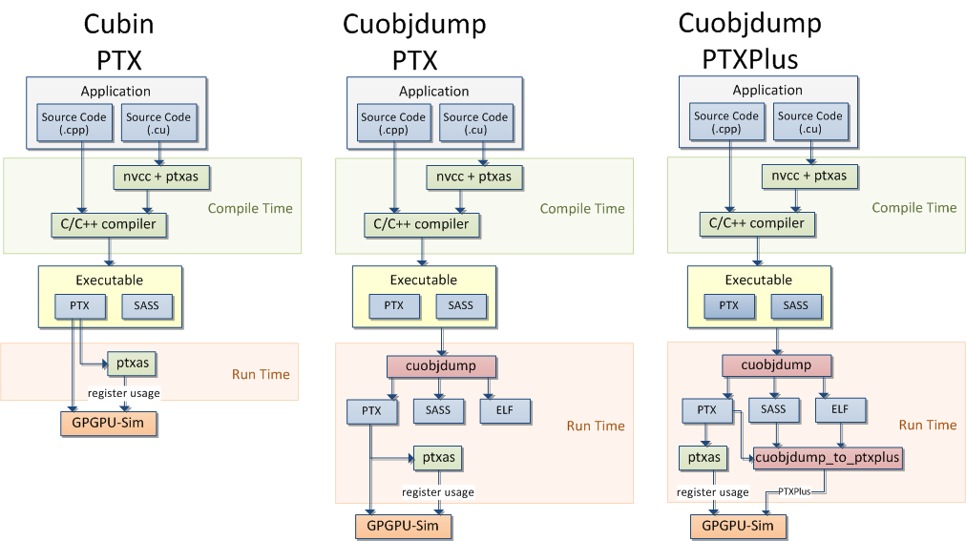
GPGPU-Sim Runtime Flow
CUDA 3.1
CUDA 4.0 and Later

Slide 16
Debugging and Visualization
GPGPU-Sim provides tools to debug and visualize simulated GPU behavior.
GDB macros: Cycle-level debugging
AerialVision: High-level performance dynamics
Notes:
Microarchitecture simulator strength: Visibility ← Allow deep understanding of performance

Slide 17
GPGPU-Sim 3.1.2
Since GPGPU-Sim 2.1.1b:
Refactored for C++ Object-Oriented Implementation
Redesigned Timing Models
SIMT Core model, Cache models, GDDR5 timing … (later)
Asynchronous Kernel Calls
Concurrent Kernel Execution
Support for CUDA 3.1, 4.0 and 4.2

Slide 18
GPGPU-Sim 3.1.2
Since GPGPU-Sim 3.0.1:
Updated timing model to model Fermi more accurately
Much more robust SASS support
Support for CUDA 4.0 (New runtime flow)
Since GPGPU-Sim 3.1.0 (June 2012):
Support for CUDA 4.1 and 4.2 (Robust runtime flow)
Support for OpenCL with newer NVIDIA drivers
Two-Level Warp Scheduler from ISCA 2012 Tutorial
Experimental Support for Libraries (CUBLAS, CUFFT)
Redesigned Cache Model
Power Model: GPUWattch

Slide 19
Roadmap
Unified timing model framework
From simple (~v2.x) to detailed (v3.x)
Fermi SASS (HW ISA) support
AMD Graphics Core Next (GCN) ISA
Kepler Model (HW ISA and timing)

Slide 20
Session Summary
GPGPU-Sim simulates
PTX/SASS
Timing Model for GPU Compute
Power Model: GPUWattch
It interface to CUDA/OpenCL application via a shared runtime library
Enhancements in GPGPU-Sim 3.1.2

Slide 21
Overview
1 | Brief Background on GPU Computing | 40mins
2 | GPGPU-Sim Overview | 30mins
3 | Demo 1: Setup and Run | 15mins
Coffee Break (10:00 – 10:30am)
4 | Microarchitecture Timing Model | 85mins
Lunch (12:00 – 1:00pm)
5a | Software Organization | 25mins
5b | Timing Model (Software) | 50mins
5c | Power Model: GPUWattch | 45mins
Coffee Break (3:00 – 3:30pm)
6 | The GPU Design Space | 10mins
7a | Demo 2: Debugging Tool | 15mins
7b | Demo 3: Visualizing Performance | 30mins
8 | Extending GPGPU-Sim (with GPUWattch) | 30mins
9 | Wrap Up and Discussion | 15mins

