Slide 1
Overview
1 | Brief Background on GPU Computing | 40mins
2 | GPGPU-Sim Overview | 30mins
3 | Demo 1: Setup and Run | 15mins
Coffee Break (10:00 – 10:30am)
4 | Microarchitecture Timing Model | 85mins
Lunch (12:00 – 1:00pm)
5a | Software Organization | 25mins
5b | Timing Model (Software) | 50mins
5c | Power Model: GPUWattch | 45mins
Coffee Break (3:00 – 3:30pm)
6 | The GPU Design Space | 10mins
7a | Demo 2: Debugging Tool | 15mins
7b | Demo 3: Visualizing Performance | 30mins
8 | Extending GPGPU-Sim (with GPUWattch) | 30mins
9 | Wrap Up and Discussion | 15mins

Slide 2
Timing Model Overview
What is a warp?
SIMT Core Internals
SIMT Frontend
Memory Unit
Interconnection Network
Clock Domains
Memory Partition
DRAM Timing Model

Slide 3
Session Objectives
After this session, you will be able to
Explain warps and branch divergence
Summarize the microarchitecture modeled by GPGPU-Sim
Group the microarchitecture components into the different clock domains
Explain why a DRAM timing model is needed

Slide 4
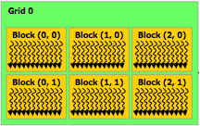
Thread Hierarchy Revisited
Recall, kernel = grid of blocks of warps of threads
Thread blocks (CTAs) contains up to 1024 threads
Threads are grouped into warps in hardware
Source: NVIDIA
SIMT Core
Each block is dispatched to a SIMT core as a unit of work: All of its warps run in the core’s pipeline until they are all done.
32 Threads
Thread Block
(CTA)
32 Threads
Thread Block
(CTA)
32 Threads
Thread Block
(CTA)
32 Threads
32 Threads
32 Threads
32 Threads
32 Threads
32 Threads
Warps
Notes:
Remember that earlier when were talking about the CUDA programming model we mentioned the thread hierarchy. Each kernel launches a grid of thread blocks.
Blocks contain many threads, and each group of 32 threads is are grouped into warps in hardware.
4

Slide 5
Warp = SIMT Execution of Scalar Threads
Warp = Scalar threads grouped to execute in lockstep
SIMT vs SIMD
SIMD: HW pipeline width must be known by SW
SIMT: Pipeline width hidden from SW (★)
Thread Warp 3
Thread Warp 8
Thread Warp
Common PC
Scalar
Scalar
Scalar
Scalar
Thread Warp 7
Thread
Thread
Thread
Thread
W
X
Y
Z
SIMT Pipeline
(★) Can still write software that assumes threads in a warp execute in lockstep (e.g. see reduction in NVIDIA SDK)
Notes:
5
In SIMD, you need to specify the data array + an instruction (on which to operate the data on) + THE INSTRUCTION WIDTH. Eg: You might want to add 2 integer arrays of length 16, then a SIMD instruction would look like (the instruction has been cooked-up by me for demo) add.16 arr1 arr2 However, SIMT doesn't bother about the instruction width. So, essentially, you could write the above example as: arr1[i] + arr2[i] and then launch as many threads as the length of the array, as you want. Note that, if the array size was, let us say, 32, then SIMD EXPECTS you to explicitly call two such 'add.16' instructions! Whereas, this is not the case with SIMT.

Slide 6
GPU Microarchitecture Overview
GPU
SIMT Core Cluster
SIMT Core Cluster
SIMT Core Cluster
SIMT
Core
SIMT
Core
SIMT
Core
SIMT
Core
SIMT
Core
SIMT
Core
Interconnection Network
Memory
Partition
Memory
Partition
Memory
Partition
GDDR3/GDDR5
GDDR3/GDDR5
Off-chip DRAM
GDDR3/GDDR5

Slide 7
Inside a SIMT Core
Done (Warp ID)
SIMT
Front End
Reg
File
SIMD Datapath
Fetch
Decode
Memory Subsystem
Icnt.
Network
Schedule
Branch
SMem
L1 D$
Tex $
Const$
Fine-grained multithreading
Interleave warp execution to hide latency
Register values of all threads stays in core

Slide 8
Inside a SIMT Core (2.0)
Schedule
+ Fetch
Decode
Register
Read
Execute
Memory
Writeback
Started from a 5-stage In-Order Pipeline
Add fine-grained multithreading
Add SIMT stacks
Notes:
As we learn more about the GPU design, we tried to add more detail to this model. At some point, we feel that we need to redesign from scratch.

Slide 9
Inside a SIMT Core (3.0)
SIMT Front End
SIMD Datapath
Branch Target PC
Fetch
SIMT-Stack
Scheduler 1
Scheduler 3
ALU
Valid[1:N]
Active
ALU
I-Buffer
Pred.
ALU
Mask
ALU
I-Cache
Decode
Issue
Operand
Scheduler 2
Collector
Score
MEM
Board
Done (WID)
Redesign Model
Three decoupled warp schedulers
Scoreboard
Operand collector
Multiple SIMD functional unit

Slide 10
Fetch + Decode
Arbitrate the I-cache among warps
Cache miss handled by fetching again later
Fetched instruction is decoded and then stored in the I-Buffer
1 or more entries / warp
Only warp with vacant entries are considered in fetch
Score-
PC
Decode
Board
A
1
PC
v
Inst. W1
r
R
2
e
B
PC
3
v
Inst. W2
r
h
c
v
Inst. W3
r
a
C
-
I
o
Selection
T
To
Fetch
Issue
Valid[1:N]
Issue
ARB
Fetch
Valid[1:N]
I-Buffer
I-Cache
Decode

Slide 11
Instruction Issue
Select a warp and issue an instruction from its I-Buffer for execution
Round-Robin Priority
GT200 (e.g. Quadro FX 5800): Allow dual issue
Fermi: Odd/Even scheduler
For each issued instruction:
Functional execution
Obtain info from functional simulator
Generate coalesced memory accesses
Reserve output register in scoreboard
Update SIMT stack

Slide 12
Scoreboard
Checks for RAW and WAW dependency hazard
Flag instructions with hazards as not ready in I-Buffer (masking them out from the scheduler)
Instructions reserves registers at issue
Release them at writeback

Slide 13
SIMT Stack
foo[] = {4,8,12,16};
One stack per warp
A: v = foo[tid.x];
B: if (v < 10)
C: v = 0;
else
D: v = 10;
E: w = bar[tid.x]+v;
A
T1
T2
T3
T4
SIMT Stack
B
T1
T2
T3
T4
PC
RPC
Active Mask
B
E
-
-
1111
1111
C
T1
T2
D
E
0011
D
C
E
1100
T3
T4
E
T1
T2
T3
T4
Time
Handles Branch Divergence

Slide 14
Operand Collector
Bank 0
Bank 1
Bank 2
Bank 3
R0
R1
R2
R3
R4
R5
R6
R7
R8
R9
R10
R11
…
…
…
…
add.s32 R3, R1, R2;
No Conflict
mul.s32 R3, R0, R4;
Conflict at bank 0
Operand Collector Architecture (US Patent: 7834881)
Interleave operand fetch from different threads to achieve full utilization

Slide 15
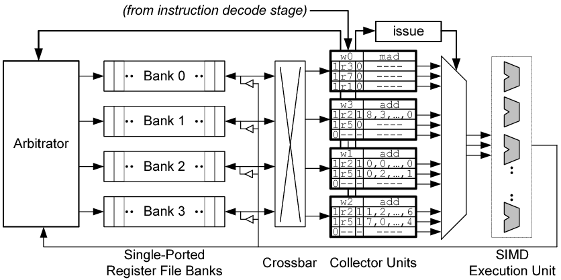
Operand Collector
(from instruction issue stage)
dispatch

Slide 16
ALU Pipelines
SIMD Execution Unit
Fully Pipelined
Each pipe may execute a subset of instructions
Configurable bandwidth and latency (depending on the instruction)
Default: SP + SFU pipes

Slide 17
Writeback
Each pipeline has a result bus for writeback
Exception:
SP and SFU pipe shares a result bus
Time slots on the shared bus is pre-allocated

Slide 18
Memory Unit
Model timing for memory instructions
Support half-warp (16 threads)
Double clock the unit
Each cycle service half the warp
Has a private writeback path

Slide 19
Constant Cache
A Read-only cache for constant memory
GPGPU-Sim simulates 1 read ports
A warp can access 1 constant cache locations in a single memory unit cycle
If more than 1 locations accessed
reads are serialized causing pipeline stalls
# of ports is not configurable

Slide 20
Texture Cache
Read-only cache with FIFO retirement
Design based on Igehy et al. Prefetching in a Texture Cache Architecture, SIGGRAPH 1998.
GPGPU-Sim support 1-D and 2-D textures
2-D locality should be preserved when texture cache blocks are fetched from memory
GPGPU-Sim uses a 4-D blocking address scheme to promote spatial locality in 2-D
Based on Hakura et al. The Design and Analysis of a Cache Architecture for Texture Mapping, ISCA 1997
Notes:
20

Slide 21
Shared Memory
Explicitly managed scratchpad memory
As fast as register files in absence of bank conflicts
Threads in a block can cooperate via shared memory
Each SIMT core has its own shared memory
Dynamically allocated to thread blocks
16kB/48kB per SIMT core in current NVIDIA GPUs (Fermi)
Notes:
21

Slide 22
Shared Memory (cont.)
Many threads accessing memory
Therefore Shared memory is highly banked
Each bank serves one address per cycle
Multiple access to a bank in a single cycle cause bank conflicts
Conflicting accesses must be serialized
Shared memory in NVIDIA GPUs has 16/32 banks
Configurable in GPGPU-Sim (version 3.1.2)
Notes:
Shared memory can be as fast as registers if there is no bank conflict if there is a bank conflict cost = max simultaneous accesses to the same bank.
22

Slide 23
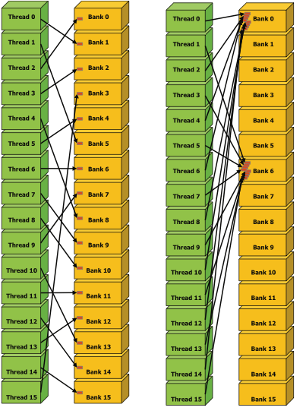
Shared Memory Bank Conflicts
Figures taken from CUDA manual by NVIDIA
No bank conflict
8-way bank conflict

Slide 24
Global Memory
Global memory is the off-chip DRAM memory
The largest and slowest memory available
Accesses must go through interconnect, memory partition and off-chip DRAM
Optionally cached in HW
L1 Data Cache
L2 Unified Cache
Notes:
24

Slide 25
Coalescing
Combining memory accesses made by threads in a warp into fewer transactions
E.g. if threads in a warp are accessing consecutive 4-byte sized locations in memory
Send one 128–byte request to DRAM (coalescing)
Instead of 32 4-byte requests
This reduces the number of transactions between SIMT cores and DRAM
Less work for Interconnect, Memory Partition and DRAM
Notes:
25

Slide 26
Coalescing (Cont.)
CUDA Capability 1.3 (e.g. GTX280)
Coalescing done per half-warp
Can create 128-byte, 64-byte or 32-byte transactions
CUDA Capability 2.0 (e.g. Fermi)
Coalescing done for a full warp
Cached: Only creates 128-byte transactions
Not Cached: Can create 128/64/32-byte transactions
GPGPU-Sim supports both
Notes:
26

Slide 27
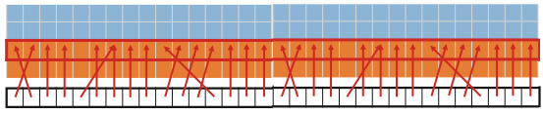
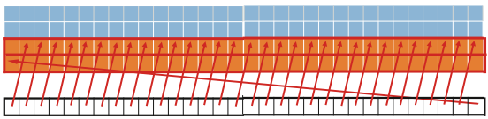
Coalescing (cont.)
Coalescing example
= 4-bytes in memory
Figures taken from CUDA manual by NVIDIA
One 128-Byte Transaction
Warp
Two 128-Byte Transactions
Warp

Slide 28
L1 Data Cache
For both local and global memory space
With different policies
Non-coherent
Single ported (128-Byte wide)
Takes multiple cycles to service non-coalesced accesses
 | Local Memory | Global Memory
Write Hit | Write-back | Write-evict
Write Miss | Write no-allocate | Write no-allocate
Notes:
Reminder: Here we are referring to “Local Memory” as defined in CUDA. It corresponds to “Private Memory” in OpenCL.

Slide 29
Memory Access Tracking
Cached access
Miss Status Holding Registers (MSHR)
Non-cached access
Encode warp, target register in request packet
Memory Unit writes replied data directly to target request

Slide 30
Miss Status Holding Registers
MSHRs keep track of outstanding memory requests
keep track of threads, target registers, request addresses
GPGPU-Sim: Each cache has its set of MSHRs
Each MSHR contains one or more memory requests to the same address
MSHRs are limited (configurable)
Memory unit stalls if cache runs out of MSHRS
One approach that might make sense
No details available from NVIDIA / AMD
Notes:
30

Slide 31
Atomic Operations
Both CUDA and OpenCL support atomic operations
Read-modify-write on a single memory location
Coalescing rules ~ global memory access
Put accesses to same memory location in separate transactions
GPGPU-Sim simulate these as:
Load operations inside a SIMT core
Skips L1 data cache
Store operations at memory partition

Slide 32
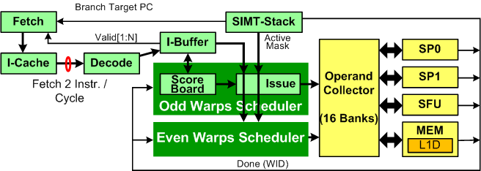
SIMT Core Model (Fermi Architecture)
Just a configuration in our model

Slide 33
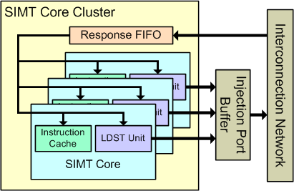
SIMT Core Cluster
Collection of SIMT cores

Slide 34
GPU Microarchitecture Overview
GPU
SIMT Core Cluster
SIMT Core Cluster
SIMT Core Cluster
SIMT
Core
SIMT
Core
SIMT
Core
SIMT
Core
SIMT
Core
SIMT
Core
Interconnection Network
Memory
Partition
Memory
Partition
Memory
Partition
GDDR3/GDDR5
GDDR3/GDDR5
Off-chip DRAM
GDDR3/GDDR5

Slide 35
Clock domains
Simulate independent clock domains for
SIMT cores
GT200: Set to ¼ of shader clock to compensate for using SIMD width of 32 instead of 8
Fermi: Set to ½ of shader clock to compensate for using SIMD width of 32 instead of 16
Interconnection network
L2 cache (if enabled)
DRAM
This is real clock (command clock)
Effective clock is 2x this clock due to DDR
Notes:
35

Slide 36
Clock Domain Crossing
We simulate send and receive buffers at clock crossing boundaries
The buffers are filled and drained in different clock domains
E.g. consider the buffer from interconnect to memory partition
Filled at interconnect clock rate
Drained at DRAM clock rate

Slide 37
Interconnection Network Model
Intersim (Booksim) a flit level simulator
Topologies (Mesh, Torus, Butterfly, …)
Routing (Dimension Order, Adaptive, etc. )
Flow Control (Virtual Channels, Credits)
We simulate two separate networks
From SIMT cores to memory partitions
Read Requests, Write Requests
From memory partitions to SIMT cores
Read Replies, Write Acks
Notes:
37

Slide 38
Topology Examples
Notes:
There are a diverse range of topologies that can be used to transfer memory requests in a many-core architecture.
In Nvidia’s GPUs, it looks something like a crossbar except multiple SIMT cores share input ports.
Intel’s Larrabee looks like a ring.
In our ISPASS paper we found that a mesh was viable as well.
38

Slide 39
Interconnection Network Config
Booksim has its own config file
Topology (topology, k ,n )
Virtual channels (num_vcs)
Buffers per VC (vc_buf_size)
Routing (routing _function)
Speedups (input_speedup, internal_speedup)
Allocators (vc_allocator, sw_allocator)
Specific to GPGPU-sim
Channel Width (flit_size)
Setting memory partition locations (use_map)
Notes:
39

Slide 40
Interconnect Injection Interfaces
SIMT Core
Router
1 Packet / Cycle
1 Flit / Cycle
Core Clock Domain
Interconnect Clock Domain
Clock Boundary

Slide 41
Interconnect Injection Interfaces
Memory Partition
Router
1 Packet / Cycle
1 Flit / Cycle
DRAM Clock Domain
Interconnect Clock Domain
Clock Boundary

Slide 42
Interconnect Injection Interfaces
L2 Cache
Router
1 Packet / Cycle
1 Flit / Cycle
L2 Clock Domain
Interconnect Clock Domain
Clock Boundary

Slide 43
Interconnect Ejection Interfaces
1 Ejection/boundary buffer per VC (1 flit / cycle)
A credit is sent back to router as a flit goes from ejection to boundary buffer
# of VCs
1 Packet / Cycle
(Round Robin)
1 Flit / Cycle
Ejection Buffers
Boundary Buffers
Router
SIMT
Core
1 Flit / Cycle
1 Credit / Cycle
Credit return buffer
Interconnect Clock Domain
Core Clock Domain
Clock Boundary
Notes:
We have one ejection buffer and one boundary buffer for each VC.
Why? If all VCs share the same set of buffers then the flits from different packet get mixed together so when
SIMT core tries to pop a packet per cycle and remove its corresponding flits from the buffer the flits are not together.
Also for each VC there is one ejection buffer and one boundary buffer. The reason for this is that we need to send a credit back to the router as a flit gets out of the ejection buffer. If we only had a single buffer then the interconnect would be forced to operate at Shader core domain since credits would be sent when the shader pops the packet. So to isolate the clock domains we have two buffers. In this design a credit is sent back to router as a flit goes from ejection to boundary buffer.
43

Slide 44
GPU Microarchitecture Overview
GPU
SIMT Core Cluster
SIMT Core Cluster
SIMT Core Cluster
SIMT
Core
SIMT
Core
SIMT
Core
SIMT
Core
SIMT
Core
SIMT
Core
Interconnection Network
Memory
Partition
Memory
Partition
Memory
Partition
GDDR3/GDDR5
GDDR3/GDDR5
Off-chip DRAM
GDDR3/GDDR5

Slide 45
Memory Address Mapping
UNSW CUDA Tutorial by NVIDIA part 4 optimizing CUDA
Off-chip memory partitioned among several memory partitions
GT200 has 8 memory partitions
G80 and Fermi had 6 memory partitions
Each memory partition has a DRAM controller
Successive 256-byte regions of memory are assigned to successive memory partitions
Address mapping is configurable in GPGPU-Sim
Notes:
45

Slide 46
Mem. Address Mapping (Cont.)
0x0000
0x0100
0x0200
0x0300
SIMT
Core
SIMT
Core
SIMT
Core
0x0400
0x0500
0x0600
Interconnection Network
0x0700
0x0800
Memory
Partition 0
Memory
Partition 1
Memory
Partition 2
Memory
Partition 3
Memory
Partition 4
Memory
Partition 5
Memory
Partition 6
Memory
Partition 7
December 2009
GPGPU-Sim Tutorial (MICRO-42)
46

Slide 47
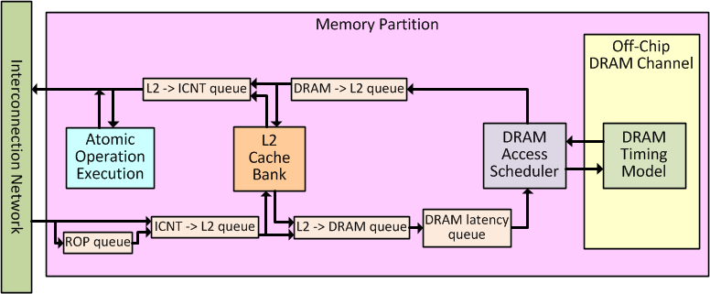
Memory Partition
Service memory request (Load/Store/AtomicOp)
Contains L2 cache bank, DRAM timing model
Model Raster Operations Pipeline (ROP) latency

Slide 48
L2 Cache Bank
GT200: Caches only texture
Fermi: Caches All memory spaces
Similar to L1 Data Cache
Missed requests are sent to DRAM
 | Local Memory | Global Memory
Write Hit | Write-back | Write-back
Write Miss | Write-allocate | Write-allocate
Notes:
Reminder: Here we are referring to “Local Memory” as defined in CUDA. It corresponds to “Private Memory” in OpenCL.

Slide 49
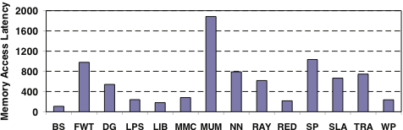
DRAM
DRAM Memory
Off-chip, high-density and high capacity
DRAM access time is Not constant
It has non-uniform access latencies
That’s why we model it!
Notes:
49

Slide 50
DRAM Access
Row access
Activate a row or page of a DRAM bank
Load it to row buffer
Column access
Select and return a block of data in row buffer
Precharge
Write back the opened row into DRAM
Otherwise it will be lost!
DRAM
Column Decoder
Column Decoder
Column Decoder
Row Buffer
Row Buffer
Row Buffer
Row Buffer
Memory
Controller
Memory
Array
Row Decoder
Row Decoder
Notes:
Accessing data in DRAM consists of three steps: precharge, row access, and column access. A row access activates a page of data in the core and transfers it to the row buffer. After that, the column access selects the desired block and transfers it to the processor through the data bus.
50

Slide 51
DRAM Row Access Locality
t_{RC} = row cycle time
t_{RP} = row precharge time
t_{RCD} = row activate time
Notes:
row access locality of a memory request stream is crucial to performance.
Within a bank, you have thousands of rows of data.
Before you can access a particular row, you have to load the row into the row buffer.
The time to close the previous row and open the new row is governed by the DRAM spec, and it can be a dominating factor in performance when there are few accesses per row, or low row access locality
51

Slide 52
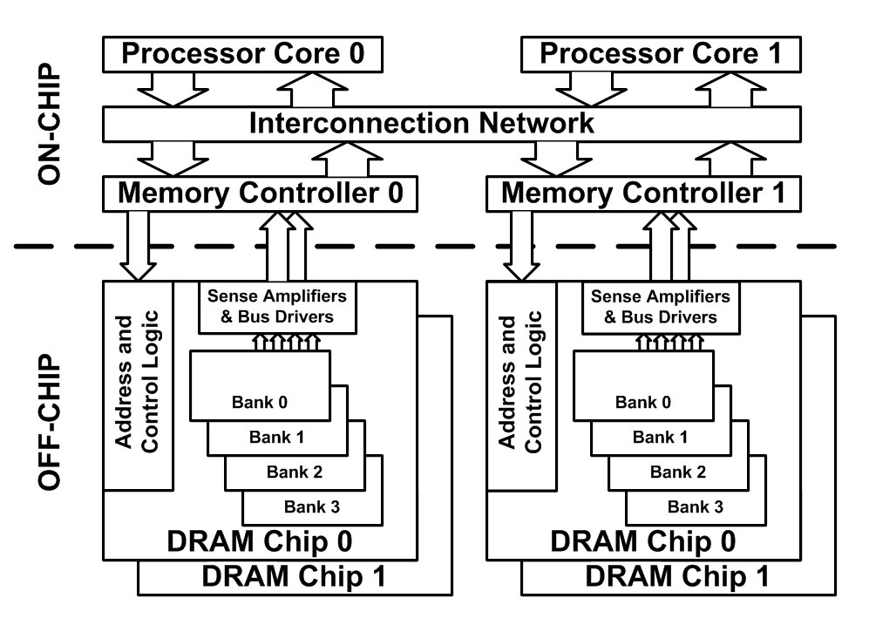
DRAM Bank-level Parallelism
To increase DRAM performance and utilization
Multiple banks per DRAM chip
To increase bus width
Multiple chips per Memory Controller
Notes:
52
You may have several chips connected in parallel to a controller to increase the bus width and the peak throughput.
Within a chip, you also have multiple banks to exploit bank-level parallelism. What this means is having multiple banks share the data bus to maximize utilization. If one bank is in the middle of switching rows, another bank can transfer data.
The BLP of memory request stream of an application is crucial to performance.
If you only use a single bank in a chip, any time it’s busy switching rows, that’s wasted data bus cycles.

Slide 53
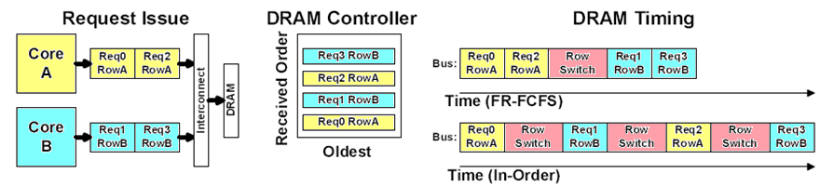
Scheduling DRAM Requests
Scheduling policies supported
First in first out (FIFO)
In-order scheduling
First Ready First Come First Serve (FR-FCFS)
Out of order scheduling
Requires associative search

Slide 54
Session Summary
Microarchitecture Timing Model in GPGPU-Sim
SIMT Core
Cache Model
Interconnection Network
Memory Partition + Address Mapping
DRAM Scheduling and Timing

Slide 55
Overview
1 | Brief Background on GPU Computing | 40mins
2 | GPGPU-Sim Overview | 30mins
3 | Demo 1: Setup and Run | 15mins
Coffee Break (10:00 – 10:30am)
4 | Microarchitecture Timing Model | 85mins
Lunch (12:00 – 1:00pm)
5a | Software Organization | 25mins
5b | Timing Model (Software) | 50mins
5c | Power Model: GPUWattch | 45mins
Coffee Break (3:00 – 3:30pm)
6 | The GPU Design Space | 10mins
7a | Demo 2: Debugging Tool | 15mins
7b | Demo 3: Visualizing Performance | 30mins
8 | Extending GPGPU-Sim (with GPUWattch) | 30mins
9 | Wrap Up and Discussion | 15mins

