Slide 1
Overview
1 | Brief Background on GPU Computing | 40mins
2 | GPGPU-Sim Overview | 30mins
3 | Demo 1: Setup and Run | 15mins
Coffee Break (10:00 – 10:30am)
4 | Microarchitecture Timing Model | 85mins
Lunch (12:00 – 1:00pm)
5a | Software Organization | 25mins
5b | Timing Model (Software) | 50mins
5c | Power Model: GPUWattch | 45mins
Coffee Break (3:00 – 3:30pm)
6 | The GPU Design Space | 10mins
7a | Demo 2: Debugging Tool | 15mins
7b | Demo 3: Visualizing Performance | 30mins
8 | Extending GPGPU-Sim (with GPUWattch) | 30mins
9 | Wrap Up and Discussion | 15mins

Slide 2
Outline
GPUWattch accuracy
Modeling
Bottom up: McPAT
Top down: Microbenchmarking
Using GPUWattch
Modifying GPUWattch

Slide 3
Session Objective
After this session, you will be able to:
Summarize what GPUWattch simulates and its accuracy with real hardware
Describe the organization/structure of GPUWattch and how it interfaces with GPGPU-Sim
Summarize how to include GPUWattch in your simulation and view/understand the output
Modify GPUWattch

Slide 4
Motivation
Performance per watt?
Important metric to manufacturers (NVIDIA keynotes at ISCA-2010, MICRO-2011)
GPGPU research should focus on both performance and energy optimizations
The GPGPU research community is missing a configurable, cycle accurate, and validated power simulator.

Slide 5
Power Model: GPUWattch
GPGPU-Sim introduces such a power model
Cycle-accurate: Integrates GPGPU-Sim v3.1.2 with McPAT v0.8
Configurable: GPGPU-Sim/McPAT configuration files
Fine-grained: Performance/event counter driven. McPAT: Circuit level implementation
Extensible: Can model new components or add more fine-grained per-component metrics
Validated: Rigorously validated against NVIDIA GTX480 and Quadro Fx 5600 GPUs
Enables the exploration of new energy-efficiency optimizations for GPGPU research

Slide 6
Contributors
GPGPU-Sim
Tor Aamodt’s research group.
McPAT
Li, S., Ahn, J. H., Strong, R. D., Brockman, J. B., Tullsen, D. M., and Jouppi, N. P. Mc- PAT: an integrated power, area, and timing modeling framework for multicore and manycore architectures. In Proceedings of the 42nd Annual IEEE/ACM International Symposium on Microarchitecture (2009) pp. 469-480.
GPUWattch
Jingwen Leng, Ahmed ElTantawy, Tayler Hetherington, Syed Gilani, Nam Sung Kim, Tor M. Aamodt, Vijay Reddi.

Slide 7
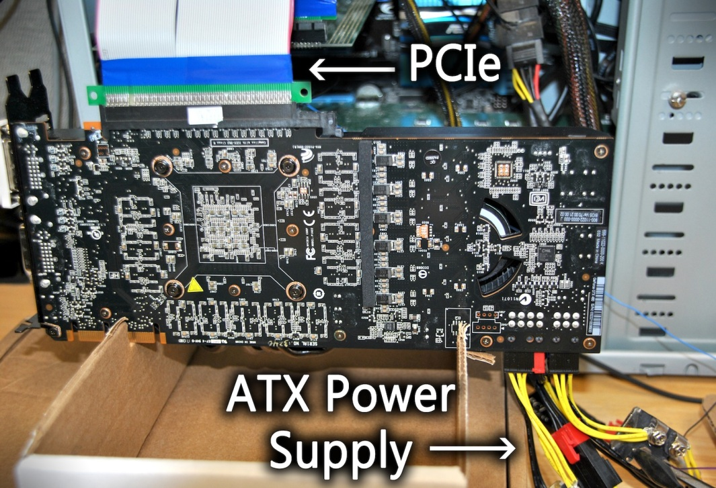
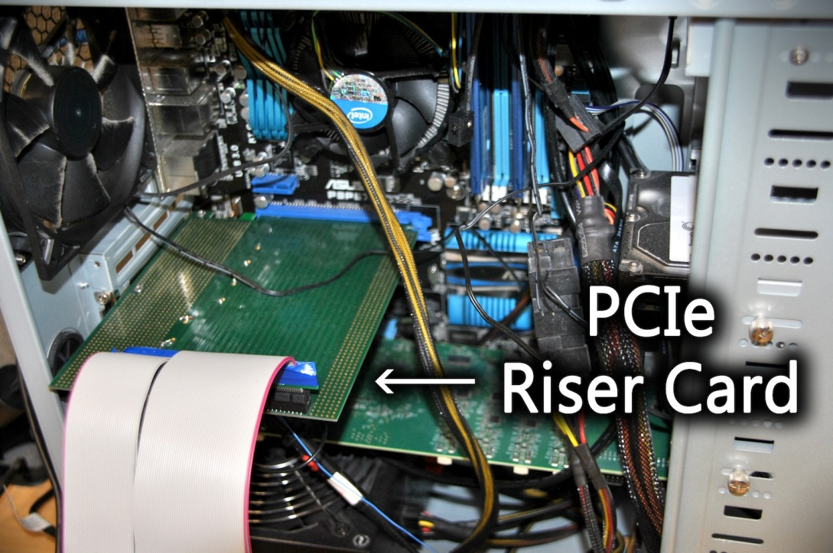
Measurement Setup
Hardware setup

Slide 8
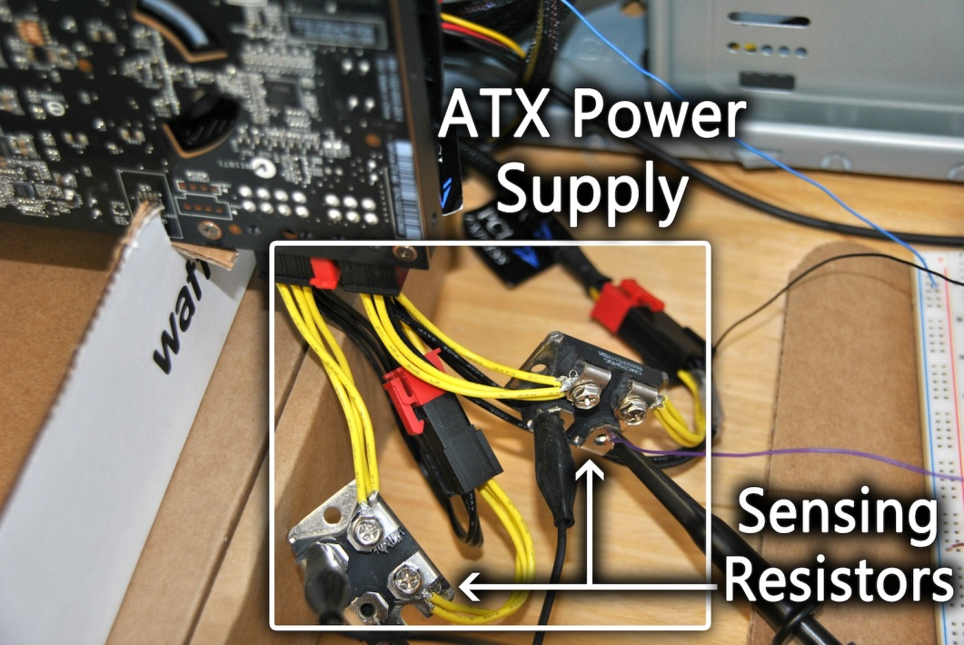
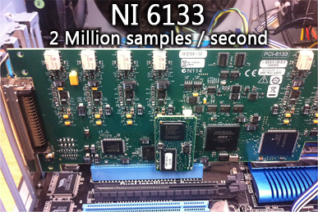
Measurement Setup
Hardware setup

Slide 9
Accuracy Average Power

Slide 10
Accuracy Average Power Breakdown

Slide 11
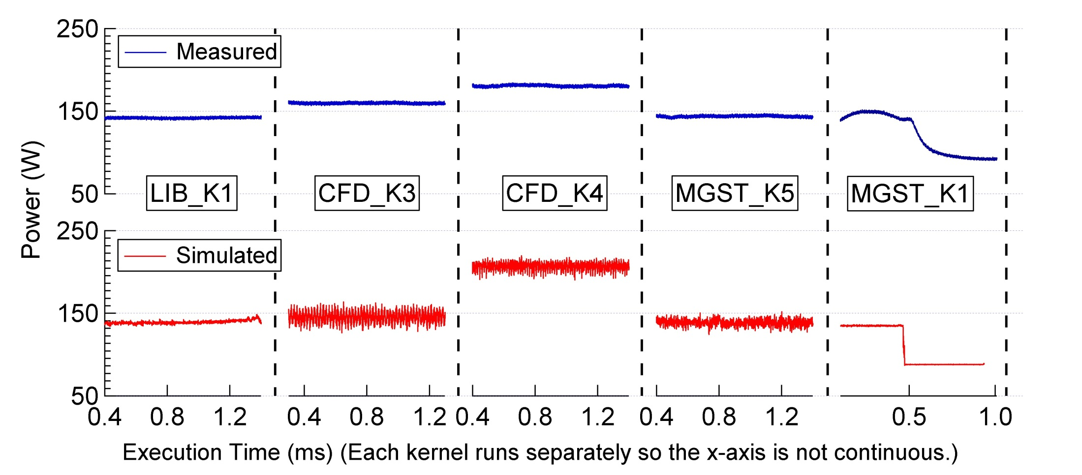
Accuracy Dynamic Traces

Slide 12
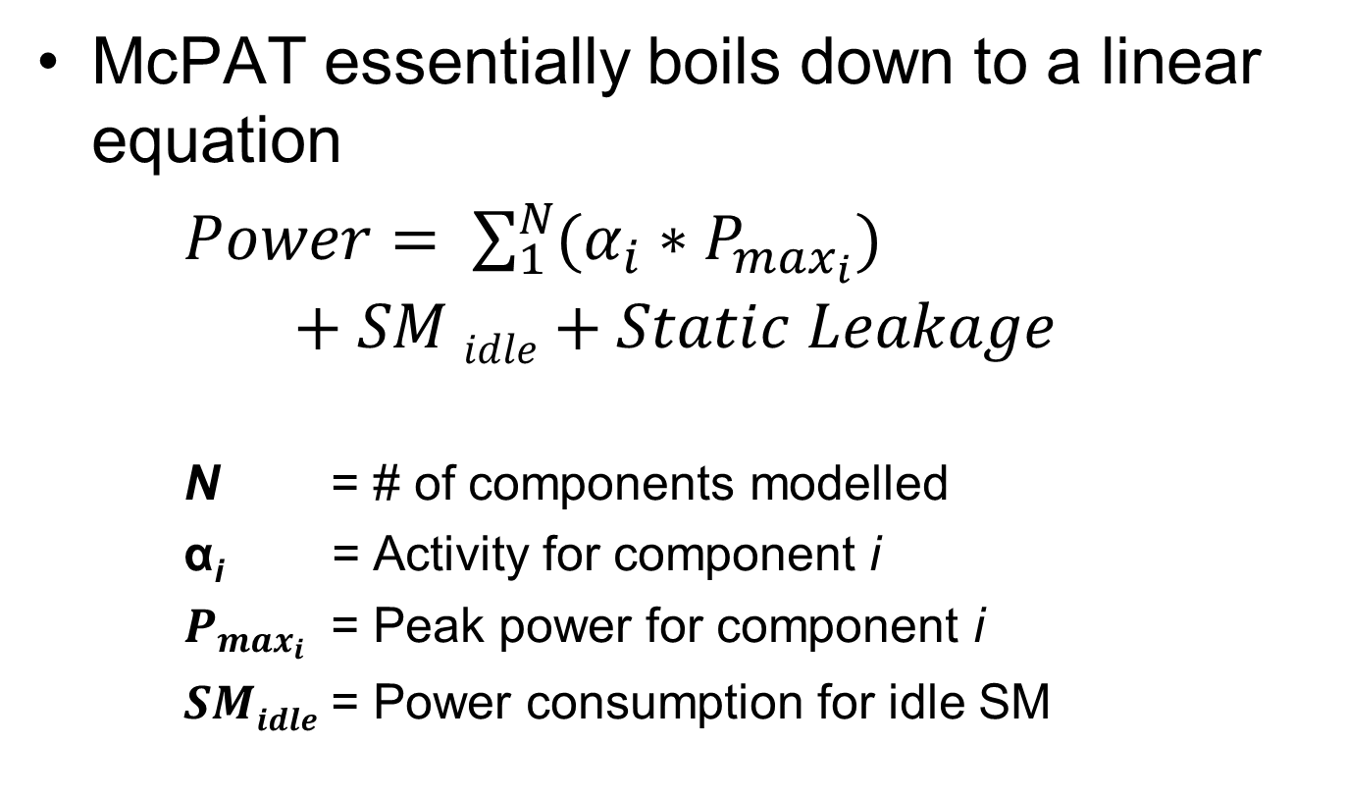
McPAT
McPAT essentially boils down to a linear equation
$Power= \sum_{1}^{N}{(α_{i}∗P_{max_{i}})}$ $$+ SM idle+Static Leakage$$
N = # of components modelled
α_{i} = Activity for component i
$P_{max_{i}}$ = Peak power for component i
$SMidle$ = Power consumption for idle SM

Slide 13
GPUWattch Structure GPGPU-Sim with McPAT
Modified McPAT
Modifications: Specific micro-architectural components
Interface
Interface
GPGPU-Sim
Modifications: Add required performance counters
Performance counters
Feedback-driven Optimizations
Static Power
Dynamic Power
Detailed Performance Stats
Detailed Power Stats
A Comprehensive Framework for Performance and Energy Optimization Research

Slide 14
Modeling GPGPU-Sim with McPAT
Inevitable modeling uncertainties of components
Unknown size or configuration
Unknown existence of components
Results in a 2 stage modeling process
Stage 1: Bottom up
Model GPGPU components in McPAT to build the initial power model
Identify Inaccuracies in the initial model
Stage 2: Top down
Resolve the inaccuracies using strategically designed microbenchmarks
Refine the initial power model

Slide 15
Modeling Bottom Up: McPAT Modifications
Baseline McPAT
Multi-core CPU power simulator
Detailed models for CPU microarchitectural blocks
Modified McPAT to account for GPU specific microarchitectural components
Some of the main components that were added/modified:
SM Pipeline
Register File
Caches
Shared Memory
Execution Units
Main Memory

Slide 16
Modeling Bottom Up: McPAT Modifications
SM Pipeline
In-order, multithreaded SIMD pipelines
Shared: E.g, scheduler, instruction fetch/decode, reg. file
Separate: E.g., functional units
Register Files
Banks (16, dual port): 1kb wide, 64-entry SRAM
Operand collection Network: 1kb wide, 16X16 crossbar
Operand collectors: 1kb wide SRAM

Slide 17
Modeling Bottom Up: McPAT Modifications
Caches
L1, L2, Texture, Constant cache: Architecture dependent sizes
Memory-coalescing logic: Synthesis based
Shared Memory
Banks (32): Architecture dependent sizes
Network: 32 x 32 crossbar network
Notes:
Shared Memory: Heavily multi-banked. Doesn’t have tagging structures as normal caches

Slide 18
Modeling Bottom Up: McPAT Modifications
Execution units
Integer ALUs: Synthesis-based
Floating point unit: Synthesis-based
Special-function unit: Synthesis-based
Main memory
Memory controller: McPAT model
NoC: McPAT model
GDDR5/GDDR3: Empirical model
Notes:
Memory controller: Changed data rates to have higher throughput, high bandwidth. No changes to architecture

Slide 19
Modeling Bottom Up: GPGPU-Sim modifications
Added performance counters required by McPAT
Structures added to manage performance counters
Files added to interface with McPAT
Existing timing model not affected by any GPGPU-Sim modifications

Slide 20
Modeling Bottom Up: GPGPU-Sim modifications
Current version utilizes 30 performance counters
Main Component | Performance Counters | Main Component | Performance Counters
Instruction cache | Read hit | L2 Data cache | Read hit
 | Read miss |  | Read miss
L1 Data cache | Read hit |  | Write hit
 | Read miss |  | Write miss
 | Write hit | Memory | Reads
 | Write miss |  | Writes
Texture cache | Read hit |  | Precharges
 | Read miss | Register file | Reads
Constant cache | Read hit |  | Writes
 | Read miss |  | Non-register file operand

Slide 21
Modeling Bottom Up: GPGPU-Sim modifications
Current version utilizes 30 performance counters
Main Component | Performance Counters | Main Component | Performance Counters
Decoding/Scheduling | Total # instructions | Shared Memory | Accesses
 | FP_INT instructions
Pipeline dutycycle | Fraction of committed instructions per cycle | Execution Units | SP accesses
Idle core | Number of cycles each SM is idle |  | SFU accesses
Interconnect | # of flits from SIMT cores to Memory Partition
 |  |  | FPU accesses
 | # of flits from Memory Partition to SIMT cores

Slide 22
Modeling Top Down: Refinement
Why Refinement?
Modeling uncertainties
Adjust hardware assumptions
Account for black boxes (Unknown unknowns)
How?
Microbenchmarking
Example: Texture cache
Model: Regular cache
Reality: Additional functions
Address translations, reorder buffers to decouple tags from data, texture samplers, etc.
These are treated as black boxes and accounted for in the refinement process

Slide 23
Using GPUWattch Configuration Options
GPGPU-Sim: gpgpusim.config
-power_simulation_enabled (1/0)
-mcpat_xml_file <filename>.xml
McPAT configurations: <filename>.xml
Default: mcpat.xml
Currently, must be included in working directory

Slide 24
Using GPUWattch Understanding Simulation Output
-power_simulation_enabled 1
gpgpusim_power_report_(date&time).log
Contains avg/max/min total powers and their power breakdowns for each component per kernel.
-power_trace_enabled 1
gpgpusim_power_trace_(date&time).log.gz
Contains detailed avg power breakdown (CSV)
gpgpusim_metric_trace_(date&time).log.gz
Contains detailed performance counter trace (CSV)

Slide 25
Using GPUWattch Advanced: For your research
Start
Set initial Configurations
Extending?
Missing Components?
Yes
No
Regular Structure
No
Yes
- Model performance impact
- Instantiate a new component from existing classes
-Model performance impact
- HDL Synthesis
- Generate corresponding performance counters
- Pass them to McPAT
Compile & Run
Simulation ….

Slide 26
Using GPUWattch Software organization
GPGPU-Sim (<root>/src/gpu-sim/)
power_stat.cc/h
power_interface.cc/h
McPAT (<root>/src/mcpat/)
gpgpu_sim_wrapper.cc/h
gpgpu_sim.verify
GPGPU-Sim
power_stat
Performance counters
Dynamic/Static power Runtime feedback stats
Modified McPAT
gpgpu_sim.verify
gpgpu_sim_wrapper
power_interface

Slide 27
Using GPUWattch Adding a new component
Step 1: If necessary, add new configuration option
XML File
_{mcpat.xml}
XML Parser
_{XML_parse.cc}
Interface
_{Class} _{root_system}
_{(XML_parse.h)}
Static Configuration
McPAT Parser
McPAT’s internal
Representation of XML File
Notes:
*This step is optional. It is only necessary when the parameters of
this component can not be decided using other existing components.

Slide 28
Using GPUWattch Adding a new component
Step 2
Decide whether this component is already modeled in McPAT
E.g., McPAT already provides models for DataCache (array.h), and FunctionalUnit (logic.h)
If not modeled in McPAT, we need to use the basic structures provided by CACTI to model the component or synthesize the component manually.

Slide 29
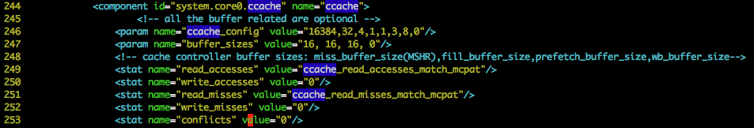
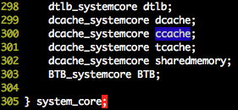
Using GPUWattch Example: Adding constant cache
Step 1: Change the XML file, and the corresponding class in XML_parse.h (class system_core for constant cache)
Cache parameters
Struct dcache_systemcore holds all cache parameters specified in the XML file.

Slide 30
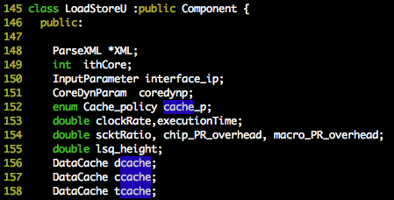
Using GPUWattch Example: Adding constant cache
Step 2:
Add the component in the LoadStoreU class (core.h)
Modify the constructor and compute function in LoadStoreU class (core.cc)
ccache.caches = new ArrayST(&interface_ip, "ccache", Core_device,
coredynp.opt_local, coredynp.core_ty);

Slide 31
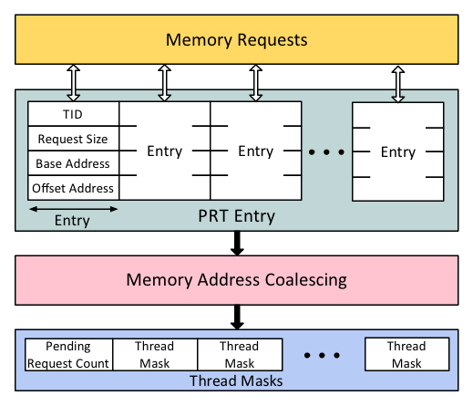
Using GPUWattch Example: Adding the Memory Coalesce Logic
Change corresponding XML file and object
There are three array structures for the MCL
Pending Request Table (PRT)
Pending Request Count (PRC)
Thread Masks

Slide 32
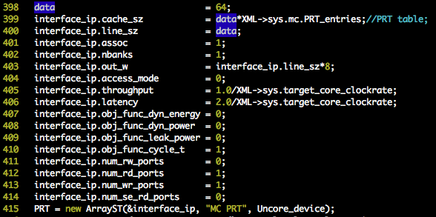
Using GPUWattch Example: Adding the Memory Coalesce Logic
Use the CACTI interface to construct these arrays
PRT (memoryctrl.cc)
Per row data size = 64 Bytes
Warp ID (6 bits) | Memory address (32 bits) per thread | Request Size (2-bits) per thread |
6 bits | 32 x 16 bits | 2 x 16 bits
Notes:
the physical implementation of SRAM will be optimized by McPAT by using the EDP metric

Slide 33
Using GPUWattch Example: Adding Synthesized Model
Describe the hardware in Verilog HDL
Synthesize it using DesignVisionTM
40nm TSMC® standard cell technology library
Timing constraints according to the GPU clock
Annotate switching activity
Use a representative set of inputs to test the synthesized design
Dump the activity factors for all the cells used in the design

Slide 34
Using GPUWattch Example: Adding Synthesized Model
Use PowerCompilerTM to annotate all the cells with switching activity information
Dynamic and leakage power reports are generated from PowerCompilerTM

Slide 35

Using GPUWattch Example: Adding Synthesized Model
Incorporate the power numbers in McPAT
McPAT model may use a different technology library/Vdd
Scale the power numbers according to McPAT’s internal scaling models
Notes:
90 = 90nm technology library.
It is the 90nm tech library. This is how McPAT internally scales power numbers

Slide 36
Summary
GPGPU-Sim power model: GPUWattch
Accuracy
How it’s modeled
GPGPU-Sim
McPAT
How to enable
Software organization
How to modify

Slide 37
Overview
1 | Brief Background on GPU Computing | 40mins
2 | GPGPU-Sim Overview | 30mins
3 | Demo 1: Setup and Run | 15mins
Coffee Break (10:00 – 10:30am)
4 | Microarchitecture Timing Model | 85mins
Lunch (12:00 – 1:00pm)
5a | Software Organization | 25mins
5b | Timing Model (Software) | 50mins
5c | Power Model: GPUWattch | 45mins
Coffee Break (3:00 – 3:30pm)
6 | The GPU Design Space | 10mins
7a | Demo 2: Debugging Tool | 15mins
7b | Demo 3: Visualizing Performance | 30mins
8 | Extending GPGPU-Sim (with GPUWattch) | 30mins
9 | Wrap Up and Discussion | 15mins

