Slide 1

Overview
1 | Brief Background on GPU Computing | 40mins
2 | GPGPU-Sim Overview | 30mins
3 | Demo 1: Setup and Run | 15mins
Coffee Break (10:00 – 10:30am)
4 | Microarchitecture Timing Model | 85mins
Lunch (12:00 – 1:00pm)
5a | Software Organization | 25mins
5b | Timing Model (Software) | 50mins
5c | Power Model: GPUWattch | 45mins
Coffee Break (3:00 – 3:30pm)
6 | The GPU Design Space | 10mins
7a | Demo 2: Debugging Tool | 15mins
7b | Demo 3: Visualizing Performance | 30mins
8 | Extending GPGPU-Sim (with GPUWattch) | 30mins
9 | Wrap Up and Discussion | 15mins
December 2012
GPGPU-Sim Tutorial (MICRO 2012) 7: Debugging, Visualization
7.<number>

Slide 2
Session Overview
GDB Macro
Debug Levels
Interactive Debugger
AerialVision
December 2012
GPGPU-Sim Tutorial (MICRO 2012) 7: Debugging, Visualization
7.<number>

Slide 3
Session Objectives
After this session, you will be able to:
  Use GDB to observe the simulated microarchitecture timing states in
  GPGPU-Sim
  Tell GPGPU-Sim to dump out extra debugging info
  Visualize high-level performance dynamics in CUDA applications
December 2012
GPGPU-Sim Tutorial (MICRO 2012) 7: Debugging, Visualization
7.<number>

Slide 4
GDB Macros
We provide a set of GDB macros that visualize detail microarchitecture states:
Useful for cycle-by-cycle debugging
See Manual for other macros
Macro | Description
dp <core_id> | Display Pipeline State in the SIMT Core with ID = <core_id>
dm <partition_id> | Display Internal States in Memory Partition with ID = <partition_id>
ptxdis <start_pc> <end_pc> | Display PTX Instruction Between <start_pc> and <end_pc>
December 2012
GPGPU-Sim Tutorial (MICRO 2012) 7: Debugging, Visualization
7.<number>

Slide 5
GDB Macros: Usage
Copy .gdbinit in GPGPU-Sim distribution to:
  Your home directory or
  Where GDB is launched
GDB loads the macros automatically and display this message:
** loading GPGPU-Sim debugging macros… **
December 2012
GPGPU-Sim Tutorial (MICRO 2012) 7: Debugging, Visualization
7.<number>

Slide 6
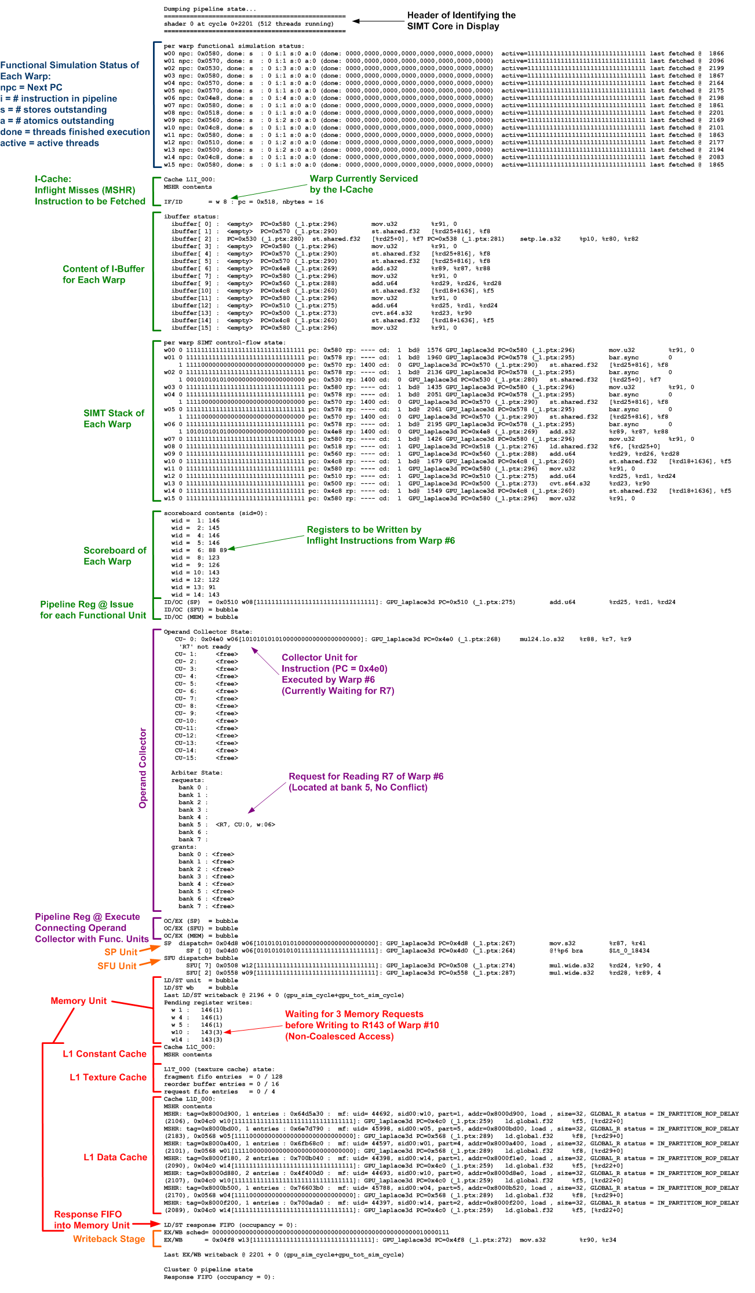
GDB Macros: DP
Front End:
I-Buffer, SIMT Stack, Scoreboard
Data Path:
Operand Collector, ALU Units
Memory Unit:
Caches, Pending Requests
December 2012
GPGPU-Sim Tutorial (MICRO 2012) 7: Debugging, Visualization
7.<number>

Slide 7
Debug Levels
Tell GPGPU-Sim to dump out extra information for debugging
Set via env. var. PTX_SIM_DEBUG
Most useful levels (see Manual for others):
Level | Description
6 | Display modified register(s) by each executed instruction
10 | Display all registers of a thread executing the instruction
December 2012
GPGPU-Sim Tutorial (MICRO 2012) 7: Debugging, Visualization
7.<number>

Slide 8
Debug Levels
PTX_SIM_DEBUG_THREAD_UID
  Limit debug output to a single thread
  Useful for tracing a single thread
December 2012
GPGPU-Sim Tutorial (MICRO 2012) 7: Debugging, Visualization
7.<number>

Slide 9
Interactive Debugger
GDB-like interface
  Complements debug level
Features
  Breakpoints for a specific thread
  Watchpoints for address
  Single stepping execution to next core cycle
To enable: Set GPGPUSIM_DEBUG to 1
  Currently limited to performance simulation
December 2012
GPGPU-Sim Tutorial (MICRO 2012) 7: Debugging, Visualization
7.<number>

Slide 10
GDB Macros Demo
December 2012
GPGPU-Sim Tutorial (MICRO 2012) 7: Debugging, Visualization
7.<number>

Slide 11
Overview
1 | Brief Background on GPU Computing | 40mins
2 | GPGPU-Sim Overview | 30mins
3 | Demo 1: Setup and Run | 15mins
Coffee Break (10:00 – 10:30am)
4 | Microarchitecture Timing Model | 85mins
Lunch (12:00 – 1:00pm)
5a | Software Organization | 25mins
5b | Timing Model (Software) | 50mins
5c | Power Model: GPUWattch | 45mins
Coffee Break (3:00 – 3:30pm)
6 | The GPU Design Space | 10mins
7a | Demo 2: Debugging Tool | 15mins
7b | Demo 3: Visualizing Performance | 30mins
8 | Extending GPGPU-Sim (with GPUWattch) | 30mins
9 | Wrap Up and Discussion | 15mins
December 2012
GPGPU-Sim Tutorial (MICRO 2012) 7: Debugging, Visualization
7.<number>

Slide 12
AerialVision: Visualizing Complex Dynamics in GPU
Visualizer Tool for GPGPU-Sim
December 2012
GPGPU-Sim Tutorial (MICRO 2012) 7: Debugging, Visualization
7.<number>

Slide 13
Introducing AerialVision
Visualizer for GPGPU-Sim
  Time Lapse View: Performance metrics vs. time
  Source Code View: Performance metrics vs. the CUDA source code
  Implemented in Python: very extensible
GPGPU-Sim modified to generate inputs for AerialVision:
Visualization
Trace
GPGPU-Sim
CUDA Application
AerialVision
visualizer.cc
PTX Instruction
Statistics
ptx-stats.cc
December 2012
GPGPU-Sim Tutorial (MICRO 2012) 7: Debugging, Visualization
7.<number>

Slide 14
AerialVision: Motivation
Common case in architectural research:
  Researchers implemented their new proposals in an architecture simulator (in this case GPGPU-Sim)
  Simulation results across a suite of benchmarks usually look like this:
Need to understand reason behind slowdowns!
Need to validate these results!
A
B
C
D
E
F
December 2012
GPGPU-Sim Tutorial (MICRO 2012) 7: Debugging, Visualization
7.<number>

Slide 15
AerialVision: Motivation
Current ways to gain insights (GPGPU-Sim)
  Performance statistics log @ end of kernel launch
    Ignores runtime dynamics in the microarchitecture
  GDB cycle by cycle stepping
    Information overload
    Slow
GPU is parallel and programmable
  Lots of insight gained from having a global view
    Time-lapse performance variations
    View multiple units in parallel
  Relate performance metrics to source code
December 2012
GPGPU-Sim Tutorial (MICRO 2012) 7: Debugging, Visualization
7.<number>

Slide 16
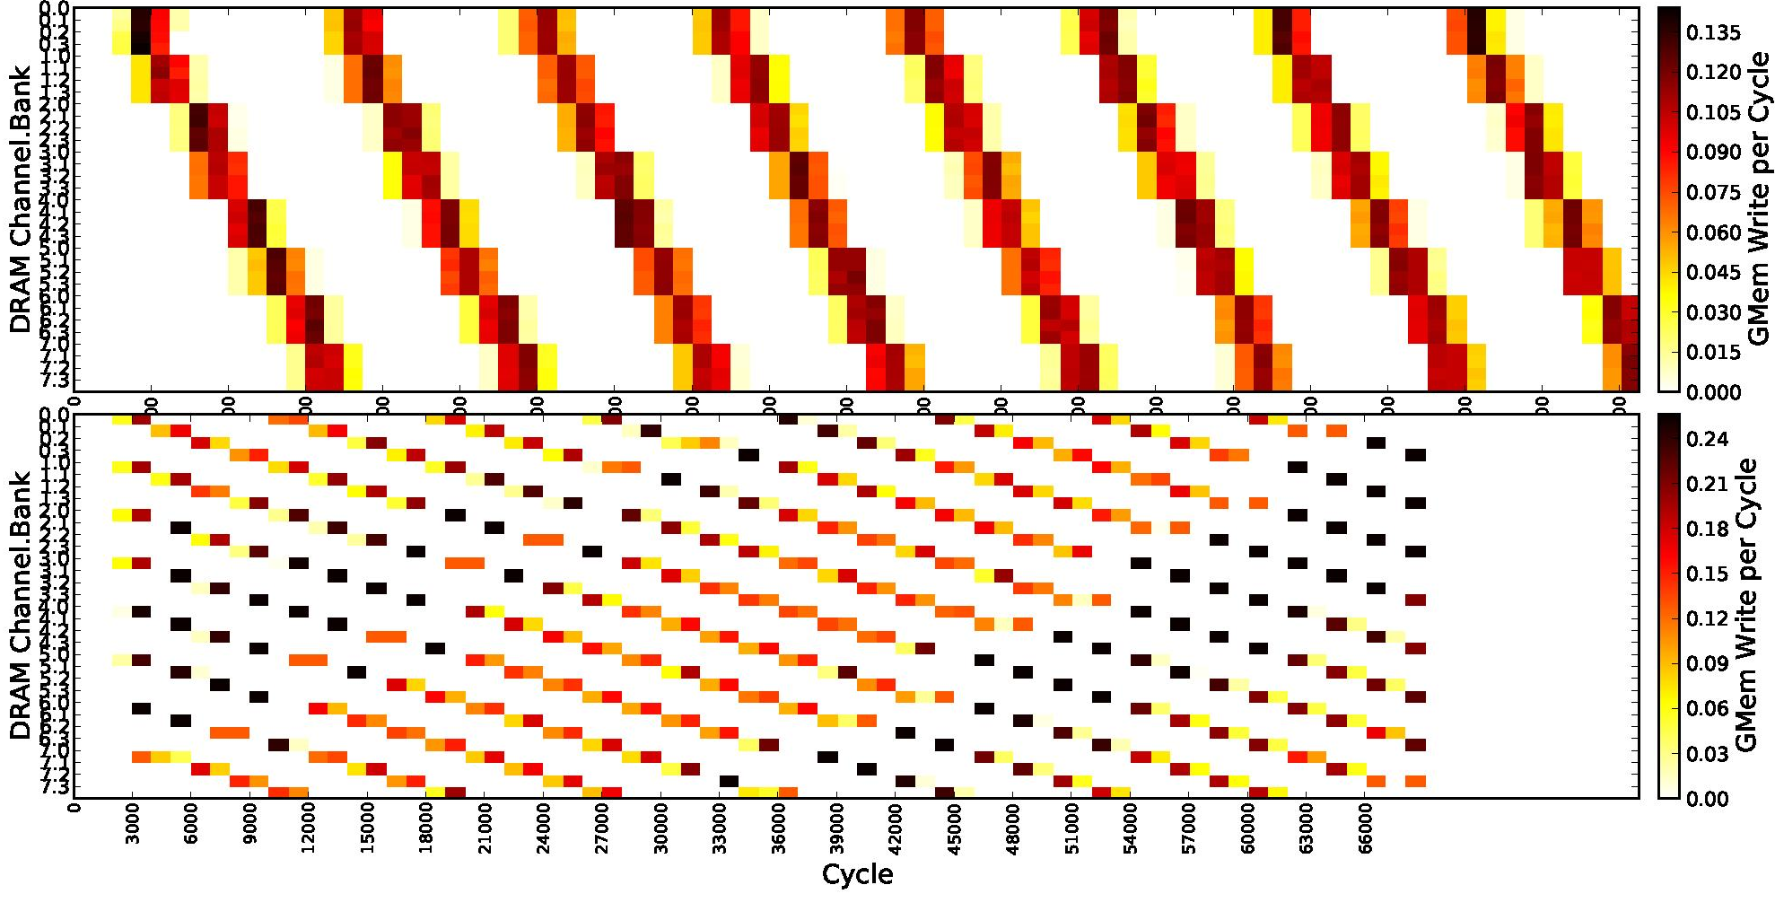
AerialVision: Motivation
Why is runtime dynamics important for GPUs?
  Many core accelerator architecture
  Intermittent contentions effect performance, but not captured by end-to-end performance statistics
Transpose with two different address mapping
DRAM utilization is ~uniform for both case!
Bottleneck goes undetected!
December 2012
GPGPU-Sim Tutorial (MICRO 2012) 7: Debugging, Visualization
7.<number>

Slide 17
AerialVision: Motivation
CUDA kernels are growing large
  MUMMerGPU = ~400 lines
  GPUDG = ~200 lines
  …
Many GPGPU-Sim users are CUDA app dev
  Use the simulator to help understand the performance of their CUDA applications
  Need to pin point performance bottleneck in the kernel code
  Benefits hardware architects as well
December 2012
GPGPU-Sim Tutorial (MICRO 2012) 7: Debugging, Visualization
7.<number>

Slide 18
Outline
AerialVision Motivation + Introduction
Time Lapse View
Source Code View
Demo
Overhead
Summary
December 2012
GPGPU-Sim Tutorial (MICRO 2012) 7: Debugging, Visualization
7.<number>

Slide 19
Time Lapse View
Visualize performance metrics versus time
  Plot up to 5 metrics in a figure for direct visual comp.
  Infinite # figures (until memory runs out)
Different type of plots for different metrics
  Line plots → global singulars (e.g. IPC)
  Parallel intensity plot → metrics across multi. HW units
  Stack bar charts → component breakdowns
  PC-Histogram → relate thread dynamics and source code
Plots are generated with Matplotlib
  Navigation tool bar for zoom and pan
  More formatting options exposed with extra widgets
December 2012
GPGPU-Sim Tutorial (MICRO 2012) 7: Debugging, Visualization
7.<number>

Slide 20
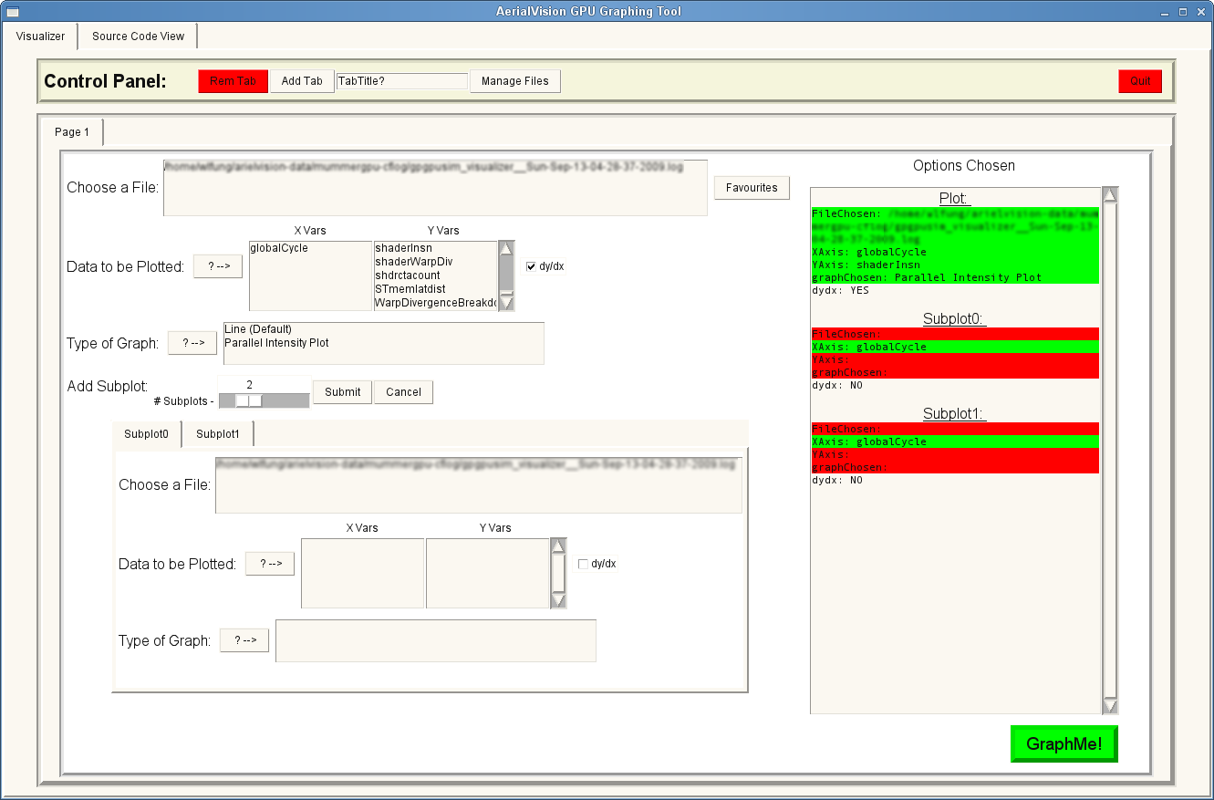
Time Lapse View –
Metric(s) Selection
Shows what you have selected for each plot
Add a new tab
(a new figure)
Select a visualizer trace file
Select metric to plot
Select type of plot
Add more plots to the figure
Configure each subplot
December 2012
GPGPU-Sim Tutorial (MICRO 2012) 7: Debugging, Visualization
Click this to start plotting!
7.<number>

Slide 21
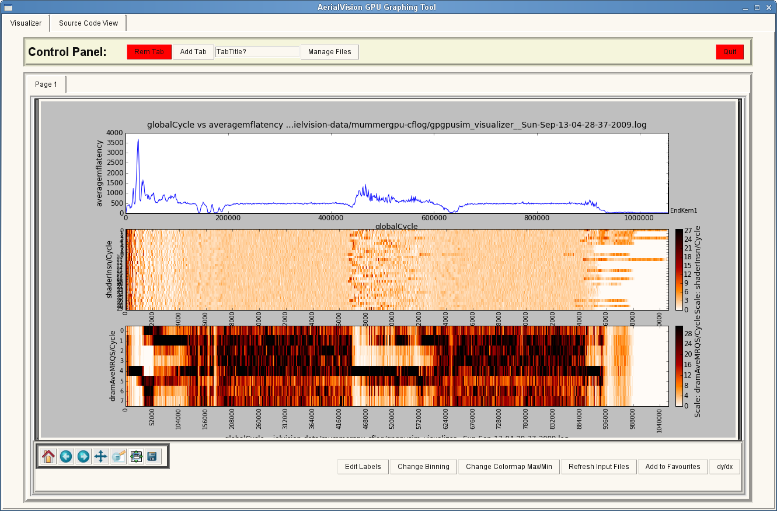
Time Lapse View –
Figure
Switch between different figures
Figure plotting selected metrics
Formatting
Tool
Navigation Tool
December 2012
GPGPU-Sim Tutorial (MICRO 2012) 7: Debugging, Visualization
7.<number>

Slide 22
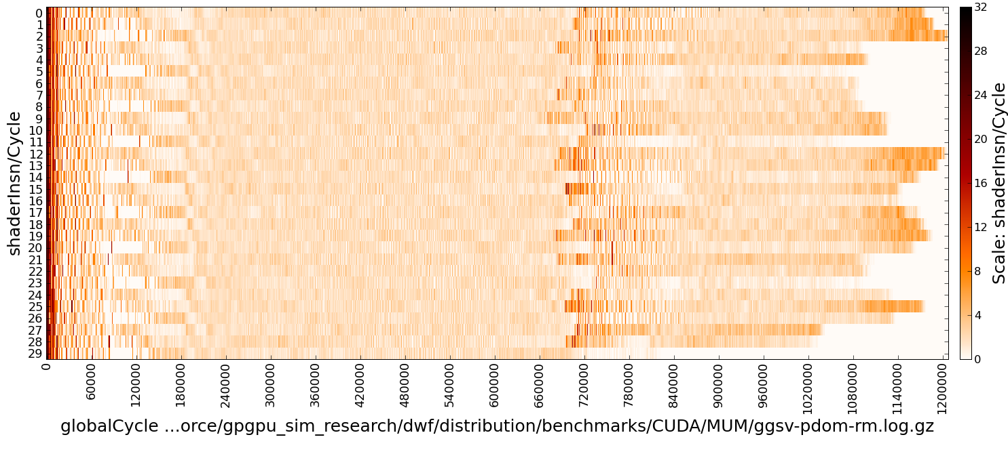
Time Lapse View –
Parallel Intensity Plot
View performance metrics for multiple parallel hardware units vs. time
  Change color mapping with “Change Colormap Max/Min”
Mapping from color to value of the metric
Data for each shader core
December 2012
GPGPU-Sim Tutorial (MICRO 2012) 7: Debugging, Visualization
7.<number>

Slide 23
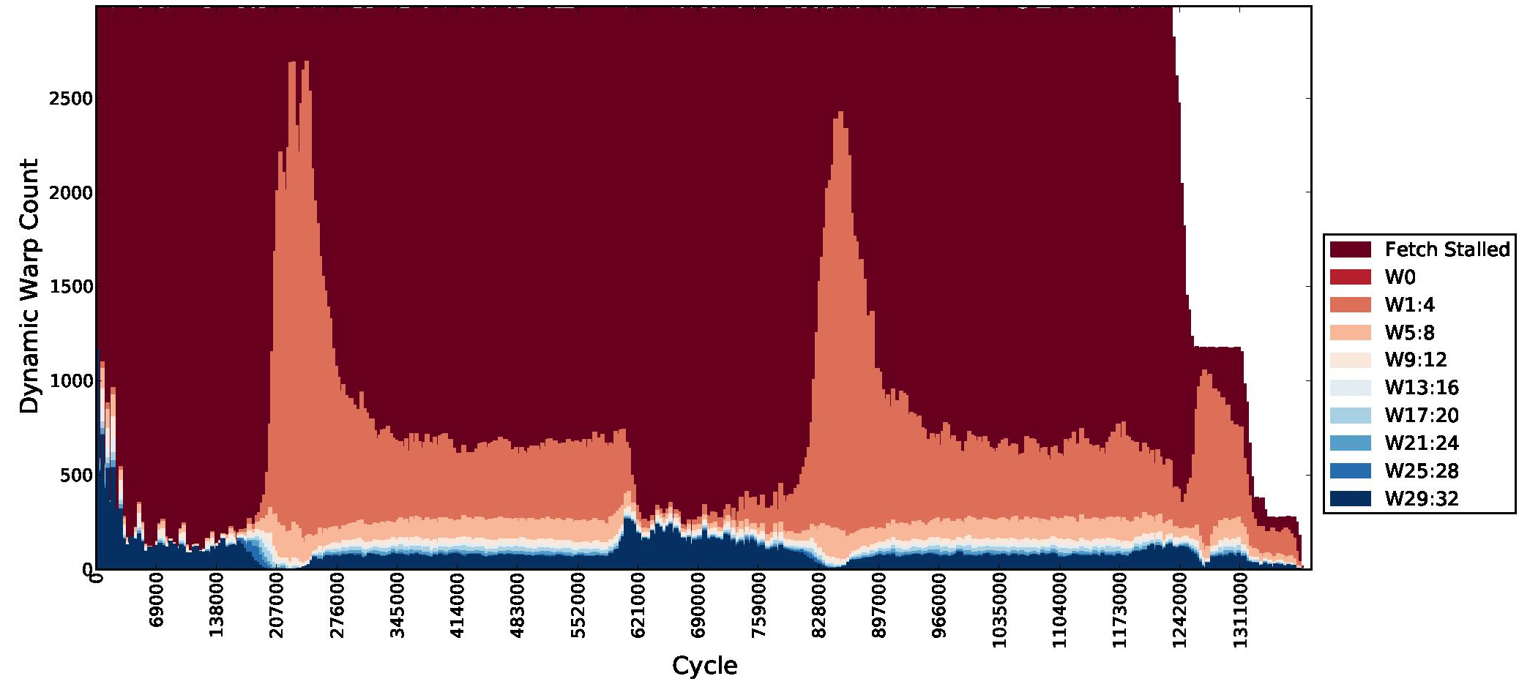
Time Lapse View –
Stacked Bar Chart
Shows the breakdown of a metric vs. time
  Warp divergence
  Load/Store latency breakdown
Each component is represented by a unique color.
December 2012
GPGPU-Sim Tutorial (MICRO 2012) 7: Debugging, Visualization
7.<number>

Slide 24
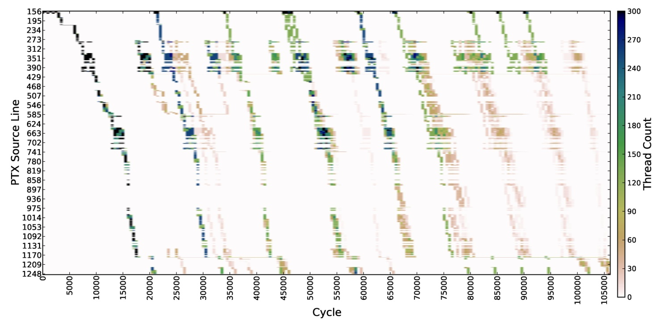
Time Lapse View –
PC-Histogram (CFLog)
A time series of histograms, representing the portion of the program that the threads has touched during a given sample period.
A thread is considered to have touched an instruction:
  After it has fetched the instruction
  Until it fetches a new instruction
Each line here represents:
A PTX instruction
OR
A line in CUDA source code.
Color at each dot indicates # threads touching the instruction during that sampling period.
CFLOG stands for
“Control Flow” Log
December 2012
GPGPU-Sim Tutorial (MICRO 2012) 7: Debugging, Visualization
7.<number>

Slide 25

Time Lapse View –
Navigation and Formatting Tools
Save
Pan
Zoom
Change plot spacing
Change Colormap Max/Min
  Configure how metric values are mapped to the color spectrum
  Allow user to normalize among all plots
  Choose a different color scheme
Change Binning
  Modify the frequency of tick labels on the axes
Edit Labels
  Edit the labels on x and y axes, and the title/colormap label
  Choose the fonts size for labels
December 2012
GPGPU-Sim Tutorial (MICRO 2012) 7: Debugging, Visualization
7.<number>

Slide 26
Source Code View
Performance Profiler
“VTuneTM” for CUDA (on GPGPU-Sim)
  Narrow bottleneck down to a single line of source code in your application
Features:
  Shows performance metrics side-by-side with the source code
  Navigation graph
    Shows the big picture
    Single-click to jump to the “code of interest”
December 2012
GPGPU-Sim Tutorial (MICRO 2012) 7: Debugging, Visualization
7.<number>

Slide 27
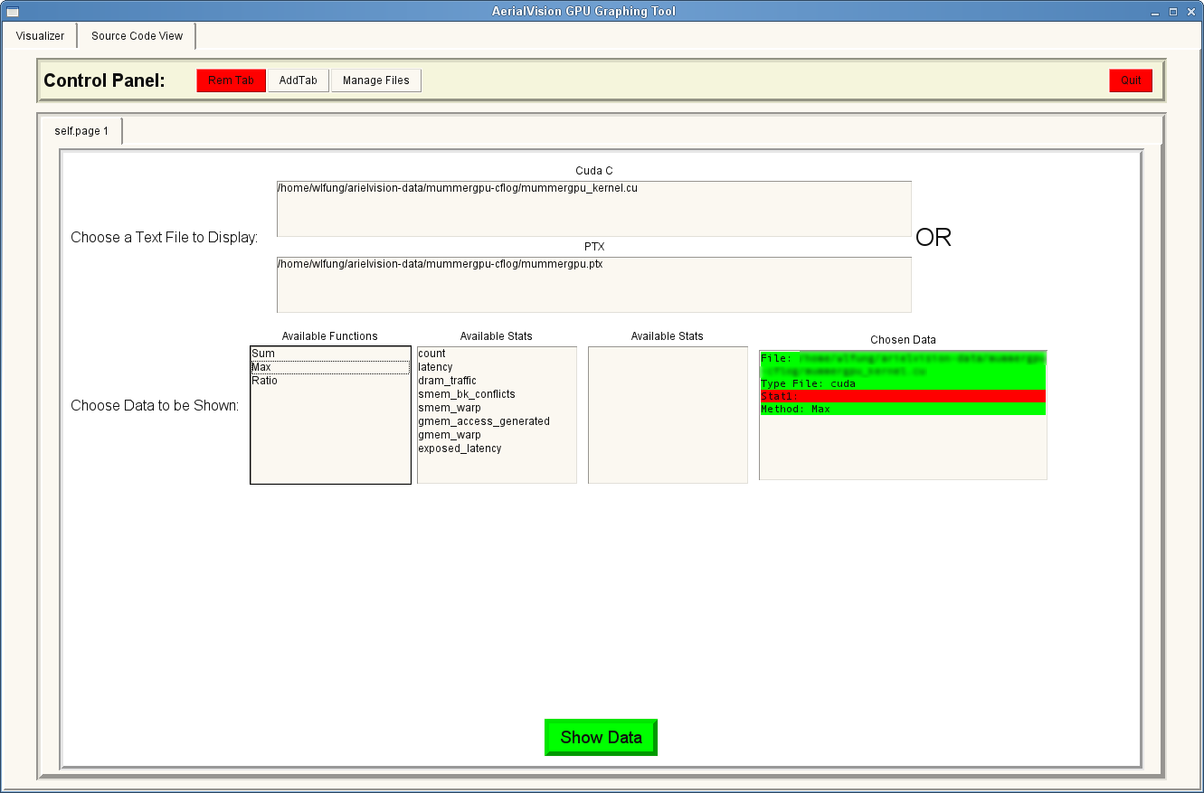
Source Code View –
Metric(s) Selection
Select the CUDA C file or PTX file to show with the metric
Choose how metrics should be combined
(More on this next)
Choose the metric to be displayed
Click this to proceed
December 2012
GPGPU-Sim Tutorial (MICRO 2012) 7: Debugging, Visualization
7.<number>

Slide 28
Source Code View –
Combine Metrics
GPGPU-Sim samples performance metrics for each PTX instruction.
Each line of CUDA C → multiple lines of PTX instructions.
  This mapping can be acquired via debug info generated by NVCC
Question: How should the metrics from multiple PTX instructions be reduced?
  Max ← Latency / Execution Count
  Sum ← Quantity counters
Sum?
Max?
221
200
a[i] = b[i] + c;
200
ld.s32 %r2, [%r1];
1
add.f32 %r4, %r2, %r3;
20
st.s32 %r4, [%r1];
We provide suggestions for each metric in the manual.
Ratio between metrics? We use Max for both.
December 2012
GPGPU-Sim Tutorial (MICRO 2012) 7: Debugging, Visualization
7.<number>

Slide 29
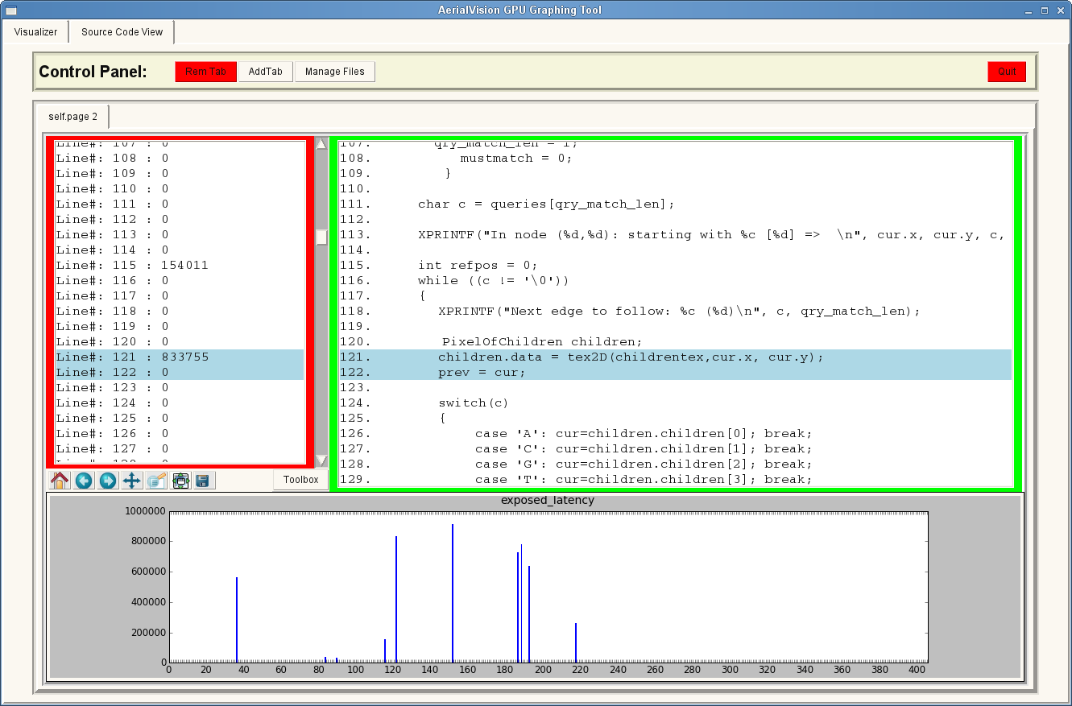
Source Code View –
Navigation
CUDA C Source Code
Metric
Data
Format
Tool
etc…
Navigation graph
December 2012
GPGPU-Sim Tutorial (MICRO 2012) 7: Debugging, Visualization
7.<number>

Slide 30
Source Code View –
Navigation
Viewer jumps to here,
with the clicked line highlighted
Right-Click Here
Line number in CUDA C File
December 2012
GPGPU-Sim Tutorial (MICRO 2012) 7: Debugging, Visualization
7.<number>

Slide 31
Overhead + Extension
GPGPU-Sim need to do extra work to generate inputs for AerialVision
  Simulation speed ~30% slower
  Data dumped to HDD = 3.4kB per sample
Turned on by default
  sampling frequency = Every 1000 cycles
Adding new metrics for AerialVision
  Next Session
Configurable
See manual for options
December 2012
GPGPU-Sim Tutorial (MICRO 2012) 7: Debugging, Visualization
7.<number>

Slide 32
Setup / Installation
To be able to use AerialVision, you only need to install its dependencies:
  python-pmw
  python-ply
  python-numpy
  libpng12-dev
  python-matplotlib
Run bin/aerialvision.py in GPGPU-Sim distribution.
December 2012
GPGPU-Sim Tutorial (MICRO 2012) 7: Debugging, Visualization
7.<number>

Slide 33
AerialVision Demo
December 2012
GPGPU-Sim Tutorial (MICRO 2012) 7: Debugging, Visualization
7.<number>

Slide 34
Session Summary
GDB Macro
Debug Level
Interactive Debugger
AerialVision – Performance Visualizer
for GPGPU-Sim
  Time Lapse View
    Metric vs. Time
  Source Code View
    Metric vs. Code
December 2012
GPGPU-Sim Tutorial (MICRO 2012) 7: Debugging, Visualization
7.<number>

Slide 35
Overview
1 | Brief Background on GPU Computing | 40mins
2 | GPGPU-Sim Overview | 30mins
3 | Demo 1: Setup and Run | 15mins
Coffee Break (10:00 – 10:30am)
4 | Microarchitecture Timing Model | 85mins
Lunch (12:00 – 1:00pm)
5a | Software Organization | 25mins
5b | Timing Model (Software) | 50mins
5c | Power Model: GPUWattch | 45mins
Coffee Break (3:00 – 3:30pm)
6 | The GPU Design Space | 10mins
7a | Demo 2: Debugging Tool | 15mins
7b | Demo 3: Visualizing Performance | 30mins
8 | Extending GPGPU-Sim (with GPUWattch) | 30mins
9 | Wrap Up and Discussion | 15mins
December 2012
GPGPU-Sim Tutorial (MICRO 2012) 7: Debugging, Visualization
7.<number>

