Slide 1
Overview
1 | Brief Background on GPU Computing | 40mins
2 | GPGPU-Sim Overview | 30mins
3 | Demo 1: Setup and Run | 15mins
Coffee Break (10:00 – 10:30am)
4 | Microarchitecture Timing Model | 85mins
Lunch (12:00 – 1:00pm)
5a | Software Organization | 25mins
5b | Timing Model (Software) | 50mins
5c | Power Model: GPUWattch | 45mins
Coffee Break (3:00 – 3:30pm)
6 | The GPU Design Space | 10mins
7a | Demo 2: Debugging Tool | 15mins
7b | Demo 3: Visualizing Performance | 30mins
8 | Extending GPGPU-Sim (with GPUWattch) | 30mins
9 | Wrap Up and Discussion | 15mins

Slide 2
Adding a Two-Level Warp Scheduler
Energy-efficient mechanisms for managing thread context in throughput processors. [Gebhart and Johnson et al., ISCA 2011]

Slide 3
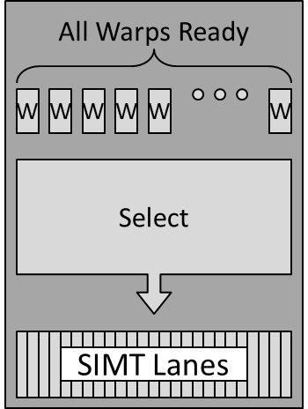
Single-Level (current) Warp Scheduler
Loose Round-Robin Policy
Pick a ready warp and issue it
Next cycle, start by the next warp
Mark Gebhart 2011

Slide 4
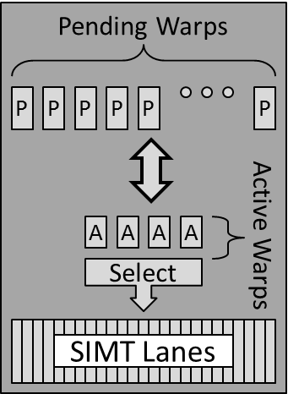
Two-Level Warp Scheduler
Two pools of warps
Ready: Ready or soon to be
Pending: Waiting on long operations
Mark Gebhart 2011

Slide 5
Two-Level Warp Scheduler
Hiding short latencies (e.g. Arith pipeline)
Requires a few warps: use ready pool
Hiding long latencies (e.g. DRAM)
Requires a lot of warps: use pending pool

Slide 6
Two-Level Warp Scheduler
Policy:
Schedule warps from the Ready pool
Move warps to Pending pool if they read a register that will be written by a long latency operation
Move warps to Ready pool if there is space

Slide 7
Why?
Improves cache hit rates
Lower power
Scheduler walks a shorter list
(Improves register file cache performance)

Slide 8
Former Implementation
Class scheduler_unit{
scheduler_unit(...);
void add_supervised_warp_id(int);
void cycle();
}

Slide 9
Virtual Base Class
Class scheduler_unit{
scheduler_unit(...);
virtual void add_supervised_warp_id(int);
virtual void cycle()=0;
}

Slide 10
Two Derived Classes
Class LooseRoundRobbinScheduler:
public scheduler_unit {…
virtual void cycle();
}
Class TwoLevelScheduler:
public scheduler_unit {…
virtual void cycle();
}

Slide 11
Tracking Long Operations
Augment Scoreboard to track registers depending on long operations
bool Scoreboard::islongop(int regnum);

Slide 12
Adding a Config Option
Add the option using the option parser in
gpu-sim.cc:
option_parser_register( … );
Read the option in shader.cc
std::string sched_config = m_config->gpgpu_scheduler_string

Slide 13
Coding Time :)

Slide 14
Overview
1 | Brief Background on GPU Computing | 40mins
2 | GPGPU-Sim Overview | 30mins
3 | Demo 1: Setup and Run | 15mins
Coffee Break (10:00 – 10:30am)
4 | Microarchitecture Timing Model | 85mins
Lunch (12:00 – 1:00pm)
5a | Software Organization | 25mins
5b | Timing Model (Software) | 50mins
5c | Power Model: GPUWattch | 45mins
Coffee Break (3:00 – 3:30pm)
6 | The GPU Design Space | 10mins
7a | Demo 2: Debugging Tool | 15mins
7b | Demo 3: Visualizing Performance | 30mins
8 | Extending GPGPU-Sim (with GPUWattch) | 30mins
9 | Wrap Up and Discussion | 15mins

