Slide 1

Autoencoder
Masoud Pourreza
Pourreza.masoud@gmail.com
2018

Slide 2

Step one : Feature!
Cat vs Dog
1

Slide 3
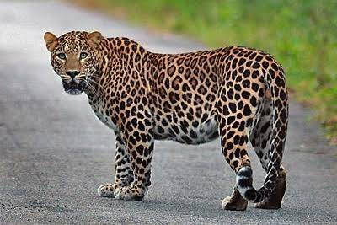
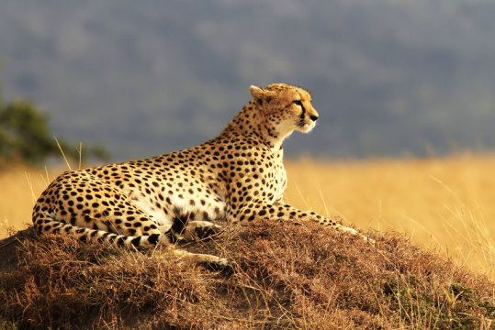
Easy?
cheetah vs leopard
2

Slide 4
Feature Engineering
Feature engineering is the process of transforming raw data into features that better represent the underlying problem to the predictive models, resulting in improved model accuracy on unseen data.
Feature engineering turn your inputs into things the algorithm can understand.
At the end of the day, some machine learning projects succeed and some fail. What makes the difference? Easily the most important factor is the features used.
3

Slide 5
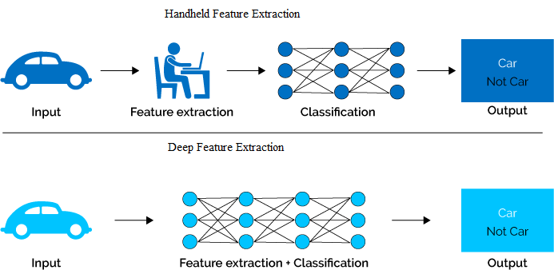
Feature Engineering (cont’d)
4

Slide 6
Unsupervised feature learning
The unsupervised feature learning approach learns higher-level representation of the unlabeled data features by detecting patterns using various algorithms
It is a self-taught learning framework developed to transfer knowledge from unlabeled data, which is much easier to obtain, to be used as preprocessing step to enhance the supervised inductive models.
5

Slide 7
Applications of AE
Dimensionality reduction
Information Retrieval
Denoising
6

Slide 8
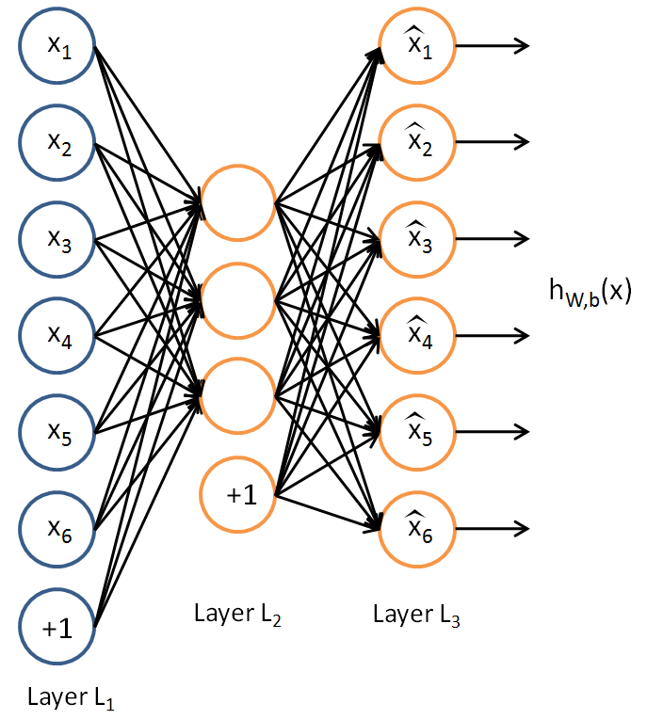
Simple Autoencoder
7

Slide 9
Encode-Decode
Encode
Decode
8

Slide 10
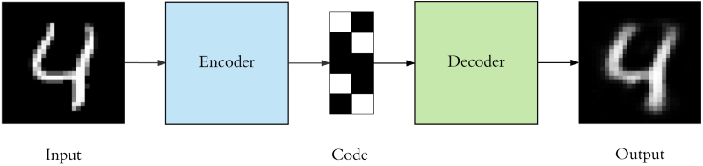
AE_Aim
9

Slide 11

10

Slide 12
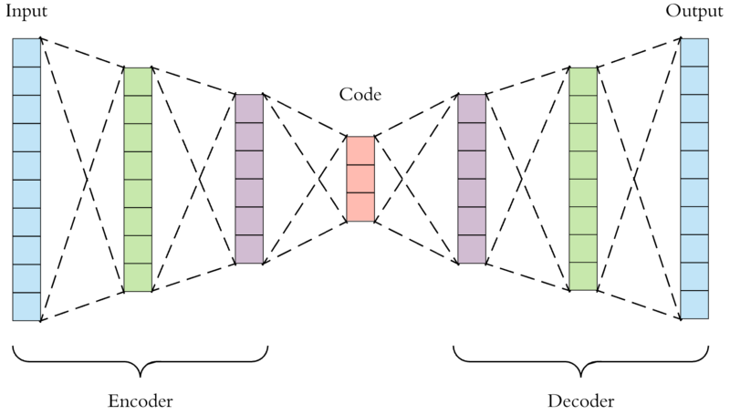
Multilayer AE
11

Slide 13
12

Slide 14
Hyper parameters
Code size: number of nodes in the middle layer. Smaller size results in more compression.
Number of layers: the Autoencoder can be as deep as we like.
Number of nodes per layer : stacked structure
Loss function: we either use mean squared error (mse)
13

Slide 15
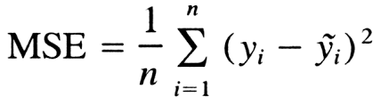
Loss functions
Binary Cross entropy= -(y log(p) + (1-y) log(1-p))
14

Slide 16
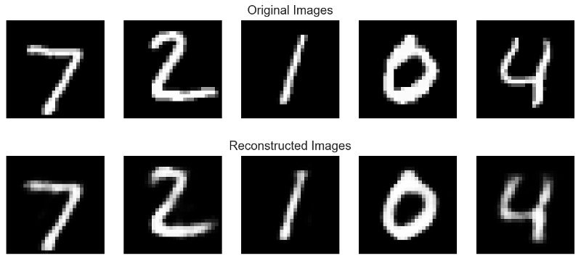
Reconstruction
15

Slide 17
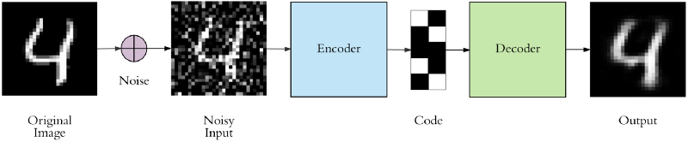
Denoising Autoencoder
16

Slide 18
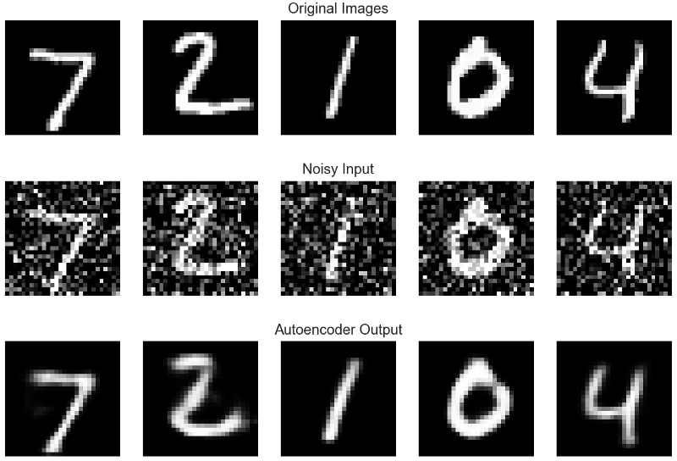
Output example
17

Slide 19
18

Slide 20
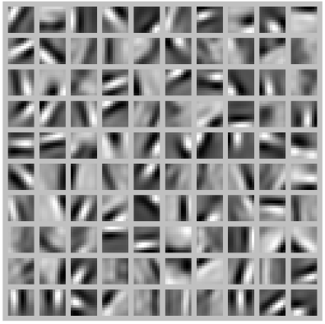
AE representation
Number of neurons=100
19

Slide 21
Sparse Autoencoder
20

Slide 22


Sparsity Loss Function
21

Slide 23
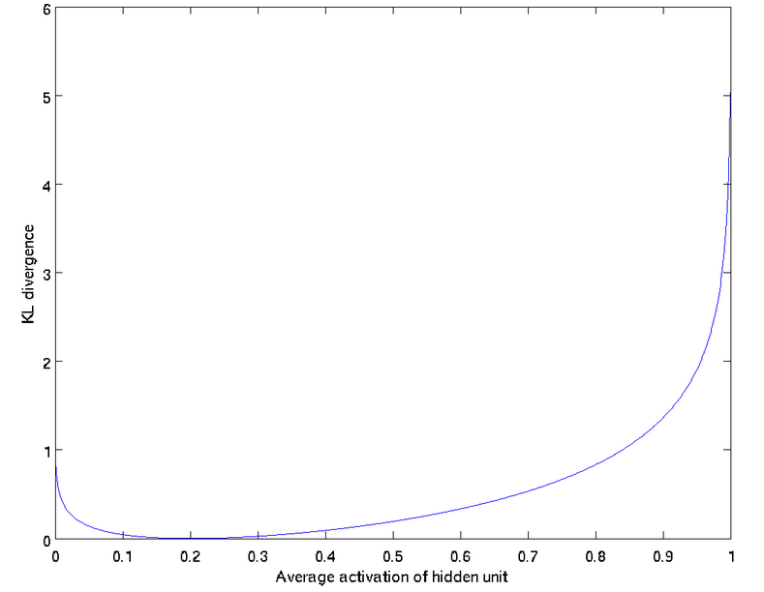
Kullback-Leibler (KL) divergence
22

Slide 24
23

Slide 25
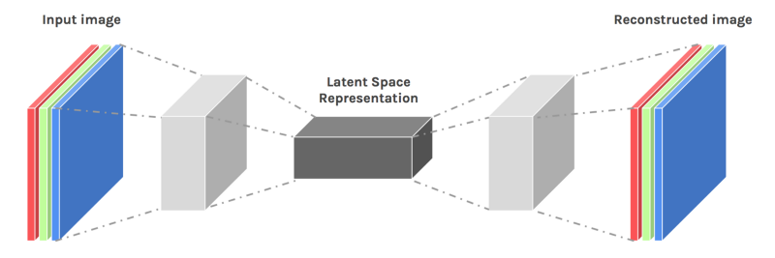
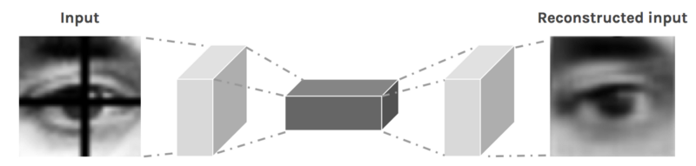
Convolutional AE
24

Slide 26
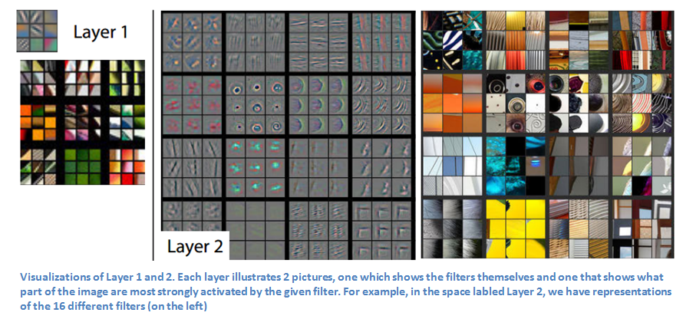
Deconvolution and unpooling
25

Slide 27
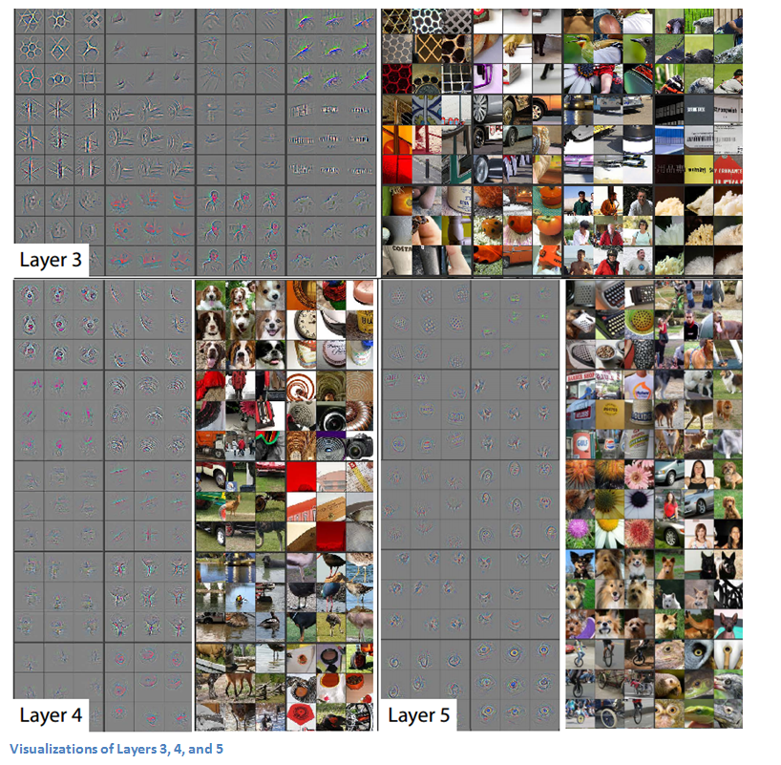
Deconvolution and unpooling (cont’d)

Slide 28
27

Slide 29
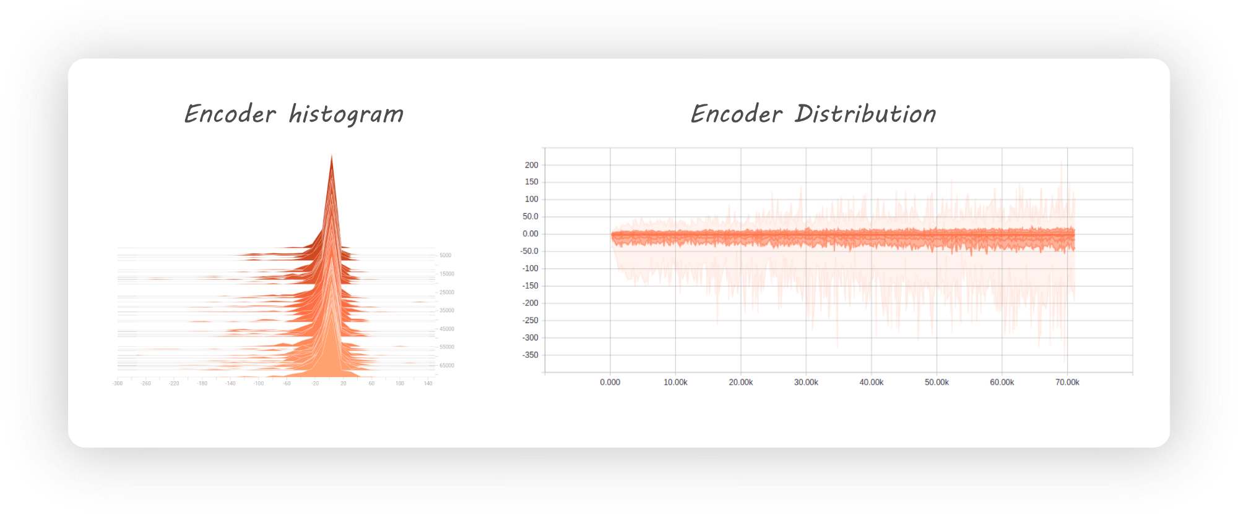
Adversarial AE
28

Slide 30
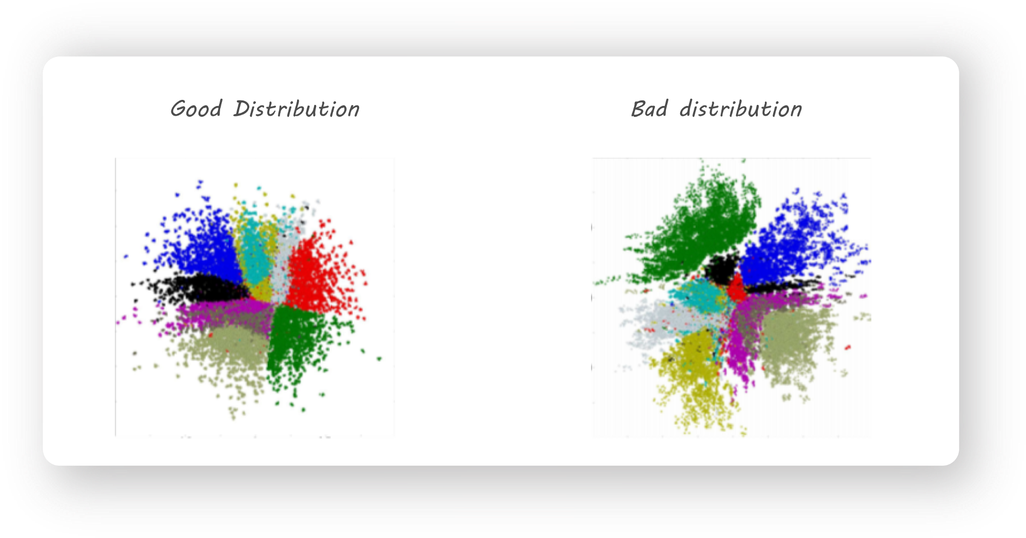
Adversarial AE (cont’d)
29

Slide 31
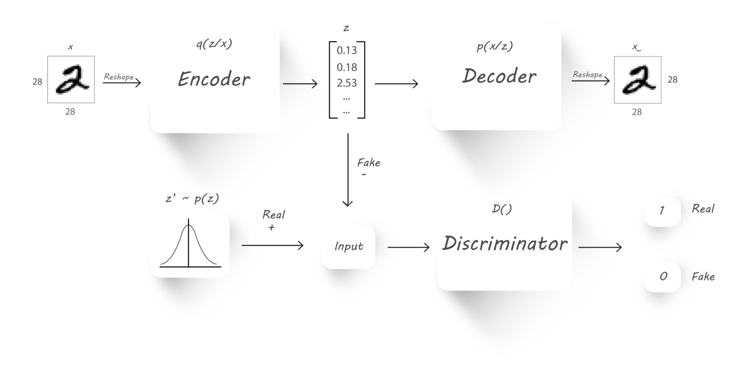
Adversarial AE (cont’d)
30

Slide 32
31

Slide 33
Other videos
https://www.aparat.com/partdpai
32

