Slide 1
Function
In python Function is a block of code or statements that is perform a specific task.
Functions help break our program into smaller and modular chunks. As our program grows larger and larger, functions make it more organized and manageable.
Once we have defined a function, we have to call that function after define it. Simply type the name of the function name.

Slide 2
Keyword def that marks the start of the function header.
A function name to uniquely identify the function. Function naming follows the same rules of writing identifiers in Python.
Parameters (arguments) through which we pass values to a function. They are optional.
A colon (:) to mark the end of the function header.
Optional documentation string (docstring) to describe what the function does.
One or more valid python statements that make up the function body. Statements must have the same indentation level (usually 4 spaces).
An optional return statement to return a value from the function.

Slide 3
Syntax1:-
def function_name():
block of statements
return expression
function_name()
Syntax2:-
def function_name(parameter):
block of statements
return expression
function_name(argument)
Note:- Need to maintain proper indentation.

Slide 4
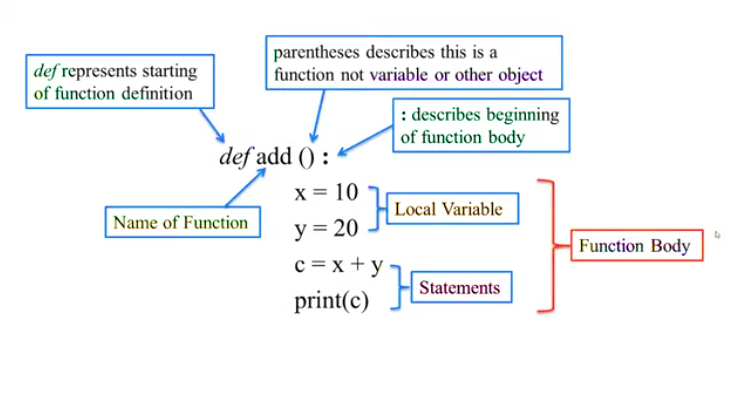

Slide 5
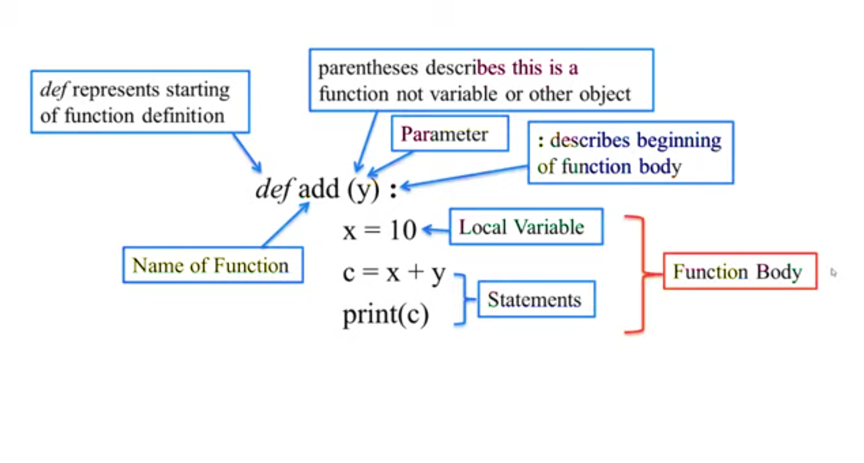

Slide 6
Types of Functions
Basically, we can divide functions into the following two types:
Built-in functions - Functions that are built into Python.
Python has several functions that are readily available for use. These functions are called built-in functions.
Int()
max()
len()
User-defined functions - Functions defined by the users themselves to do create a specific task are called user-defined function.

Slide 7
Advantage of Function
Advantage of Function Write once and use it as many time as you need. This provides code reusability.
Function facilitates ease of code maintenance.
Divide Large task into many small task so it will help you to debug code.
You can remove or add new feature to a function anytime.
Information hiding

Slide 8
Calling a Function
Calling a function A Function runs only when we call it, function can not run on its own.
Syntax:-
function_name()
function_name (arg1, arg2, ...)
Ex: -
add ()
add (20)
item(“India")

Slide 9
Parameters or Arguments?
The terms parameter and argument can be used for the same thing: information that are passed into a function.
From a function's perspective:-
A parameter is the variable listed inside the parentheses in the function definition.
An argument is the value that is sent to the function when it is called.

Slide 10
How Function Work
Def add( ):
x = 10
y = 20
print(x + y)
add()

Slide 11
How Function Work
Def add(y):
x = 10
print(x + y)
add(20)
The parameter y do not know which type of value they are about to receive till the value is passed at the time of calling the function. It means the type of data is determined only during runtime is called Dynamic Typing.

Slide 12
Types of Arguments
Python supports various types of arguments that can be passed at the time of the function call. Let’s discuss each type in detail
Default Argument
Keyword Argument
Variable-length Argument

Slide 13
Default Arguments
A default argument is a parameter that assumes a default value if a value is not provided in the function call for that argument. The following example illustrates Default arguments.
def myFun(x, y=50):
print(x)
print(y)
my Fun (10)
Output:-
10
50

Slide 14
Keyword Arguments
The idea is to allow the caller to specify the argument name with values so that caller does not need to remember the order of parameters
def student (firstname, lastname):
print (firstname, lastname)
student (firstname=‘Hello',lastname=‘India’)
Output:-
Hello India

Slide 15
Variable-length Arguments
In Python, we can pass a variable number of arguments to a function using special symbols. There are two special symbols:
*args (Non-Keyword Arguments)
**kwargs (Keyword Arguments)

Slide 16
Docstrings
The first string after the function header is called the docstring and is short for documentation string. It is briefly used to explain what a function does.
Although optional, documentation is a good programming practice. Unless you can remember what you had for dinner last week, always document your code.
In the above example, we have a docstring immediately below the function header. We generally use triple quotes so that docstring can extend up to multiple lines. This string is available to us as the __doc__ attribute of the function.

Slide 17
Example Docstrings
def add(x):
“““this is your docstring”””
a=1
b=2
print(a+b)
print(add._doc_)
Output:-
this is your docstring

Slide 18
Return Statement
The function return statement is used to exit from a function and go back to the function caller and return the specified value or data item to the caller.
Syntax:
return [expression_list]
The return statement can consist of a variable, an expression, or a constant which is returned to the end of the function execution. If none of the above is present with the return statement a None object is returned.

Slide 19
Return Statement
def square_value (num):
return num**2
print(square_value(2))
print(square_value(-4))
Output:-
4
16

Slide 20
The pass Statement
function definitions cannot be empty, but if you for some reason have a function definition with no content, put in the pass statement to avoid getting an error.
Example:-
def myfunction():
pass

