Slide 1
PROBLEM
One equipment issue can become a port bottleneck
THE CAUSAL CHAIN
Reactive, not predictive
Weather / Equipment
Delays become visible after they reach berths and cranes.
Asset Risk
Risk tracked in silos
Equipment health and weather sit apart from congestion data.
Reduced Capacity
Vessel Delay
Small issues cascade
One at-risk asset can affect capacity and vessel queues.
Queue Growth
Port Congestion
PORTSENTINEL NEXUS / ARJUNA / L1 + U1
01
Notes:
Problem framing based on docs/problem-statement.md. Kandla is the reference setting, not evidence of measured operational congestion.

Slide 2
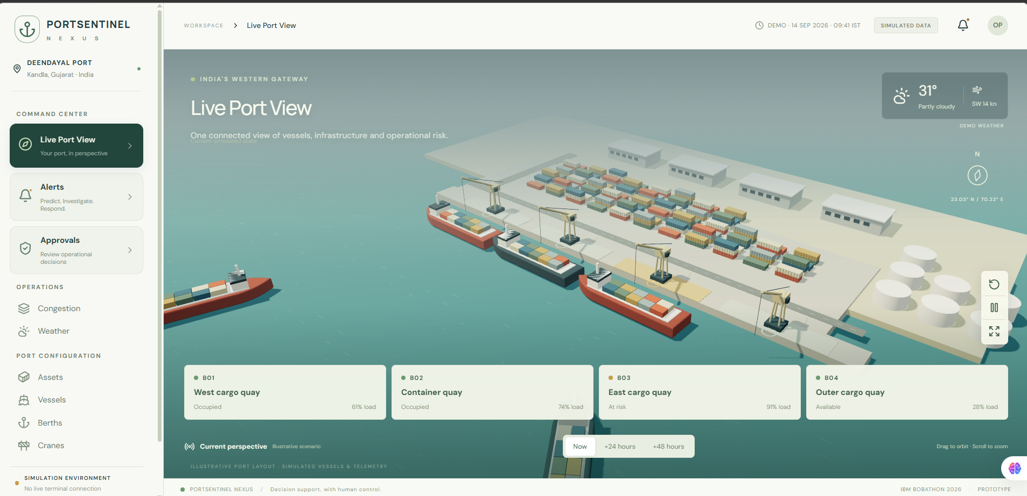
SOLUTION
See the bottleneck before it becomes congestion
SEE
Live Port View
PREDICT
Alerts
DECIDE
Approvals
Kandla example. Simulated operations. Actual product interface.
Data
Prediction
Recommendation
Human Approval
Operational Plan
PORTSENTINEL NEXUS / ARJUNA / L1 + U1
02
Notes:
Original dashboard screenshot retained from the updated deck. Sources: docs/solution-overview.md and docs/architecture.md. Operational plans are saved and not executed.

Slide 3
DEMO / ARCHITECTURE
The documented system behind the product
Vessel + Weather + Asset / Berth Data
PortSentinel Nexus
Model 1: Infrastructure Failure Risk
+ Model 2: Congestion Prediction
Deterministic queue simulation
Risk / Congestion Signal
Recommended Solution
Human Approval
Actual PortSentinel dashboard
React + Three.js
Operational Plan
FastAPI backend / SQLite persistence
Groq explains backend findings
Human approval stays explicit. Plans are not executed.
PORTSENTINEL NEXUS / ARJUNA / L1 + U1
03
Notes:
Sources: docs/architecture.md; src/backend/app/congestion.py; src/backend/app/failure_model.py. Model 1 is the supplied calibrated XGBoost classifier with unconfirmed class semantics and proxy preprocessing. Model 2 is a deterministic berth queue, not a trained ML congestion model. Groq selects/orders backend facts for explanation only.

Slide 4
IBM TECHNOLOGY INTEGRATION
BOB assistance in software engineering
INTENDED ROLE
“BOB accelerates the engineering behind PortSentinel.”
Requirement
Backend / API
+ logic
Integration
BOB assistance
Testing / Debugging
/ Validation
PORTSENTINEL NEXUS
Engineering support includes implementation, integration and documentation.
BOB-assisted development is not verified in the project docs. watsonx is not implemented.
PORTSENTINEL NEXUS / ARJUNA / L1 + U1
04
Notes:
Source: docs/solution-overview.md, IBM Technologies Used. The documentation explicitly does not claim successful IBM inference or Bob-assisted development history. This diagram is an intended engineering role, not evidence of completed IBM usage. Groq is the configured runtime explanation provider. No watsonx implementation is claimed.

Slide 5
IMPACT
A path beyond the Kandla prototype
TODAY
PILOT
ENTERPRISE
SCALE
Prototype
Planned
Planned
Planned
Earlier bottleneck visibility
Human-controlled adoption
Credible, transparent data
Extensible beyond one port
Connect risk to capacity and queue estimates.
Validate with operators and actual equipment records.
Integrate systems and retain source provenance.
Adapt the configuration and workflow to other ports.
“A decision system that helps operators see risk early, understand it, and approve the right action before congestion occurs.”
PORTSENTINEL NEXUS / ARJUNA / L1 + U1
05
Notes:
Vision retained from the updated source deck. Current benefits are prototype capabilities, not measured field results. Pilot, enterprise and scale stages are planned. Port operations are simulated; external Open-Meteo weather is separately labelled.

