Slide 1


CONTEXT AWARE GOSSIP-BASED
DECENTRALISED MONITORING
SYSTEM
B.Tech Project
Supervisor:
Students:
Dr. Mahendra Shukla
Ankesh Gupta 2022IMT-014
Lokesh Mehar 2022IMT-066
Parthkumar Mungra 2022IMT-082

Slide 2

INTRODUCTION
1
Centralized System
Decentralized System
2

Slide 3
3
IMPLEMENTATION CHALLENGES & SOLUTIONS
Problem | Our Solution
Single Point of Failure | Fully decentralized gossip-based architecture with no central coordinator
Network Bandwidth Constraints | Priority-based Value of Information (VoI) filtering mechanism reducing bandwidth utilisation
High Communication Latency | Push-pull hybrid gossip protocol with local peer-to-peer exchanges
Resource Limitations | Lightweight container-based implementation with adaptive resource awareness
3

Slide 4
HOW THE PROJECT ADDRESS THE PROBLEMS
4
TECHNOLOGY | Gossip Protocol | Priority-Based Filtering | Consensus Mechanism
ISSUE | Single point of failure, Centralized bottlenecks | Network congestion, Resource waste | Data reliability, Trust in distributed system
Our Project’s Solution | Decentralized peer-to-peer communication with eventual consistency | Context-aware metric prioritization reducing the traffic | Leaderless quorum consensus for trustworthy information retrieval
4

Slide 5

OBJECTIVES
8
To Develop:
Decentralized edge monitoring system
via stochastic gossip based information dissemation and
intellegent priority-based metric filtering
For?
Resource contrainted & highly volatile edge IoT environments

Slide 6
EXPERIMENTAL SETUP
9
  Each node was simulated as a docker container
  Containers communicated over docker-bridge
  Metrics stored in local SQLite database
...
/node1
/node3
Docker bridge
/node2
/node-n

Slide 7
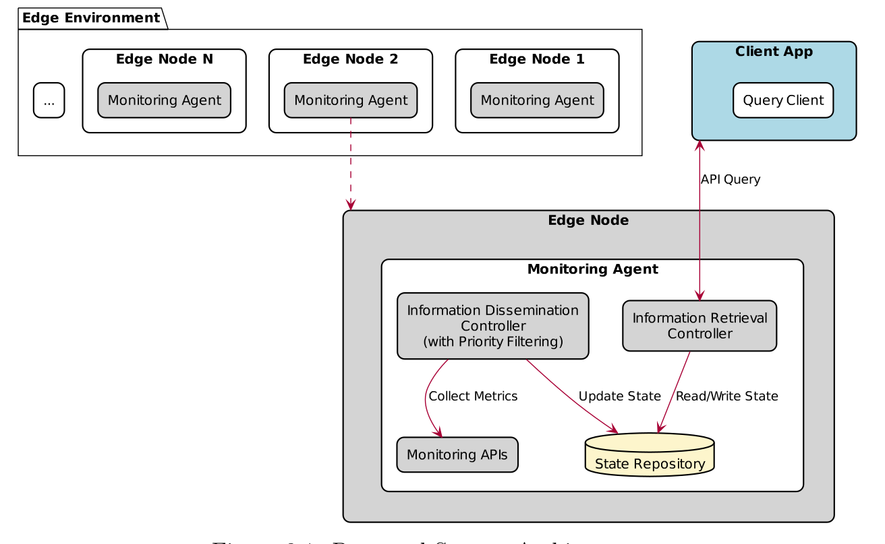
SYSTEM ARCHITECTURE
10

Slide 8

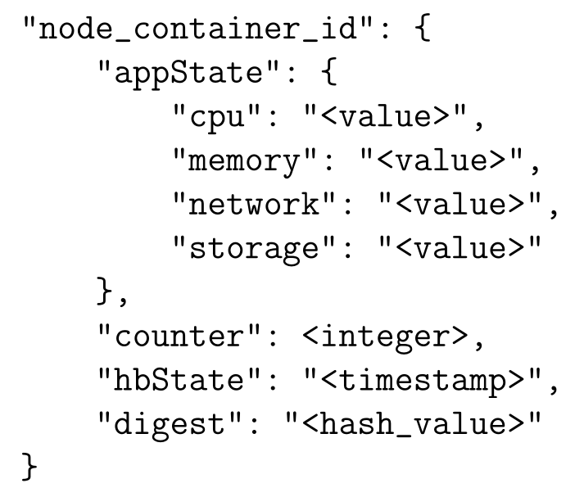

DATA FORMAT
11
(Metadata has hash of the appData)
Filtered metrics may not have all
Determines freshness
Determines liveliness
For integrity

Slide 9
SYSTEM ARCHITECTURE
12
Divided into two main workflows
Workflows
  Information Dissemination
2. Information Retrieval
  Collect
  Share
  Update
Fault Tolerantly
Query for
  Fresh
  Consistent data

Slide 10


PRIORITY BASED FILTERING
14
PRIORITY
HIGH
MEDIUM
LOW
  Never filtered
  Vital data metrics like CPU
  Zero bandwidth saving
  Sent less frequently
(Every k rounds)
  Sent least frequently
(Every p rounds , p>k)
Delta (Δ) Threshold to handle sudden spikes/dips

Slide 11
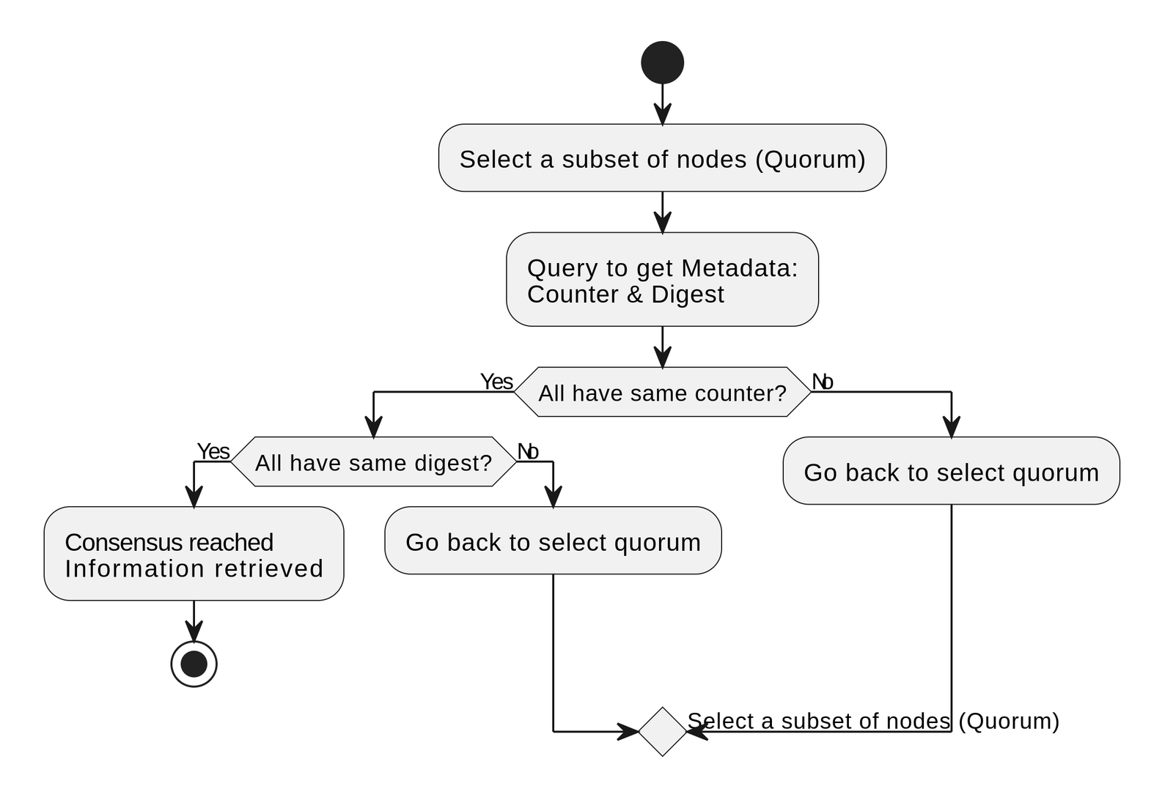

INFORMATION RETRIEVAL
15
Uses Leaderless Quorum Consensus (LQC)
Query

Slide 12

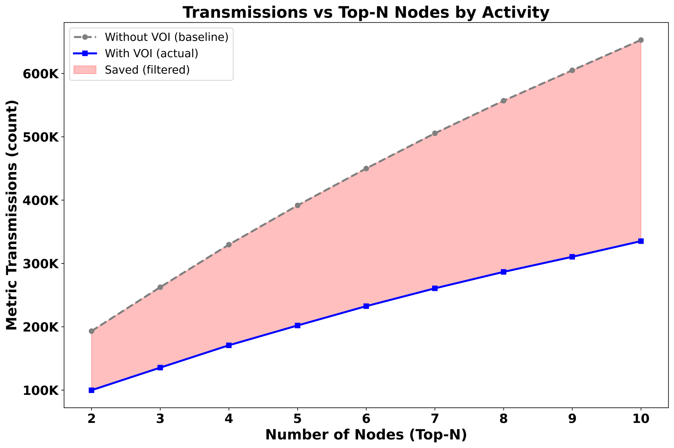
Dramatic Reduction in Overall Network Traffic
16
  ~50% consistent transmission reduction across all node scales
  VoI system: ~310K vs Baseline: ~600K transmissions (10 nodes)
  Framework scales efficiently with node growth

Slide 13

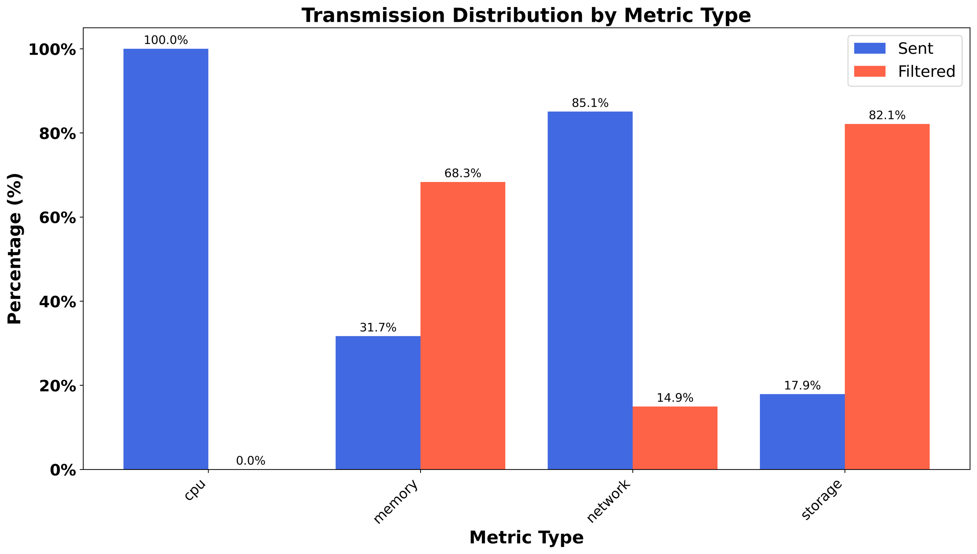
Validating Priority-Based Filtering Logic
17
  CPU (High Priority): 100% transmitted (critical metric preserved)
  Storage (Low Priority): 82.1% updates filtered
  Memory & Network (Medium Priority): moderate filtering
  Confirms framework adapts filtering to metric importance

Slide 14

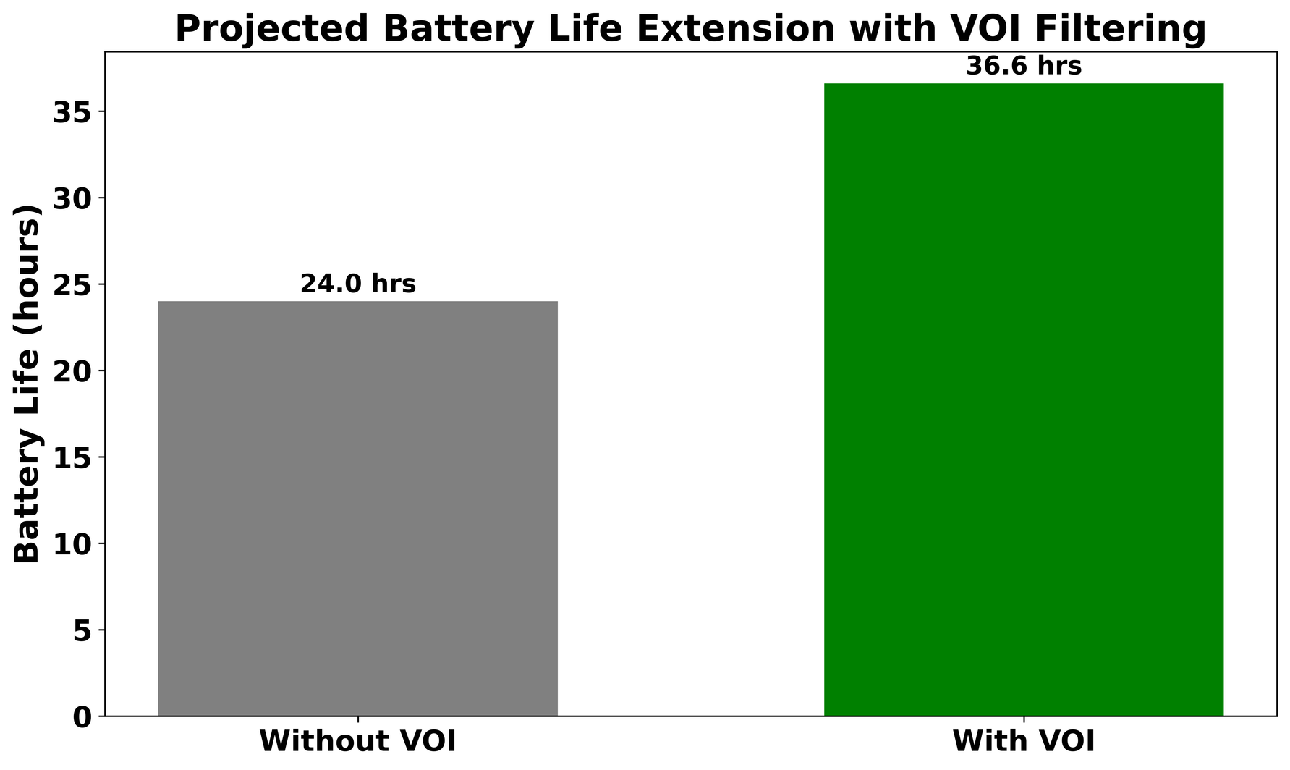
Projected Battery Life Improvement
18
  Extending Device Lifetime by 52.5%
  Baseline battery: 24.0 hours
  With VoI: 36.6 hours
  Gain: +12.6 hours (~52.5%)
  Textended = Tbaseline / 1 − (Rfiltered · α)
2. Rfiltered = Nfiltered/Ntotal

Slide 15
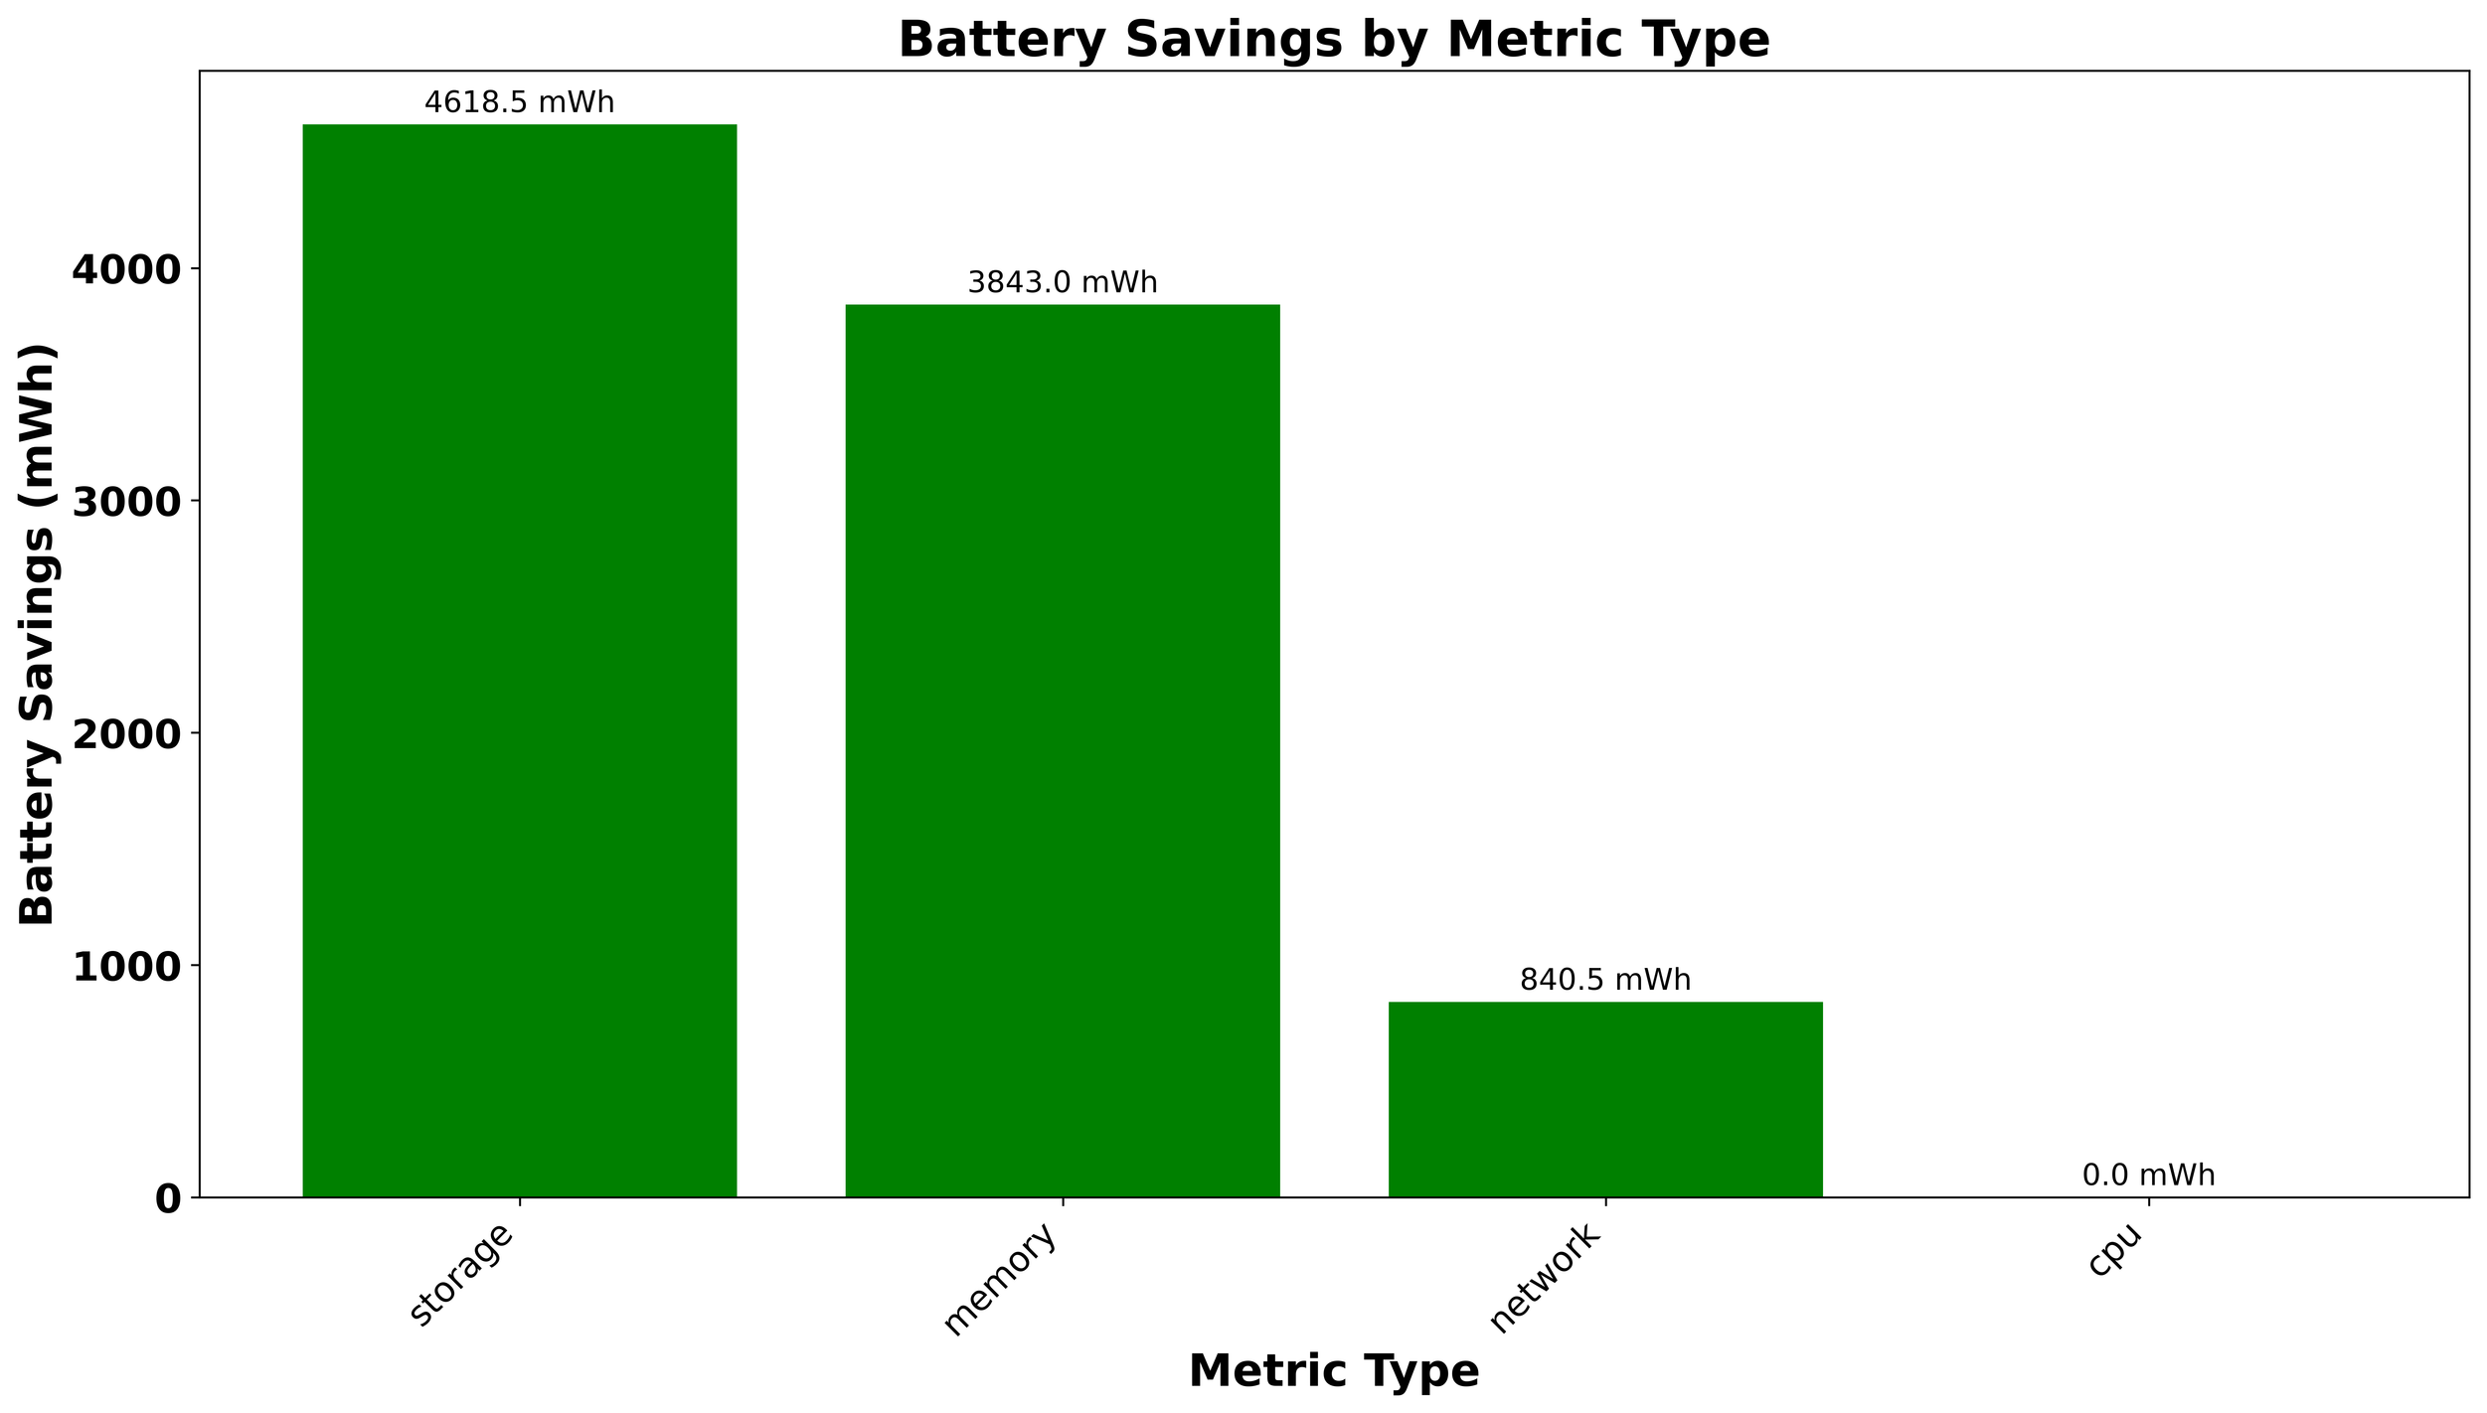
Impact of Smart Filtering On battery
19
  Storage: 4618.5 mWh saved (heavily filtered)
  Memory: 3843.0 mWh saved
  CPU: 0.0 mWh (never filtered → performance intact)
  Savings mirror filtering priorities
  Esaved, type = Nfiltered, type · Etransmission, type, 2.Bsaved = (Esaved*100)/Cbattery

Slide 16

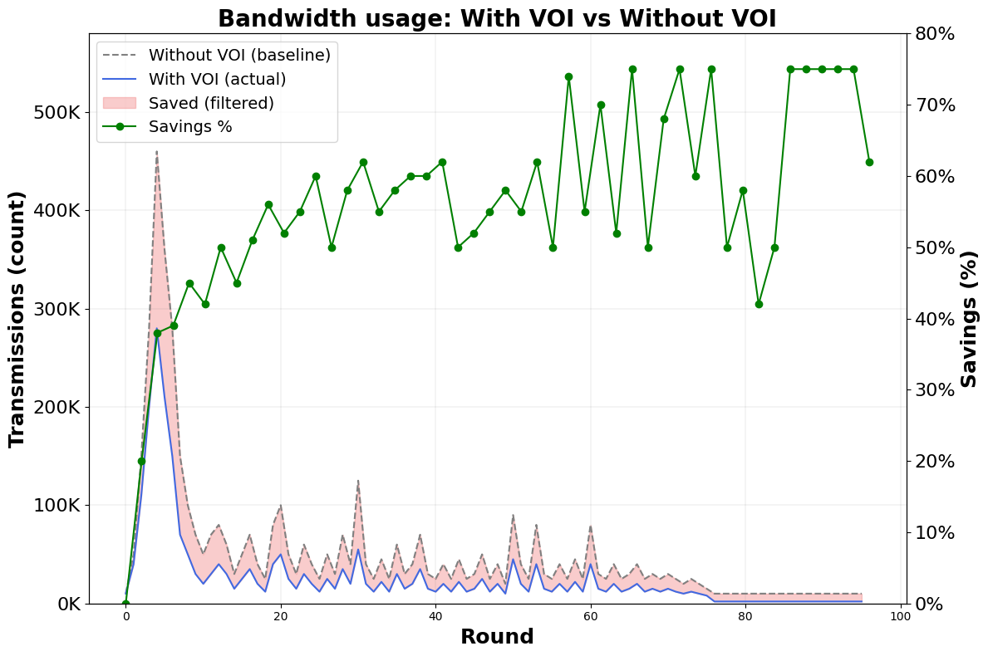
Consistent Real-Time Bandwidth Savings
20
Startup Spike
Filtering Impact
Stable Savings
Scalable Efficiency

Slide 17

CONCLUSION
21
Bandwidth Efficiency : Cut transmissions by ~60%, saving 50–75% per round.
1
Device Lifetime: Extended battery life by 52% (24h → 36.6h)
2
Smart Filtering: Kept all critical CPU data, suppressed 82% low-priority updates.
3
Scalable & Resilient: Consistent gains across rounds and larger networks.
4

Slide 18


FUTURE SCOPE
22
Stronger Security: Zero-trust design with lightweight encryption.
1
Real-World Testing: Deploy on large-scale testbeds (Raspberry Pi / edge-cloud).
2
Adaptive Filtering: ML-based dynamic VoI rules for smarter real-time optimization.
3

Slide 19
REFERENCE
23
[1]S. Ilager, S. Nastic, and S. Dustdar, “DEMon: Decentralized Monitoring for Highly Volatile
Edge Environments,” in 2022 IEEE/ACM 15th International Conference on Utility and
Cloud Computing (UCC). IEEE, 2022, pp. 145–155.
[2]M. Satyanarayanan, “The emergence of edge computing,” Computer, vol. 50, no. 1, pp.
30–39, 2017.
[3]A. Demers, D. Greene, C. Hauser, W. Irish, J. Larson, S. Shenker, H. Sturgis, D. Swinehart,
and D. Terry, “Epidemic algorithms for replicated database maintenance,” ACM SIGOPS
Operating Systems Review, vol. 22, no. 1, pp. 8–32, 1987.
[4] X. Liu and XJingyi Wu; Tianheng Xu; Ting Zhou; Xianfu Chen; Honglin Hu; Celimuge Wu "Adaptive NOMA-Based Spectrum Sensing for Uplink IoT Networks " Volume: 10, Issue: 1, February 2024 Zhang,

Slide 20
THANK YOU
Parthkumar Mugra , Ankesh Gupta, Lokesh Mehar, Mahendra K. Shukla, and O. J. Pandey, Context aware gossip-based
decentralised monitoring
system, IEEE Wireless Communications Letters, September 2025, under revision

