Slide 1

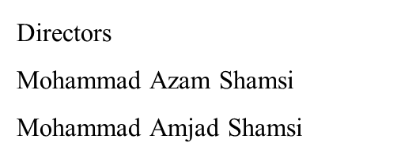



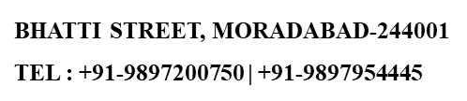

Slide 2
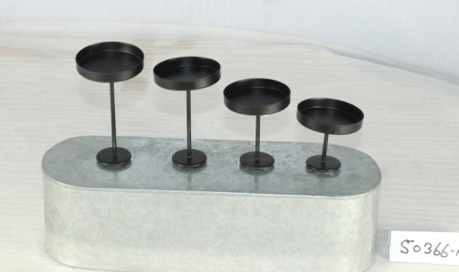
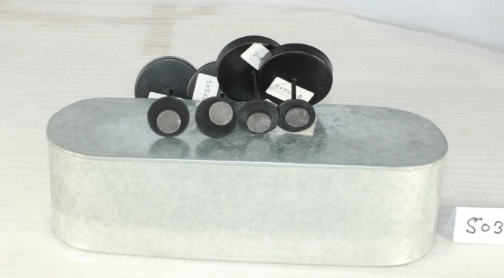
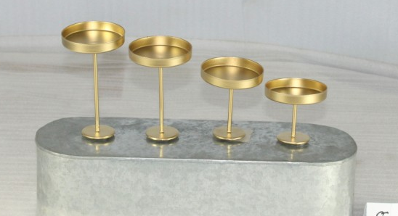
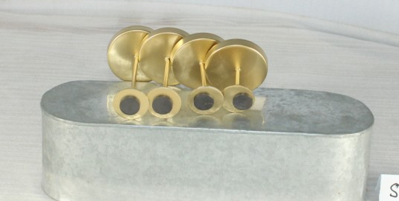
ITEM NO 50366-ABC
SIZE 6 X 6 X 12 CM
SIZE 6 X 6 X 10 CM
SIZE 6 X 6 X 8 CM
SIZE 6 X 6 X 6 CM
ITEM NO 50366-ABC
SIZE 6 X 6 X 12 CM
SIZE 6 X 6 X 10 CM
SIZE 6 X 6 X 8 CM
SIZE 6 X 6 X 6 CM
ITEM NO 50366-ABC
SIZE 6 X 6 X 12 CM
SIZE 6 X 6 X 10 CM
SIZE 6 X 6 X 8 CM
SIZE 6 X 6 X 6 CM
ITEM NO 50366-ABC
SIZE 6 X 6 X 12 CM
SIZE 6 X 6 X 10 CM
SIZE 6 X 6 X 8 CM
SIZE 6 X 6 X 6 CM

Slide 3
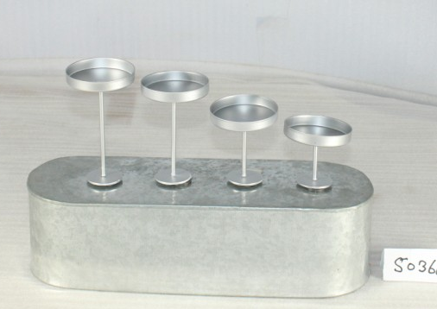
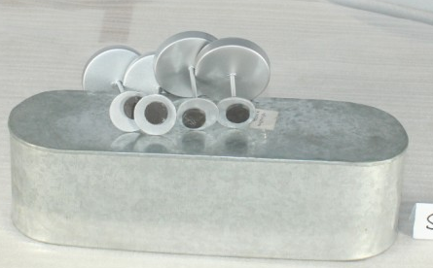
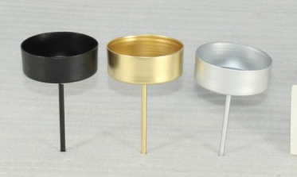
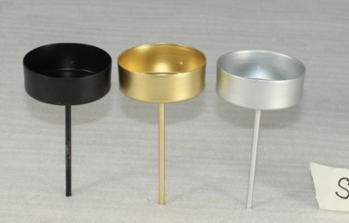
ITEM NO 50366-ABC
SIZE 6 X 6 X 12 CM
SIZE 6 X 6 X 10 CM
SIZE 6 X 6 X 8 CM
SIZE 6 X 6 X 6 CM
ITEM NO 50366-ABC
SIZE 6 X 6 X 12 CM
SIZE 6 X 6 X 10 CM
SIZE 6 X 6 X 8 CM
SIZE 6 X 6 X 6 CM
ITEM NO 50367
SIZE 6 X 6 X 10 CM
ITEM NO 50368
SIZE 6 X 6 X 12 CM

Slide 4
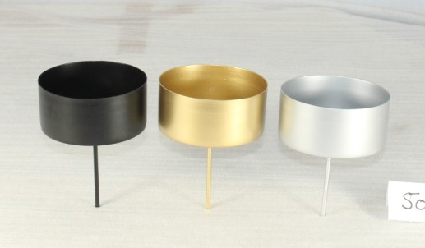
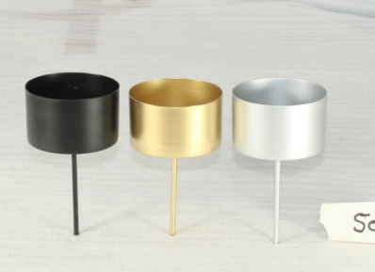
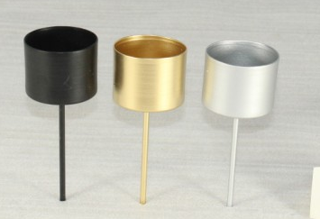
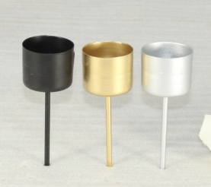
ITEM NO 50378
SIZE 10 X 10 X 15 CM
ITEM NO 50379
SIZE 7.5 X 7.5 X 15 CM
ITEM NO 50369
SIZE 5 X 5 X 14 CM
ITEM NO 50370
SIZE 4 X 4 X 11 CM

Slide 5
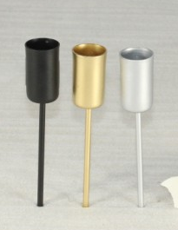
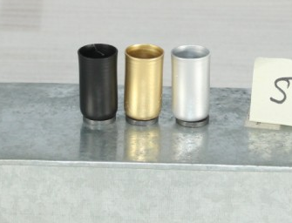
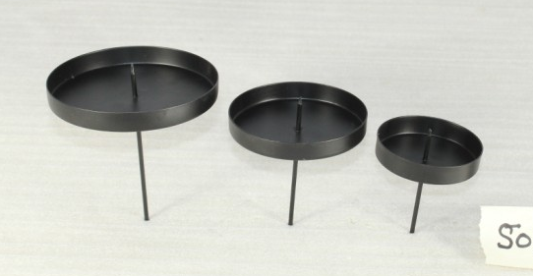
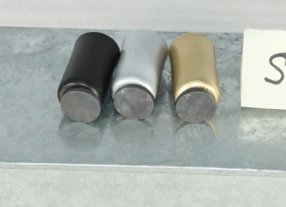
ITEM NO 50372
SIZE 2 X 2 X 4 CM
ITEM NO 50376
SIZE 2 X 2 X 13 CM
ITEM NO 50380-ABC
SIZE 10 X 10 X 12 CM
SIZE 8 X 8 X 10 CM
SIZE 6 X 6 X 8 CM
ITEM NO 50372
SIZE 2 X 2 X 4 CM

Slide 6
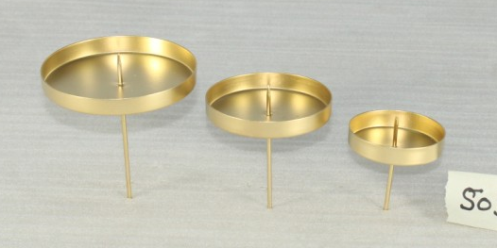
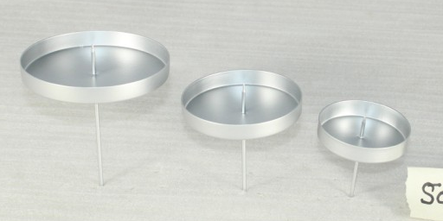
ITEM NO 50380-ABC
SIZE 10 X 10 X 12 CM
SIZE 8 X 8 X 10 CM
SIZE 6 X 6 X 8 CM
ITEM NO 50380-ABC
SIZE 10 X 10 X 12 CM
SIZE 8 X 8 X 10 CM
SIZE 6 X 6 X 8 CM

