Slide 1
AU Messenger
CSC102 Object Oriented Programming
An Application For All
Team
Roll No. Name Programe
AU1841028 Parth Patel BTECH ICT
AU1841046 Shreyansh Shah BTECH ICT
AU1841102 Dhruv Sharma BTECH ICT

Slide 2
Problem Definition
Students can interact with each other in more convenient way also students can interact with faculty in informal way and faculty can directly provide study materials to students.
Every time you want to contact faculty you will not have to write mail you can communicate in informal way also , and study material sharing will be also easy
Easy interactions between students and between student and faculty.

Slide 3
Objective and End Users
Sending message to anyone of AU (depends on receiver’s choice whether he/she want to receive message from whom)
Faculty can send file easily to their students on basis of their course and year.
You can make groups with your colleagues so formal and informal information can be shared easily.
You will not have to send mail every time to faculty for any kind of communication even faculty can reach to you easily.
Students
Faculty

Slide 4
Key functionality/features
OTP Verification through mail sending system
Password Changing Option Available for the Register User.
Easy way to chat with your friends and to ask your doubts to the Faculty.
Profile Picture Editing is available.

Slide 5
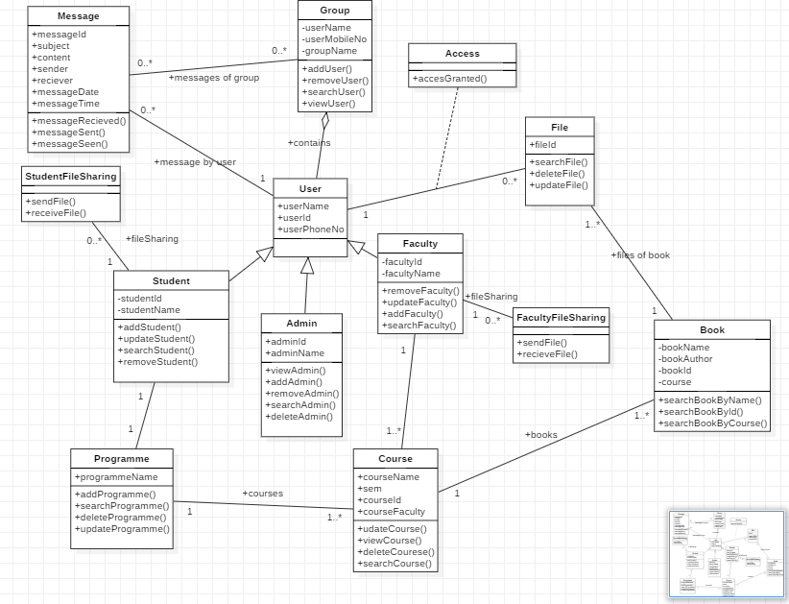
Class Diagram

Slide 6
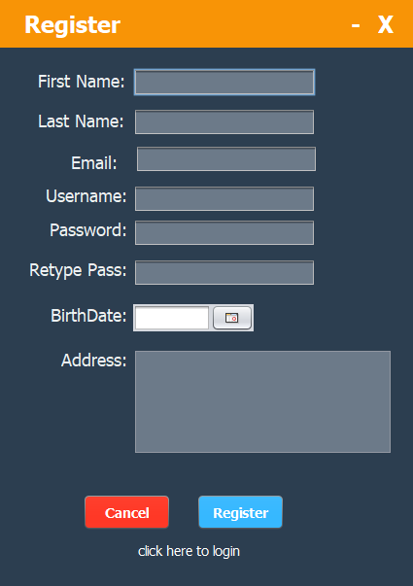
Design

Slide 7
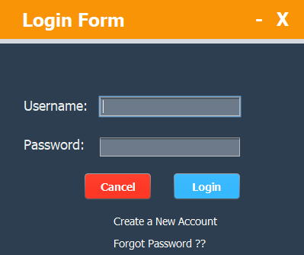
Design

Slide 8
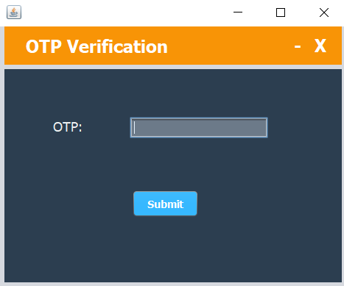
Design

Slide 9
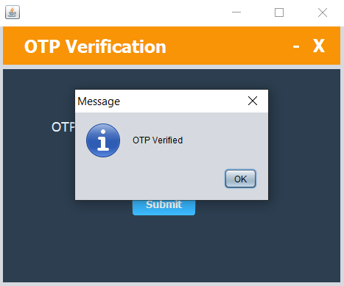
Design

Slide 10
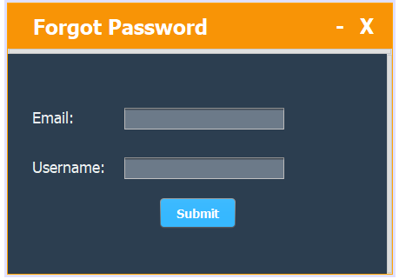
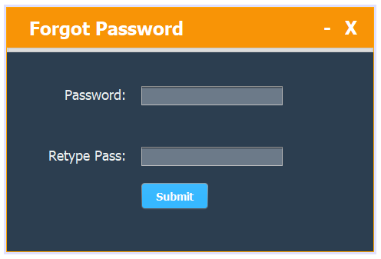
Design

Slide 11
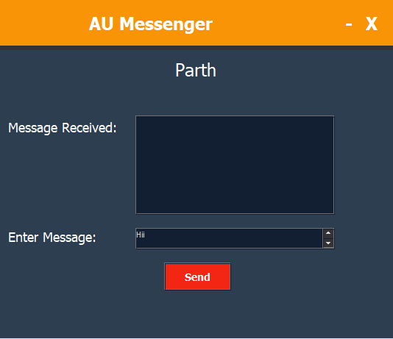
Design

Slide 12
Thank You

