Slide 1
MINI PROJECT REPORT
Single Phase
Power Monitor
Real-Time Voltage, Current & Power Measurement
Maharudra Patil | Parth Kulkarni | Sarvesh Malani
Dept. of Electronics Engineering, Walchand Institute of Technology, Solapur | 2025-26

Slide 2
Problem Statement & Objectives
⚡ The Problem
🎯 Objectives
Traditional meters show only cumulative usage — no real-time insight.
Voltage fluctuations damage sensitive equipment.
Undetected current surges cause overloading hazards.
Affordable real-time monitoring tools are unavailable for small users.
Increased electricity bills from unmonitored consumption.
Measure RMS voltage and current in real time.
Calculate instantaneous active power (P = V × I).
Track cumulative energy consumption (Wh).
Display parameters live on OLED display.
Build a low-cost (<₹700), portable, compact solution.

Slide 3
System Block Diagram
ZMPT101B
Voltage Sensor
A0
Arduino Nano
(ATmega328P)
ADC + Processing
OLED Display
(SSD1306)
0.96" I2C
AC Supply
230V / 50Hz
I2C
ACS712
Current Sensor
A1
Signal flow: AC mains → Sensors (analog out) → Arduino ADC (A0/A1) → Computation → OLED via I²C bus

Slide 4
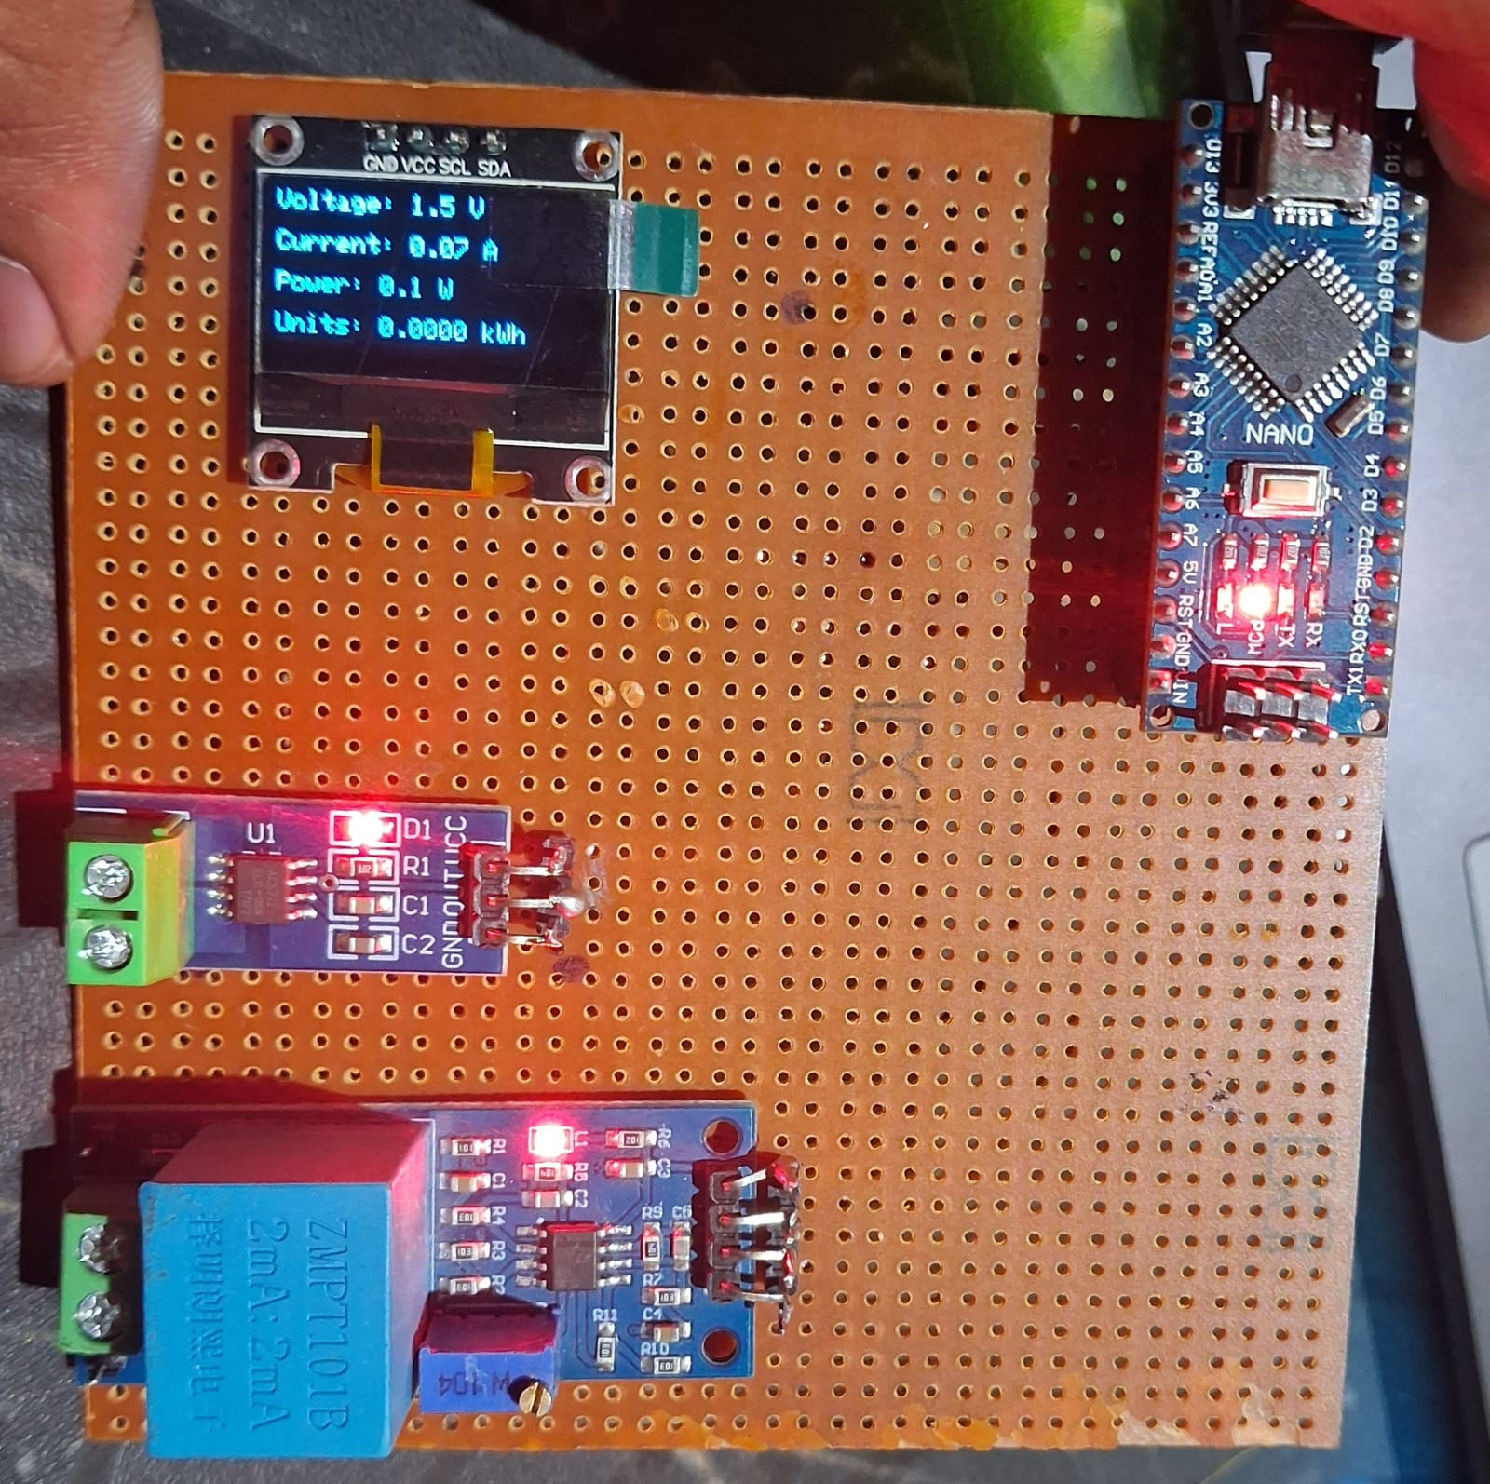
Key Components
⚡
🔌
ZMPT101B
ACS712
Voltage Sensor
Current Sensor
Measures AC up to 250V
Galvanic isolation
0–5V output, 2.5V offset
Hall-effect, 5A range
185 mV/A sensitivity
Galvanic isolation
🖥
📺
Arduino Nano
OLED SSD1306
Microcontroller
Display
ATmega328P @ 16 MHz
10-bit ADC, 6 analog pins
32 KB Flash memory
0.96", 128×64 pixels
I2C protocol (A4/A5)
High contrast, 3.3–5V

Slide 5
Working Principle
01
Signal Sensing
ZMPT101B & ACS712 simultaneously sense AC voltage and current, producing safe 0–5V analog signals centred at 2.5V.
02
ADC Sampling
Arduino Nano samples 1000 data points from A0 & A1 within one complete 20ms AC cycle (50Hz).
03
RMS Calculation
Instantaneous values are squared, averaged over the full cycle, and square-rooted:
V_rms = √(Σv²/N), I_rms = √(Σi²/N)
04
Power & Energy
Active Power: P = V_rms × I_rms (PF = 1 for resistive loads).
Energy is accumulated by integrating P over time (Wh).
05
Display Update
All four values (V, A, W, Wh) are rendered on the OLED every 1 second using a millis()-based non-blocking timer.

Slide 6
Hardware Design & Circuit
Pin Connections
Design Considerations
Module
Pin
Arduino
🔒
Safety & Isolation
ZMPT101B
OUT
A0
ZMPT101B & ACS712 provide galvanic isolation from mains — microcontroller is fully protected.
ACS712
OUT
A1
📐
ADC Reference
OLED SSD1306
SDA
A4
Both sensors biased at 2.5V offset, fitting the 0–5V ADC range without signal clipping.
OLED SSD1306
SCL
A5
🔇
Noise Filtering
ZMPT101B/ACS712
VCC
5V
100µF cap on ZMPT101B output and 10nF on ACS712 FILTER pin reduce switching noise.
OLED SSD1306
VCC
3.3V
💰
Cost Efficiency
All Modules
GND
GND
All components are off-the-shelf. Total BOM cost: ₹500–₹700 only.

Slide 7
Software Design & Implementation
🛠 Tools Used
📄 Core Firmware Logic
Arduino IDE v2.x — compile & upload firmware
Embedded C / Arduino C++ — programming language
Adafruit SSD1306 & GFX Library — OLED driver
Proteus 8 Professional — circuit simulation
Serial Monitor — debugging & calibration
double sumV = 0, sumI = 0;
for (int i = 0; i < 1000; i++) {
double v = (analogRead(A0)*5.0/1023.0 - 2.5)
* vCal;
double c = (analogRead(A1)*5.0/1023.0 - 2.5)
/ 0.185;
sumV += v * v;
sumI += c * c;
}
float Vrms = sqrt(sumV / 1000);
float Irms = sqrt(sumI / 1000);
float Power = Vrms * Irms;
// Display refreshed every 1 s via millis()

Slide 8
Testing & Results
Parameter
Measured Value
Actual Value
Error (%)
Voltage
219.4 V
220 V
0.27%
Current
1.98 A
2.0 A
1.0%
Power (Calculated)
434.0 W
440 W
1.36%
Frequency
49.8 Hz
50 Hz
0.40%
Load: 100W incandescent lamp @ 230V AC mains | Reference: Calibrated DMM + Clamp meter
0.27%
1.0%
1.36%
0.40%
Voltage Accuracy Error
Current Accuracy Error
Power Accuracy Error
Frequency Error

Slide 9
Achievements & Future Scope
✅ Achievements
🚀 Future Scope
Real-time V, I, P, Energy on compact OLED display.
Voltage accuracy: 0.27% | Power accuracy: 1.36%.
Calibrated & debugged ACS712 offset and ADC noise.
Validated via Proteus simulation before hardware.
Total cost under ₹700 — affordable & portable.
IoT Integration — ESP8266/ESP32 for remote web dashboard.
True Power Factor — measure reactive & apparent power.
Data Logging — SD card / EEPROM for historical analysis.
Multi-Phase Extension — 3-phase industrial systems.
Cloud Integration — ThingSpeak / Blynk for alerts.
Thank You | Department of Electronics Engineering, Walchand Institute of Technology, Solapur | 2025-26

Slide 10
Conclusion
The Single Phase Power Monitor project successfully demonstrates a low-cost and efficient system for real-time measurement of electrical parameters such as voltage, current, power, and energy. Using Arduino and sensors, the system provides accurate readings and helps users monitor electricity usage effectively. This project is useful for reducing energy wastage and improving power management. Overall, it is a simple, compact, and practical solution that can be further enhanced with advanced features like IoT-based remote monitoring.

