Slide 1


Prototype Submission Phase

Slide 2
Team - mohammedzaeem_8e58
Aaditya Deshpande
Parth Toshniwal
Mahak Kokate
Shrijita Maitra
Mohammad Zaeem
THEME : Bioinformatics

Slide 3
PROBLEM STATEMENT
To make a Quantum GAN model for novel protein sequence generation
Need for Quantum GANs - Quantum GANs provide an exponential advantage in time as compared to classical GANs.

Slide 4
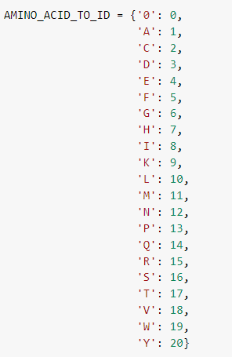
PREPROCESSING
The data used for protein sequencing was taken from file train_sequences.csv ^{[1]}
To convert this sequences to a data in format of
numbers mapping is used as shown
The longest sequence was of 505 ;
to make it 512 , 7 Empty rows added
and reshaped into 16,000 image
like data of 32X16 each.

Slide 5
SOLUTION
Ease of deployment –
Solution can be deployed on cloud platforms like AWS and Azure using their
Quantum Simulators/Devices
Solution can be converted into an API such that all hyperparameter tuning and data injection can be performed seamlessly
Solution can be deployed as a container on any supported cloud platform
Solution can be offered as a SaaS(System as a Service) offering as well as standalone trainable marketplace offering
Eg - Hyperparameters such as embedding selection, epoch batch learning rate, q_depth, data injection in form of csv

Slide 6
SOLUTION
Scalability –
● Solution is scalable to a large extent using different components of
cloud platforms
● Brief description - data can be stored in s3 bucket
● Model training can be performed on virtual instanced and dockerized
accordingly
● Data pipeline can be created for ETL and EDA tasks
● Solution can be offered as a SaaS offering as well as standalone trainable
marketplace offering

Slide 7
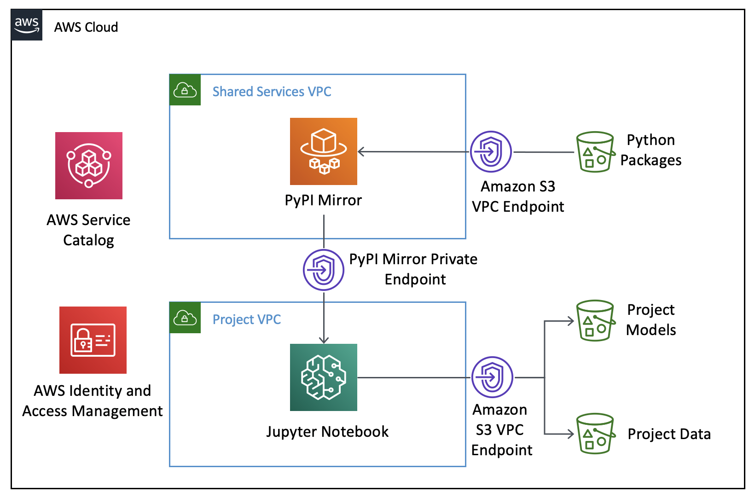
SOLUTION
Proposed AWS Cloud based development architecture

Slide 8
SOLUTION
● Quantum ML provides better generalization than classical DL
● No of training parameters are lesser than classical DL parameters
● Fewer data points required by QML in comparison to classical DL
to understand behavioral distribution
● Once system is deployed on a gate based QC machine we can
leverage Quantum speed of model training

Slide 9
SOLUTION - Comparison
Parameters (For QGAN)
Learning rate for the generator = 0.005
Learning rate for the discriminator = 0.001
Number of training iterations = 200
Batch size = 1
Num_qubits = 9
q_depth = 8
Weights = q_depth*num_qubits
Comparison (a similar classical model ^{[4]} was trained on the same dataset for comparison)
generator_loss (quantum) = 0.651
discriminator_loss (quantum) = 1.217
generator_loss (classical) = 1.216
discriminator_loss (classical) = 0.201

Slide 10
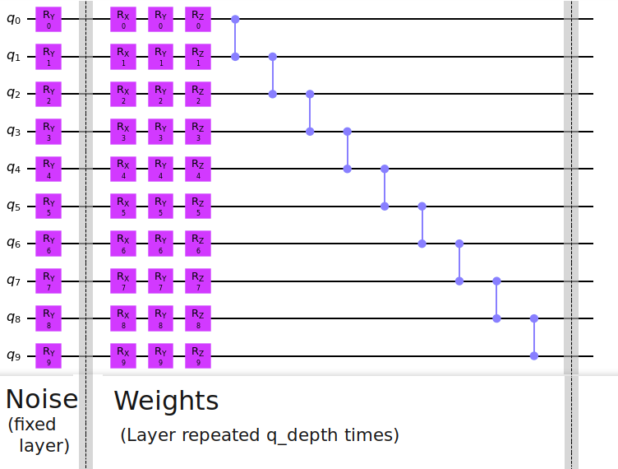
Part of the quantum circuit used in the Generator. Repeated circuit is applied q_depth times

Slide 11
1.State Embedding – A latent vector, z∈R^{N} ,is sampled from a uniform
distribution in the interval [0,π/2). All sub-generators receive the same
latent vector which is then embedded using RY gates. ^{[5]}
2.Parameterized Layers – The parameterized layer consists of parameterized
RY gates followed by control Z gates. This layer is repeated q_depth times in
total. ^{[5]}
3.Non-Linear Transform – The model we used is based upon taking a partial
measurement, and tracing out the ancillary subsystem. Such a transform is
known as non-linear transformation. ^{[5]}
4. Post Processing – Due to the normalization constraint of the measurement,
we apply a post-processing technique to each patch. ^{[5]}
METHODOLOGY

Slide 12
Input Protein Sequences
The input data required for training and testing is fed first
Preprocessing
The protein sequences are then converted into their
respective IDs
Image Like (32x16)
Data is then reshaped into an appropriate size (32x16)
QGANs
Then the QGAN network is trained
Generated Sequence
Finally the results are interpreted

Slide 13
Attachments
Link to code - https://github.com/alphabet27/QGAN-2022

Slide 14
Future Endeavours
We plan to cluster the protein sequences in order to enhance model performance
Clusters are said to improve the target prioritization and clusters have been considered function modules in the past decades ^{[6]}
This can be further enhanced via clustering using Quantum Computers which would provide further advantage in processing of data

Slide 15
References
https://zenodo.org/record/4068040
https://doi.org/10.5281/zenodo.4068040
https://github.com/Biomatter-Designs/ProteinGAN
https://machinelearningmastery.com/how-to-develop-a-generative-adversarial-network-for-an-mnist-handwritten-digits-from-scratch-in-keras/
https://pennylane.ai/qml/demos/tutorial_quantum_gans.html
https://www.frontiersin.org/articles/10.3389/fphar.2019.00109/full

