Slide 1
OOP Mini Project Phase-1 Evaluation

Slide 2
Group Members:
Abhinav Talesra (2019AAPS0223H)
Shreyas Sajilal (2019A3PS0436H)
Parth Aggarwal (2019AAPS0218H)
Indrashis Das (2019AAPS0248H )

Slide 3
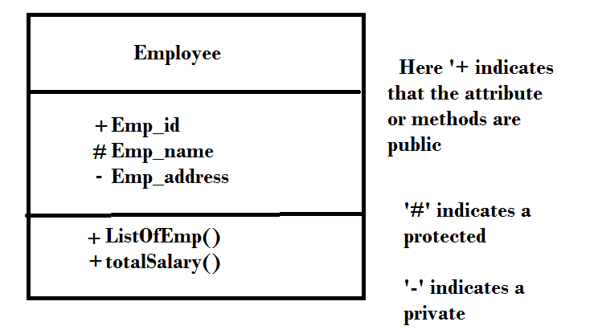
Class Diagram:

Slide 4
Classes:
User
Book
Register
Admin
Wallet
Request
DBConnection
Database

Slide 5
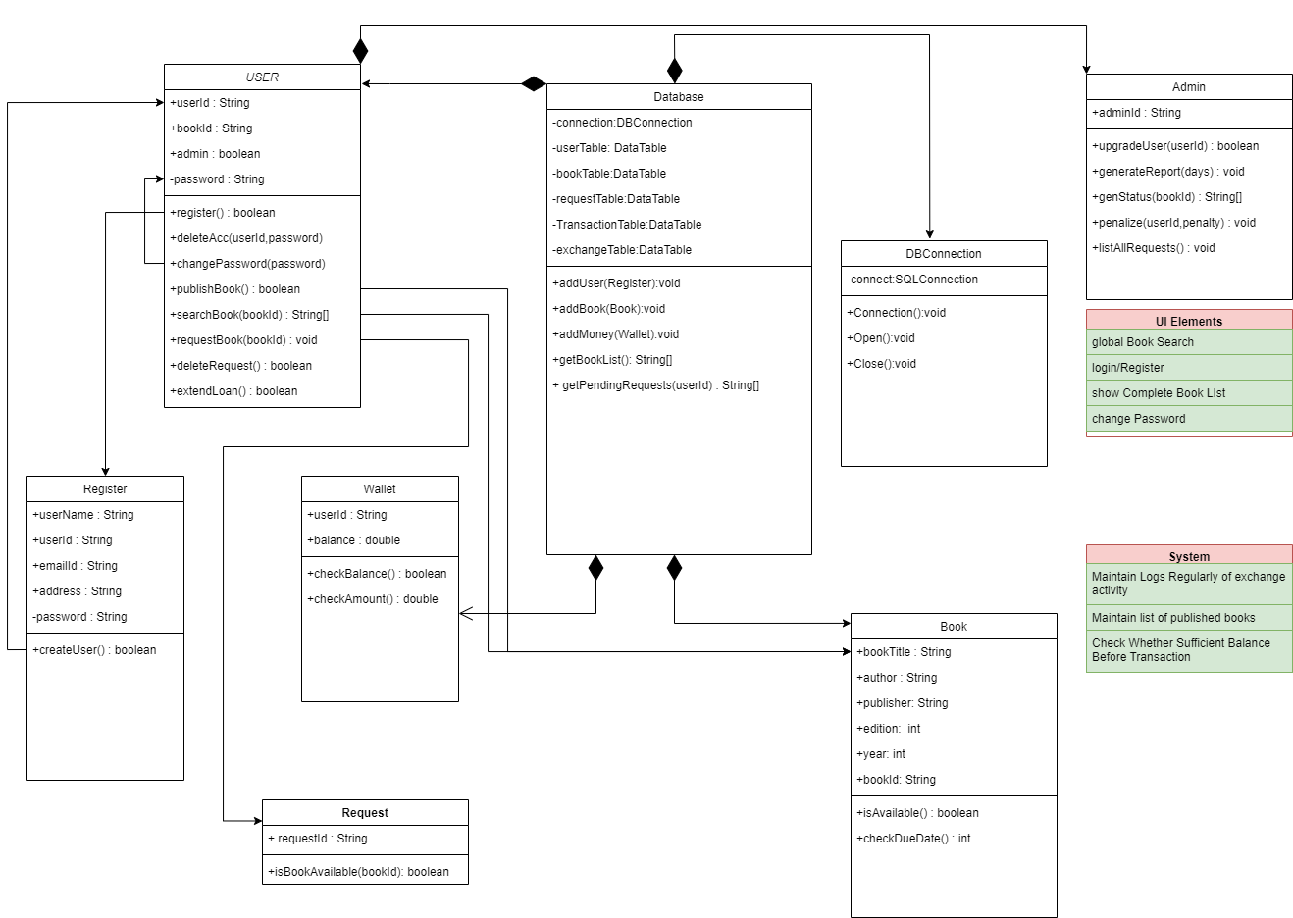

Slide 6
Thank You

