Slide 1
AICT: Assistive Image Caption and Tweet
Parth Birthare
19BCE1635
Sujit Kumar
19BCE1544

Slide 2
Abstract
With the advent of more user applications, a larger number of visual data is generated every second.
To keep track of this data and to annotate this visual data with the use of artificial intelligence, opens up gates for this project.
And to facilitate this, several computer vision techniques help to generate captions that has applications in numerous domains.
Examples include editing application recommendation, virtual assistants, image indexing, for visually impaired persons, for social media, and other natural language processing applications.
Once such a model is developed it can be used for the above mentioned applications and for new research areas.

Slide 3
Overview
Image caption is a very recent concept and there is a lot of research going on currently to automate the process.
Even though some considerable amount of accuracy has been achieved, the models developed are still not accurate enough and so explains the constant and recent use of new methods and artificial intelligence for the same.
There are quite some standard datasets that are used for such purposes – FLICKR 8K, FLICKR 30K, MS-COCO, even the ImageNet database that contains 4,197,122 annotated images.
It is the benchmark for the image classification and object detection algorithms.
In this work too, the models trained on the ImageNet dataset will be used for better accuracy and standard.

Slide 4
Objectives
To study about NLP and computer vision and deep learning.
To develop an automated tool that generate image caption.
To make a system that automatically tweets a caption for the uploaded image.
To make a system that uses assistive technology to read the caption to visually impaired people.

Slide 5
Steps and Tools
Study the dataset.
Preprocess and clean the dataset.
Feature extraction.
Tokenization.
Define the model using CNN, LSTM.
Implement the algorithm.
Use assistive technology and Twitter API to make a tweet bot.

Slide 6
Introduction
As discussed in the starting slides, generating meaningful information from the visual data is feasible by humans but is quite tiresome and involves semantic gaps. Therefore to minimize the human involvement, computer vision, NLP and deep learning solves the issue.
This work involves the use of deep learning methods – convolution neural networks and recursive neural networks(LSTM – long short term memory) for generating image caption.
Both CNN and LSTM are artificial neural networks.
CNN takes in an input image, assign importance or learnable weights and biases to various aspects/objects in the image and is able to differentiate one from the other.
It scans images to extract useful features and combine them to classify images. It is RTS (rotation, translation and scaling) invariant like the HOG features.

Slide 7
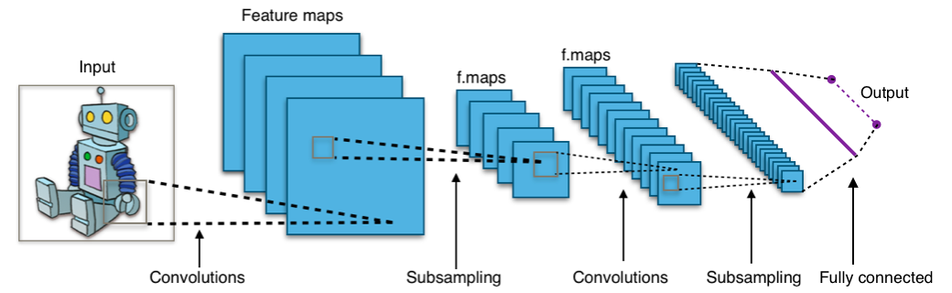
CNN

Slide 8
LSTM on the other hand stand for Long Short-Term Memory networks are a complex area of deep learning and a type of recurrent neural network that are capable of learning order dependence in sequence prediction problems.
It is a type of behavior or constraint that is required in complex problem domains like machine translation, speech recognition, and more.
These are having some internal mechanisms which are known as gates that facilitate the flow of information.
A typical LSTM unit consists of a cell, input gate, output gate and forget gate.
The cell is for remembering values over random time intervals whereas the gates regulate information flow ingoing and outgoing from the cell.
In simple words, based on the previous word, the next word can be predicted.
Unlike RNN which has short term memory, it overcomes it by having a forget gate.

Slide 9
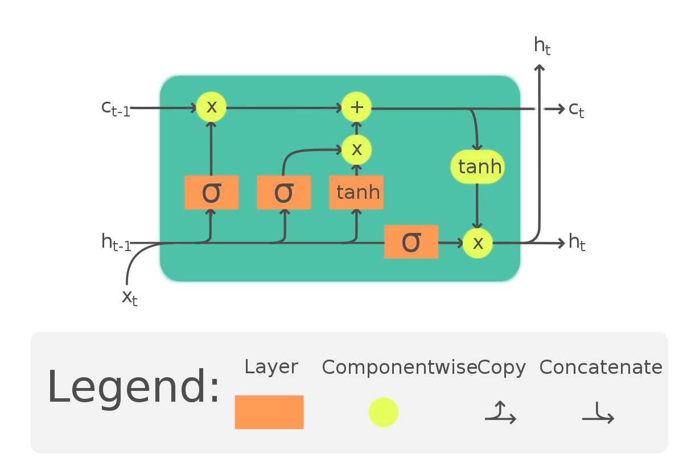
LSTM

Slide 10
Related Works
As mentioned in the beginning of the slides, this is a very recent topic and uses computer vision and deep learning techniques to solve the problems.
Among the ones mentioned, one such was image captioning using beam search, but the one using CNN and RNN seemed to have more accurate results.
In other works, they used Inception V3 model which is also an image recognition model.
In this work, Xception model is used which is better than the standard Inception model as in Xception model, the Inception modules are replaced by depth wise separable convolutions which lead to better performance.

Slide 11
Methodology
The methodology involves making an image caption generator using CNN and LSTM.
The features will be extracted from a CNN based model on the ImageNet dataset as mentioned earlier – Xception.
Xception is a CNN which is 71 layer-deep.
The features are then given to the LSTM model that generates the image caption.

Slide 12
Methodology
CNN extracts feature from the image where a pre-trained model – Xception will be used.
LSTM based on the information/output from CNN will generate a close description of the image.
The architectures are thus merged for this work.
The workflow and methodology for one example used for this work is displayed.

Slide 13

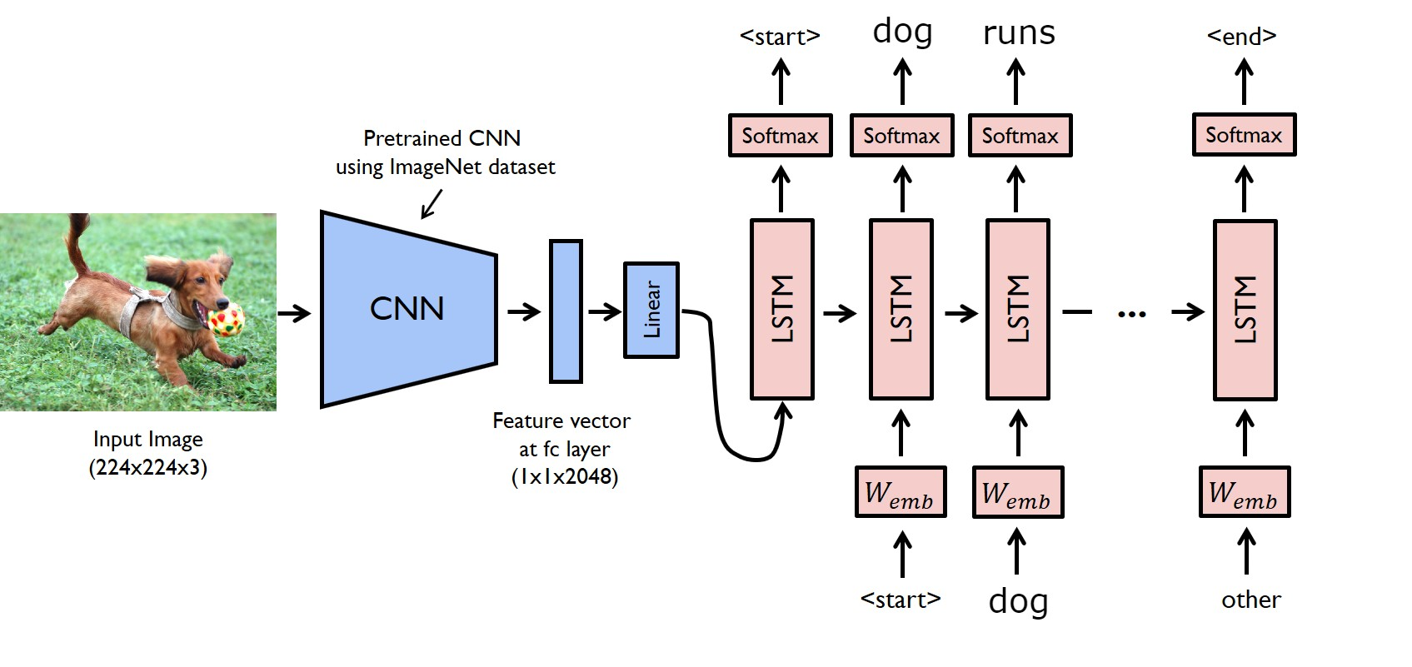
Methodology

Slide 14
Experiment & result
Import relevant packages
Acquire and perform data cleaning
Extract feature vector from images
Load dataset for training model
Tokenize vocabulary
Create a data generator
Define a CNN-RNN model
Train model
Test model

Slide 15
Experiment & result
Import relevant packages
Here all the important packages that are necessary for the work are imported.
The packages include string, NumPy, PIL, os pickle, neural network packages- keras and tqdm for progress bar.
These help in string formatting, for working with arrays and matrices, manipulating and saving different image file formats, for system directory and files related tasks, for serializing and deserializing python object structure, for neural networks and progress bar respectively.

Slide 16
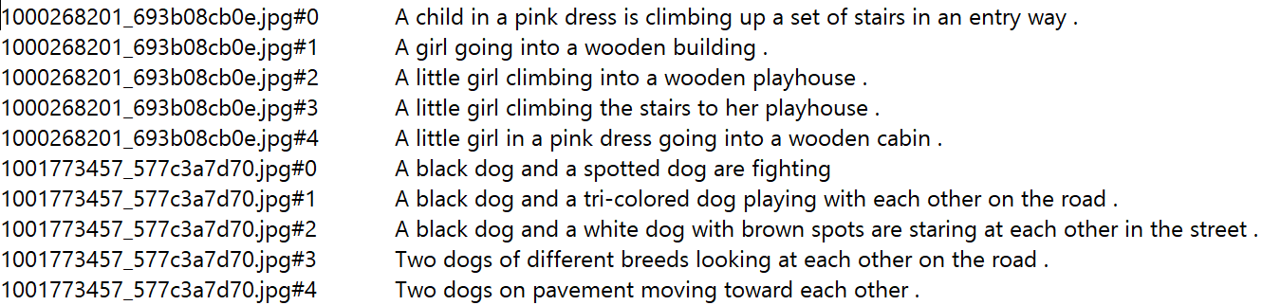
Experiment & result
Acquire and perform data cleaning
The main data files look like this – with images and their captions separated by a new line. Each image has 5 captions.
This step involves loading data into a string, mapping captions with their images, clean text, separate unique words to form a vocabulary and storing preprocessed data into a descriptions file.

Slide 17
Experiment & result
Extract feature vector from images
Here, I use transfer learning and use pretrained Xception model which is trained on large datasets and extract features from that model.
The features dictionary is dumped to features file.
The pickle object contains image and its feature vector extracted from the Xception pre-trained CNN model

Slide 18
Experiment & result
Load dataset for training model
Here, the model is trained using the Flickr_8k.trainImages.txt.
It contains about 6000 images for training the model.

Slide 19
Experiment & result
Tokenize vocabulary
Since human readable language are not understandable by computers, the data is tokenized.
Each word of vocabulary is mapped with a unique index value.
These tokens are created from the vocabulary using the keras tokenizer function and saved to tokenizer file.

Slide 20
Experiment & result
Create a data generator
Each image from the 6000 images on which the model has to be trained has feature vector length of 2048 and even the captions are represented as numbers.
Since data for 6000 images is not possible to be held in memory, a generator method that derives batches is used.

Slide 21
Experiment & result
Define a CNN-RNN model
In the model, these are the main functions
Extract features from pretrained model Xception.
Word embedding layer that handles text, followed by LSTM
model 1 and model 2 are merged together and processed by dense layer to make final prediction since both 1 and 2 model produce fixed length vector.
A visual representation of the model is created.

Slide 22
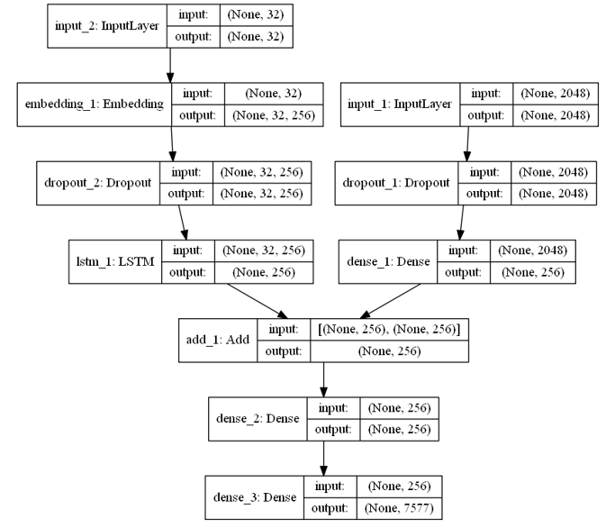
Experiment & result
Define a CNN-RNN model

Slide 23
Experiment & result
Train model
Here, I use the 6000 training images by generating the input and output sequences in batches and fitting them to the model using model.fit_generator() method.
The model is saved in the models directory.

Slide 24
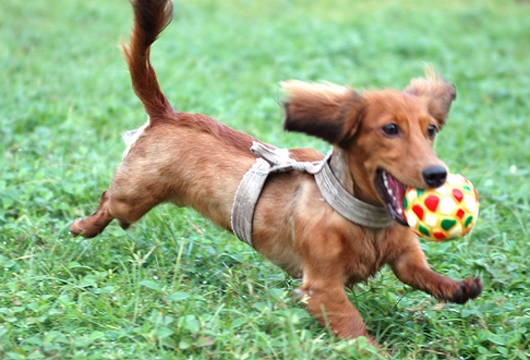
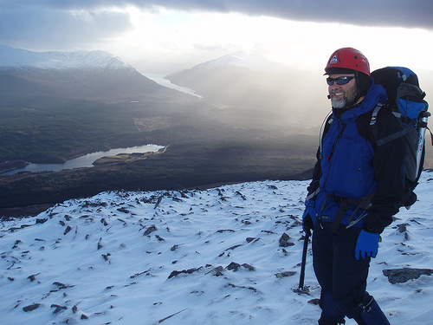
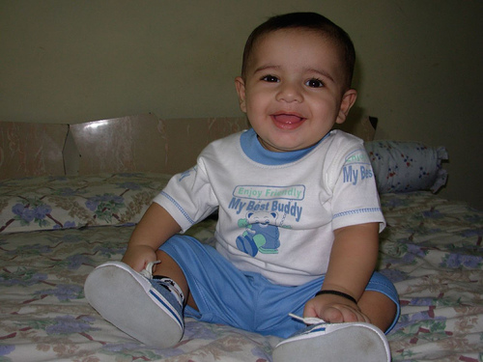

Experiment & result
Test model
dog runs through the grass
man in red jacket is walking down snowy mountain
small boy is sitting on bed

Slide 25
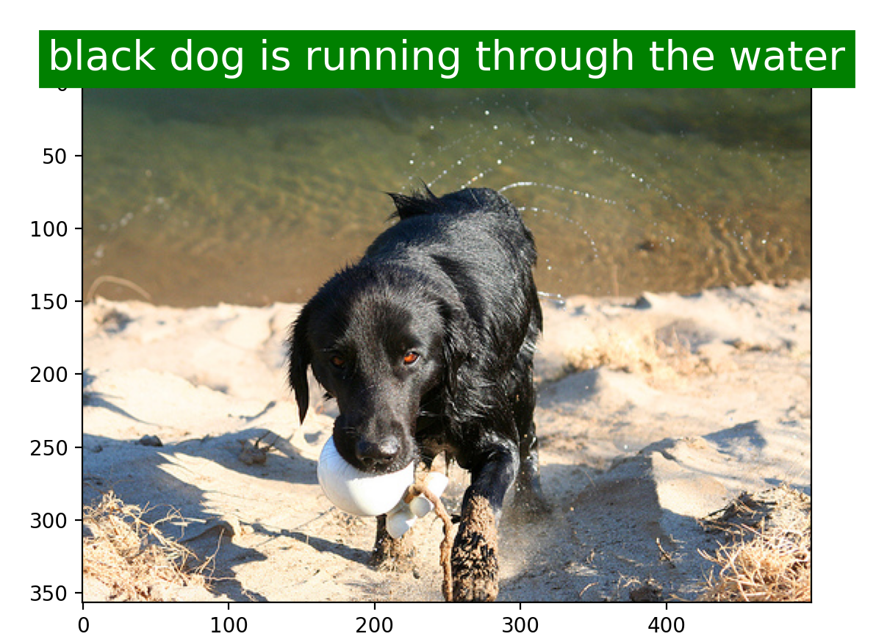
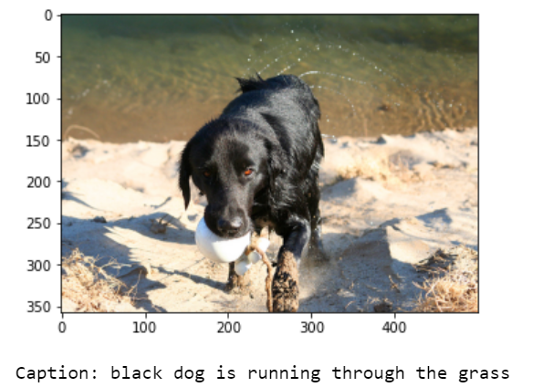
Experiment & result
Image for dog coming out of water on sand using my model.
Image for dog coming out of water on sand using existing model.

Slide 26
Experiment & result
Visual results show that my model generates captions for images better than the existing model and besides that it also generates an audio for that caption with also an option for tweeting about the same.
Comparing the BLEU scores of my model and the existing models, it is found that my model showed better accuracy and a good score concluding that it is better.
The BLEU score for various model are compared with my and are taken from a paper where they compared their models.

Slide 27
Conclusion
Therefore AICT is implemented and solves the various problems mentioned in the aim and motivation by generating the image caption and narrates the same to the user. Further this model was found to be better than the previously generated models.
The proposed system will help to automatically generate captions and tweet them according to the user’s choice. Moreover, the test to speech module will allow people to listen to the audio as well.
This system model is found to be better than the model generated using Inception V3 which was used in the existing works. Therefore a better model is developed.

Slide 28
Future Works
If better computing capacity is obtained, the images can be trained on bigger datasets and more complex models can be tried, but due to computational constraints, this is the best model with this kind of computational power and dataset.
The future works for this project at this stage is to convert this to a paper and start looking for publishers for it, and possibly create an application for opening it for public use so that people could use it in everyday life.

Slide 29
End of presentation

