Slide 1
Version Control with Git and GitHub
Parth Jamkhedkar

Slide 2
What is Version Control?
System that manages changes to code, documents, or digital content over time
Enables multiple developers to collaborate on projects safely
Track modifications and revert to previous versions when needed
Essential for maintaining code integrity and facilitating teamwork
Provides complete project history as backup and recovery system

Slide 3
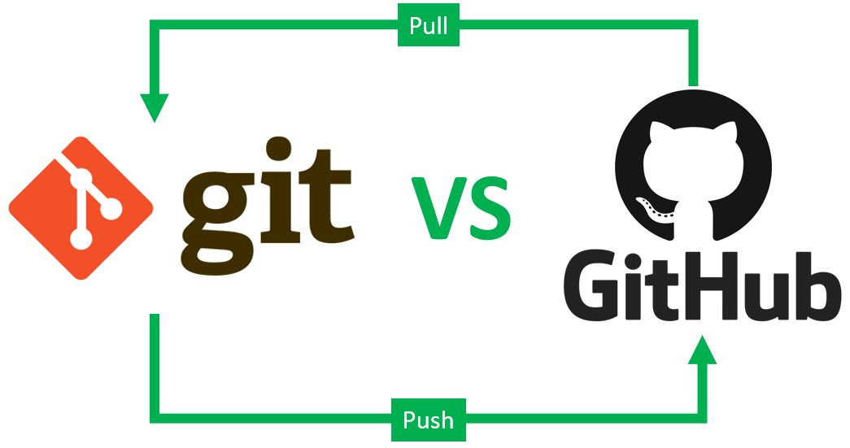
Git vs GitHub: Understanding the Difference

Slide 4
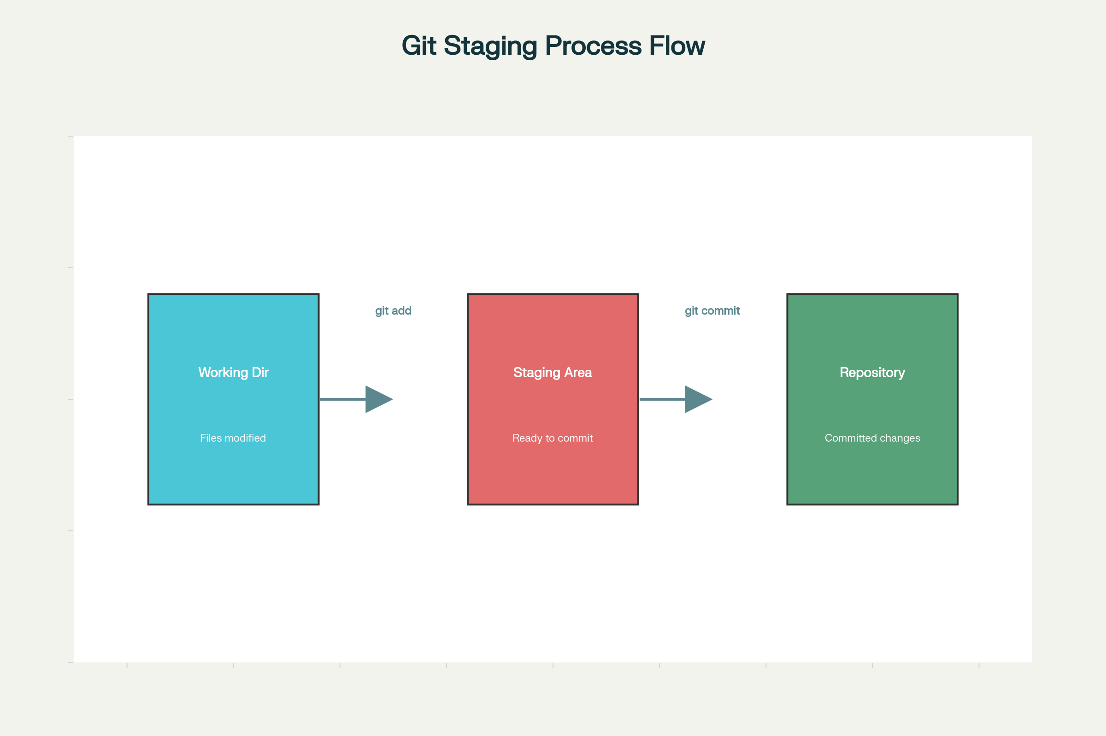
Git Three-Stage Workflow

